Slide 1
Indian Education
Regional Summit
Community Members finding and implementing school solutions
Notes:
Opening: Choose one from page 26 or 27
Get data from Bonnie to create “Dissonance”
Introduce yourself:
I am Tommie Miel – Deputy Associate Superintendent for State Intervention in the State of Arizona.
When I am not being the Grandmother to Nathan, Kailtin, Nickelos, and Dimitri - I am working with schools to support them in their efforts to improve student achievement.

Slide 2

Think, Pair, Share
Involving communities provides access to additional resources and opportunities for school environments and programs that meet the needs of all students, not just some students.
Engaging All Families
Steven M. Constantino
Notes:
Constantino is the former principal of Stonewall Jackson High School in Manassas, Virginia. Brought school from very troubled (no body wants to be here school) to May 2001 Time’s “High School of the Year.” He believes emphatically that “Families are a child’s first and best teachers.”
Think – What comes to mind as you read this quote from Constantino’s Book?
Pair/Share – Share your thoughts with another participant.
Share your thoughts with the group

Slide 3
FOCUS
AZ State System of Support
  Snapshot view
  In-depth look at community involvement
Opportunity for interaction
  Components of community meeting format
Reflect and engage in conversation
  What looks good and might work
  What might not work and why

Slide 4


TWO KEY PIECES TO THE ACCOUNTABILITY PUZZLE IN ARIZONA:
AZ LEARNS
NCLB
Notes:
And, now to begin…

Slide 5
GUIDING PRINCIPLES FOR SCHOOL SUPPORT
The Arizona Department of Education provides three levels of school support for all schools and districts:
◙School Improvement Assistance
◙School Improvement Intervention
◙Prevention
 | AZLEARNS | NCLB
Prevention | Excelling Highly Performing Performing | Met AYP (2 or more consecutive years) Warning (not met AYP first time)
School Improvement Assistance | Underperforming – Year 1 Underperforming – Year 2 | School Improvement – Year 1 School Improvement – Year 2
School Improvement Intervention | Underperforming – Year 3 → Failing Intervention Plan Implementation – Year 5 | Corrective Action – Year 3 Restructuring Planning – Year 4 Restructuring – Alternate Governance - Year 5

Slide 6
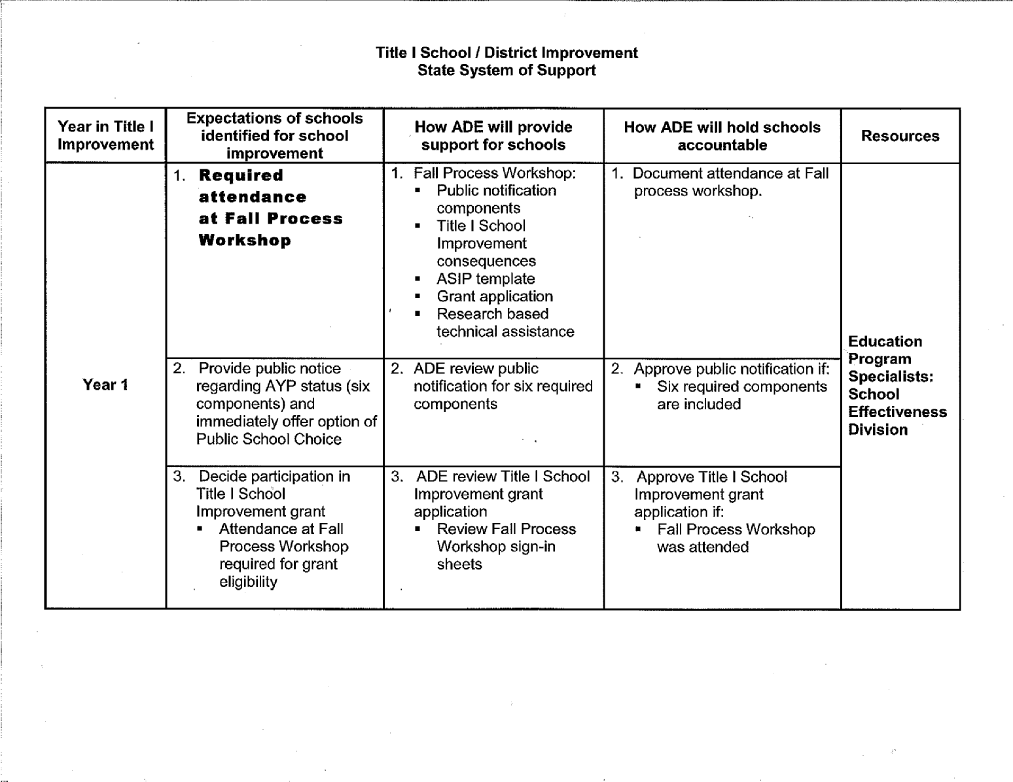
State System of Support

Slide 7
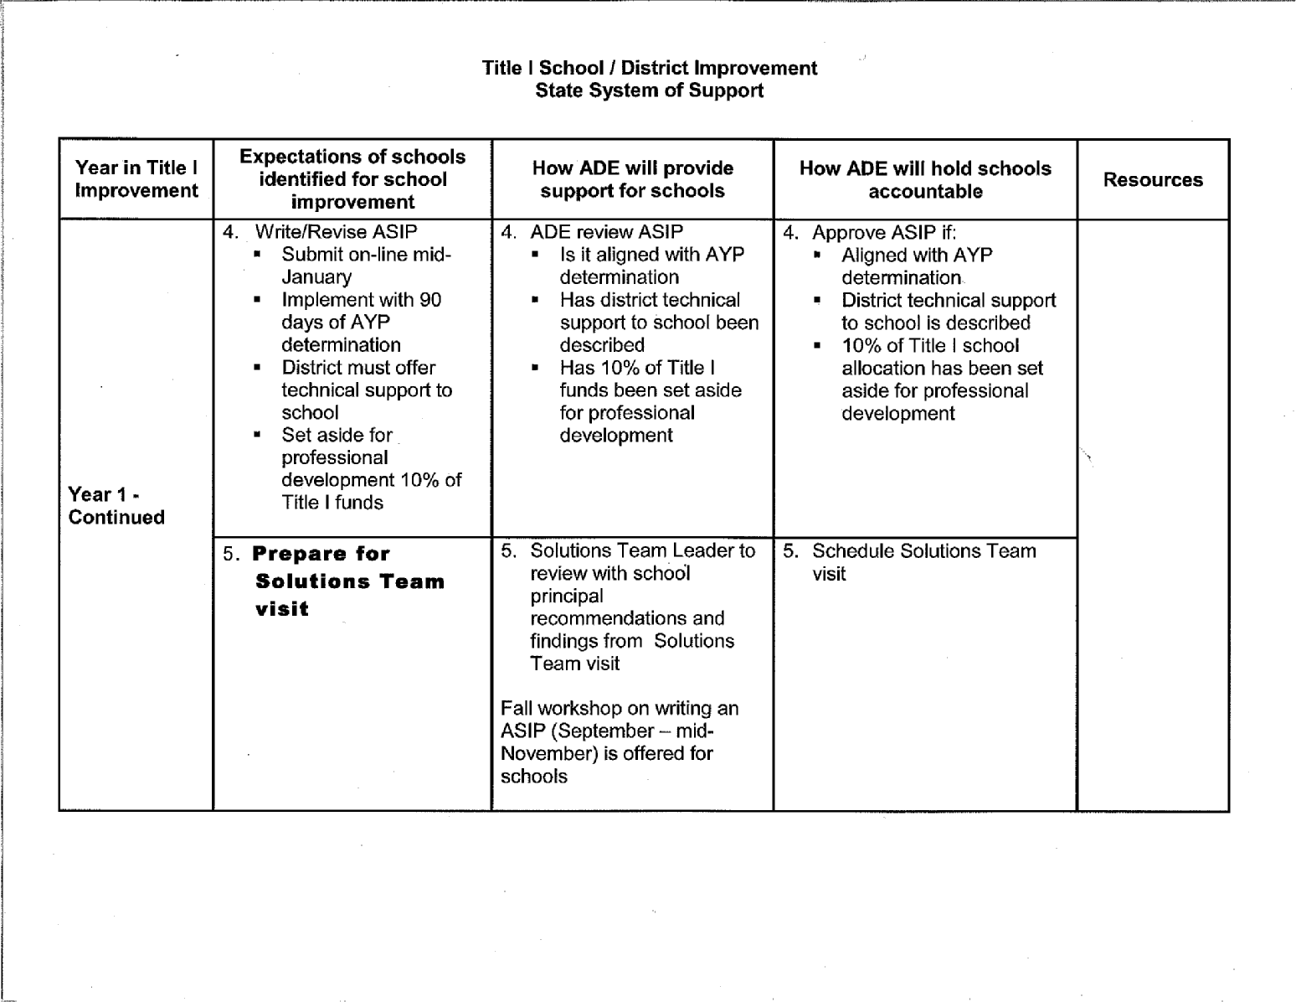
State System of Support

Slide 8
School Classifications
School Classifications
  The achievement profile shall be used to determine a school classification including:
  1. Excelling
  2. Highly Performing
  (Performing Plus has been added)
  3. Performing
  4. Underperforming
  5. Failing to Meet Academic Standards

Slide 9
What is Underperforming?
AIMS Scores – Arizona instrument to measure standards
Measure of Academic Progress (MAP) – the extent of academic progress made by pupils in each school, each year
Graduation/Dropout Rates
Adequate Yearly Progress (AYP)
Notes:
Schools are measured against themselves over a three-year period and against the direction all Arizona schools moved.

Slide 10
AZ LEARNS
State Accountability System
Year 1 Underperforming
  Solution Team Visit
Year 2 Underperforming
  ASSIST Coach
Third year failing school
  Appeals Process
Failing to Meet Academic Standards

Slide 11
State System of Support Solutions Teams
Mandated by Legislation
Team Membership
  Master Teachers
  Fiscal Analysts
  Curriculum/assessment experts
Team Visit
  On-site visit that will produce statement of findings that will validate or redirect school’s improvement efforts
  Offers specific recommendations for moving forward
Notes:
ARS 15-241
The superintendent of public instruction shall assign a solutions team to an Underperforming School or a School Failing to Meet Academic Standards
Assigning to Under Performing Schools supports the Superintendent’s mission to provide high quality service to all schools.
Team members must complete a Solutions Team application and submit it along with a resume and three letters of reference
Selected team members are required to attend an initial two-day training session and then yearly attend a one-day session for updating.
These teams are not assigned for continuous work with the school.
The Solutions Team visit and the resulting Statement of Findings are not the “fix”. Together, they establish a framework for support.

Slide 12
State System of Support
ASSIST Coach
Monthly follow-up support is provided to each school by an ASSIST Coach. This person serves as a resource to the school leadership team,
  Assisting in the coordination of all educational resources, specifically those available through the Arizona Department of Education;
  Assisting the school in developing capacity for sustained school improvement;
  Documenting school progress in implementing improvement plans that increase academic achievement for all students.

Slide 13
State System of Support
Academic and Instructional Support
Offers professional development opportunities
  Catalog of Professional develop/technical assistance available from Department of Education
  Over 6,547 educators have participated
Creating trends in Solution Team findings
  Academies offered based on needs in underperforming schools, state AIMS scores, and requests from the field
Updating Resource Guide for the Standards and Rubrics for School Improvement.
Academies personalized for each region of the state
  Chinle – requested by educators in that region
  Window Rock/ Ganado – Currently in initial stages of planning event
Notes:
Provides educators with tools and resources to increase student achievement
Show: Trends in Solution Teams findings graph, Standards and Rubrics, Resource Guide

Slide 14
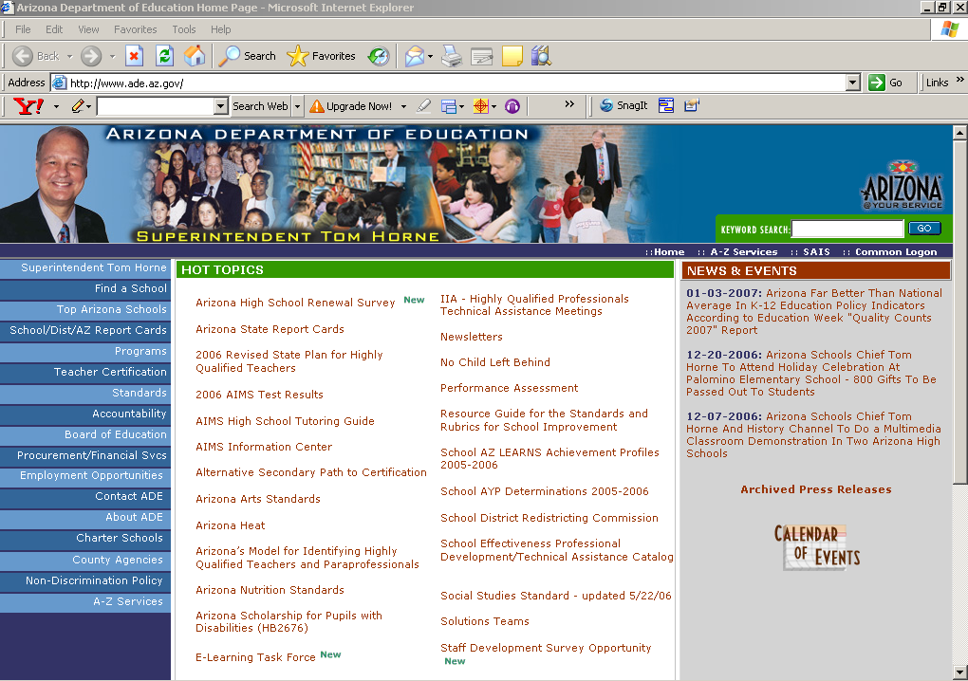
ADE Support Links
Solutions Teams
www.ade.az.gov/

Slide 15

ADE Support Links
Standards and Rubrics for School Improvement

Slide 16

ADE Support Links
www.ade.az.gov/schooleffectiveness/ STDSRUBRIC.pdf

Slide 17
ADE Support Links
Resource Guide for
the Standards and Rubric
www.ade.az.gov/

Slide 18

ADE Support Links
Standard 1: School and District Leadership Capacity
www.schoolsmovingup.net/cs/az/print/htdocs/az/home.htm

Slide 19
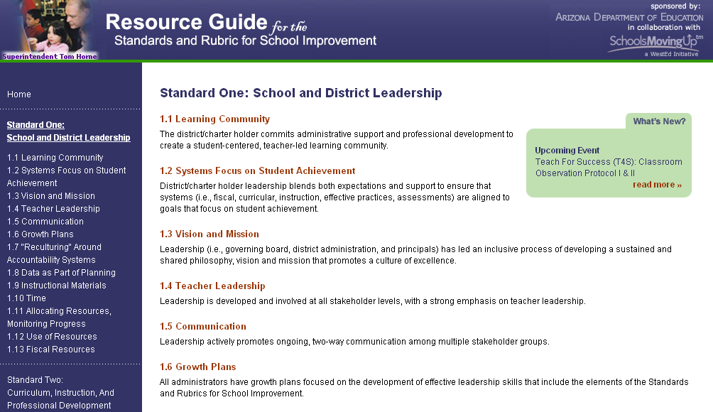
ADE Support Links

Slide 20
State System of Support
State Intervention
AZ LEARNS
  Third year underperforming
  Unsuccessful appeal
NCLB
  Corrective Action
  Planning for Restructuring
  Restructuring Implementation
Notes:
Alternative Governance

Slide 21
Appeals Process
Preliminary release of AZ LEARNS Achievement Profiles
Conduct Appeals Workshop in cooperation with R&E
School submission of Appeal
State Intervention and R&E make Appeals Visits to schools
Appeals Committee hears appeals and determines school’s designation

Slide 22
Intervention Site Visit Activities
Staff meeting presentation and teacher survey
Classroom visits
Teacher focus groups
School leadership interview
District leadership interviews
School tour

Slide 23
ARS 15-241 (U)
Desired Outcomes
The school has properly implemented its school improvement plan.
The school curriculum is aligned with Arizona Academic Standards.
The school provides teacher training/Professional Development.
The school has prioritized its budget.
The school provides other proven strategies to improve academic performance.

Slide 24
Collection of Data
Principal’s Progress Report
Solution Team Recommendations
ASSIST Coach notes
Student Assessment Data
Site visit information

Slide 25
Team Intervention Planning
Team Intervention Planning (TIP)
  Team Members
    ADE
    Field Representatives
Consensus Document
  Identification of needs based on data
  Discussion of capacity to meet identified needs
  Recommendations for Intervention
Intergovernmental Agreement (IGA)
  Exhibit A
Notes:
Show Consensus Document

Slide 26
INTERVENTION OPTIONS
Continued Implementation of the ASIP with the Intervention Specialist
Assigning a Mentor to the Principal
Assigning a Turn-around Principal to the school
Assigning Mentor Teacher(s) to the school
Replacing Teachers
Restructuring the school through an outside agency
Notes:
There is a range of interventions that can be recommended from replacement of school administration to assignment of state intervention coach to support school administration in improvement efforts.

Slide 27
Recommended Interventions
The state shall in collaboration with the district leverage multiple sources of revenue and multiple social services agencies that will address student and family drug, alcohol, dropout prevention, violence, mental, and physical health issues.
The district shall work in collaboration with the tribal leaders to promote the value of education, its relationship to career opportunities and the quality of life.
Notes:
The recommended interventions that brought me here are stated on the slide.

Slide 28
Native American Dropout Prevention Initiative
Interagency collaboration to develop community meeting format
  Tommie Miel – Deputy Associate Superintendent for State Intervention – School Effectiveness
  Maxine Daly – Deputy Associate Superintendent for Innovative and Exemplary Programs
  Deborah Norris – Indian Education Director
  Bonnie Talakte – Director for Native American Dropout Prevention Initiative
  Leon Oosahwe – Education Specialist

Slide 29
Community Meeting Format
Who should be the participants?
List of Stakeholders
  Determining participants
  Who would you add?
Collected input from the Superintendents of each of the districts
Day and time of meetings
Notes:
Show: List of participants

Slide 30
Community Meeting Format
Agenda
Welcome and Purpose
  To support communities as they capitalize on their strengths and respond to the challenges and barriers to increasing graduation rates.
Introductions/roles/representation by participants
  Check In
    Name
    Family
    Region
    Occupation
    My contribution
Notes:
Decisions made were based on a desire to be sensitive to tribal cultures
Format for each meeting is similar
Agendas for subsequent meeting would begin where a previous meeting had adjourned
Check-in could consume a great deal of the meeting time. Talk about why it is important to take that time.
Who else is here beside me?
Am I in good company?
How can each of these people really help?
How can I really help? What resources do I have?

Slide 31
Community Meeting Format
Agenda
Establishment of meeting Parameters
  Provide practice sessions
    Meeting norms
Questions to be addressed
  Provide practice session
    What is good about your school and what is your school doing to help your child be successful?
    What are the community strengths that contribute to the academic success of your children?
    What challenges do your children face and how might these challenges prevent your child from doing well in school?
        Identifying concerns
        Prioritizing concerns
Notes:
After their practice session, Show sample of parameters that were selected by the first community meeting group.

Slide 32
Parameters
Stay on Agenda
  Agenda to have time allotments
  Include breaks in the agenda
Attend all meetings
Commitment to the process and follow-up activities
Be on time
Avoid blame games
Frank constructive discussions
No put downs and respect others opinions
One person speaks at a time

Slide 33
Community Meeting Format
Agenda
Community provided with student data
  Health Services and Human Services:
    Number of:
        Successful juvenile suicides over past 5 years
        Juvenile drug or alcohol overdoses
        Teen pregnancies and live births
        Neglected, abused and abandoned children reported
        Parents attending court ordered parenting skills workshops
  Wellness Center
    Types of services provided to juveniles over past 5 years
    Number of:
        Juveniles self-referred for services
        Juveniles referred for attempted suicides

Slide 34
Community Meeting Format
Agenda
Community provided with student data
  Juvenile Court
    Number of:
        Juvenile offenses over the past 5 years
        Juveniles incarcerated due to drug and alcohol related crimes
        Juveniles incarcerated due to violent crimes
  Education
    School Officials
        School Profile Information
        Number of scholarships and grants awarded
        Number of college graduates
    Tribal Education Director
Notes:
Talk with partner about how this information may be helpful to a community interested in continuing improvement.
What if any, other kind of information might be helpful? Talk about why you would include this information.

Slide 35
Expanded Purpose of
Community Meetings
Designed to be a series of on-going discussions
Create sub-groups of the community that will develop and implement action plans to bring about improvement
Have communities recognize and employ their strengths to overcome identified barriers to school improvement
Have communities unite and voice their values regarding an education for their youth
Have communities assume the responsibility for the continuation of these problem-solving activities
Notes:
This is not a one-shot attempt
It is an attempt to being community members together focused on a common goal
It is attempt to help communities recognize their strengths and use them to help being about improvement
If education is not valued by the adults in a child’s life how can it become valuable to the child?
The people who make up the communities are the ones who remain. These are the people who determine what is and is not acceptable in their communities and in their schools.

Slide 36
3…2…1
Reflect
  What looks good and might work
  What might not work and why
3 Big Ideas from today
2 Points to Ponder
1 Suggestion for Improvement
Notes:
Use 3 X 5 cards to list your responses.

Slide 37


Pair Share
Engage in conversation
  Share 3…2…1
  Reach a consensus on one idea to share with whole group
  Write on chart posted on the wall
Notes:
Have Large Post-It paper on the walls
Have markers available.
Briefly review what has been written on the chart paper. Ask for volunteers to summarize

Slide 38
Reflections from
First Community Meeting
What meeting parameters were selected?
Comments regarding first community meeting. Are any participants present?
Do we plan to make any revisions for the next meetings? What and why?

Slide 39
Native American Drop-Out Prevention Grant De-Briefing Notes
Make sure handouts get done and the corrected final copies get to Bonnie for review
1 person to co-ordinate materials needed for each meeting
All PowerPoint presentations on one computer
Future meetings:
  Need ample amounts of generic packets
  Need ample amount of blank name tags

Slide 40
Native American Drop-Out Prevention Grant De-Briefing Notes
Allow 10 minutes for new introductions
Introductions are important but should be kept to 30 seconds – responsibility of facilitator
Set time parameters at beginning of meeting and ask the group to keep these parameters
Superintendent speaks in support of the grant and work of the committee
Designate local administrators to call people to remind them of the next meeting
Send out proposed agenda

Slide 41
Something to Ponder
Educators cannot expect total engagement and high standards from students if both families and schools cannot form powerful alliances to guide those students to academic and lifelong success.
Engaging All Families
Steven M. Constantino

Slide 42
Contact Information
Phyllis Schwartz
Associate Superintendent
School Effectiveness Division
Arizona Department of Education
Phone: 602-364-2313
Phyllis.Schwartz@azed.gov
Tommie Miel
Deputy Associate Superintendent
State Intervention
Arizona Department of Education
Phone: 602-364-2281
Tommie.Miel@azed.gov

