Slide 1
Addressing Chronic Absence: Why It Matters, What Can You Do

Slide 2
Defining Key Terms
Average Daily Attendance: The percentage of enrolled students who attend school each day.
Satisfactory Attendance: Missing 5% or less in an academic year.
Chronic Absence: Missing 10% or more of school in an academic year for any reason—excused or unexcused.
Severe Chronic Absence: Missing 20% or more days of school per year – approximately two months of school.
Truancy: Typically refers only to unexcused absences and is defined by each state. . In CA, it is missing 3 days of school without a valid excuse, or being late to class 3 times without a valid excuse. In MD, it is unlawfully absent 20% of days if enrolled 90 days.

Slide 3
Attendance is Critical to Student Success
Exposure to Language: School exposes children to language-rich environments they may not have at home.
Time on Task: Students who miss too much school fall behind and have a hard time catching up.
Persistence: Good attendance builds habits, essential for success in school and life.
Engagement: Attendance indicates an engaged student; absences can signal disengagement.
Classroom Churn: Too many students missing too many days slow down classroom instruction and affect school climate.
School Funding: In states where funding depends on enrollment, good attendance pays.

Slide 4
Students Chronically Absent in Kindergarten & 1st Grade Much Less Likely to Read Proficiently in 3rd Grade
Percent Students Scoring Proficient or Advanced on 3rd Grade ELA Based on Attendance in Kindergarten and 1st Grade Attendance
No risk | Missed less than 5% of school in K & 1st t
Small risk | Missed 5-9% of days in both K & 1st
Moderate risk | 5-9% of days absent in 1 year &10 % in 1 year
High risk | Missed 10% or more in K & 1st
Source: Applied Survey Research & Attendance Works (April 2011)

Slide 5
School Readiness & Early Attendance Are Critical to Early School Success
3rd Grade ELA Test Scores By Attendance and School Readiness Level
No risk | Missed less than 5% of school in K & 1st t
Small risk | Missed 5-9% of days in both K & 1st
Moderate risk | 5-9% of days absent in 1 year &10 % in 1 year
High risk | Missed 10% or more in K & 1st
Source: Applied Survey Research & Attendance Works (April 2011)

Slide 6
The Chronic Early Absence Is Most Troubling for Poor Children
Chronic K Absence predicted lower 5th grade performance even for if attendance had improved in 3rd grade.
5th Grade Math and Reading Performance By K Attendance
Source: ECLS-K data analyzed by National Center for Children in Poverty (NCCP)
Note: Average academic performance reflects results of direct cognitive assessments conducted for ECLS-K.

Slide 7
Chronic Absence is Especially Challenging for Low-Income Children
Poor children are 4 X more likely to be chronically absent in K than their highest income peers.
Children in poverty are more likely to face systemic barriers to school:
Unstable Housing
Poor Transportation
Inadequate Food and Clothing,
Lack of Safe Paths to School Due to Neighborhood Violence
Chaotic Schools with Poor Quality Programs, etc.

Slide 8
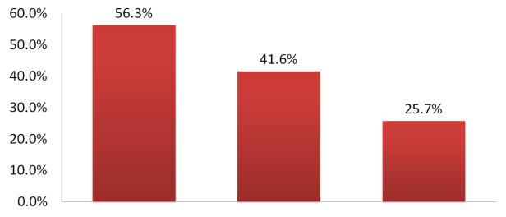
Chronically Absent 6th Graders Have Lower Graduation Rates
Dropout Rates by Sixth Grade Attendance (Baltimore City Public Schools, 1990-00 Sixth Grade Cohort)
Severely Chronically Absent
Chronically
Absent
Not Chronically
Absent
Source: Baltimore Education Research Consortium SY 2009-2010

Slide 9
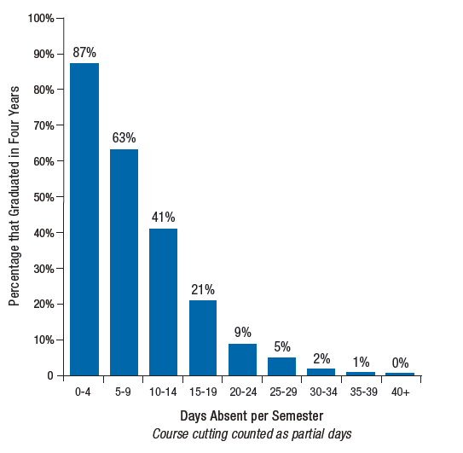
9th Grade Attendance Predicts Graduation for Students of All Economic Backgrounds
Note: This Chicago study found attendance was a stronger graduation predictor than 8th grade test scores.
Source: Allensworth & Easton, What Matters for Staying On-Track and Graduating in Chicago Public Schools, Consortium on Chicago School Research at U of C, July 2007

Slide 10
Schools + Communities CAN Make a Difference
Characteristics of Successful Attendance Initiatives
Partner with community agencies to help parents carry out their responsibility to get children to school.
Make attendance a priority, set targets and monitor progress over time.
Examine factors contributing to chronic absence, especially from parent and student perspectives.
Clearly communicate expectations to parents.
Begin early, ideally in Pre-K.
Combine universal strategies that create an engaged learning environment & build a culture of attendance with targeted interventions.
Offer positive supports before punitive action.

Slide 11
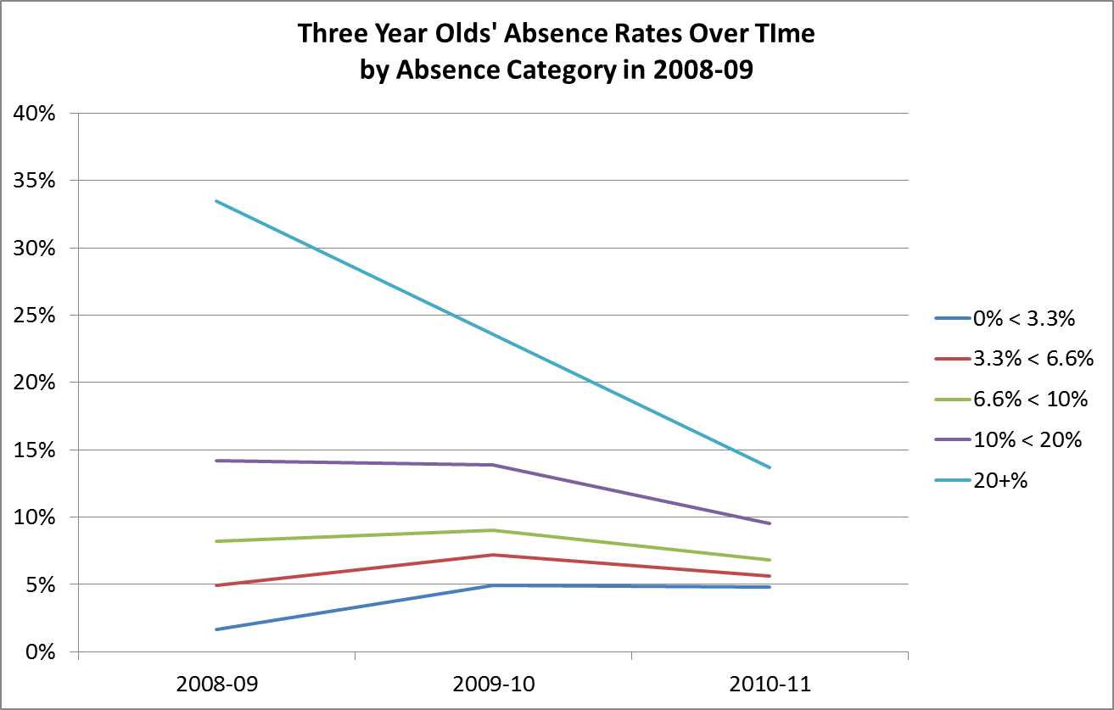
Why Start in PreK?:
What is the connection between attendance in PreK and K?
Source: Consortium on Chicago School Research &
The Office of Early Childhood Education, Chicago Public Schools

Slide 12
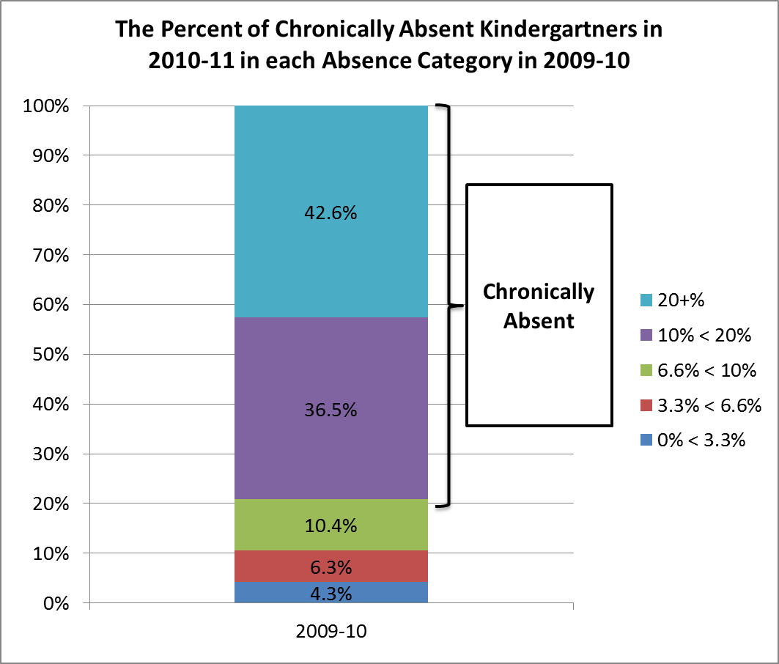
In Chicago, most chronically absent kindergartners had poor attendance the year before.
Source: Consortium on Chicago School Research &
The Office of Early Childhood Education, Chicago Public Schools

Slide 13
In Baltimore, chronic absence in both preK and K predicted significantly worse outcomes including
Greater likelihood of continued poor attendance. 50% chronically absent again in G1, 45% in G2.
Lower outcomes in G1, G2 in reading and math, and math in G3
More often retained (26% by 2010-11 compared with 9% of students with no chronic absence)
More likely to be identified as needing special education

Slide 14
Attendance Works Inquiry Cycle
1. Crunch the numbers
3. Share the results
4. Generate solutions
6. Try out interventions
7. Assess what worked or not
2. Mine the data
5. Use data to set targets
Vet Results
for Accuracy
Notes:
Conceptually, here is how our thinking has evolved in helping communities analyze and act on their chronic absence data. Much thanks to Sue Fothergill and Phyllis Jordan for their work on the AW Inquiry Cycle which is our conceptual framework for how we approach TA.
The tools and resources we will share are helpful but we don’t want to offer them in isolation. We want to unpack our ideas about the process that we think happens as you work with communities.
Talk through each step of the cycle: 1. It all starts with data…

Slide 15
1. Crunch the numbers
Calculate chronic absence & satisfactory attendance by grade, school, and sub-populations:
Using the District Attendance Tracking Tool (DATT) available for free from Attendance Works
Manipulating your own SIS system
Adopting another method that generates the same data.

Slide 16
2. Mine the Data
Review Data To Answer Key Questions
To what extent do we have a problem?
Are our patterns typical of early chronic absence (highest in kindergarten & 9th)?
Are there significant changes over time? Why?
Are there particular schools or sub-groups that we should be concerned about?
Where are the bright spots/outliers? What do they tell us about good practices?
Notes:
Bright spots are defined as schools with better-than expected attendance compared to schools with similar demographics.

Slide 17
3. Share Your Results
A. Identify Key Audiences
B. Determine How To Share
(an easily revised power point can work well initially)
C. Keep in Mind Key Messages
We all gain when kids attend regularly
It starts early
It’s not just about truancy
We need to look at the right data
Schools + Communities can turn poor attendance around.

Slide 18
4. Generate solutions
Solutions Only Work If Grounded in Understanding Of What Leads to Chronic Absence
Discretion
Parents don’t know attendance matters
School lacks a strong culture of attendance
Aversion
Child is struggling academically
Child is being bullied
Barriers
Lack of access to health care
No safe path to school
Poor transportation
Special thanks to Dr. Robert Balfanz, Everyone Graduates Center, Johns Hopkins University, Baltimore, MD for providing this framework.

Slide 19
4. Generate solutions
Proposed Universal Strategies For Influencing Discretion and Identifying Causes of Absence
Attendance Incentives
Parent Engagement
Personalized Early Outreach
Attendance Data Team
Notes:
What’s on AW website: What works section; PLN page
Processes: AW website—self-assessments and worksheets—have sample loaded on webex tab

Slide 20
Strategies for 3 Tiered Approach
Recovery
Programs
Case management and wrap-around services
Referral as last resort for court -based intervention
Recovery
Programs
Early outreach, support, mentoring for student with poor attendance.
Identify and remove barriers
Attendance contracts
Intervention
Programs
Safe & supportive school environment
Engaging classroom environments
Parent education about why attendance matters and how to help each other get students to school.
On-going attention to attendance data
Recognition for good and improved attendance
Collaboration with afterschool & early childhood
School-based health supports
Universal/Preventive
Programs

Slide 21
Attendance Works Inquiry Cycle
1. Crunch the numbers
3. Share the results
4. Generate solutions
6. Try out interventions
7. Assess what worked or not
2. Mine the data
5. Use data to set targets
Vet Results
for Accuracy

