Slide 1
PreK-3rd:
A Comprehensive Reform Strategy
Kristie Kauerz, Ed.D.
Research Scientist, PreK-3rd Grade Education

Slide 2
Understanding Why Early Achievement Gaps Exist
(and Persist)

Slide 3
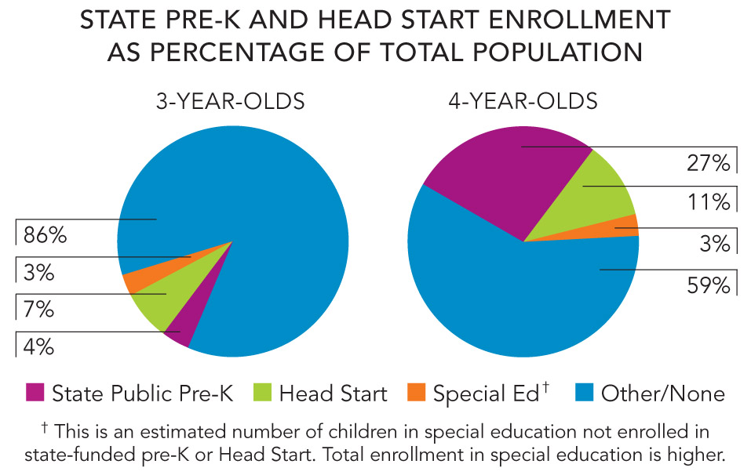
Lack of Access to High Quality Early Learning
Source: NIEER, The State of Preschool 2010. New Brunswick, NJ: Rutgers University.

Slide 4
Inconsistent Quality in Elementary Classrooms
(across 1st, 3rd, and 5th grades)
Pianta, R. C., Belsky, J., Houts, R., Morrison, F., & National Institute of Child Health and Human Development Early Child Care Research Network (2007). Opportunities to learn in America's elementary classrooms. Science, 315, 1795-1796.
Notes:
Inconsistent Quality of Classroom Experience

Slide 5
What is PreK-3rd?

Slide 6
PreK-3rd Essentials
PreK
High quality PreK closes early achievement gaps and helps children be ready for school.
High quality Full-Day Kindergarten is a transition year for all children.
High quality early grades build strong foundations for lifelong learning.
FDK
Grades 1-3
Notes:
Change wording on FDK.

Slide 7
PreK-3rd Improves Each Grade Level and Aligns Across Grade Levels
0-3
PreK
FDK
1st Grade
2nd Grade
3rd Grade
Within
Within
Within
Within
Within
Within
Across
Notes:
Kristie Kauerz, ELNAC

Slide 8
PreK-3rd:
The Core Goals
Develop strong foundational cognitive skills (literacy/communication and math).
Develop social and emotional competence.
Establish patterns of engagement in school and learning.

Slide 9
Buckets of PreK-3rd Effort
Ways to Keep Cross-Sector Work a Priority
  Governance, strategic plans, mutual accountabilities
Administrator Quality and Capacity
  Leadership creates inclusive culture focused on instruction
Teacher Quality and Capacity
  Classroom teachers are meaningfully engaged in improving children’s learning opportunities
Instructional Tools and Practices
  Standards, curricula, and assessments are aligned and focused on what matters

Slide 10
Buckets of PreK-3rd Effort
Instructional Environment
  Physical learning environments (classroom and school) promote relationships and active learning
Data-driven Improvement
  Current and relevant data used to set priorities and to improve instruction
Engaged Families
  Families and communities actively support student learning
Transitions and Pathways
  Focus on children’s movement through the continuum

Slide 11
Effective PreK-3rd Implementation Requires
Intentionality and strategic plans
Focused leadership
Fidelity to best practices
Discipline to reduce distractions and streamline systems
Teamwork and dedication to relationships

Slide 12
PreK-3rd Implementation and Evaluation Framework
A guide to strategically build and improve PreK-3rd reforms
Co-funded by Foundation for Child Development; W.K. Kellogg Foundation; Gates Foundation; and Stone Foundation
Available Summer 2012

Slide 13
Key Take-aways

Slide 14
2nd Grade
There is no silver bullet; every year matters.
We need to improve the quality of learning opportunities, PreK-3rd.
We need to increase the continuity and improve the alignment across programs and across classrooms.
PreK
FDK
0-3
3rd Grade
1st Grade

Slide 15
PreK-3rd Improves Each Grade Level and Aligns Across Grade Levels
0-3
PreK
FDK
1st Grade
2nd Grade
3rd Grade
Within
Within
Within
Within
Within
Within
Across
Notes:
Kristie Kauerz, ELNAC

Slide 16
Kristie Kauerz, Ed.D.
Research Scientist, PreK-3rd Education
Ph: 206.221.3893
kauerzk@uw.edu

