Slide 1

Montana’s schools of Promise SIG structure & process Emphasizing the Role of School Board Coaching
Mandy Smoker Broaddus, School Transformation Director and Stevie Schmitz, School Board Coach

Slide 2
Year 1 Achievement Data Results
A unique approach – elements of Montana’s model
High Performing High Poverty Readiness Model
MT Indicators of Success
Staffing Model
Onsite Transformation Teams & job duties
Specific successes related to School Board Coaching

Slide 3
SIG Schools 10th Grade Reading Data Over Time

Slide 4
SIG Schools 10th Grade Reading Data Over Time

Slide 5
SIG Schools 10th Grade Math Data Over Time

Slide 6
SIG Schools 10th Grade Math Data Over Time

Slide 7
SIG Schools 10th Grade Math Data Over Time

Slide 8
SIG Schools 10th Grade Math Data Over Time

Slide 9
The Montana Model – A Unique Approach to SIG

Slide 10
Elements of Montana’s work & model
Community Meetings and building buy in
MOUs/Implementation Agreements
Independent Evaluators for certified staff
Changes at the SEA to Support SIG
Job Embedded Professional Development:
OPI Onsite staff - Transformational Leader, Instructional Coach, Community Liaison and School Board Coach

Slide 11
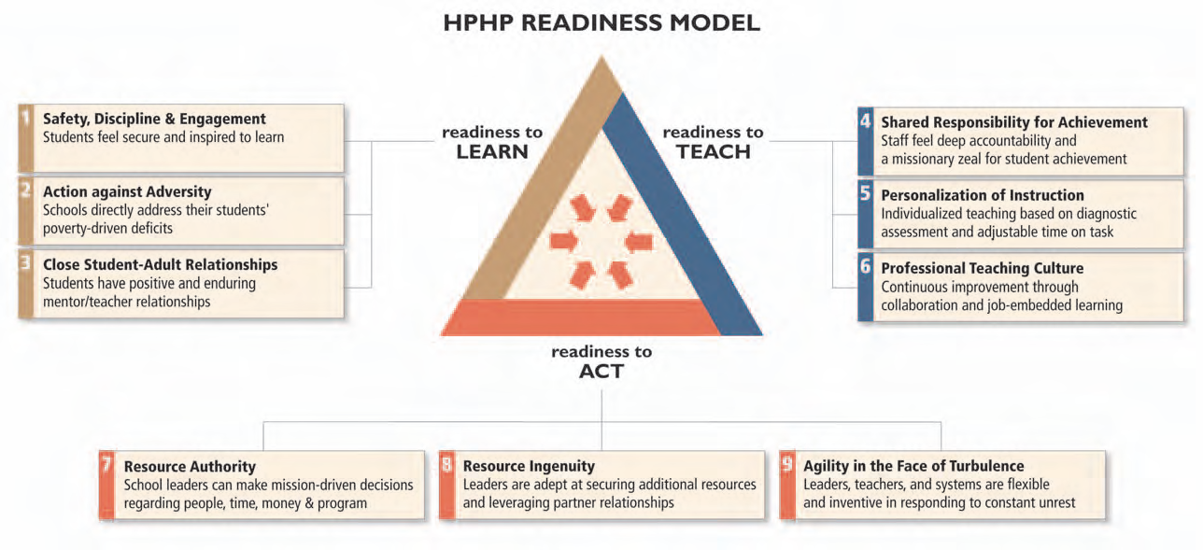
Mass Insight High Performing-High Poverty Schools Readiness Model

Slide 12
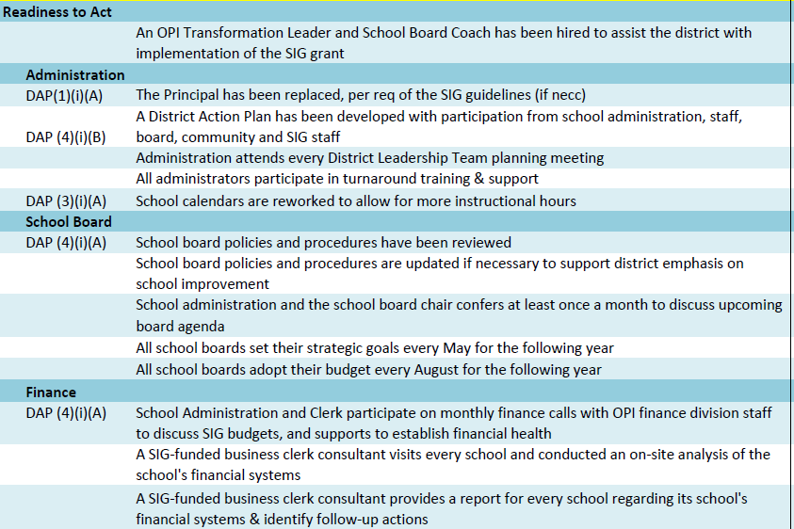
SIG Schools Indicators of Success

