Slide 1

Montana’s schools of Promise SIG structure & process Emphasizing the Role of School Board Coaching
Mandy Smoker Broaddus, School Transformation Director and Stevie Schmitz, School Board Coach

Slide 2
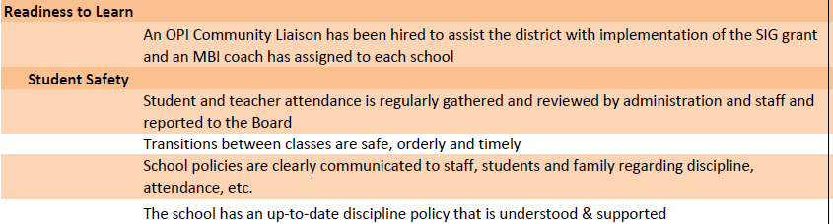
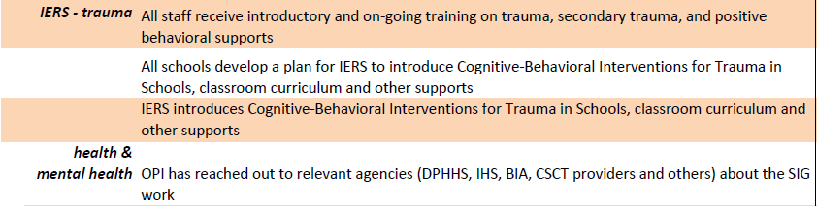
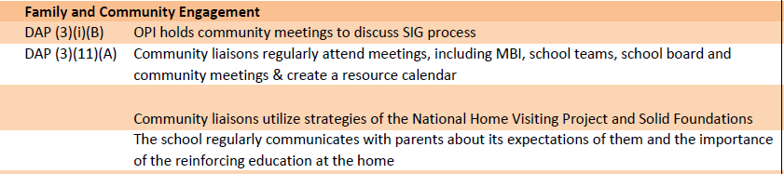
SIG Schools Indicators of Success

Slide 3
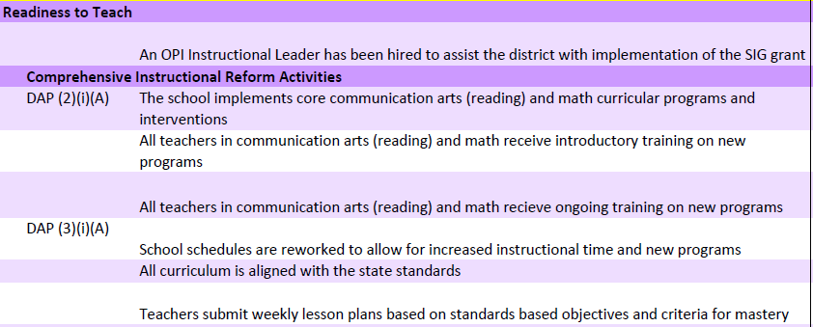
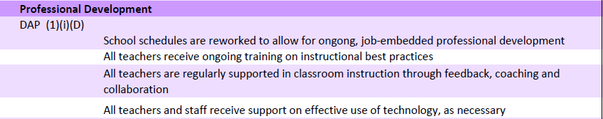
SIG Schools Indicators of Success

Slide 5
Onsite Transformation Teams
The Transformation Leader is responsible for the areas of SIG requirements that call for schools to develop and increase teacher and administrator effectiveness, use comprehensive instructional reform strategies, increase learning time, create community-oriented schools, and provide operational flexibility and support. The duties of the Transformation Leader are:
Ensure teaching and learning opportunities are enhanced and maximized to ensure student growth at all times
Coordinate, organize, schedule, implement, and monitor the activities of the local School Improvement Team, the District Action Plan and the overall functions of the SIG Grant in coordination with the SIG School Transformation Director and other OPI staff
Research, collect, analyze, manage, and report scholastic review data, school improvement activities, professional development practices, as well as methods to improve overall school administration functions
Support local education agencies and their efforts to use accountability data to evaluate school performance and identify areas in need of improvement
Coordinate with educational professionals, institutions, and technical advisors to support school improvement process
Identify professional development needs of school and district leaders and develop/support leadership capacity within the district
Align planning and implementation between Title I initiatives and improvement efforts for overall school improvement – e.g., Special Education, Early Reading First, Five-Year Comprehensive Education Plans, Montana Behavioral Initiative, etc.
Develop project objectives and activities that require interagency coordination/collaboration and partners

Slide 6
Onsite Transformation Teams
The Instructional Leader is responsible for the areas of SIG requirements that call for schools to develop and increase teacher effectiveness, use comprehensive instructional reform strategies, increase learning time, and create community-oriented schools. The duties of the Instructional Leader are:
Ensure teaching and learning opportunities are enhanced and maximized to ensure student growth at all times
Conduct needs assessment of school districts, teachers, administrators, and curriculum
Develop, direct, manage, and/or supervise all aspects of improving instructional strategies across a broad range of professional areas, including language arts and math
Facilitate and build capacity of program design, evaluation, and implementation
Establish criteria, process, and procedures to develop classroom assessments (formative assessments) in a broad range of curriculum/content areas in consultation with the curriculum/content specialists of those areas
Identify professional development needs, develop training modules, and codify and promote model lessons and instructional practices
Focus on differentiated instruction/Response to Intervention (RtI), alignment of curriculum, and using data to inform instruction

Slide 7
Onsite Transformation Teams
The Community Liaison is responsible for the area of SIG requirements that calls for community-oriented schools by providing ongoing mechanisms for student, family and community engagement. The duties of the Community Liaison are:
Provide technical assistance and support to schools, school boards, administrators, staff, and stakeholders in the areas of youth engagement and well-being, school climate, and community involvement
Assist in the analysis and development of a positive, enriching school climate
Assist with the assessment and data collection of student/community perceptions
Support advocacy efforts that encourage school districts to adopt and implement comprehensive youth-school-community policies
Build awareness and educate the community leaders, educators, and the general public about youth-school-community engagement activities, and motivate them to get involved
Collaborate and build productive partnerships with specialists, outside partners, and civic groups to determine community needs and the availability of services, and develop goals for meeting those needs
Establish and maintain cooperative working relationships with teachers, school administrators, students, youth councils, school boards, educational associations, state and federal agencies, and the general public – provide support and build capacity among these entities and individuals to engage with families and students at the highest levels
Represent student and community voice in all meetings and decisions

Slide 8
Onsite Transformation Teams
The School Board Coach is responsible for the areas of SIG requirements that call for schools to develop and increase teacher and school leader effectiveness, increase learning time, create community-oriented schools, and provide operational flexibility and support. The duties of the School Board Coach are:
Conduct an initial/ongoing assessment of board needs through one-on-one interviews with each board member and appropriate school and district staff
Identify structures that will help increase board engagement in increasing student achievement through:
Creating a trusting environment
Establishing a shared vision and high expectations
Creating a collaborative culture
Embedding continuous improvement and support in all policy and decision making
Attend monthly board meetings and build capacity among trustees and administration with development and implementation of board agendas
Develop capacity of board members through resources/information, targeted professional development and training sessions
Increase capacity around operations, including financial health and budgeting.

Slide 9
School Board Coach Successes
School Board Coaches have been welcomed by local trustees, and are “staffing” out trustee revision of policies, adherence to policy, and focus on school improvement
Regular meetings with the board chair, clerk and superintendent have helped to increase focus on student achievement and issues relating to truancy and drop-outs
Support in school finance issues has helped to develop stronger financial reporting and fidelity with the budget
Training for board members, clerks, and administrators has provided a better understanding of roles and responsibilities for all

