Slide 1

A PLACE-BASED APPROACH TO SCHOOL TURNAROUND
Anna Hinton
US Department of Education
Office of Innovation and Improvement, Parental Options and Information

Slide 2
“Boosting student achievement is not an either-or solution. Educators and the broader community should be attacking both in-school and out-of-school causes of low achievement.”
– Secretary Arne Duncan, Feb 7, 2012

Slide 3
ED Place-Based Theory of Action
New, Existing Resource Opportunities Drive Priority Activities
Establish clear results and indicators shared by multiple agencies serving same people in a targeted place
RESOURCE LEVERAGING, ALIGNMENT, INTEGRATION, AND TARGETING
Develop shared data tools:
a) collection strategies
b) analytic framework to target people and places
c) longitudinal management and evaluation systems
d) identification of funds by place (school, census tract, etc.)
High
New, place-based funding (Promise Neighborhoods)
Existing public funds used for place-based approach
(ED – SIG, 21st CCLC, etc.; HUD, Justice, State, local, etc.)
Integrate programs to create cradle-to-career continua
with comprehensive supports (housing, health, etc.)
Early Learning
Great schools (PK-12)
College & Career
Private funding (individual, corporate, philanthropic)
Build capacities within organizations and communities
Existing public funds without specific place-based element
Low
Break down “silos” (public and private, Fed, state, local)
Capture and share learning – process evaluations, case studies, and impact of place-based strategies

Slide 4

A PLACE-BASED APPROACH TO SCHOOL TURNAROUND
Justin Cohen
School Turnaround Group
Mass Insight Education

Slide 5

A PLACE-BASED APPROACH TO SCHOOL TURNAROUND
Yvonne S. Minor-Ragan
Buffalo Promise Neighborhood
Westminster Foundation

Slide 6

Image goes here

Slide 7
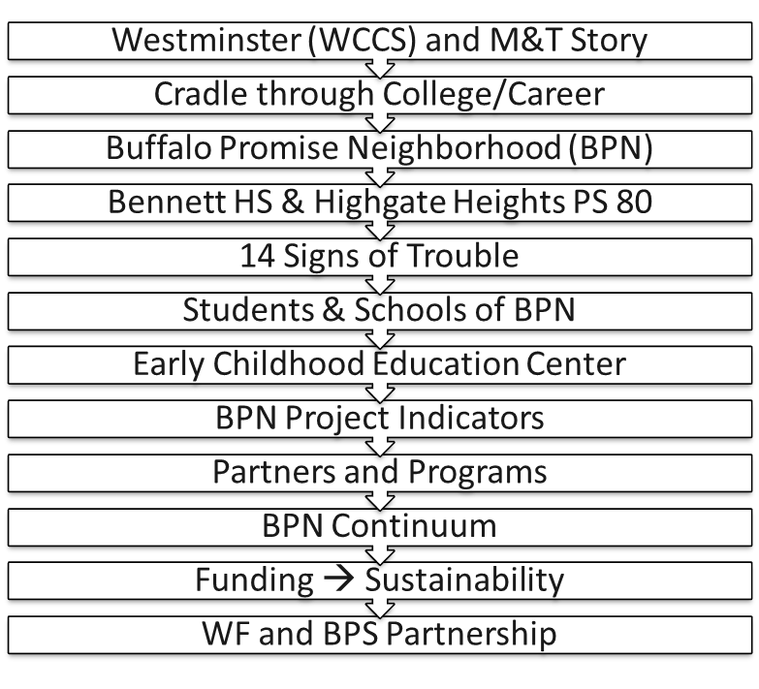
Presentation Objectives

Slide 8
Westminster Community Charter School (WCCS) and M&T Bank
Since 1993, M&T-WCCS-Buffalo Public Schools Partnership Demonstrates A Commitment To Childhood Education
M&T receives “Pathfinder Award”
School 68 renamed: Westminster Community School
Summer School begins Program exceeds capacity
M&T Bank adopts School 68
Columbia University: Teachers College
Library is acquired and integrated into WCCS
Westminster’s Literacy Symposium
Nutritional Program
1993 1994 1995 1997 2000 2004 2006 2008 2009 2010-12
Dr. Yvonne Minor-Ragan
Exceeds District in Terra Nova exams
Charter Conversion:
Westminster Community Charter School
New Addition to WCCS
three primary classrooms, health clinic, a new main office , conference room, an atrium, parking lot, playground, and basketball court
Promise Neighborhood
Planning Award
Implementation Award
Charter Renewed
CNN “Investing in the Futures”
NYSDOE “Most Improved School”
NYSDOE “High Performing School”
Notes:
6/21/2011

Slide 9




Cradle through College/Career
Notes:
6/21/2011

Slide 10
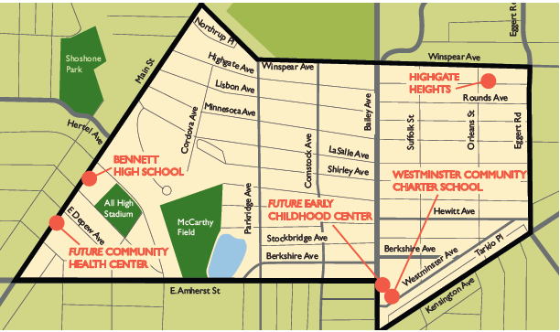


Buffalo Promise Neighborhood (BPN)
Notes:
6/21/2011

Slide 11
Bennett HS & Highgate Heights P.S. 80
Indicator | Bennett High School | Highgate Heights P.S. 80
Enrollment | 1,000 | 550
Graduation rate | 48% | 100%
Free and reduced lunch | 78% | 88%
Public assistance: students | 91-100% | 81-90%
Attendance rate | 81% | 92%
Dropout rate | 12% | 0%
ELA Secondary Level | 46% | 39%
Math Secondary Level | 43% | 58%
Teacher turnover rate
Less than 5 yrs. experience | 22% | 36%
All teachers | 11% | 26%
Notes:
6/21/2011

Slide 12
14 Signs of Trouble
Academic
25% of kindergarteners are below age-appropriate academic functioning
40% of BPN children do NOT attend an early education program
20% of BPN children are academically proficient in Math and English
Less than 50% graduate Bennett HS
HS seniors want to attend college but are NOT ready
Students change schools frequently
Between MS and HS: absenteeism increases
Health
Less than 50% of children under age 5 have a “medical home”
Less than 50% get recommended 5 daily servings and exercise
Family/Community
60% of students do NOT feel safe going to and from school
60% of children lack a caring adult at home or at school
Less than 50% have access to the internet (home and school)
BPN teenaged girls are more than 2X as likely to get pregnant than girls throughout NYS
12.5% of BPN youth are neither employed nor in school
Additional information
67% of BPN households are single-parent families
40% Owner-Occupied Homes

Slide 13
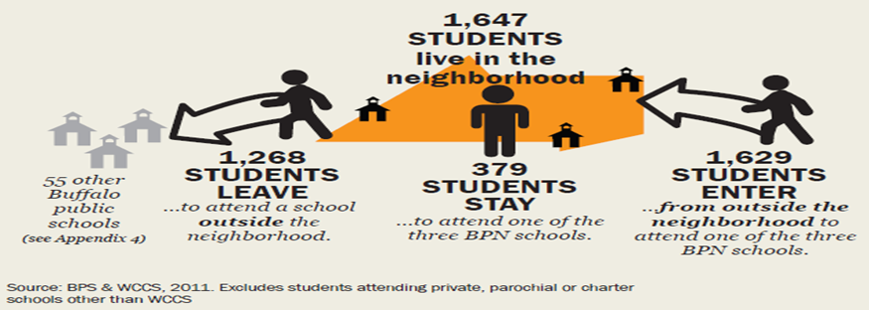
Students & Schools of BPN
Fewer than 25% of BPN children attend a BPN school
Buffalo Public Schools enrollment policy review
Notes:
6/21/2011

Slide 14


Early Childhood Education Center
The Early Childhood Education Center will:
Begin the Buffalo Promise Neighborhood (BPN) continuum of solutions
Serve 150 of BPN’s children
Ensure children enter kindergarten ready
Address the needs (academic, social and health) in our targeted neighborhood
Establish community feeder school platform
Partner with a community based early childhood education organization

Slide 15
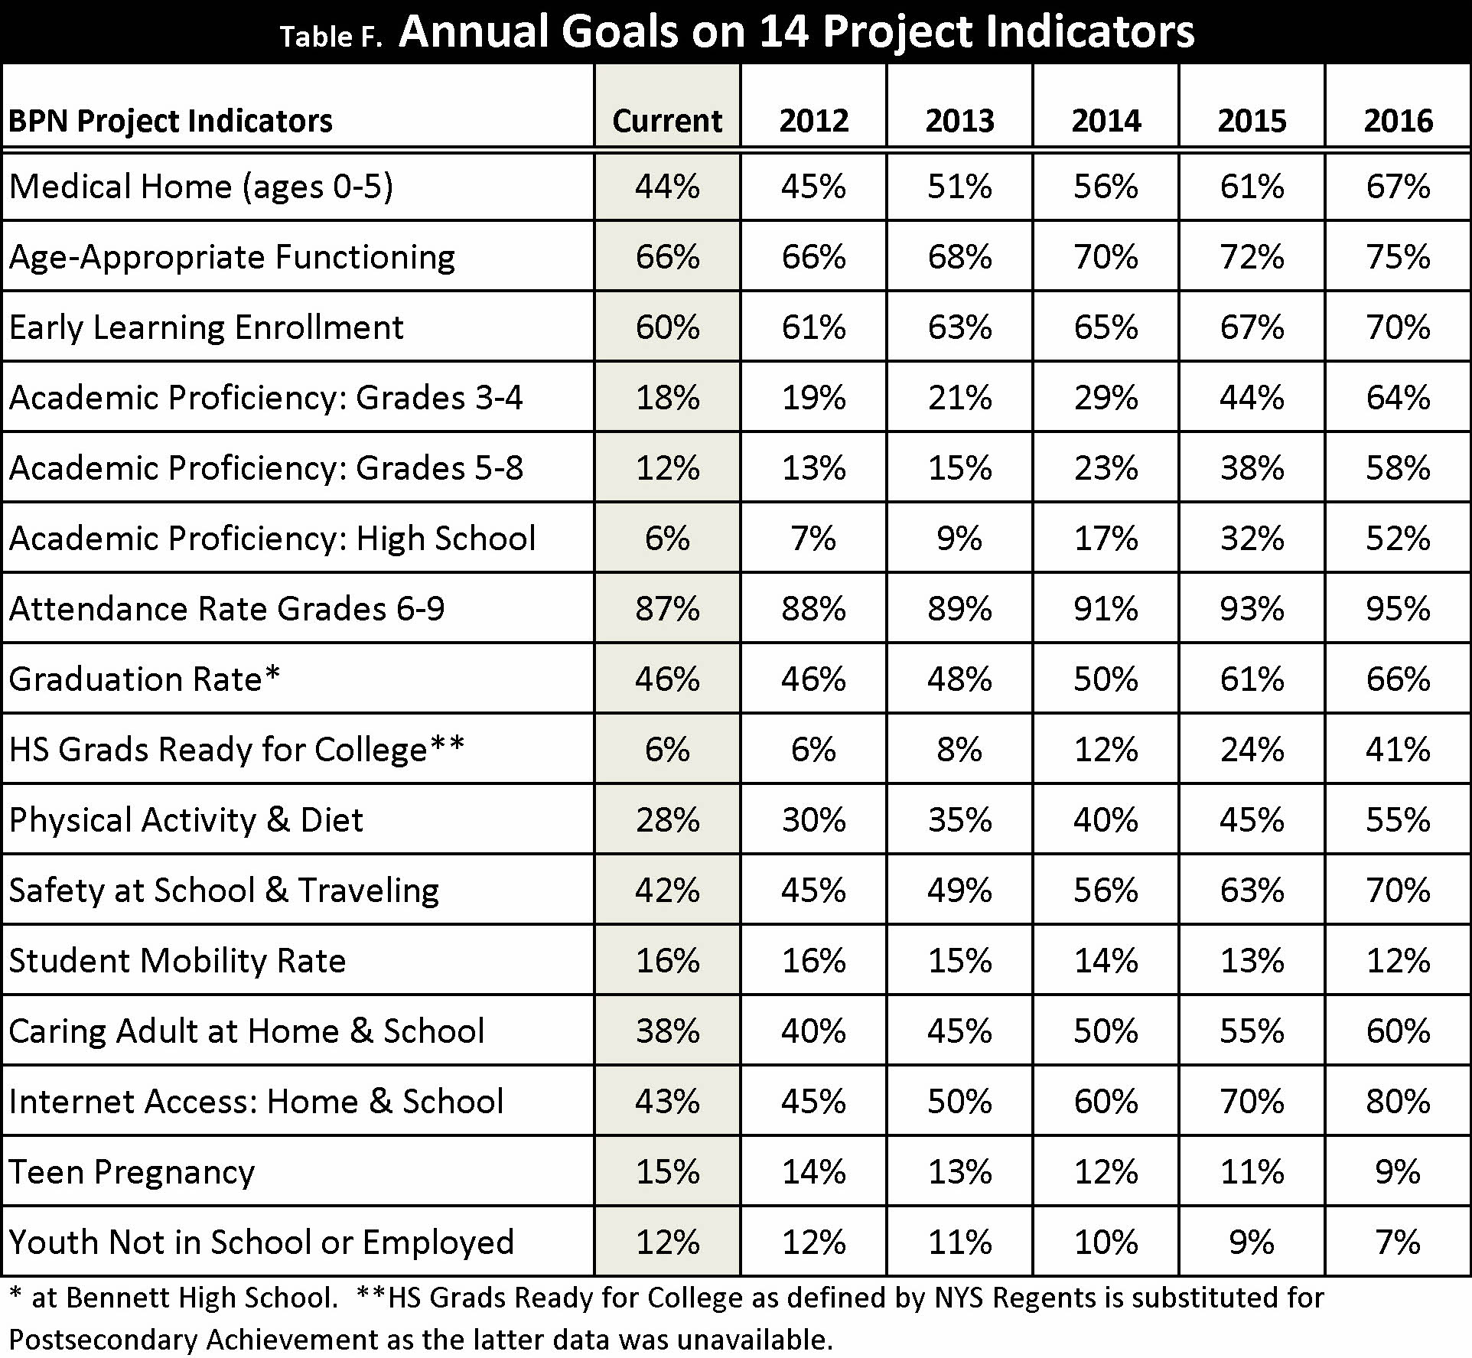
BPN Project Indicators

Slide 16
Partners and Programs
Belmont Housing Resources for WNY | EPIC (Every Person Influences Children)
Bethel Head Start | Erie County
Buffalo Public Schools (BPS) | Jeremiah Partnership
Buffalo Urban League | John Hopkins University: Talent Development
Catholic Charities of Buffalo | The John R. Oishei Foundation
City of Buffalo | M&T Bank
Closing The Gap | Read to Succeed Buffalo
College Success Center | United Way of Buffalo and Erie County
College Summit | University at Buffalo
Community Health Center of Buffalo (CHCB) | Westminster Community Charter School (WCCS)
Council For Unity | Westminster Foundation (WF)

Slide 17
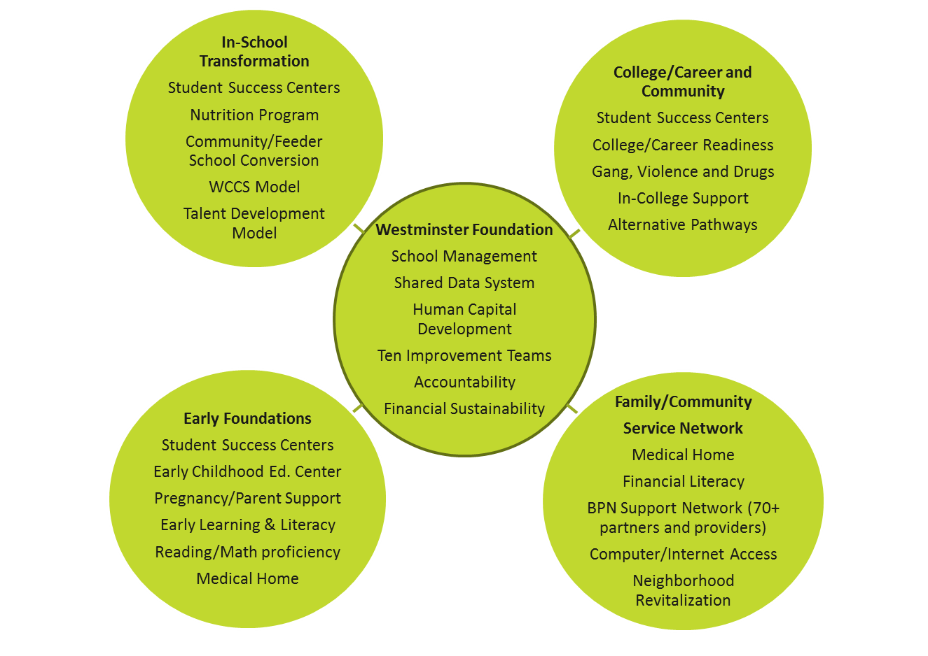
BPN Continuum

Slide 18
Funding → Sustainability
Continuum Initiatives | PN Grant & Match | Private Sector Fundraising | Service Providers & Agencies In-kind | Cumulative Total
Early Foundations | $2.7M | $3.2M | $9.1M | $15.0M
School Transformation | $7.4M | $2.9M | $2.5M | $12.8M
College/Career Connections | $1.5M | $1.2M | $2.2M | $4.9M
Family/Community Services Network | 0.4M | $1.3M | $3.8M | $5.5M
Total | $12M | $8.6 | $17.6M | $38.2M

Slide 19
WF and BPS Partnership
Westminster Foundation’s (WF) commitment:
School Management and BPN Services Network
Develop and maintain longitudinal database system
Manage all BPN partnership relationships for the three BPN schools.
In-kind services and/or monetary funding
$2.5 million to build and early learning childhood education center
Fundraising campaign
Buffalo Public Schools’ (BPS) commitment:
Top management and departments collaboration with BPN plan
Partnership between WF, BPS, Bennett HS and Highgate Heights PS 80
Operations and logistics support
Data sharing for longitudinal database
Funding of day-to-day operations
SIG funding: programming and position support

Slide 20
Presentation Objectives

