Slide 1



Response to Intervention
and
SLD Identification
Notes:
OSEP Leadership Conf 3/30/05

Slide 2
The IDEA Partnership wishes to acknowledge the work of Lou Danielson, Ph.D., Director, Research to Practice Division, Office of Special Education Programs; Dr. Daryl Mellard, Director, National Research Center on Learning Disabilities (NRCLD), University of Kansas; and Dr. Douglas Fuchs, Director, National Research Center on Learning Disabilities (NRCLD), Vanderbilt University.
Slides displaying the National Research Center on Learning Disabilities (NRCLD) logo contain original text presented by Lou Danielson on June 21, 2006 to the members of the IDEA Partnership Focus Group and/or Daryl Mellard on April 1, 2005 to the members of the National Association of School Psychologists (NASP).
-and-
We are deeply grateful for being allowed to adapt the original presentations in order to provide additional access to all education stakeholders.
July 2007
IDEA Partnership
Notes:
OSEP Leadership Conf 3/30/05

Slide 3
Session Overview
RTI Process
  What is it?
  What might it look like in practice?
SLD Identification
  What are the current issues/problems?
  What data can RTI yield that will assist in SLD determination?
Resources for further consideration
July 2007
IDEA Partnership
Notes:
OSEP Leadership Conf 3/30/05

Slide 4
RTI Process
What is it?
July 2007
IDEA Partnership
Notes:
OSEP Leadership Conf 3/30/05

Slide 5
RTI is…
the practice of providing high-quality
instruction/intervention matched to student needs
and
using learning rate over time
and level of performance
to
inform educational decisions
July 2007
IDEA Partnership
Notes:
OSEP Leadership Conf 3/30/05

Slide 6
What do we mean by RTI?
RTI has two goals: prevent academic problems and determine students with LD.
2 or more tiers of increasingly intense interventions.
Use a problem solving model or standardized treatment protocol for intervention tiers.
Implementation of a differentiated curriculum with different instructional methods.
Varied duration, frequency, and time of interventions, and
Explicit decision rules for judging learners’ progress.
Notes:
OSEP Leadership Conf 3/30/05

Slide 7
Goals of RTI
Prevention of academic/behavior problems
  Attend to skill gaps early
  Provide interventions/instruction early
  Close skill gaps to prevent failure
Determination of eligibility as a student with a specific learning disability
  Pattern of inadequate response to interventions may result in referral to special education
  Student intervention response data are considered for SLD eligibility
July 2007
IDEA Partnership
Notes:
OSEP Leadership Conf 3/30/05

Slide 8
RTI Process
What might it look like in practice?
July 2007
IDEA Partnership
Notes:
OSEP Leadership Conf 3/30/05

Slide 9
What does RTI implementation look like?
Students receive high quality, research-based instruction by qualified staff in their general education setting.
General education instructors and staff assume an active role in students’ assessment in that curriculum.
School staff conduct universal screening of (a) academics and (b) behavior.
School staff implement specific, research-based interventions to address the student’s difficulties.
Notes:
OSEP Leadership Conf 3/30/05

Slide 10
Other features of RTI
Continuous progress monitoring of student performance occurs (weekly or biweekly).
School staff use progress-monitoring data and decision rules to determine interventions’ effectiveness and needed modifications.
Systematic assessment of the fidelity or integrity with which instruction and interventions are implemented.
Notes:
OSEP Leadership Conf 3/30/05

Slide 11
Intervention Levels
Two or more tiers
Tiers include increasing levels of intensity of interventions
  Primary Instruction -- differentiated curriculum and instruction for all students
  Secondary Interventions -- Targeted interventions for students at-risk
  Tertiary Interventions -- Strategic/Intense interventions for students with intensive needs
July 2007
IDEA Partnership
Notes:
OSEP Leadership Conf 3/30/05

Slide 12


Continuum of School-Wide Instruction
Tertiary Intervention (~5%)
Specialized Individualized
Systems for Students with Intensive Needs
~5%
~15%
Secondary Intervention (~15%)
Specialized Group
Systems for Students with
At Risk Performance
Primary Instruction (~80%)
School-/Classroom-wide
Systems for All Students,
Staff and Settings
~80% of Students
Adapted from”What is School-Wide PBS?”
Notes:
OSEP Leadership Conf 3/30/05

Slide 13
Primary Instruction
Expectation = 80% or more of students successful with general education curriculum and instruction
Assessment = Universal screenings for academics and social/emotional growth (behaviors)
Intervention = Through differentiated instructional practices
Roles and responsibilities = primarily the general education teacher
July 2007
IDEA Partnership
Notes:
OSEP Leadership Conf 3/30/05

Slide 14

Which students may have a learning gap?
Low income
Culturally diverse
English language learners
Special education
Disengaged
Male or female
Career and technical education
Gifted education
July 2007
IDEA Partnership
Source: National Education Association IDEA Resource Cadre presentation on Differentiated Instruction, developed in collaboration with Deborah E Burns, Curriculum Coordinator, Cheshire Connecticut Public Schools and Kathleen Whitmire, Director, School Services in Speech-Language Pathology, American Speech and Hearing Association
Notes:
OSEP Leadership Conf 3/30/05

Slide 15
Differentiated Instruction
Meeting diverse needs of diverse student population
Differentiating based on content and student strengths and needs
Choosing curriculum components to differentiate
  Within the core curriculum
  Consistent with state learning standards
July 2007
IDEA Partnership
Notes:
OSEP Leadership Conf 3/30/05

Slide 16

Differentiating Instruction…
CORE CURRICULUM
Intro
Teaching
Learning
Pacing
Products
Objective
Resources
Grouping
Extension
Assessment
July 2007
IDEA Partnership
Source: National Education Association IDEA Resource Cadre presentation on Differentiated Instruction, developed in collaboration with Deborah E Burns, Curriculum Coordinator, Cheshire Connecticut Public Schools and Kathleen Whitmire, Director, School Services in Speech-Language Pathology, American Speech and Hearing Association
Notes:
OSEP Leadership Conf 3/30/05

Slide 17
Secondary Intervention
Expectation = 15% of students may be at risk and in need of targeted interventions
Assessment = progress monitoring of student response to specific intervention
Intervention = standard protocol treatment intervention as available from the research; evidence-based intervention as available in the literature
Roles and responsibilities = variety of personnel as determined at the local site
July 2007
IDEA Partnership
Notes:
OSEP Leadership Conf 3/30/05

Slide 18
Standard Treatment Protocol Approach To Responsive-to-Intervention
The standard treatment is for the student to receive a validated, intense intervention
The bad news is that all students receive the same intervention
The good news is that the interventions are well-specified, sequenced with clear outcomes
The interventions are more likely to be delivered with fidelity; training is consistent
Increases the consistency of services; easy to check for implementation
Notes:
OSEP Leadership Conf 3/30/05

Slide 19
What types of interventions?
Standard Treatment Protocol Interventions
  From scientific-based education research
Evidence-based Interventions
  From education research
Experiential-based Interventions
  From best practice with like students
July 2007
IDEA Partnership
Notes:
OSEP Leadership Conf 3/30/05

Slide 20
Tertiary Intervention
Expectation = 5% of students may be at significant risk and in need of intense interventions
Assessment = progress monitoring of student response to specific intervention
Intervention = standard protocol treatment intervention as available from the research; evidence-based intervention as available in the literature; unique intervention based on teacher expertise
Roles and responsibilities = variety of personnel as determined at the local site
July 2007
IDEA Partnership
Notes:
OSEP Leadership Conf 3/30/05

Slide 21
Problem-Solving Method
What is the problem?
Why is it
happening?
Did it work?
What should be done about it?
July 2007
IDEA Partnership
Notes:
OSEP Leadership Conf 3/30/05

Slide 22
Determining interventions
  Use of problem-solving methodology
    Define problem
    Brainstorm solutions
    Choose intervention with greatest potential for student success
      Standard treatment protocol intervention
      Evidence-based intervention
    Monitor and assess intervention outcomes
July 2007
IDEA Partnership
Notes:
OSEP Leadership Conf 3/30/05

Slide 23
Explicit decision rules
Necessary for determining expected response or inadequate response to intervention
Considering
  Expected level of achievement of peer group
  Target for this student
  Movement toward the target
  Trajectory of improvement, or lack thereof
July 2007
IDEA Partnership
Notes:
OSEP Leadership Conf 3/30/05

Slide 24
Program/Process Evaluation
Systematic and ongoing
Assess integrity/fidelity of implementation of interventions
Assess integrity of implementation of overall process
  High quality, research-based instruction
  Screening and progress monitoring
  Data analysis
  Problem-solving
  Data-driven decision-making
July 2007
IDEA Partnership
Notes:
OSEP Leadership Conf 3/30/05

Slide 25
Advantages of RTI Approach
Provides instructional assistance in a timely fashion (e.g., NOT a wait-to-fail model)
Helps ensure a student’s poor academic performance is not due to poor instruction
or inappropriate curriculum
Informs teacher and improves instruction because assessment data are collected
and closely linked to interventions
Notes:
OSEP Leadership Conf 3/30/05

Slide 26
SLD Identification
What are the current issues/concerns?
July 2007
IDEA Partnership
Notes:
OSEP Leadership Conf 3/30/05

Slide 27

Identification of SLD
Current “wait to fail” model
Misidentification
Disproportionality
July 2007
IDEA Partnership
Notes:
OSEP Leadership Conf 3/30/05

Slide 28
Researcher Roundtable on Specific Learning Disabilities
SLD is a valid concept with converging evidence across indicators and methodologies
SLD are disorders of learning and cognition intrinsic to the individual(s)
Each disorder significantly affects a relatively narrow range of academic and performance outcomes
SLD may occur in combination with other disabling conditions, but are not due primarily to other conditions
Adapted from opening remarks by Lou Danielson, Ph.D., Director, Research to Practice Division, Office of Special Education Programs to the National SEA Conference on SLD Determination, Kansas City, MO, April 19-21, 2006
July 2007
IDEA Partnership
Notes:
OSEP Leadership Conf 3/30/05

Slide 29
Researcher Roundtable on Response to Intervention
There should be alternate ways to identify SLD
Response to quality intervention is the most promising method of alternate identification
  Can promote effective practices in schools
  Can help to close the gap between identification and treatment
RTI should be based on problem solving models that use progress monitoring to gauge the intensity of intervention in relation to the student’s response to intervention
Adapted from opening remarks by Lou Danielson, Ph.D., Director, Research to Practice Division, Office of Special Education Programs to the National SEA Conference on SLD Determination, Kansas City, MO, April 19-21, 2006
July 2007
IDEA Partnership
Notes:
OSEP Leadership Conf 3/30/05

Slide 30
SLD Determination and IDEA 2004
(P.L. 108-446)
New language in the law:
“…a local education agency may use a process that determines if the child responds to scientific, research-based intervention as a part of the evaluation procedures…”
  Sec. 614(b)6B [emphasis added]
In the special education research literature, the process mentioned in this language is generally considered as referring to RTI.
From opening remarks by Lou Danielson, Ph.D., Director, Research to Practice Division, Office of Special Education Programs to the National SEA Conference on SLD Determination, Kansas City, MO, April 19-21, 2006
July 2007
IDEA Partnership
Notes:
OSEP Leadership Conf 3/30/05

Slide 31
RTI as part of SLD Identification
What data can RTI yield that will assist in SLD determination?
July 2007
IDEA Partnership
Notes:
OSEP Leadership Conf 3/30/05

Slide 32
Explicit decision rules
Necessary for determining expected response or inadequate response to intervention
Considering
  Expected level of achievement of peer group
  Target for this student
  Movement toward the target
  Trajectory of improvement, or lack thereof
July 2007
IDEA Partnership
Notes:
OSEP Leadership Conf 3/30/05

Slide 33
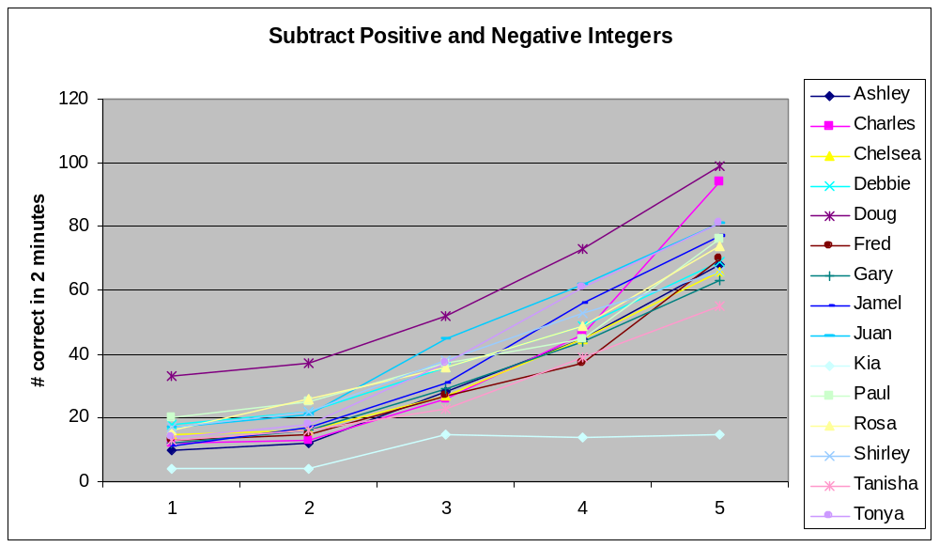
Classroom teacher screening for a specific indicator…
Baseline
Source: Sharon R Schultz, from a presentation/facilitated dialogue entitled RTI: Schoolwide Transformation (Spring 2007)
Notes:
OSEP Leadership Conf 3/30/05

Slide 34
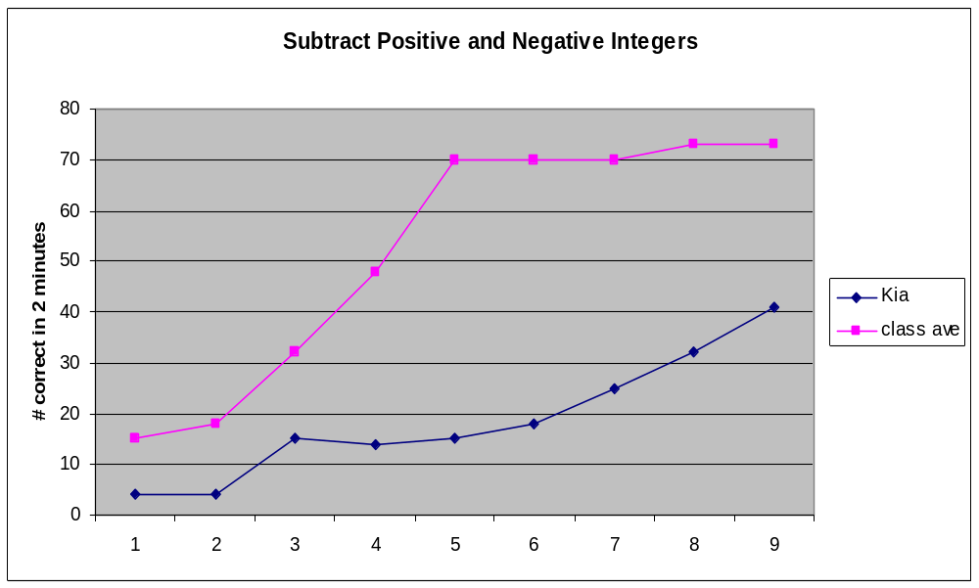
Progress Monitoring for a specific intervention…
Baseline
Gened instruction
Targeted Intervention Initiated
Source: Sharon R Schultz, from a presentation/facilitated dialogue entitled RTI: Schoolwide Transformation (Spring 2007)
Notes:
OSEP Leadership Conf 3/30/05

Slide 35
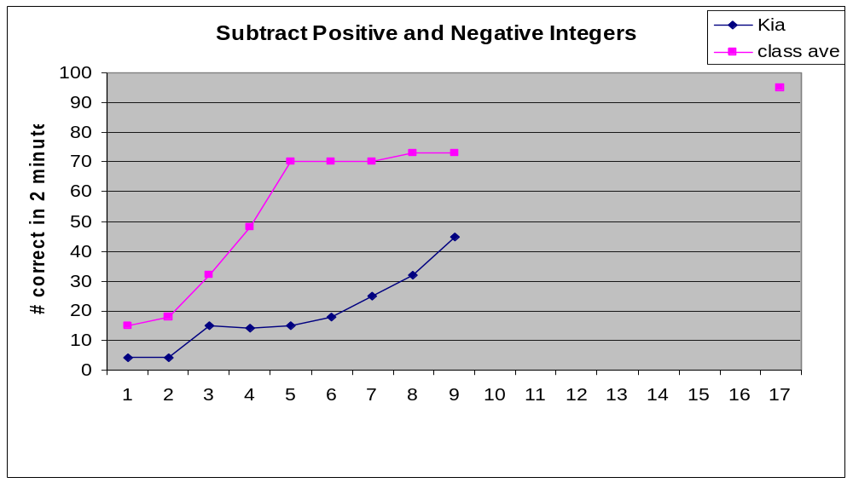
Progress Monitoring for a specific intervention…
AIMLINE
Kia’s TRENDLINE
Baseline
Targeted Intervention Initiated
Gened instruction
Successful Intervention !!
Source: Sharon R Schultz, from a presentation/facilitated dialogue entitled RTI: Schoolwide Transformation (Spring 2007)
Notes:
OSEP Leadership Conf 3/30/05

Slide 36
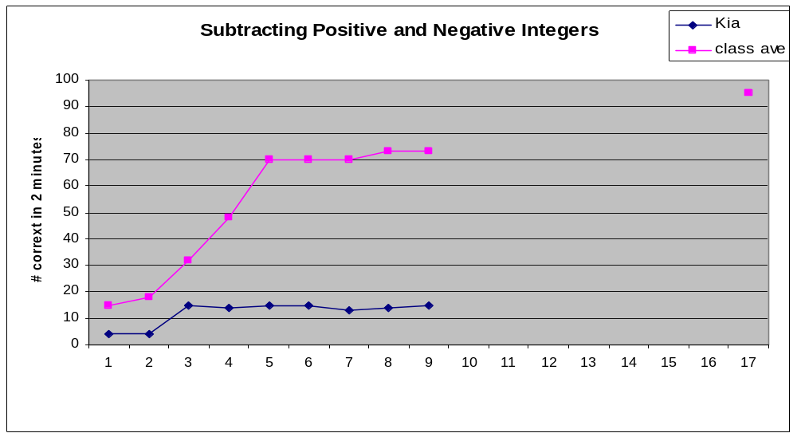
Progress Monitoring for a specific intervention…
AIMLINE
Kia’s TRENDLINE
Baseline
Targeted Intervention Initiated
Gened instruction
Unsuccessful Intervention !!
Source: Sharon R Schultz, from a presentation/facilitated dialogue entitled RTI: Schoolwide Transformation (Spring 2007)
Notes:
OSEP Leadership Conf 3/30/05

Slide 37
Progress Monitoring for a specific intervention…
Rule of Four
AIMLINE
Kia’s TRENDLINE
Baseline
Targeted Intervention Initiated
Gened instruction
Unsuccessful Intervention !!
Source: Sharon R Schultz, from a presentation/facilitated dialogue entitled RTI: Schoolwide Transformation (Spring 2007)
Notes:
OSEP Leadership Conf 3/30/05

Slide 38
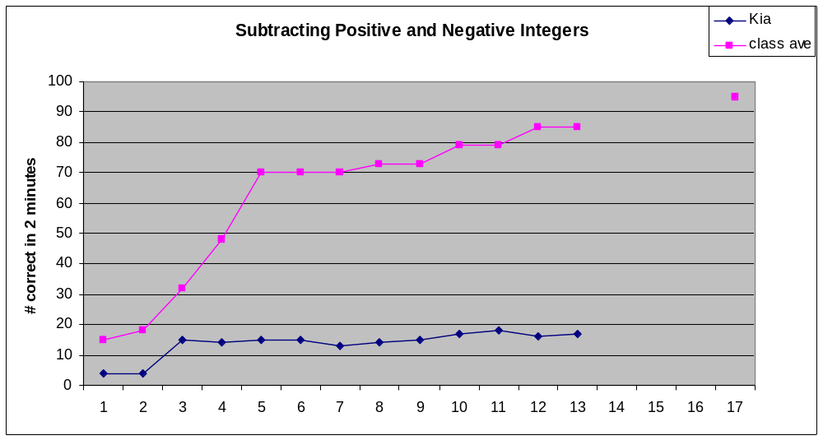
Progress Monitoring for a specific intervention…
Rule of Four
AIMLINE
Kia’s TRENDLINE
Baseline
Targeted Intervention Initiated
Gened instruction
Targeted Intervention Initiated
Another targeted intervention -or- intense intervention?
Source: Sharon R Schultz, from a presentation/facilitated dialogue entitled RTI: Schoolwide Transformation (Spring 2007)
Notes:
OSEP Leadership Conf 3/30/05

Slide 39
Monitoring progress…
How often will skill probes be administered?
How many probes will be administered before determining to continue, fade, or change a particular intervention?
What is a pattern of inadequate response?
  How many different interventions at each tier?
  How much time in each tier?
July 2007
IDEA Partnership
Notes:
OSEP Leadership Conf 3/30/05

Slide 40
RTI Symposium
Participants included advocates, instructional staff, researchers, and state-level education officials
Speakers shared knowledge / expertise, organized around six questions related to RTI implementation in both school districts and research sites
Symposium materials (e.g., papers, PowerPoint presentations, video highlights) are available on our website: www.nrcld.org
Notes:
OSEP Leadership Conf 3/30/05

Slide 41
Regional Resource Centers
  www.rrfcnetwork.org
Federal Resource Center
  Michele Rovins, Director
Region 1: Northeast
  Kristin Reedy, Director
Region 2: Mid-South
  Kenneth Warlick, Director
Region 3: Southeast
  Elizabeth Beale, Director
Region 4: North Central
  Michael Sharpe, Director
Region 5: Mountain Plains
  John Copenhaver, Director
Region 6: Western
  Caroline Moore, Director
July 2007
IDEA Partnership
Notes:
OSEP Leadership Conf 3/30/05

Slide 42
For More Information:
IDEA Partnership’s RTI Initiative
Website: www.ideapartnership.org
    A Partnership Collection on RTI
    Many Journals, Many Voices
    Results for Kids: Resources
July 2007
IDEA Partnership
Notes:
OSEP Leadership Conf 3/30/05

Slide 43
Reflections!
Questions?
Discussion.
?
.
!
.

!
!
?
July 2007
IDEA Partnership
Notes:
OSEP Leadership Conf 3/30/05

