Slide 1

Transforming America’s Primary Education System for the 21st Century
Ruby Takanishi
United States Department
of Education Webinar
March 13, 2012
www.fcd-us.org

Slide 2

SETTING THE STAGE
“Now, if we are to prevent the achievement gap and develop a cradle-to-career educational pipeline, early learning programs are going to have to be better integrated with the K-12 system”
- U.S. Secretary of Education
Arne Duncan
Keynote address to the National Association for the Education of Young Children – November 18, 2009

Slide 3

TRANSFORMING AMERICA’S PRIMARY EDUCATION SYSTEM
Current primary education system (Kindergarten to Grade 4) must be changed.
Both PreK/early learning programs and K-12 Grades must be linked to create a birth through postsecondary learning continuum (P-16).
PreK-3rd is the first building block of a transformed P-16 public education system for the 21st Century.

Slide 4
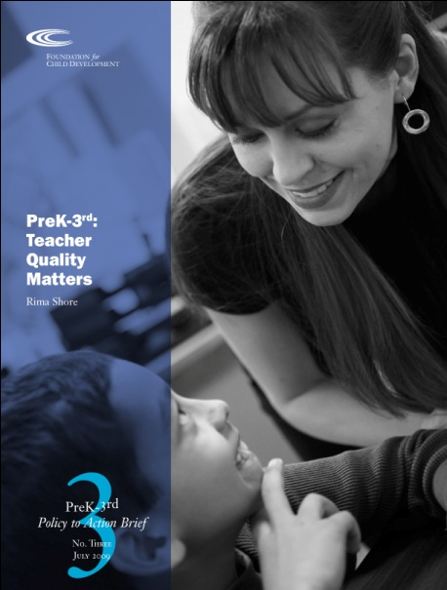
A NATION AT (LONGTERM) RISK
Why we must transform American education starting with PreK/early learning:
Children come to Kindergarten unprepared.
The education pipeline is sprouting leaks between PreK and Third Grade.
The majority of American children are not being well-educated from PreK to Third Grade:
Just about 30 percent of all children are reading at or above grade level when they are first tested for NAEP at the beginning of Fourth Grade.

Slide 5

A NATION AT (LONGTERM) RISK
For children of color living in low-income households, the overwhelming majority – about 80 percent nationally – are not reading at grade level when they are first tested for NAEP.
To describe these facts as constituting a crisis is a vast understatement.

Slide 6
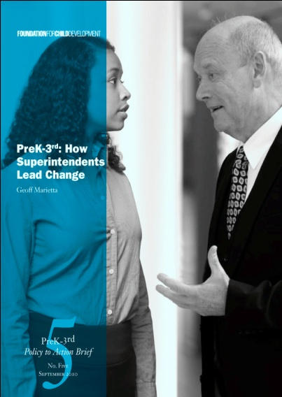
WHAT IS PREK-3RD GRADE?
Shared understanding of the cultural and economic conditions of children’s lives, and their influences on learning and health.
Full-Day, Voluntary PreK Programs beginning at least by age three, preferably age two.
Full-Day, Required Kindergarten.
Superintendent leadership for district-wide change.

Slide 7

WHAT IS PREK-3RD GRADE?
Principal leadership that provides time and resources for teacher teams centered on PreK-3rd Grade alignment of standards, curriculum, instruction and assessment.
Family engagement focused on what children are learning in classrooms.
Increasing time for close alignment of instruction in before and after school programs, including weekends and summer programs.

Slide 8
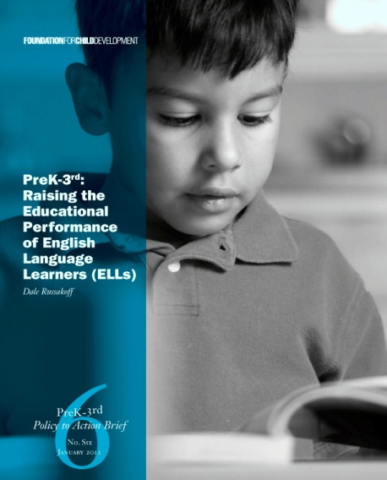
WHY PREK-3RD IS IMPORTANT FOR
SECOND LANGUAGE LEARNERS
All children require sustained, aligned instruction from PreK-3rd Grade, especially in oral language and in academic English.
Second Language Learners have the major task of acquiring another language.
More learning time – before, during, and after school, including summer programs is required, and all must be tightly aligned with what happens in classrooms.

Slide 9
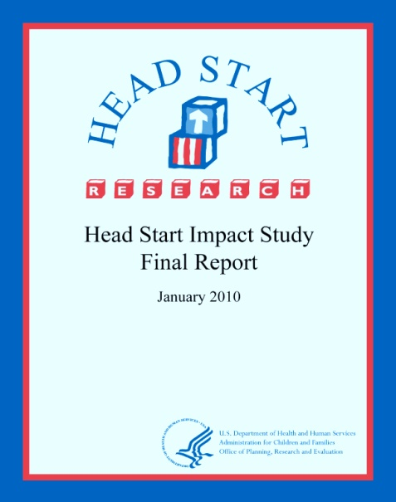

PREK-3RD: AN EVIDENCE-DRIVEN STRATEGY
Quality early learning programs must be sustained by a quality K-12 education system: National Head Start Impact Study.
Third Grade outcomes are crucial for future educational success in schools: Double Jeopardy: How Third-Grade Reading Skills and Poverty Influence High School Graduation.
Programs that are well-connected and integrated in learning opportunities from PreK-3rd Grade have positive outcomes: Montgomery County (MD) Public Schools, Bremerton (WA) and Chicago Child-Parent Center Education Program (IL).

Slide 10
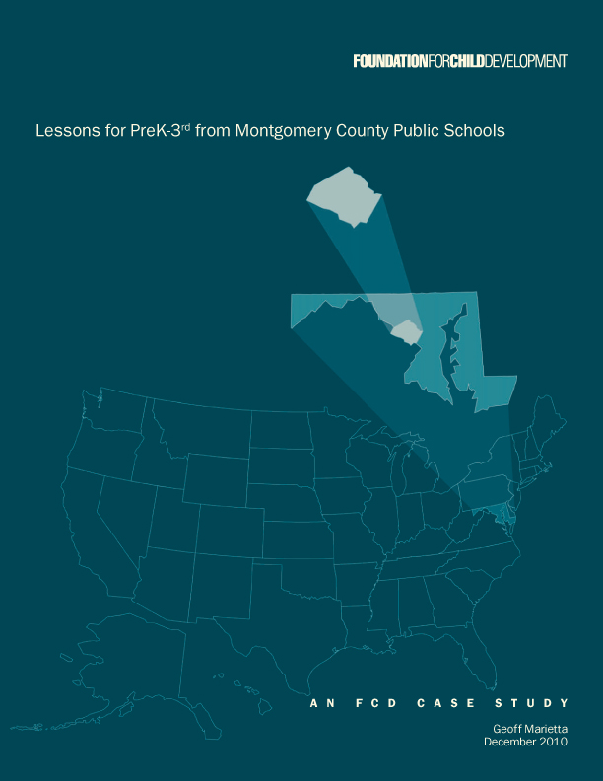
WHAT DO WE KNOW ABOUT PREK-3RD’S EFFECTIVENESS?
Montgomery County Public Schools (Maryland)
Ninety percent of Third Graders in MCPS are proficient readers, including almost 75 percent of students in the Limited English Proficient (LEP) sub-group.
The reading gap between the LEP sub-group and all Third Grade students has narrowed by 36 percentage points since 2003.
Student learning in PreK-3rd does not fade out in middle and high school.
Eighty-six percent of of MCPS students go to college, including nearly 80 percent of African American students and over 75 percent of Latino students.
Nearly 50 percent of all former MCPS students earn a college degree within six years of graduation (a rate nearly double that of the nation as a whole).

Slide 11
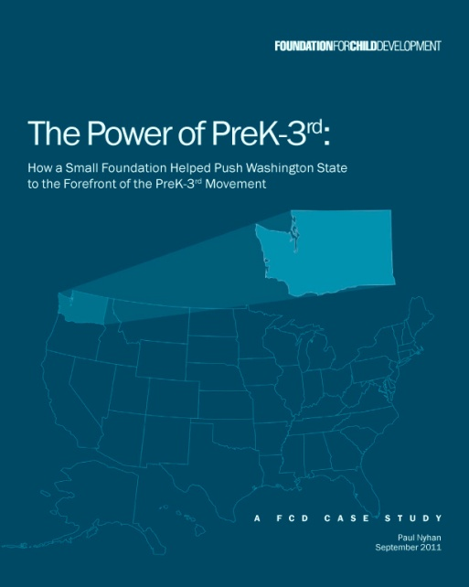
WHAT DO WE KNOW ABOUT PREK-3RD’S EFFECTIVENESS?
Bremerton Public Schools (Washington)
The percentage of Fourth Graders meeting state reading standards rises every year – up from 59 percent in 2003, to 74 percent in 2009.
Sixty-six percent of entering Kindergarteners in 2009, knew their letters, an increase of 62 percent in eight years.

Slide 12
WHAT DO WE KNOW ABOUT PREK-3RD’S EFFECTIVENESS?
Chicago Child-Parent Center Education Program (Illinois, and expanding to Wisconsin, Minnesota, and Michigan)
The Chicago Longitudinal Study focused on participants in the Child-Parent Center Education Program (CPCEP), a Title I-funded effort that provides up to six years of continuous learning experiences from PreK, starting at age three, through Third Grade.
Now in its 26th year, findings show that the impact of the CPCEPs can endure through the third decade of life, and that the benefit-costs of the CPCEPs are an 18 percent annual return on investment for society.
The data show that high-quality early education programs that begin in PreK and continue through Third Grade lead to higher school graduation rates and socioeconomic status; lower drug and alcohol abuse; and lower arrests and incarcerations.

Slide 13
WHAT DO WE KNOW ABOUT PREK-3RD’S EFFECTIVENESS?
Chicago Child-Parent Center Education Program (CPCEP)
For participants at age 28, the positive outcomes among the 957 individuals who began the program in PreK, compared to a comparison group of 529 individuals of similar backgrounds but did not experience the program, included:
Nine percent more of the CPCEP children completed high school.
Twenty percent more achieved moderate or higher socioeconomic status.
Nineteen percent more had health insurance coverage as an employment benefit.
Twenty-eight percent fewer abused drugs and alcohol.
Twenty-two percent fewer had a felony arrest.
Twenty-eight percent fewer experienced incarceration.
Source: “School-Based Early Childhood Education and Age-28 Well-Being: Effects by Timing, Dosage, and Subgroups.” Science, 9 June 2011, doi:10.1126/science.1203618.

Slide 14
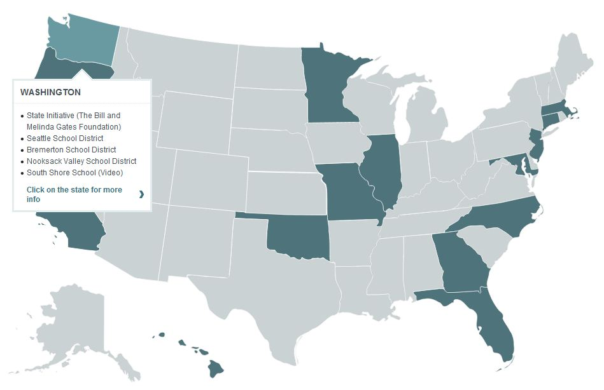
WHERE IS PREK-3RD HAPPENING?
THE FCD PREK-3RD MAP

Slide 15

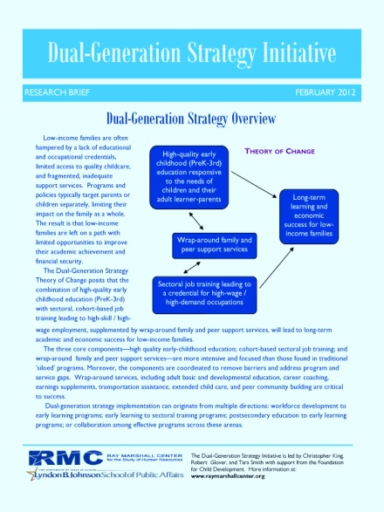

KEY TAKEAWAYS: KEEP OUR EYES ON THE PRIZE
The prize: Raising the achievement levels of all children, and narrowing the achievement gaps between groups of children.
PreK-3rd is not ‘just another thing’ in districts: the ambition is turnaround of districts, not just schools.
PreK-3rd is not ‘the silver bullet’: PreK-3rd is the first building block of a cradle-to-career public education system for the 21st century.
PreK-3rd must be a dual-generation strategy: Engaging families in increasing their own education and literacy is necessary to leverage their children’s learning in schools.

Slide 16

PREK-3RD:
BUILDING BLOCK FOR A LIFELONG EDUCATION
PreK-3rd is not a silver bullet or the panacea for all our educational woes. It is just an important part of a lifelong educational experience that provides the fundamentals and fosters a disposition for lifelong learning.
When children are well-educated, they are healthier and more likely to live happier lives than those who are left behind in prisons and in poverty.
They flourish.
Our communities and the nation benefit.

Slide 17

FOR INDEPTH RESOURCES ON PREK-3RD
GO TO:
www.fcd-us.org

