Slide 1
Using Early Warning Systems to Target Tiered Interventions for Dropout Prevention
Mindee O’Cummings
National High School Center

Slide 2
Sobering Statistics…
Nearly one-third of all high school students leave the public school system before graduating
1.2 million students drop out of high school each year – that’s 12 million over the next decade
7,000 students drop out of high school every day
15% of the high schools in the U.S. produce 50% of our dropouts – schools Balfanz and Legters call “dropout factories”
Balfanz, R. and Legters, N. (2006, July 12). The graduation rate crisis we know and what can be done about it. Retrieved online from http://web.jhu.edu/CSOS/graduationgap/edweek/Crisis_Commentary.pdf

Slide 3
Economic Consequences
A new high school dropout in 2000 had less than a 50% chance of getting a job
That job earned less than half of what the same job earned 20 years ago
Lack of education is strongly correlated with welfare dependency and incarceration
Cutting the number of dropouts in half would reap $45 billion in revenues and decreased costs (Levin et al., 2007)

Slide 4
Early Warning Systems
Early warning systems (EWS) use readily available data housed at the school to:
Predict which students are at-risk for dropping out of high school
Target resources at the school and district level to support off-track students while they are still in school, before they drop out
Examine patterns and identify school climate issues that may contribute to disproportionate dropout rates at a subset of high schools or within subpopulations of students

Slide 5
9th Grade is a Critical Year
Ninth grade is a “make or break year”
More students fail 9th grade than any other grade in high school
A disproportionate number of students who are held back in 9th grade subsequently drop out
By the end of 9th grade or even during the first semester, powerful indicators exist that can predict whether students will complete high school:
Engagement
Course performance
Chicago’s “On-Track” Indicator
Herlihy, C. (2007). State and district-level supports for successful transition into high school. Washington, DC: National High School Center.
Allensworth, E., & Easton, J.Q. (2007). What matters for staying on-track and graduating in Chicago Public High Schools: A close look at course grades, failures and attendance in the freshman year. Chicago: Consortium on
Chicago School Research.

Slide 6
Key 9th Grade Indicators
Engagement
Attendance/ absenteeism
Course Performance
Course grades
Number of credits earned
“On-track” Indicator
Core course performance & accumulated credits
Research from several U.S. school districts provides a strong foundation for defining 9th grade warning signs that students might drop out, but local adaptation is key

Slide 7
“High-Yield” Academic Indicators: Attendance

Slide 8
“High-Yield” Academic Indicators: Course Failures

Slide 9
“High-Yield” Academic Indicators: GPA

Slide 10
Chicago’s “On-track” Indicator
Students are “on-track” if they:
have not failed more than one semester long core course, AND
have accumulated enough credits for promotion to the 10th grade.
Number of Semesters with Fs in Core Courses | # of Credits Accumulated Freshman Year
 | Less than 5 | 5 or more
2 or more courses | Off-track | Off-track
0 or 1 courses | Off-track | On-track

Slide 11
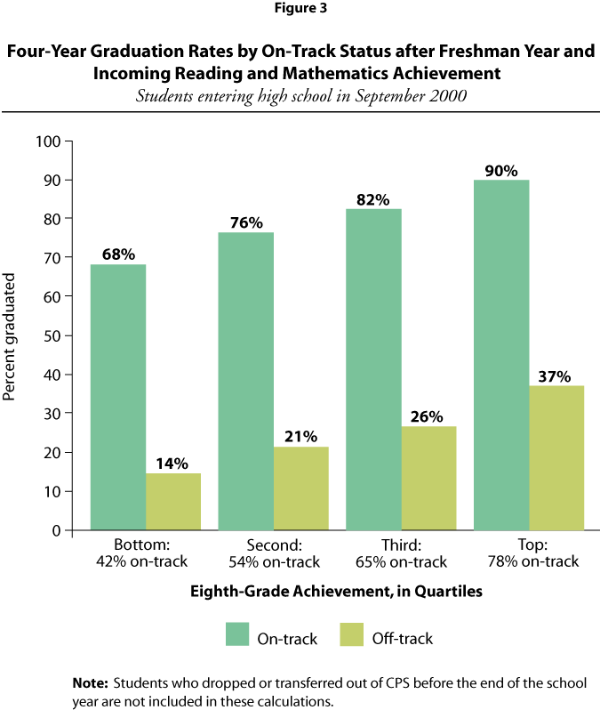
On-Track Indicator
Source: Allensworth & Easton (2005)

Slide 12
“High Yield” 9th Grade Indicators
Indicators | Benchmark (red flag)
Absenteeism | Missing 10% or more of instructional time
Course failures | One of more failed courses
Grade point average | 2.0 or lower (on a 4-point scale)
“Off-track” | Fail two or more semester core courses, or accumulate fewer credits than the number required for promotion to the 10th grade

Slide 13
Implementing the EWS Process
STEP 1 – Establish Roles and Process
STEP 2 – Use the EWS Tool
STEP 3 – Analyze EWS Data
STEP 4 – Interpret EWS Data
STEP 5 – Apply Interventions
STEP 6 - Reflect and Revise

Slide 14
Step One: Establish Roles and Process
EWS teams should include school- and district-level individuals who have:
Authority to make decisions
Knowledge of diverse students
Expertise to manage and analyze data
Information about strategies

Slide 15
Step Two: Use the EWS Tool
Routinely available data are good predictors of whether a student is likely to drop out of high school
First-month absences, in addition to end of the semester grades, are additional strong predictors of dropout
The goal is to effectively and efficiently allocate dropout prevention resources to change the odds for students with a high propensity to drop out
Not all students at-risk will need all interventions available
Analysis of different patterns of risk can help target appropriately
EWS data = knowledge to make these decisions

Slide 16
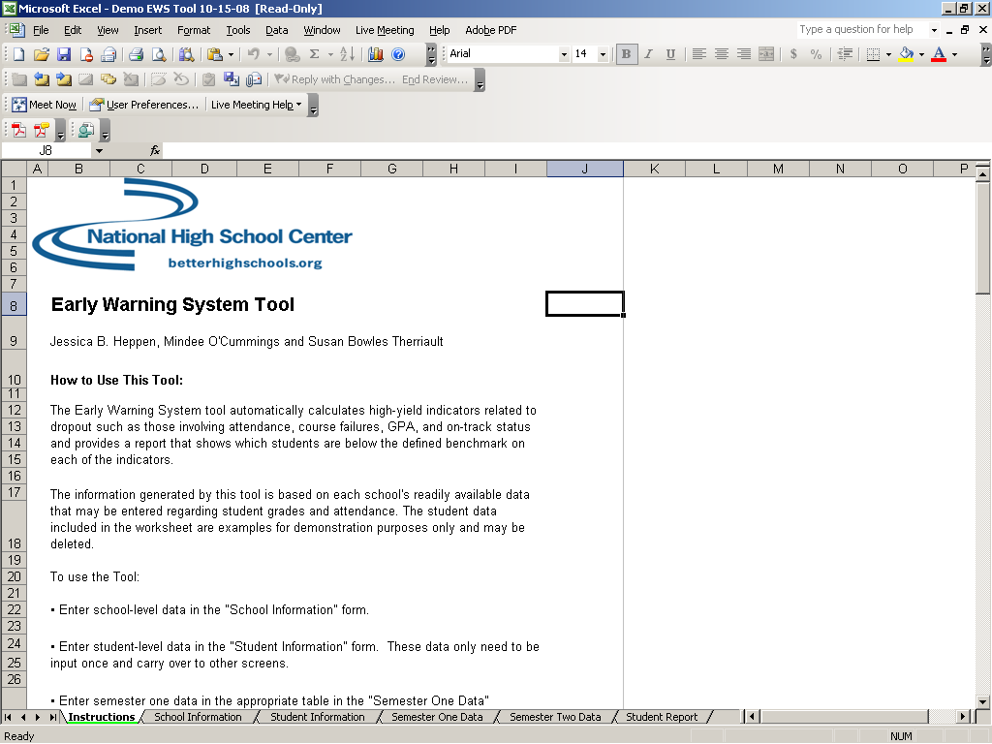

Slide 17
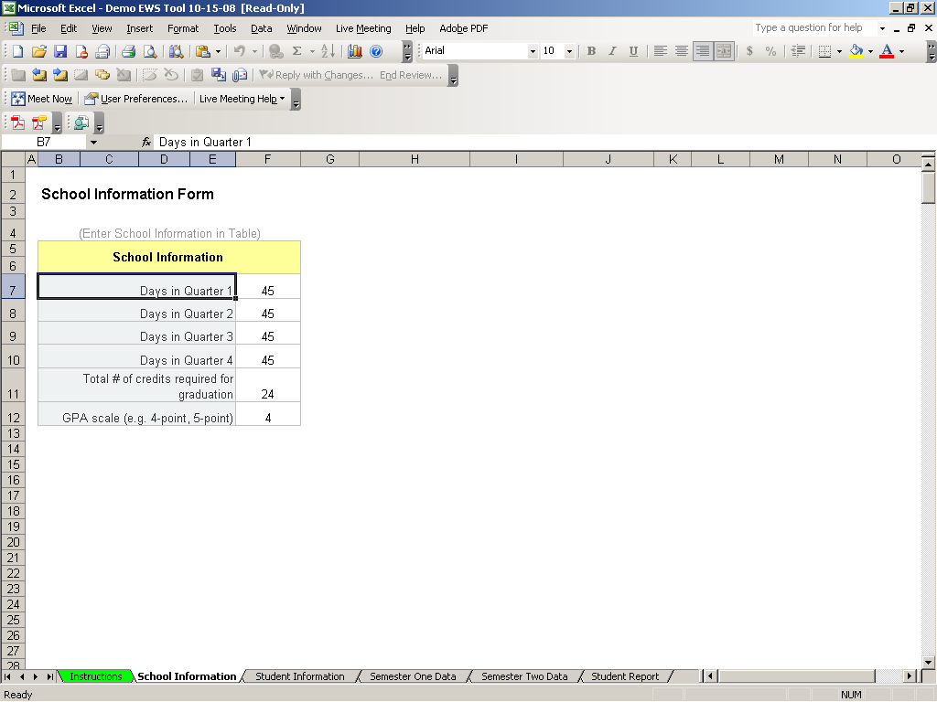

Slide 18
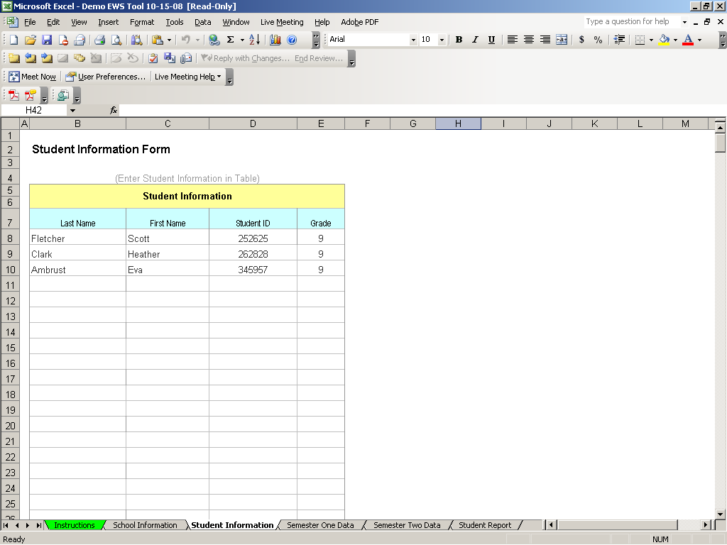

Slide 19
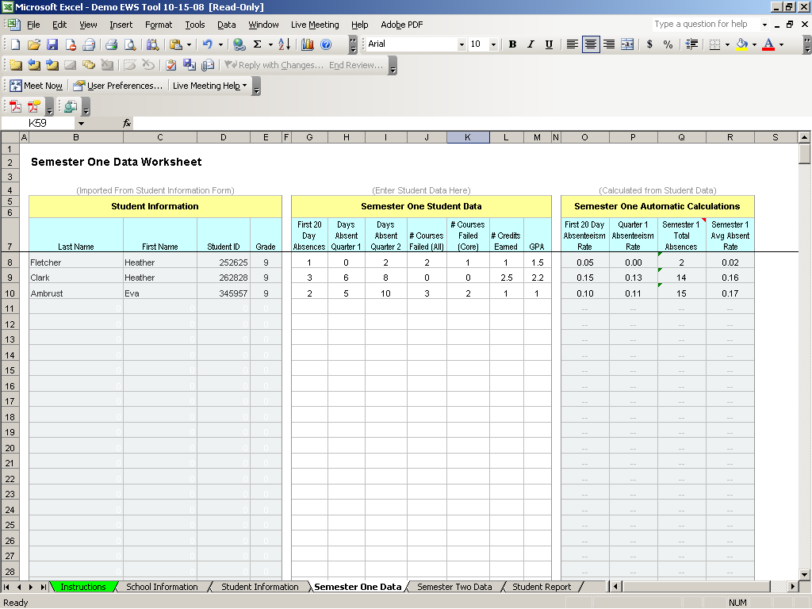

Slide 20
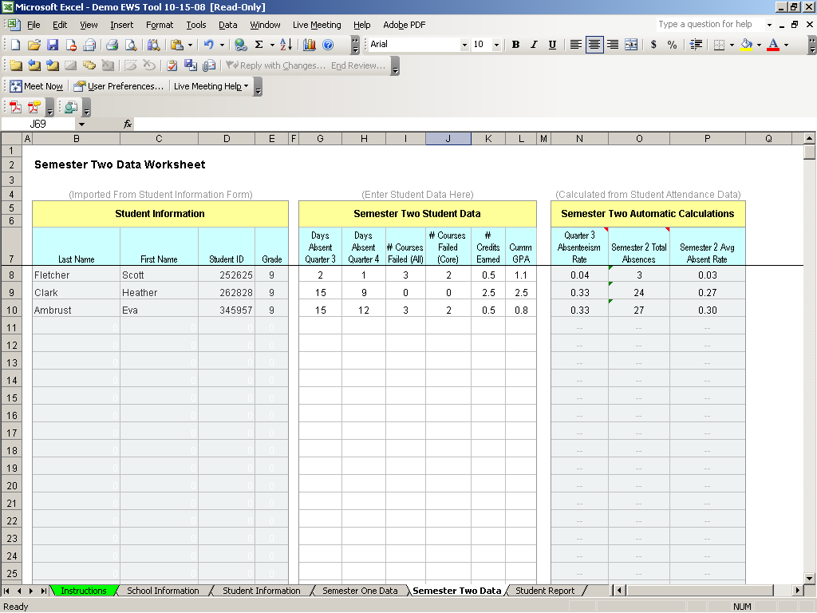

Slide 21
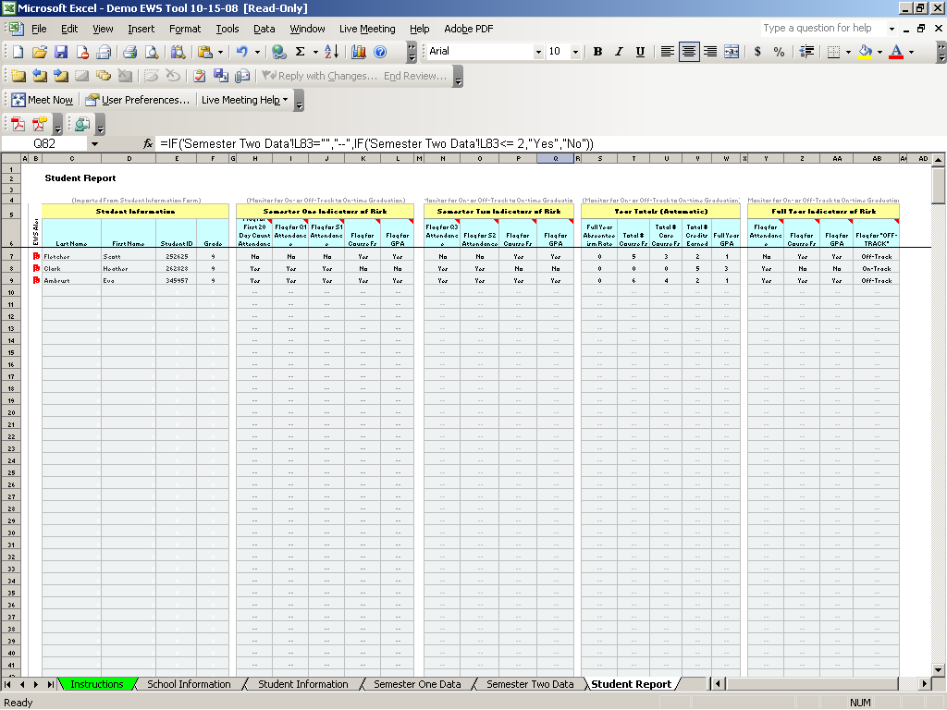

Slide 22
Step Three: Analyze EWS Data
Questions about EWS data:
Student-level patterns: What do your data tell you about individual students who are at-risk?
School-level patterns: What do your data tell you about how the school is doing?
Are students who were flagged from the beginning remaining “off-track” through the year?
Are students who were flagged at one reporting period back “on-track” at the next?

Slide 23
Step Four: Interpret EWS Data
Digging deeper than the indicators:
Indicators are just observable signals, not root causes
Characteristics of students who are flagged can further help target interventions at the appropriate intensity

Slide 24
Step Four: Interpret EWS Data (cont.)
Understanding Characteristics of Students At-Risk
Decisions to persist or drop out are affected by multiple contextual factors - family, school, neighborhood, peers.
Personal and school factors contribute to success or failure during the freshman year
Attendance and course performance problems are distinct indicators in the EWS but are highly interrelated, and both can signal disengagement
Student background characteristics are less important in explaining failures than behaviors in high school

Slide 25
Step Five: Applying Interventions
Example Programs that incorporate this strategy:
America’s Choice
First Things First
School Development Program
Talent Development High School
Example Programs that incorporate this strategy:
America’s Choice
Talent Development High School
Example Programs that incorporate this strategy:
America’s Choice
Check and Connect
Coca-Cola VYP
Interpersonal Relations Personal Growth Class
NGP
Quantum Opportunities Program
School Development Program
Talent Development High School
Twelve Together
Example Programs that incorporate this strategy:
Academic Literacy Program
Positive Behavioral Interventions and Supports (PBIS)
Rehabilitation, Empowerment, National supports, Education, and Work (RENEW)
RTI
Strategic Instruction Model
Example Programs that incorporate this strategy:
ALAS
Check and Connect
Coca-Cola VYP
Interpersonal Relations Personal Growth Class
PBIS
Project COFFEE
Talent Development High School
Teen Outreach Program
Example Programs that incorporate this strategy:
Middle College High School
NGP
STEP
Example Programs that incorporate this strategy:
ALAS
Check and Connect
First Things First
Interpersonal Relations Personal Growth Class
Project COFFEE
Twelve Together
Example Programs that incorporate this strategy:
Career Academies
First Things First
Middle College High School
NGP
Project COFFEE
Talent Development High School
Example Programs that incorporate this strategy:
Project GRAD
Example Programs that incorporate this strategy:
Career Academies
Ninth Grade Success Academies
STEP
Example Programs that incorporate this strategy:
Check and Connect
PBIS
Example Programs that incorporate this strategy:
Career Academies
Learning to Work Program (NYC)
Lifelong Options Program (LOP)
Middle College High School
Project COFFEE
RENEW
Twelve Together
Example Programs that incorporate this strategy:
ALAS
First Things First
Support Center for Adolescent Mothers (Family Growth Center)
NGP
Talent Development High School
Focus on achievement in core courses
Content recovery courses
Tutoring as an academic support
Tiered approaches
Attendance and behavior monitors
Advisories and team teaching
Counseling and mentoring
Small learning communities and school within a school for greater personalization
Partnerships between high schools and feeder middle schools
Ninth grade transition programs
Support for students with disabilities outside of school
Career and college awareness
Family engagement
Community engagement
Example Programs that incorporate this strategy:
ALAS
America’s Choice
Career Academies
Check and Connect
Support Center for Adolescent Mothers (Family Growth Center)
Middle College High School
NGP
Quantum Opportunities Program
Teen Outreach Program

Slide 26
Tiered Approach to Dropout Prevention
Tier Three Individualized
Tier Two
Targeted
Tier One
Universal

Slide 27
New Hampshire's Model
Individualized
Targeted
School-wide
Examples: RENEW (Rehabilitation, Empowerment, Natural supports, Education and Work) facilitators
Examples: Intervention Team of specialists and administrators will focus on students who exhibit challenging behaviors and who are at risk
Examples: Positive Behavioral Supports model (PBS) and Universal Leadership Team including a diverse representation of “opinion-leaders”

Slide 28
Minnesota’s Model
Targeted
Selected
Universal
Examples: Individualized behavior plans, wrap-around services, alternative programs (5% of students)
Examples: Interventions build specific skills, school-within-a-school model, or mentoring programs (15% of students)
Examples: Extracurricular activities, school-to-work programs, or positive discipline programs

Slide 29
Step Six: Reflect and Revise
During the school year: Regularly, collectively, and systematically
Over multiple school years: Validate the indicators to maximize predictive power of the system, e.g.
 | Displayed Early Warning Sign in 9th Grade?
Graduated in 4 (or 5) Years? | YES | NO
YES | False Positive (or Effective Intervention) | Accurate Prediction
NO | Accurate Prediction | False Negative

Slide 30
More Information:
Dropout Prevention Resources www.betterhighschools.org/topics/
DropoutPrevention.asp
Contact Information
Mindee O’Cummings– mocummings@air.org

