Slide 1


USING EARLY WARNING SYSTEM DATA TO DESIGN STRATEGIC STUDENT INTERVENTIONS
Robert Balfanz, Everyone Graduates Center, Johns Hopkins University
Kelli Pfaff, Deputy Director of Post-Secondary Readiness, Denver Public Schools (DPS)
Mark Calhoun, RTI Coordinator, East High School, DPS
Dale Downing, Product Manager Principal Portal, DPS
Doug Ferguson, Manager of Business Intelligence, DPS
Tom Imperiale, Business Analyst, DPS
Chung Pham, Senior Research Analyst, DPS
Moderated by: Ashley Brown, Education Program Specialist, U.S. Department of Education and Brian Keating, Webinar Facilitator and Knowledge Manager, Maher & Maher

Slide 2


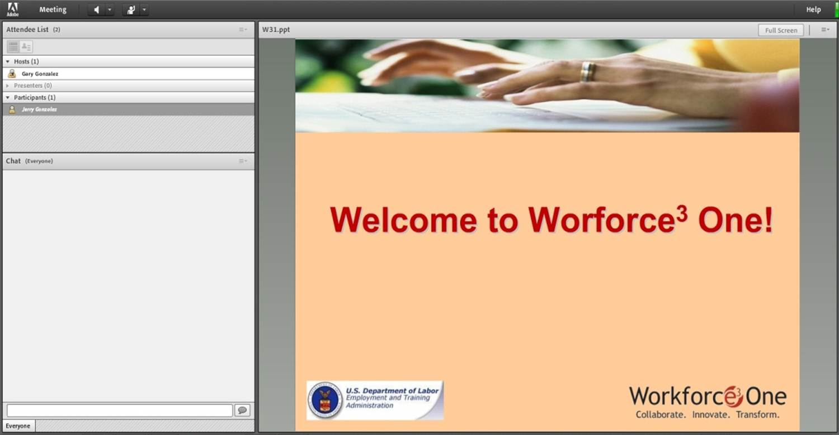
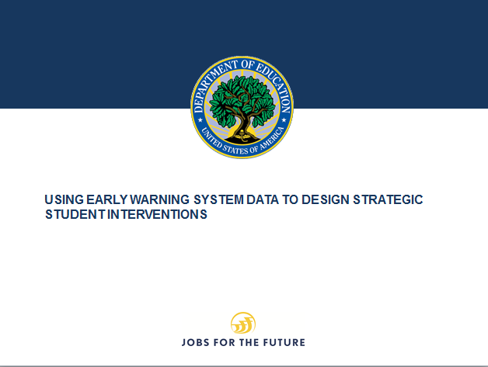

Welcome to Workforce³ One!
Notes:
WELCOME SLIDE
FACILITATOR:
There are some areas that I would like to call to your attention:
The first is the Presentation Slide area; it’s where the main visual content for the webinar will appear and it will be the main focus of your attention throughout the webinar.
The second area is the Full Screen option. If you select the Full Screen option, the PPT will enlarge. If any images or text appear too small, please select the Full Screen option, but please keep in mind that you won’t be able to use the Chat to submit any questions unless you deselect the Full Screen option when you are in Full Screen mode.
The third is the speakers and status options. You can mute and unmute the audio coming out of your computer speakers using the speaker button. The Status Options dropdown presents you with a few options to choose from so that you can give the speakers real-time feedback in a shorthand way.
The Attendee List; located at the top left of your screen displays a list of all attendees of this webinar.
Next is the Chat Room, also at the left of the screen, directly below the attendee list, it allows you to ask questions, or make comments during the webinar. We are using a ONE-WAY conference call for the audio portion of this webinar—you can hear the presenters, but they cannot hear you. Due to the large number of attendees, and to control background noise and interruptions, we’re going to rely on this CHAT feature to solicit your questions throughout the session. Those of you attending with a group will want to designate a “scribe” to represent your group by entering questions as they occur ANY TIME throughout the session. Your questions are automatically transmitted to the presenters and will be answered during dedicated question and answer periods.
IF POLLING WILL BE CONDUCTED, INFORM USERS THE POLLING WINDOWS WILL NOT APPEAR IF THE USER IS IN FULL SCREEN MODE.
IF SCREEN SHARING WILL BE CONDUCTED, INFORM USERS THAT WHAT IS BEING BROADCAST WILL NOT APPEAR IF THE USER IS IN FULL SCREEN MODE.
(Click to next slide)

Slide 3
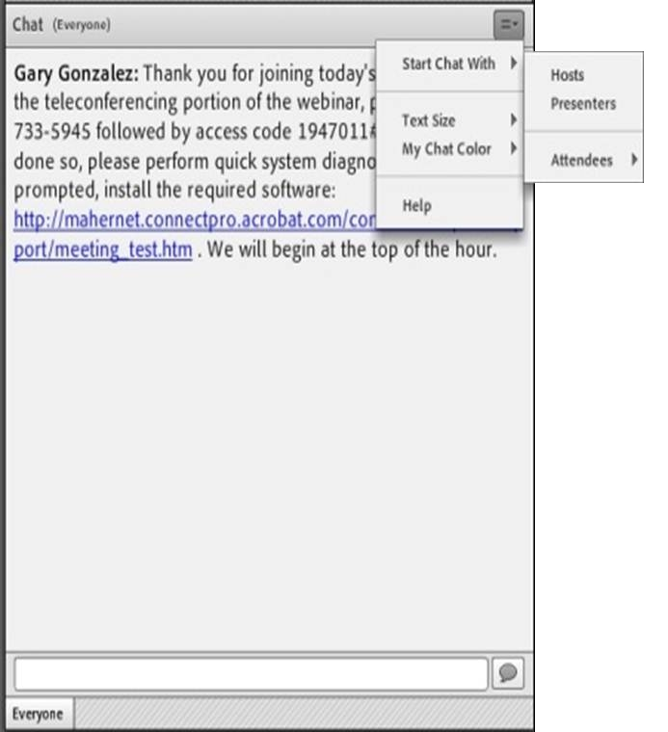
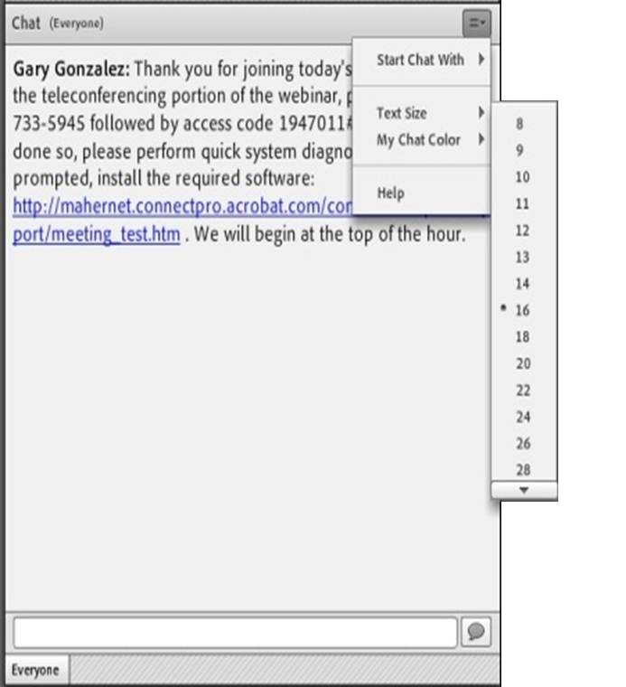
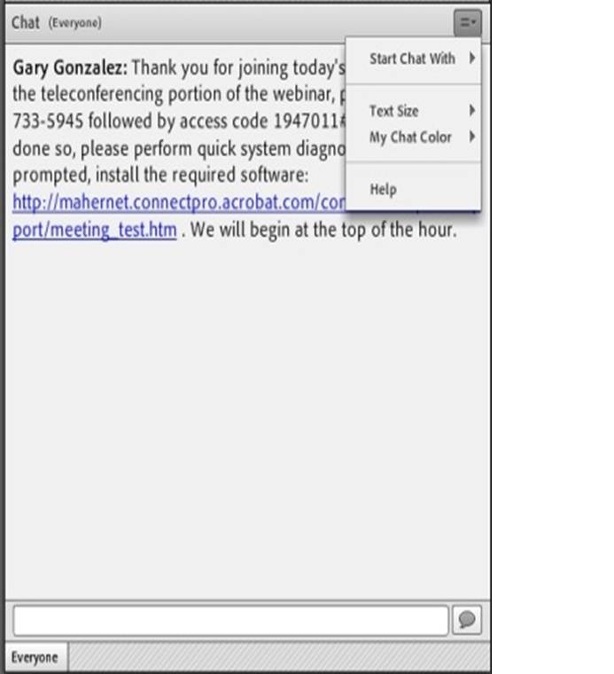
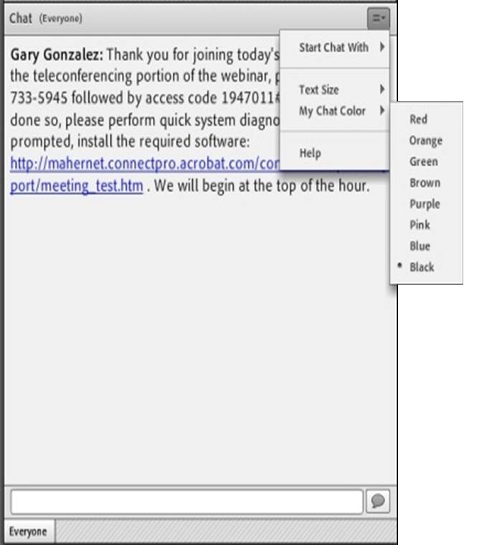
Submitting Questions: Open Chat
Drop-Down Menu
To submit a question, type the question in the text field and press your Enter/Return key.
Please enter the name to whom the question is directed.
To send questions only to the presenters, select Presenters from the drop-down menu before pressing your Enter/Return key.
Change Text Size and Chat Color…
Text Field
Notes:
OPEN CHAT SLIDE
FACILITATOR:
If you would like to submit a question during the question and answer portion of the presentation, please enter that question into the Chat Room. The Chat Room is located in the lower left portion of the virtual classroom.
To submit a question, type the question in the text box and press “enter” or “return” on your keyboard.
Note that by default, your question will be sent to everyone viewing the presentation. If you would like to send your question to the presenter only, please select Presenter from the drop-down menu at the top right of the chat window..
Again, please be sure to enter your questions at ANY TIME throughout our session. We’ll make time to answer as many of them as possible at the end of today’s presentation.
(Click to next slide)

Slide 4
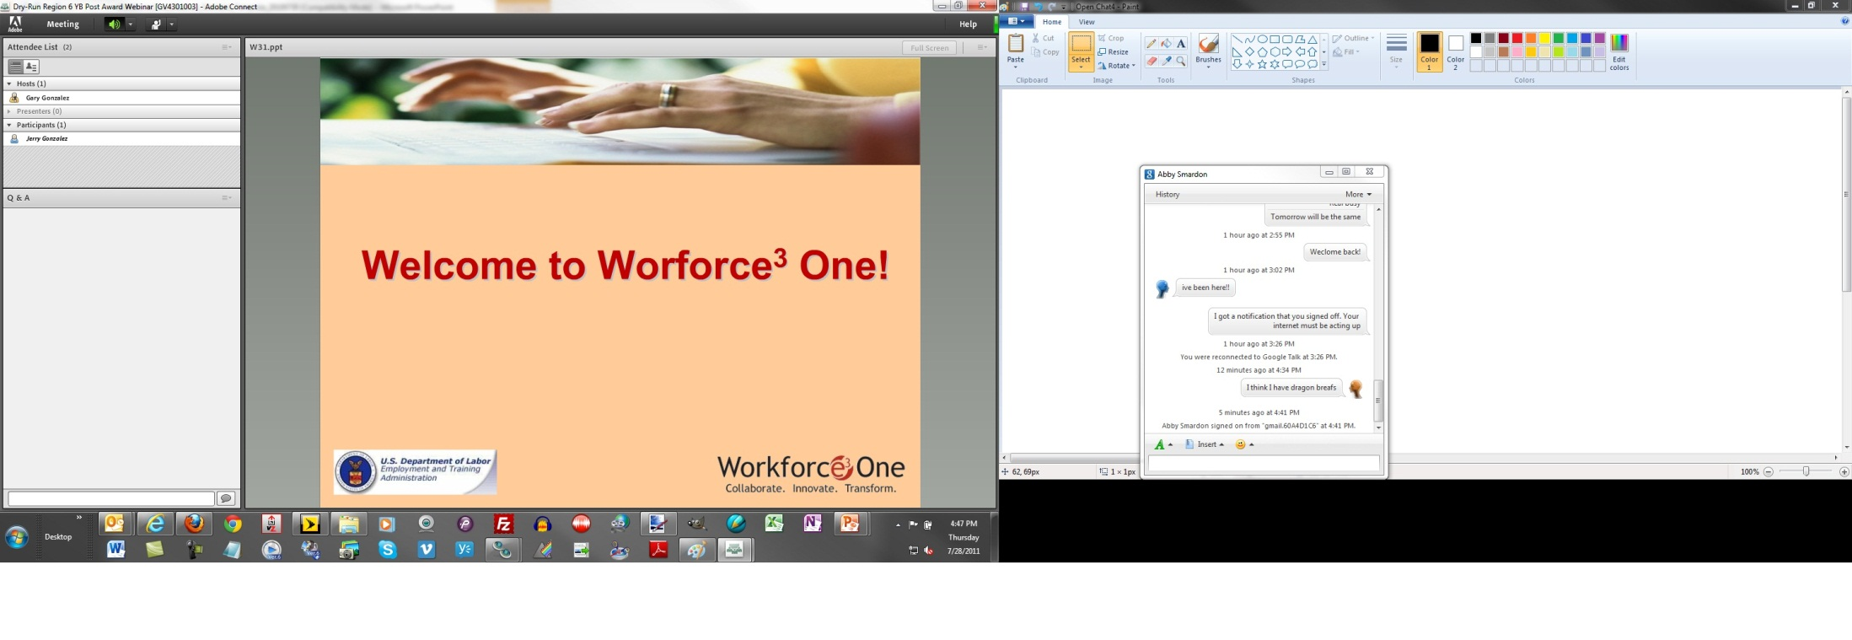
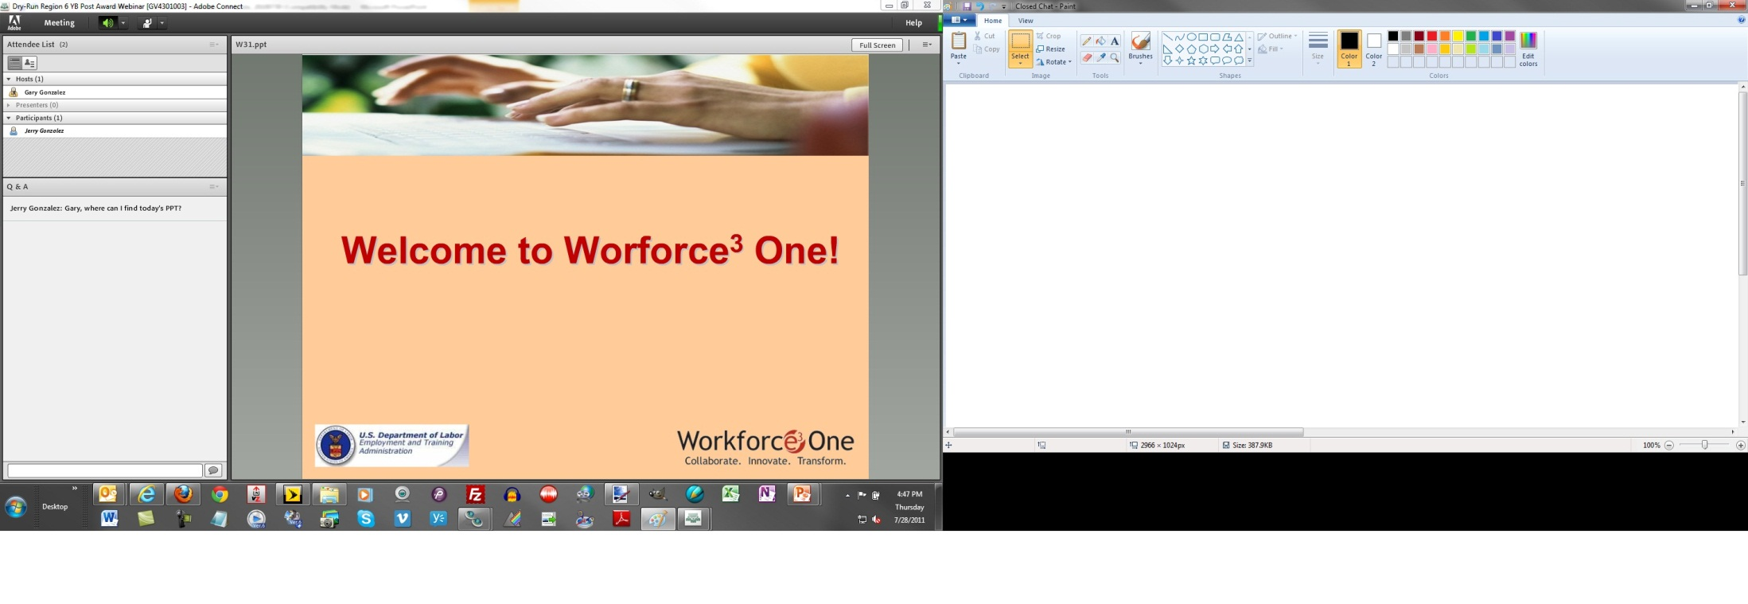
Submitting Questions: Closed Chat
To submit a question, type the question in the text field and press your Enter/Return key.
Please enter the name to whom the question is directed.
Your name and your question will appear on your screen, indicating successful submission.
Questions are directly transmitted to presenters—no other participants will see your questions.
Text Field
Gary, where can I find today’s PPT?
Notes:
CLOSED CHAT SLIDE
FACILITATOR:
To submit a question using the Chat feature, type the question in the text box and press “enter” or “return” on your keyboard.
When you submit a question, your name and your question will appear on your screen, indicating successful submission. Note that questions are directly transmitted to presenters—no other participants will see your questions.
Again, please be sure to enter your questions at ANY TIME throughout our session. We’ll make time to answer as many of them as possible during the session.
(Click to next slide)

Slide 5
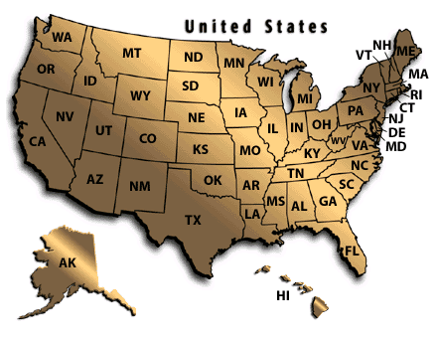
Practice
In the Chat Room, please type the name of your organization, your location, and how many people are attending with you today.
Notes:
PRACTICE SLIDE
FACILITATOR:
In order to get an idea of who is attending this webinar with us today, and to give you a chance to practice using the Chat feature, please type the name of your organization, your location, and how many people are attending with you today in the Chat Room, and then click the arrow button to submit your entry.
(NOTE: WAIT FOR RESPONSES TO BEGIN APPEARING IN PRESENTER CHAT, ACKNOWLEDGE SOME OF THOSE RESPONSES, AND CLICK TO NEXT SLIDE)

Slide 6
PARTICIPANTS WILL
Hear about the key facets of a strong early warning system intervention system.
Learn about lessons learned from early adopters and users of early warning systems.
Learn about the Denver Public School system’s efforts, experiences, and findings.
6

Slide 7
OVERVIEW
EWS Core Components
Intervention Systems – Whole School/Targeted/Intensive
EWS Indicator Tool
Learning from Early Adopters: Focus on ABC’s
EWS Post-Secondary Success: Early Findings
DPS’ Early Warning System: Background, Stop Light Report, Monitoring, Lessons Learned, and Next Steps
7

Slide 8
CORE IDEA OF EARLY WARNING SYSTEMS (EWS)
To graduate college and career ready, students need to successfully navigate several key transitions and acquire a set of academic behaviors. In short, they need to learn how to succeed at school.
Students signal that they are on- or off-track towards these outcomes through their attendance, behavior, and course performance—the ABC’s.
By tracking the ABC’s, it is possible to identify when students are beginning to fall off-track, providing time to intervene and alter their trajectory through school and beyond.
Using ABC Early Indicator data it is possible to design more targeted and effective interventions at the individual, classroom, school, and even district and state levels.
8

Slide 9
BUILDING STRONG INTERVENTION SYSTEMS: KEY IDEA
Need to understand scale and scope of challenge at school level—how many students have off-track indicators?
If it’s 50 or less, a student support team or graduation coach can lead the effort.
If it’s closer to 100 or more, teacher teams will need to play a critical role.
In both cases, investments in mission building, professional development, coaching and networking are critical to success.
Combine ready access, at the classroom level, to on- and off-track indicators (the ABC’s), with regular time to analyze the data and an organized response system that can act upon early warning data in both a systematic and tailored manner.
9

Slide 10
EARLY WARNING INDICATOR DATA TOOL
Without additional support to provide interventions at the scale and intensity required to meet each student’s individual needs, teachers can easy feel overwhelmed.
Research has shown that when teachers feel overwhelmed by the level of challenge in high needs schools, they will often lower expectations for students.
10
Notes:
10

Slide 11
INTERVENING AT THE SCHOOL LEVEL: BASIC IDEA
Compose a “support list” of students and revise it every few weeks based on the indicators.
Act on the data shown in the “support list.”
Make decisions about actions and interventions as a team.
Use knowledge of your school and students when choosing interventions (one size does not fit all).
11

Slide 12
ADVANCED APPROACH TO IMPLEMENTING AT THE SCHOOL LEVEL: LINK EARLY WARNING DATA TO TIERED INTERVENTIONS
Have diagnostic tools to deduce if student behavior is driven by academic, socio-emotional needs or both.
Recognize and build on student strengths.
Look for and act upon patterns that emerge from the data—at individual, classroom, school, and district levels.
Systematically apply school-wide preventative, targeted and intensive interventions until students are on-track.
12

Slide 13
TWO KEY QUESTIONS
What is the most effective level of intervention: student, classroom, or school level?
Does the school have the scale and scope of interventions needed to reach all students effectively?
13

Slide 14
KEEPING EARLY SECONDARY STUDENTS ON TRACK TO GRADUATION (GRADES 6-10)
 | EXAMPLES OF ACADEMIC INTERVENTIONS | EXAMPLES OF BEHAVIORAL/ATTENDANCE INTERVENTIONS
WHOLE SCHOOL PREVENTATIVE | Research- and Standards- Based Core Curriculum Extended Time Math and Literacy Blocks Benchmark Assessments | Positive Behavior Supports Attendance Campaigns (first absence brings a response, social incentives) Hands On/Minds On Courses (Music, Art, Science, Debate, Sports)
TARGETED | Elective Replacement Extra Help Courses Linked to Core Course | Behavior/Attendance Team-Problem Solving, Contracts and Daily Monitoring Mentoring
INTENSIVE | Tutoring | Social Service Supports
14

Slide 15
IS YOUR SCHOOL READY TO PROMOTE THE ABC’S OF STUDENT SUCCESS?
 | ATTENDANCE | BEHAVIOR (INCLUDING EFFORT) | COURSE PERFORMANCE
WHOLE SCHOOL | Need: Capacity: Effectiveness:
TARGETED
INTENSIVE
15

Slide 16
BUILDING A STRONG INTERVENTION SYSTEM: KEY IDEA
Practice intervention discipline; do not go first to highest intensity intervention.
Track outcome of interventions frequently.
Cast a wide support net; involve students, parents, non-profits and community organizations in keeping students on-track.
In schools with large numbers of off-track students, often need to organize a “second shift” of adults from non-profits and the community to ensure all off-track students can be supported.
16

Slide 17
KEY ABC INTERVENTIONS: LEARNING FROM EARLY ADOPTERS
17

Slide 18
KEEPING STUDENTS ON-TRACK TO POSTSECONDARY: CONSIDER BOTH ACADEMIC AND SOCIAL NEEDS
Middle Grades: Intermediate academic skills (reading comprehension and fluency, transition from arithmetic to mathematics) and a need for adventure and camaraderie.
High School: Transition to adult behaviors and mindset and a path to college and career readiness, as well as the right extra help for students with skills below grade level.
18

Slide 19
FOCUS ON THE ABC’S: ATTENDANCE
Understand that chronic absenteeism (missing a month or more of school) is much more widespread, particularly in high-poverty communities, than is commonly recognized and that, like bacteria in hospitals, creates havoc.
Organize comprehensive efforts built around knowledge that, from the middle grades on, student absenteeism driven by a combination of student choice, school factors driving students away, and out-of-school factors pulling them away.
Create programming that compels students to come to school, e.g. most engaged secondary grade students often found in cognitively rich activities which combine teamwork with performance (robotics, debate, drama, chess etc.).
Build an attendance problem solving capacity into schools; districts extend it via a network of relationships with wraparound service providers and organizations which can provide additional adults during the school day to serve as “Success Mentors.”
19

Slide 20
FOCUS ON THE ABC’S: BEHAVIOR AND EFFORT
Model and teach resiliency, self-management and organization skills.
Implement school-wide positive behavior support programs and alternatives to suspensions.
May need to re-examine disciplinary policies.
Work to ensure that students experience consistent academic and behavioral norms as they travel from class to class.
Build Success Scripts in students’ heads (effort leads to success); work to undermine Failure Scripts (success is capricious, withholding effort keeps you psychologically safe).
20

Slide 21
FOCUS ON THE ABC’S: COURSE PERFORMANCE
Provide course coaching assistance, support, and on occasion even advocacy to enable students to succeed in their courses, including monitoring assignment completion and preparation for tests and quizzes, as well as helping students catch up when absent.
Make sure tutoring efforts are linked tightly with needs and expectations of students’ courses (don’t work on fractions if Friday’s test is on probability).
Need effective second chance and credit recovery programs which hold students accountable but provide a reason for them to keep trying.
21

Slide 22
EXTENDING EARLY WARNING INTERVENTION SYSTEMS TO POSTSECONDARY SUCCESS EARLY FINDINGS
22

Slide 23
NEED TO BUILD AND PROVIDE TRANSITIONAL SUPPORT FROM HIGH SCHOOL TO COLLEGE AND CAREER
All students need a clear pathway from college to post-secondary schooling and training.
Many students will need additional supports, both academic and social, to successfully make the transition.
Currently no one owns the space between students meeting HS graduation requirements and starting college and career training.
23

Slide 24
POSTSECONDARY SUCCESS INDICATORS: EARLY FINDINGS
Not having any off-track indicators for high school graduation leads to increased odds of post-secondary attainment.
But to have high odds of post-secondary attainment, need to have a very strong 9th grade year, including strong attendance, no behavior problems, B or better average-and be on-age.
Low ABC’s predict high school dropout; high ABC’s predict post-secondary success.
Means we can have a unified high school graduation to post-secondary success indicator system.
24

Slide 25
THE GOOD NEWS IS . . .
We know why students drop out, which schools they drop out from and what the warning signs are.
Effective interventions and examples of substantial improvement exist, even in cities once viewed as unreformable and states viewed as too poor.
We are left with a giant engineering challenge of getting the right supports, to the right students, at the right time, at the scale and intensity required.
America is good at engineering challenges.
25

Slide 26
DENVER PUBLIC SCHOOLS’ EARLY WARNING SYSTEM
DEVELOPING AN ABC STOPLIGHT FRAMEWORK K-12
26

Slide 27
BACKGROUND OF CREATION OF EARLY WARNING INDICATORS IN DPS
Johns Hopkins University (2008) provided DPS with data to underpin the development of our early-warning system.
Produced first report 2009—ABC Stoplight—single risk indicator used at the beginning of the year (snapshot picture of the report).
Created two supplemental reports 2010—Daily Student Status and On-Track to Graduate to provide on-going tracking.
Strong correlation between ABC risk indicator and number of freshmen on-track.
27

Slide 28
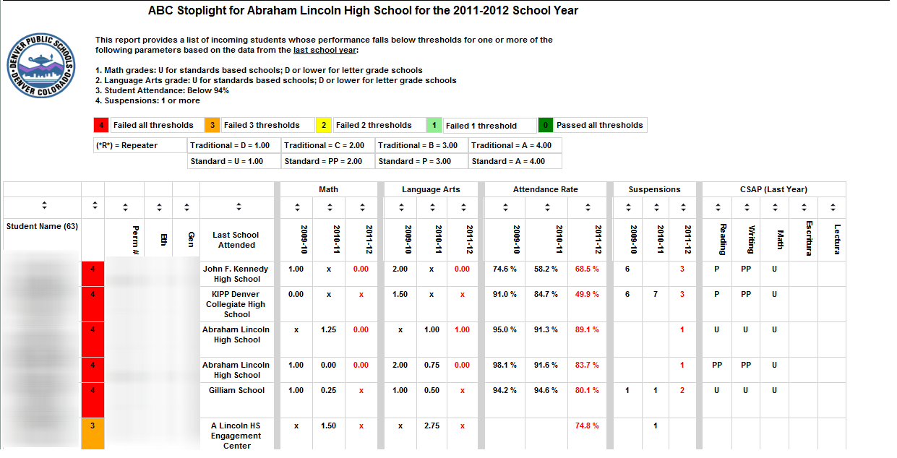
ABC STOPLIGHT REPORT
District hosts a Middle—High School Transitions Summit in early May—transitions teams from middle and high schools exchange information about high risk students to inform scheduling and interventions.
Use ABC Stoplight Report to inform creating students’ schedules, course offerings and support systems for incoming students (i.e., Academic Success Classes, social/emotional supports).
Math grades: U for standards based schools; D or lower for letter grade schools
Language Arts grade: U for standards based schools; D or lower for letter grade schools
Student Attendance: Below 94%
Suspensions: 1 or more
28

Slide 29
ABC SCORES VS. ON-TRACK STATUS
29

Slide 30
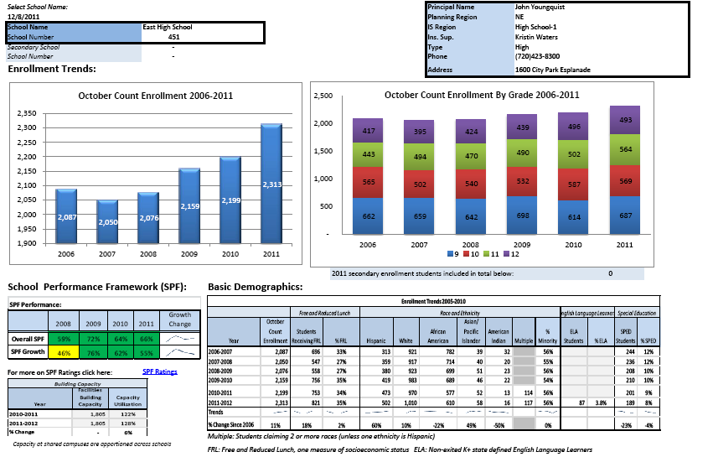
Enrollment Snapshot for East HS
30

Slide 31
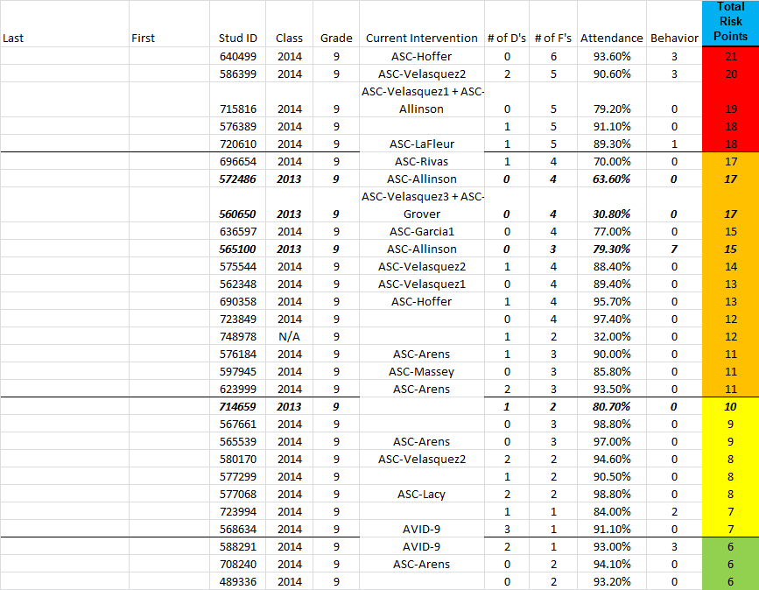
PROGRESS MONITORING CASE STUDY: DENVER EAST HIGH SCHOOL
District reports: Daily Student Status Report and On-Track to Graduate Reports provide a “real-time” ABC Stoplight
31

Slide 32
LESSONS LEARNED
Invest time to engage end users to ensure usability of products.
Need for a continuum of “real-time” data K-12 throughout the year. Data Quality and Frequency are of the utmost importance.
Importance of establishing school policies, practices and system enhancements to ensure teachers’ weekly grades are included in the risk analysis.
Provide Professional Development around RTI best practices—focus on process not just content—at district and school level.
Support a school-based empowered RTI Coordinator to run reports, develop identification system, monitor implementation and track impact of interventions.
Partner with the City and community partners early to leverage and coordinate attendance and behavior supports.
32

Slide 33
NEXT STEPS
Piloting an Early Warning System through a grant from Dell Foundation with SchoolNet Respond.
Using the ABC’s as a foundation for identification of students and state assessments.
Building stronger evidence base of interventions for attendance, behavior and math/literacy.
Developing a framework to expand the early warning indicators/On-Track to College K12.
Training for schools on urgency of this work (i.e., grading practices, RTI, value-chain, etc.).
33

Slide 34
ABC STOPLIGHT FRAMEWORK
Comprehensive risk score per student
For all Ed. Levels and programs
Each grade will use a specific set of measures to calculate a risk status
End of year measures will be predictive of performance in the next grade
Current year measures will be compared to previous end of year (prediction) to highlight efficacy of interventions.
INDICATOR | K | 1 | 2 | 3 | 4 | 5 | 6 | 7 | 8 | 9 | 10 | 11 | 12
Attendance |  |  |  |  |  |  | • | • | • | • | • | • | •
Chronic Absenteeism | • | • | • | • | • | •
Behavior |  |  |  |  |  |  | • | • | • | • | • | • | •
Failing key courses (Language Art, Math) |  |  |  |  |  |  | • | • | • | • | • | • | •
Off track to graduate |  |  |  |  |  |  |  |  |  | • | • | • | •
Segmentation |  |  |  |  |  |  |  |  |  | • | • | • | •
Reading at grade level (DRA, CSAP if applicable) | • | • | • | • | • | • | • | • | •
Writing at grade level (CSAP) |  |  |  | • | • | • | • | • | •
Math at grade level (CSAP) |  |  |  | • | • | • | • | • | •
ELA trajectory for ELL students | • | • | • | • | • | • | • | • | • | • | • | • | •
34

Slide 35
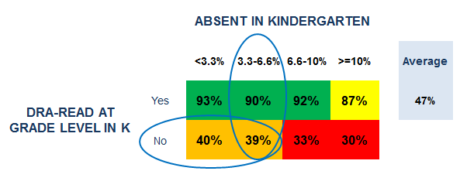
KINDERGARTEN ABC STOPLIGHT OUTCOME: READ AT GRADE LEVEL IN 1ST GRADE
Example of predictive analysis for Reading in Grade 1:
Student has an absence rate of 5.5% in Kindergarten
Student is not reading at grade level in Kindergarten
Student has a 39% likelihood of reading at grade level in Grade 1
35

Slide 36
QUESTIONS & ANSWERS

Slide 37
FOR FURTHER DISCUSSION
Visit the School Turnaround Learning Community Discussion site: http://www.schoolturnaroundsupport.org/content/discussions.
Get real-time feedback from webinar presenters on the unique challenges facing your school/district until 5pm on Friday, March 16.
Pose questions and/or share promising practices employed in your school/district on the discussion board.
37

Slide 38
FOR MORE INFORMATION
Visit the Everyone Graduates Center website at www.every1graduates.org
Email Robert Balfanz at rbalfanz@csos.jhu.edu
Email Joanna Fox at jfox@jhu.edu
Contact Kelli Trotsky Pfaff at 303-726-8994 (C), 720-423-3147 (O), or kelli_pfaff@dpsk12.org
38

Slide 39
Office of Elementary & Secondary Education
TEL 1.800.872.5327
400 Maryland Avenue, SW, Washington, D.C. 20202
www.ed.gov
TEL 617.728.4446 FAX 617.728.4857 info@jff.org
88 Broad Street, 8th Floor, Boston, MA 02110
2000 Pennsylvania Avenue, NW, Suite 5300, Washington, DC 20006
WWW.JFF.ORG

