Slide 1


CONSIDERATIONS in the design and execution of an adolescent literacy initiative in an urban school system
Sheila A. Brown, Ed.D, Consultant, Urban School District Leadership Former Deputy Superintendent, Boston Public Schools
Lynn Dougherty, Hillsborough County Public Schools
Moderated by: Christopher Tate, Education Program Specialist, U.S Department of Education and Brian Keating, Webinar Facilitator and Knowledge Manager, Maher & Maher

Slide 2


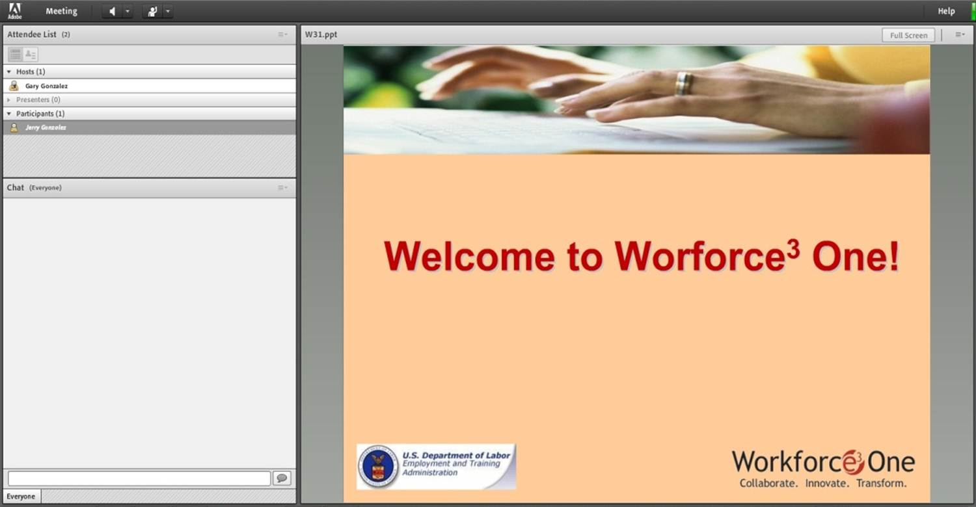


Welcome to Workforce³ One!
2
Notes:
WELCOME SLIDE
FACILITATOR:
There are some areas that I would like to call to your attention:
The first is the Presentation Slide area; it’s where the main visual content for the webinar will appear and it will be the main focus of your attention throughout the webinar.
The second area is the Full Screen option. If you select the Full Screen option, the PPT will enlarge. If any images or text appear too small, please select the Full Screen option, but please keep in mind that you won’t be able to use the Chat to submit any questions unless you deselect the Full Screen option when you are in Full Screen mode.
The third is the speakers and status options. You can mute and unmute the audio coming out of your computer speakers using the speaker button. The Status Options dropdown presents you with a few options to choose from so that you can give the speakers real-time feedback in a shorthand way.
The Attendee List; located at the top left of your screen displays a list of all attendees of this webinar.
Next is the Chat Room, also at the left of the screen, directly below the attendee list, it allows you to ask questions, or make comments during the webinar. We are using a ONE-WAY conference call for the audio portion of this webinar—you can hear the presenters, but they cannot hear you. Due to the large number of attendees, and to control background noise and interruptions, we’re going to rely on this CHAT feature to solicit your questions throughout the session. Those of you attending with a group will want to designate a “scribe” to represent your group by entering questions as they occur ANY TIME throughout the session. Your questions are automatically transmitted to the presenters and will be answered during dedicated question and answer periods.
IF POLLING WILL BE CONDUCTED, INFORM USERS THE POLLING WINDOWS WILL NOT APPEAR IF THE USER IS IN FULL SCREEN MODE.
IF SCREEN SHARING WILL BE CONDUCTED, INFORM USERS THAT WHAT IS BEING BROADCAST WILL NOT APPEAR IF THE USER IS IN FULL SCREEN MODE.
(Click to next slide)

Slide 3
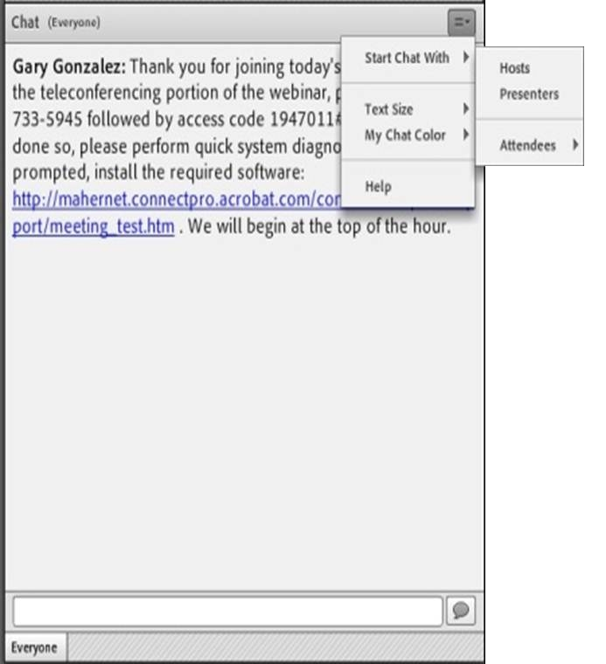
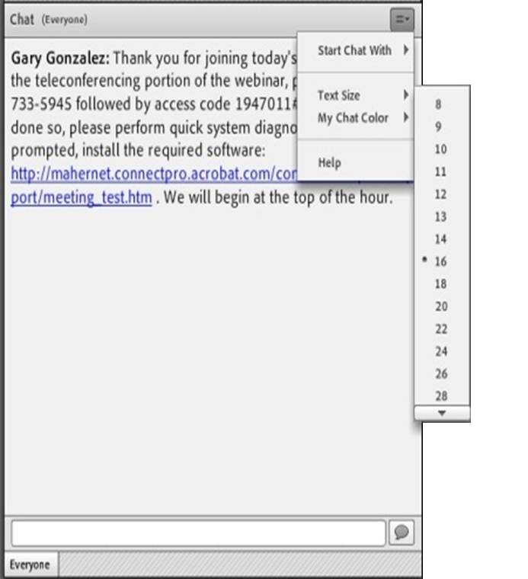
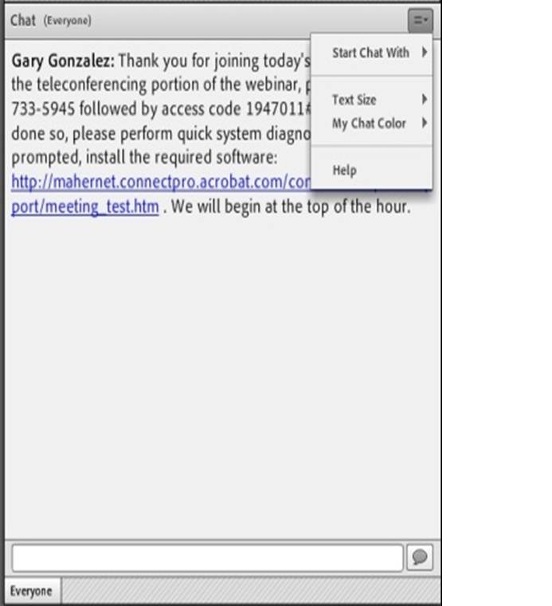
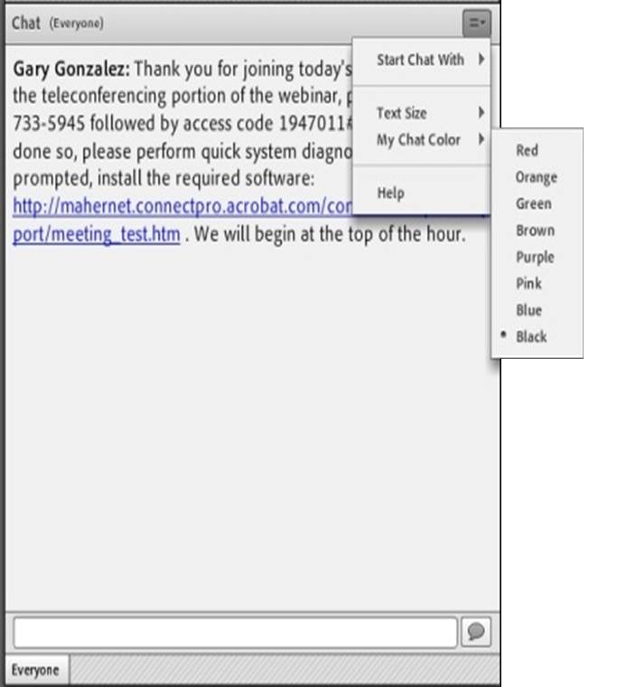
SUBMITTING QUESTIONS: OPEN CHAT
Drop-Down Menu
To submit a question, type the question in the text field and press your Enter/Return key.
Please enter the name to whom the question is directed.
To send questions only to the presenters, select Presenters from the drop-down menu before pressing your Enter/Return key.
Change Text Size and Chat Color…
Text Field
3
Notes:
OPEN CHAT SLIDE
FACILITATOR:
If you would like to submit a question during the question and answer portion of the presentation, please enter that question into the Chat Room. The Chat Room is located in the lower left portion of the virtual classroom.
To submit a question, type the question in the text box and press “enter” or “return” on your keyboard.
Note that by default, your question will be sent to everyone viewing the presentation. If you would like to send your question to the presenter only, please select Presenter from the drop-down menu at the top right of the chat window..
Again, please be sure to enter your questions at ANY TIME throughout our session. We’ll make time to answer as many of them as possible at the end of today’s presentation.
(Click to next slide)

Slide 4
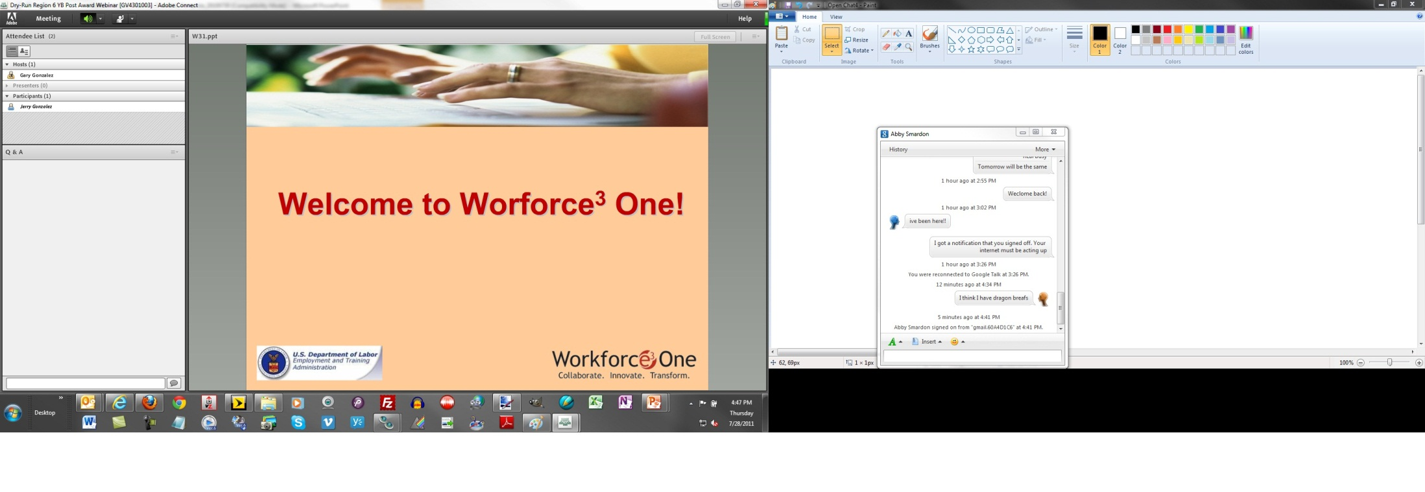

SUBMITTING QUESTIONS: CLOSED CHAT
To submit a question, type the question in the text field and press your Enter/Return key.
Please enter the name to whom the question is directed.
Your name and your question will appear on your screen, indicating successful submission.
Questions are directly transmitted to presenters—no other participants will see your questions.
Text Field
Gary, where can I find today’s PPT?
4
Notes:
CLOSED CHAT SLIDE
FACILITATOR:
To submit a question using the Chat feature, type the question in the text box and press “enter” or “return” on your keyboard.
When you submit a question, your name and your question will appear on your screen, indicating successful submission. Note that questions are directly transmitted to presenters—no other participants will see your questions.
Again, please be sure to enter your questions at ANY TIME throughout our session. We’ll make time to answer as many of them as possible during the session.
(Click to next slide)

Slide 5

PRACTICE
In the Chat Room, please type the name of your organization, your location, and how many people are attending with you today.
5
Notes:
PRACTICE SLIDE
FACILITATOR:
In order to get an idea of who is attending this webinar with us today, and to give you a chance to practice using the Chat feature, please type the name of your organization, your location, and how many people are attending with you today in the Chat Room, and then click the arrow button to submit your entry.
(NOTE: WAIT FOR RESPONSES TO BEGIN APPEARING IN PRESENTER CHAT, ACKNOWLEDGE SOME OF THOSE RESPONSES, AND CLICK TO NEXT SLIDE)

Slide 6
CONSIDERATIONS in the design and execution of an adolescent literacy initiative in an urban school system
Sheila A. Brown, Ed.D, Consultant, Urban School District Leadership Former Deputy Superintendent, Boston Public Schools
Lynn Dougherty, Hillsborough County Public Schools
Moderated by: Christopher Tate, Education Program Specialist, U.S Department of Education and Brian Keating, Webinar Facilitator and Knowledge Manager, Maher & Maher

Slide 7
OVERVIEW
Components of an Effective Adolescent Literacy Initiative
Results of an Urban School District
Key Lessons Learned
7

Slide 8
Considerations in the Design and Execution of an Adolescent Literacy Initiative in an Urban School System
A clear vision for all schools
A core instructional program across content areas aligned to state standards
Tiered interventions and extended learning opportunities
Deep and ongoing professional learning
A comprehensive assessment system that drives classroom, school, and district decision making
Resources (people, time, and $$) aligned to the work
Community support aligned to the work
8

Slide 9
A Clear Vision for All Schools
How might a district develop a clear vision?
Who should be at the table?
What is the superintendent’s role in communicating the vision?
Who are the other key stakeholders who need to be involved in the development and communication of the vision?
9

Slide 10
A Core Instructional Program Across Content Areas Aligned to the State Standards: Key Considerations
What are the essential learnings by grade level and content area?
What content is taught and assessed in all schools (e.g., common texts, quarterly assessments, mid terms, final exams)?
How will we ensure consistency in grading (e.g., anchor papers and assignments)?
Will we adopt common pedagogical models in the district?
10
Notes:
10

Slide 11
Tiered Interventions and Extended Learning Opportunities
What are our students’ needs in reading and writing?
What strategies and/or structured interventions exist to meet those needs?
How might we need to alter the traditional school day and academic year in order to support students with significant gaps in learning?
How often will we check in on the progress of every student?
What are the entrance and exit criteria for each intervention?
11

Slide 12
Deep and Ongoing Professional Learning Considerations
Teacher and administrator training by experts
Ongoing “Collaborative Coaching and Learning” at the school level
Knowledgeable and engaged principals, supervisors of principals and other senior district leaders
School based professional learning focused on literacy and owned by the Instructional Leadership Team
12

Slide 13
Collaborative Coaching and Learning Cycle
Using Data, Identify Student Needs
Identify Area of Inquiry for CCL Team-review and discuss readings
Participate in Lab Site Work (pre-conference, observation, debrief)
Classroom Practice and Follow-up
One on One Coaching
13

Slide 14
A Comprehensive Assessment System that Drives Classroom, School, and District Decision Making
Assessment system is is comprised of screening, diagnostic, formative and summative measures, specifically designed to meet the needs of adolescents and to answer district questions
Teachers interpret and discuss results regularly
Looking at student work is a key component of the assessment system and informs instructional and professional learning decisions
14

Slide 15
Resources Aligned to the Work (People, Time, and Money)
Student instructional day and year
Master schedule is designed to meet student needs
Grants, private dollars and general school purposes dollars are aligned to the instructional priorities in the district
Grants with the potential to detract from the instructional focus are not pursued
School improvement plan is reviewed for alignment to instructional focus
(See Hawley-Miles and Frank 2008, The Strategic School Making the Most of People, Time, and Money)
15

Slide 16
Community and Family Support Aligned to the Work
Family members are active members of school-based Instructional Leadership Teams
The business community plays a role in supporting adolescent literacy development in the workplace
The philanthropic community plays a role in funding aspects of the work
16

Slide 17
The Results of an Adolescent Literacy Initiative in an Urban School System
English Language Arts MCAS Gains HS
1998 43% Proficient or Advanced
2003 77% Proficient or Advanced
Mathematics MCAS Gains HS
Other
Broad Prize Winner 2006
Broad Prize Finalist 2002, 2003, 2004, 2005
2003 74% Proficient or Advanced
1998 25% Proficient or Advanced
17

Slide 18
Lessons Learned
Understanding the students’ needs is paramount.
The work is only as strong as the knowledge, coherence and alignment between and among key stakeholders.
Less is more.
Teacher expertise in content and pedagogy matters.
Instructionally savvy principals make a demonstrable difference in student achievement (Education Matters, 2001).
High functioning Instructional Leadership Teams contribute demonstrably to improved student outcomes (Education Matters, 2001).
18

Slide 19
A LOOK UNDER THE HOOD: AN ADOLESCENT LITERACY INITIATIVE IN HILLSBOROUGH COUNTY PUBLIC SCHOOLS
19

Slide 20
The Inner Workings of an Adolescent Literacy Initiative
The instructional design of an effective adolescent literacy initiative
The fine-tuning of the instructional design
The on-going maintenance of the instructional design
20

Slide 21
Designing the Instructional Components
Determining and designing the vision
Selecting the designers
Communicating the design to all stakeholders
21

Slide 22
Bringing the Instructional Design to Life Through Core Instructional Program
Understanding the content versus process dilemma
Creating and implementing a district core literacy principle
Establishing core content expectations and assessments
Scheduling models that assist in the delivery of core instruction
Acquiring materials and resources that support the delivery of core instruction
22

Slide 23
Fine Tuning the Instructional Design through Tiered Interventions and Extended Learning Opportunities
Identifying individual and small groups of students’ literacy needs
Implementing strategies and/or structured interventions to meet those needs
Scheduling models that assist in the delivery of intervention
Monitoring progress for decision-making purposes
Determining clear entrance and exit criteria for each intervention
23

Slide 24
Sustaining the Instructional Design through the District Professional Development System
Establishing training models for teachers and administrators
Support of a school-based, student-centered coaching model
Setting literacy leadership expectations for principals, supervisors of principals and other senior district leaders
Sustaining support from the district for site-based professional learning communities and Reading Leadership Teams
24

Slide 25
Student Centered Coaching Model
Using Data, Identify Student Learning Goal
Identify Instructional Practices Most Likely to Produce Student Learning Goal
Determine Coaching Practices to Implement during Cycle
Identify Instructional Practices the Teacher is Now Using on a Consistent Basis
Review of Evidence that Students Accomplished Desired Learning Goals
25

Slide 26
Assessing Student Outcomes that Drive Instructional Design and Delivery Decisions
Creating and monitoring an assessment system comprised of screening, diagnostic, formative and summative measures, specifically designed to drive the instructional design and delivery
Implementing regularly scheduled interpretation and discussion sessions based on student results with administrators, teachers, students, and parents
Examining student work as a part of the work of the professional learning communities with each school
26

Slide 27
Acquiring Necessary Resources to Support the Instructional Design
Combining grants, private dollars and general school purposes dollars to support the district’s instructional design
Coordination of school improvement plan goals and strategies to support the district’s instructional design
27

Slide 28
Community and Family Support Aligned to the Work
Including family members as active partners of district and school-based design teams
Sharing vision and goals with the business community to encourage their role in supporting adolescent literacy development in the workplace
Partnering with the philanthropic community to support funding aspects of our work
28

Slide 29
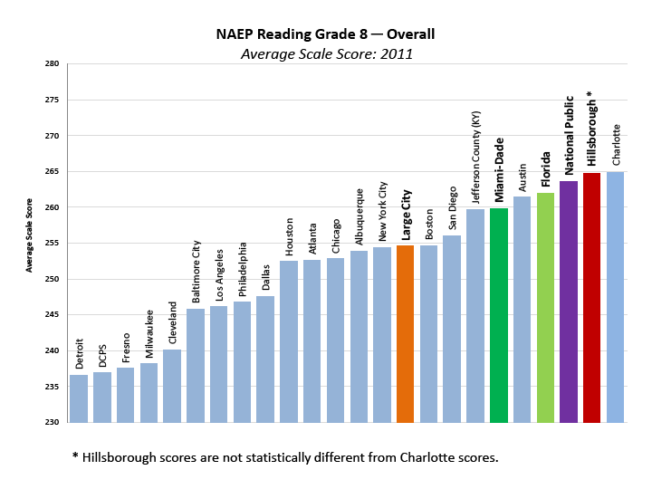
The Results of an Adolescent Literacy Initiative in an Urban School System
29

Slide 30
Lessons Learned
Understanding students’ needs is vital to the design implementation.
Communicating and collaborating are the keys to a successful implementation.
Focusing on the vision, carefully considering the implementation strategies, and analyzing the data eliminates unfounded decision- making.
Supporting teachers through district and site-based professional development is critical to sound implementation.
Engaging district and site-based administrators in the decision- making and the implementation process ensures a sound support system for the teachers and students.
High functioning Reading Leadership Teams contribute to maintaining the vision and fidelity to the instructional design.
30

Slide 31
QUESTIONS & ANSWERS
31

Slide 32
Upcoming Events
April 25 2:30-4pm EST: Next Webinar on Accelerated Learning Interventions for High School Students Significantly Below Grade Level in Mathematics
April 25-27: Collaborative discussion on learning interventions in literacy and math on the U.S. Department of Education School Turnaround Learning Community website http://www.schoolturnaroundsupport.org/node/1611/content/discussions
32

Slide 33
Office of Elementary & Secondary Education
TEL 1.800.872.5327
400 Maryland Avenue, SW, Washington, D.C. 20202
www.ed.gov
TEL 617.728.4446 FAX 617.728.4857 info@jff.org
88 Broad Street, 8th Floor, Boston, MA 02110
122 C Street, NW, Suite 650A, Washington, DC 20001
WWW.JFF.ORG

