Slide 1


ALGEBRA INTENSIFICATION:
Research-based Interventions for Algebra Success
Kathi Cook, The Charles A. Dana Center at the University of Texas at Austin
Deborah Bower, Ballard High School, Seattle Public Schools
Moderated by: David Yi, Education Program Specialist, U.S. Department of Education and Brian Keating, Webinar Facilitator and Knowledge Manager, Maher & Maher

Slide 2


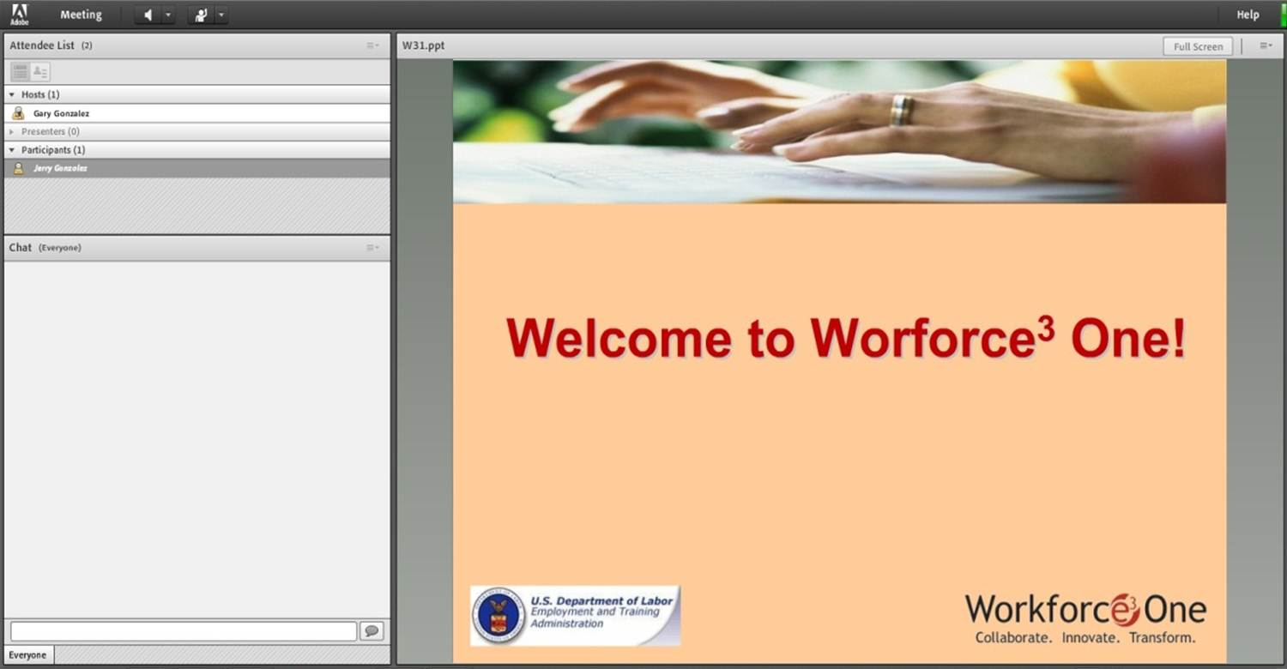


Welcome to Workforce³ One!
2
Notes:
WELCOME SLIDE
FACILITATOR:
There are some areas that I would like to call to your attention:
The first is the Presentation Slide area; it’s where the main visual content for the webinar will appear and it will be the main focus of your attention throughout the webinar.
The second area is the Full Screen option. If you select the Full Screen option, the PPT will enlarge. If any images or text appear too small, please select the Full Screen option, but please keep in mind that you won’t be able to use the Chat to submit any questions unless you deselect the Full Screen option when you are in Full Screen mode.
The third is the speakers and status options. You can mute and unmute the audio coming out of your computer speakers using the speaker button. The Status Options dropdown presents you with a few options to choose from so that you can give the speakers real-time feedback in a shorthand way.
The Attendee List; located at the top left of your screen displays a list of all attendees of this webinar.
Next is the Chat Room, also at the left of the screen, directly below the attendee list, it allows you to ask questions, or make comments during the webinar. We are using a ONE-WAY conference call for the audio portion of this webinar—you can hear the presenters, but they cannot hear you. Due to the large number of attendees, and to control background noise and interruptions, we’re going to rely on this CHAT feature to solicit your questions throughout the session. Those of you attending with a group will want to designate a “scribe” to represent your group by entering questions as they occur ANY TIME throughout the session. Your questions are automatically transmitted to the presenters and will be answered during dedicated question and answer periods.
IF POLLING WILL BE CONDUCTED, INFORM USERS THE POLLING WINDOWS WILL NOT APPEAR IF THE USER IS IN FULL SCREEN MODE.
IF SCREEN SHARING WILL BE CONDUCTED, INFORM USERS THAT WHAT IS BEING BROADCAST WILL NOT APPEAR IF THE USER IS IN FULL SCREEN MODE.
(Click to next slide)

Slide 3
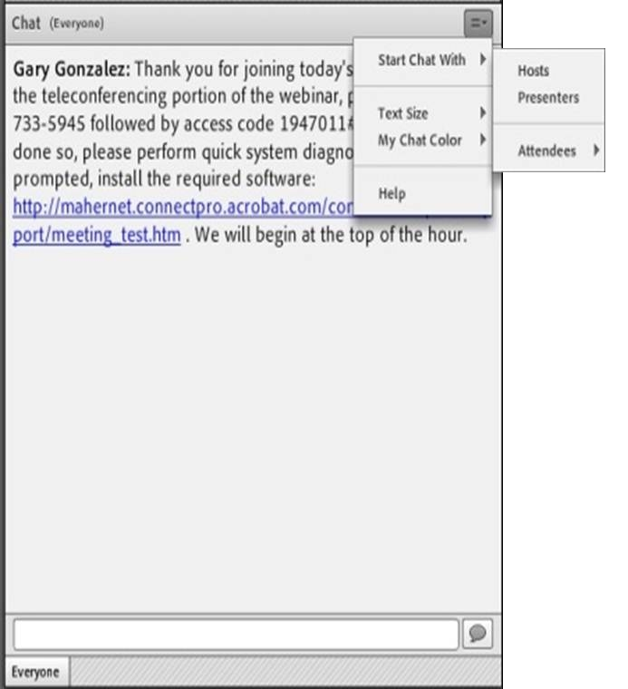
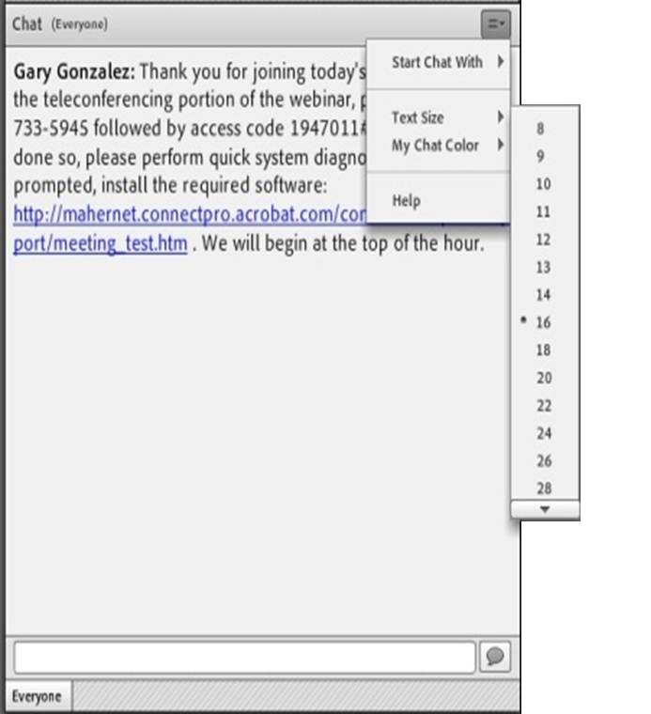
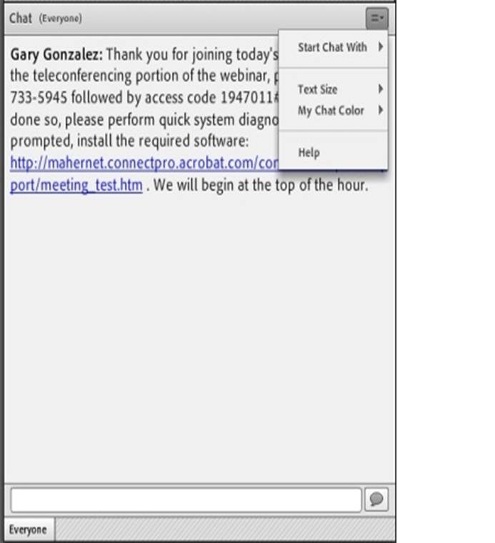
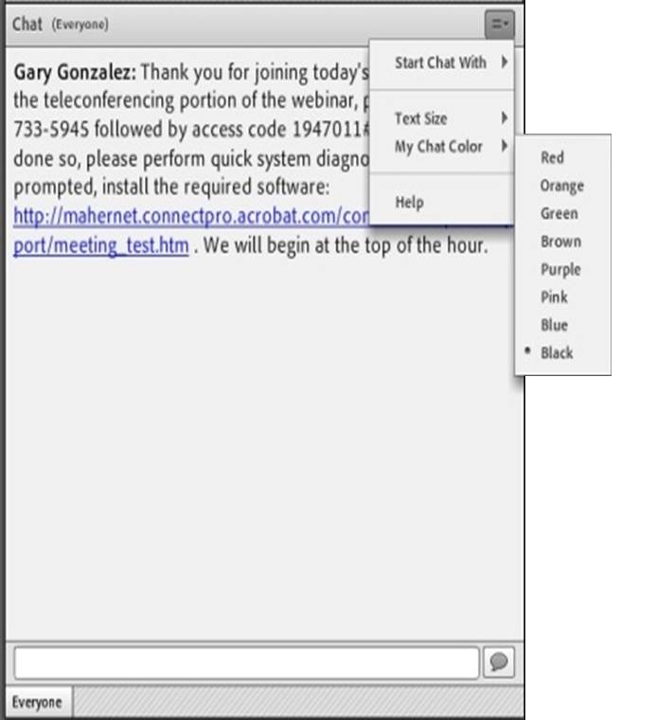
SUBMITTING QUESTIONS: OPEN CHAT
Drop-Down Menu
To submit a question, type the question in the text field and press your Enter/Return key.
Please enter the name to whom the question is directed.
To send questions only to the presenters, select Presenters from the drop-down menu before pressing your Enter/Return key.
Change Text Size and Chat Color…
Text Field
3
Notes:
OPEN CHAT SLIDE
FACILITATOR:
If you would like to submit a question during the question and answer portion of the presentation, please enter that question into the Chat Room. The Chat Room is located in the lower left portion of the virtual classroom.
To submit a question, type the question in the text box and press “enter” or “return” on your keyboard.
Note that by default, your question will be sent to everyone viewing the presentation. If you would like to send your question to the presenter only, please select Presenter from the drop-down menu at the top right of the chat window..
Again, please be sure to enter your questions at ANY TIME throughout our session. We’ll make time to answer as many of them as possible at the end of today’s presentation.
(Click to next slide)

Slide 4
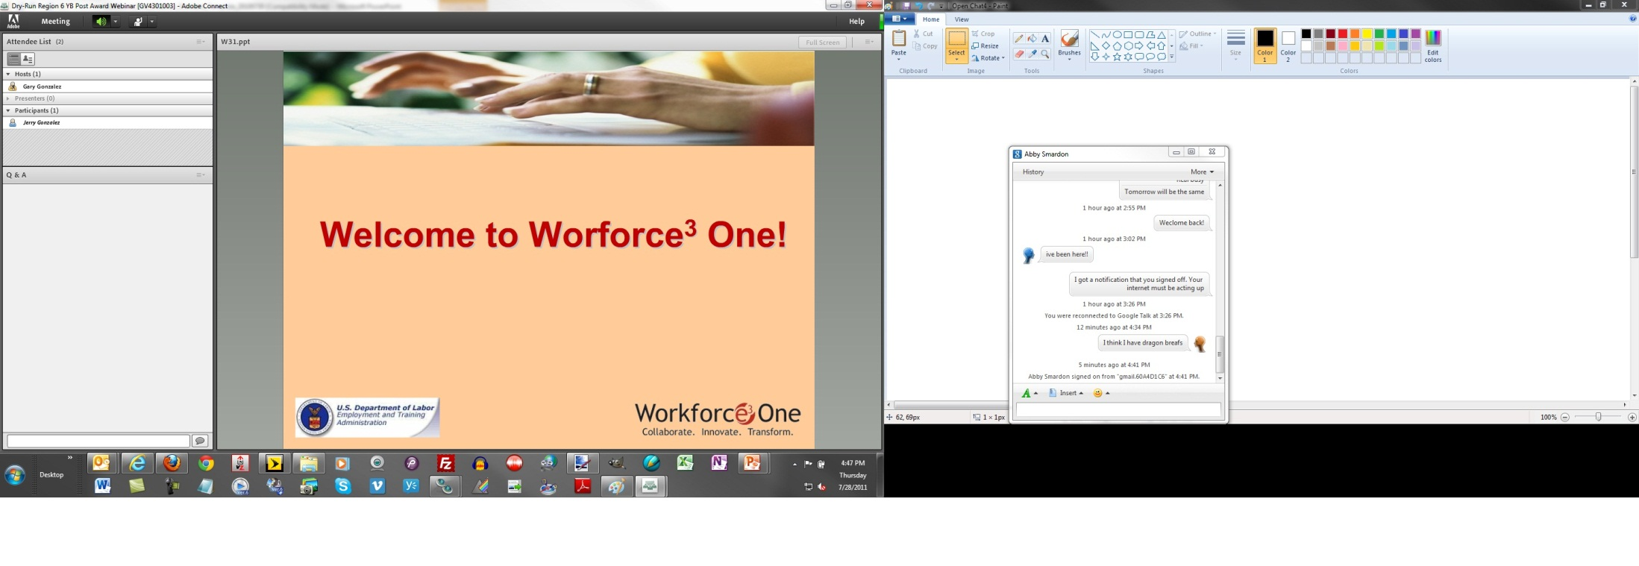

SUBMITTING QUESTIONS: CLOSED CHAT
To submit a question, type the question in the text field and press your Enter/Return key.
Please enter the name to whom the question is directed.
Your name and your question will appear on your screen, indicating successful submission.
Questions are directly transmitted to presenters—no other participants will see your questions.
Text Field
Gary, where can I find today’s PPT?
4
Notes:
CLOSED CHAT SLIDE
FACILITATOR:
To submit a question using the Chat feature, type the question in the text box and press “enter” or “return” on your keyboard.
When you submit a question, your name and your question will appear on your screen, indicating successful submission. Note that questions are directly transmitted to presenters—no other participants will see your questions.
Again, please be sure to enter your questions at ANY TIME throughout our session. We’ll make time to answer as many of them as possible during the session.
(Click to next slide)

Slide 5

PRACTICE
In the Chat Room, please type the name of your organization, your location, and how many people are attending with you today.
5
Notes:
PRACTICE SLIDE
FACILITATOR:
In order to get an idea of who is attending this webinar with us today, and to give you a chance to practice using the Chat feature, please type the name of your organization, your location, and how many people are attending with you today in the Chat Room, and then click the arrow button to submit your entry.
(NOTE: WAIT FOR RESPONSES TO BEGIN APPEARING IN PRESENTER CHAT, ACKNOWLEDGE SOME OF THOSE RESPONSES, AND CLICK TO NEXT SLIDE)

Slide 6
ALGEBRA INTENSIFICATION:
Research-based Interventions for Algebra Success
Kathi Cook, The Charles A. Dana Center at the University of Texas at Austin
Deborah Bower, Ballard High School, Seattle Public Schools
Moderated by: David Yi, Education Program Specialist, U.S. Department of Education and Brian Keating, Webinar Facilitator and Knowledge Manager, Maher & Maher
Notes:
Thank you everyone for your participation. Before we get started let me share with you a couple house-cleaning items.
--Out of respect to our presenters we will put everyone on mute to eliminate background noises
--We want you to participate and so please submit your questions using the “Questions” box in the control panel. We will answer questions at the end of the presentation.
Introduce presenters----Kathi and Debbie----and let people know that they will also receive these slides to review on their own

Slide 7
THE CHALLENGE: STRUGGLING STUDENTS, RAMPED UP REQUIREMENTS
Many more students now taking Algebra I are one or more grade levels behind in mathematics.
Many struggling students are hindered by a lack of engagement and a lack of commitment to learning.
Three years of mathematics beyond Algebra I are now required for high-school graduation.
Algebra I remains the most failed course in most districts.
Curricula and teacher preparation have not kept pace with changing needs.
New approaches are needed to ensure underprepared students can get back on track to succeed in high school.
The part of this presentation (slides 7 through 34) that focuses on intensification and on the Intensified Algebra I program is copyright 2012 by the partnership behind IA: The Charles A. Dana Center at The University of Texas at Austin, Agile Mind, Inc., and the Learning Sciences Research Institute at the University of Illinois at Chicago.
7

Slide 8
The solution: an architecture for intensification
Intensification is a systemic effort to address the contextual needs of your students in learning on-level content.
It may mean:
Increasing the amount of time with content;
Using a variety of pedagogical supports; and/or
Developing students’ socio-motivational well-being around the content.
It does not mean delaying rich mathematical experiences until students acquire “the basics.”
Copyright 2012 Charles A. Dana Center at the University of Texas at Austin, Learning Sciences Research Institute at the University of Illinois at Chicago, and Agile Mind, Inc.
8
Notes:
8

Slide 9
WHAT RESEARCH TELLS US
Providing routines and structures that help struggling learners organize critical mathematics content increases their learning (Deshler & Lenz).
Accessing prior knowledge and addressing students’ misconceptions increases learning (Swan & Bell, Burkhardt, Shell Centre).
Engaging students with challenging tasks that involve active meaning-making increases learning (Horizon Research, Hiebert & Grouws).
On-going cumulative distributed practice improves learning and retention (Rohrer, Mayfield).
Formative assessment is a key intervention for improving student achievement (Black & Wiliam, Hiebert & Stigler).
Promoting learners’ beliefs about their own intelligence can increase their motivation and effort to learn mathematics (Dweck, Goode, Midgely, Aronson).
Copyright 2012 Charles A. Dana Center at the University of Texas at Austin, Learning Sciences Research Institute at the University of Illinois at Chicago, and Agile Mind, Inc.
9

Slide 10
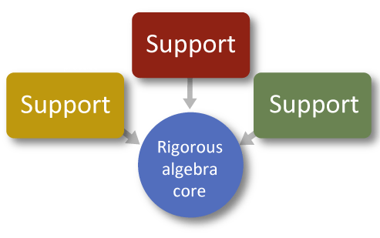
ARCHITECTURE FOR INTENSIFICATION
Copyright 2012 Charles A. Dana Center at the University of Texas at Austin, Learning Sciences Research Institute at the University of Illinois at Chicago, and Agile Mind, Inc.
10

Slide 11
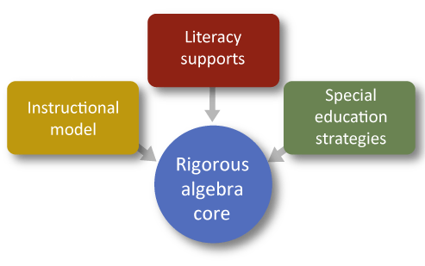
ONE POSSIBLE ARCHITECTURE…
Copyright 2012 Charles A. Dana Center at the University of Texas at Austin, Learning Sciences Research Institute at the University of Illinois at Chicago, and Agile Mind, Inc.
11

Slide 12

CREATING ACTIVE LEARNERS
“Learning is something students do, not something that is done to them.”
—National Research Council, 1996.
Slide copyright 2012 Charles A. Dana Center at the University of Texas at Austin, Learning Sciences Research Institute at the University of Illinois at Chicago, and Agile Mind, Inc.
12

Slide 13
COMPARE THE TWO TASKS
The formula to find the number of diagonals, d, that can be drawn from one vertex in a polygon with n sides is d = n - 3 . Use the formula to find d when n is 6.
Find an algebraic rule to describe the relationship between the number of sides of a polygon, n, and the number of diagonals that can be drawn from one vertex, d.
Use n as the independent variable, and express your rule using function notation.
Explain how you found the rule.
Slide copyright 2012 Charles A. Dana Center at the University of Texas at Austin, Learning Sciences Research Institute at the University of Illinois at Chicago, and Agile Mind, Inc.
13

Slide 14
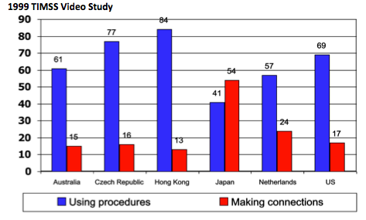
Types of math problems presented
14

Slide 15
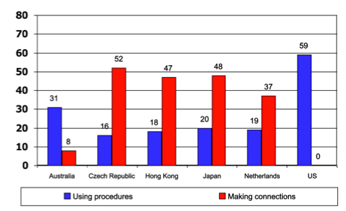
How teachers implemented making connections math problems
15

Slide 16
Intensification strategy
Use of high cognitive-demand tasks
“Not all tasks are created equal, and different tasks will provoke different levels and kinds of student thinking.”
—Stein, Smith, Henningsen, & Silver, 2000
“The level and kind of thinking in which students engage determines what they will learn.”
—Hiebert et al., 1997
Slide copyright 2012 Charles A. Dana Center at the University of Texas at Austin, Learning Sciences Research Institute at the University of Illinois at Chicago, and Agile Mind, Inc.
16

Slide 17
Types of math problems presented
Task Set-Up
Task Implementation
Student Learning
A.
High
High
High
B.
Low
Low
Low
C.
High
Low
Moderate
Stein and Lane, 1996
17

Slide 18
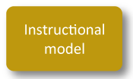

Intensification strategy
Use of an inquiry-based model of instruction to support students’ conceptual understanding
Maintain cognitive demand through all three parts of the model.
Copyright 2012 Charles A. Dana Center at the University of Texas at Austin, Learning Sciences Research Institute at the University of Illinois at Chicago, and Agile Mind, Inc.
18

Slide 19
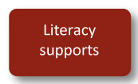
Intensification strategy
Leverage findings from literacy in the content areas
[T]he lack of reading-to-learn skills is behind much of poor student performance in the content areas.
Many students have not developed specific techniques to appreciate the nuances of the big ideas in the domains of knowledge. In short, for many learners the big ideas are invisible.
Gomez, L., & Gomez, K. (2007). Reading for learning: Literacy supports for 21st century work. Phi Delta Kappan, 89(3), 224–228.
Slide copyright 2012 Charles A. Dana Center at the University of Texas at Austin, Learning Sciences Research Institute at the University of Illinois at Chicago, and Agile Mind, Inc.
19

Slide 20


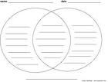

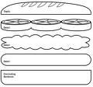

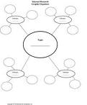
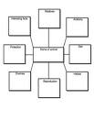

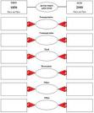
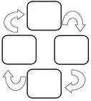
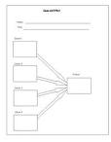

A MYRIAD OF GRAPHIC ORGANIZERS
20

Slide 21
MATH JOURNAL EXAMPLE
Based on your investigation, what conjectures can you make about the relationship between algebraic and geometric solutions to systems of linear equations? Complete the Math Journal to describe your conjectures.
ALGEBRAIC RESULT | WHAT DOES THE GRAPH LOOK LIKE? | WHAT MIGHT THIS TELL YOU ABOUT THE NUMBER OF SOLUTIONS FOR THE SYSTEM?
Answer includes one value for x and one value for y.
Equations simplify to a false equation containing only numbers (for example, 0 = 12).
Equations simplify to a true equation containing only numbers (for example, 18 = 18).
Copyright 2012 Charles A. Dana Center at the University of Texas at Austin, Learning Sciences Research Institute at the University of Illinois at Chicago, and Agile Mind, Inc.
21

Slide 22

Intensification strategy
Use of learning routines
“Some students in school today don’t see a connection between their efforts and school success, don’t know what it is they need to practice, can’t imagine themselves ever being ‘academic,’ and have never seen ‘academics played.’ . . .
A first step in helping students become full participants in the classroom is to ensure that all students value and understand the importance of learning and learning rituals.”
Lenz, B.K., Deshler, D. (2004). Teaching Content to All: Evidence-Based Practices in Middle and Secondary Schools. Boston: Pearson Education, Inc.
Slide copyright 2012 Charles A. Dana Center at the University of Texas at Austin, Learning Sciences Research Institute at the University of Illinois at Chicago, and Agile Mind, Inc.
22

Slide 23

EXPLICIT TEACHING ROUTINES
Copyright 2012 Charles A. Dana Center at the University of Texas at Austin, Learning Sciences Research Institute at the University of Illinois at Chicago, and Agile Mind, Inc.
23

Slide 24
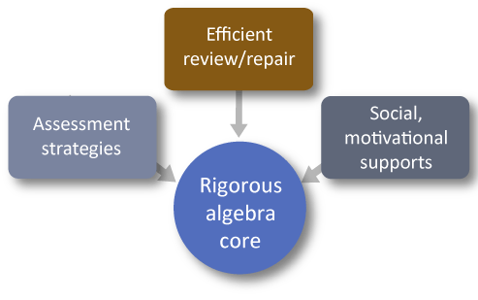
ANOTHER POSSIBLE INTENSIFICATION FRAMEWORK
Copyright 2012 Charles A. Dana Center at the University of Texas at Austin, Learning Sciences Research Institute at the University of Illinois at Chicago, and Agile Mind, Inc.
24

Slide 25
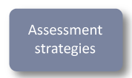
INTENSIFICATION STRATEGY: FIVE KEY FORMATIVE ASSESSMENT STRATEGIES
Clarifying and understanding intentions and criteria for success
Engineering effective classroom discussions that elicit evidence of learning
Providing feedback that moves learning forward
Activating students as instructional resources for each other
Activating students as the owners of their own learning
…AND ONE BIG IDEA
Use evidence about learning to adapt instruction to meet student needs
Wiliam, D. & Thompson, M. (2007). Integrating Assessment with Learning: What Will It Take to Make it Work? In Dwyer, C. A. (Ed.), The Future of Assessment: Shaping, Teaching and Learning. Mahwah, N. J.: Erlbaum.
Slide copyright 2012 Charles A. Dana Center at the University of Texas at Austin, Learning Sciences Research Institute at the University of Illinois at Chicago, and Agile Mind, Inc.
25

Slide 26
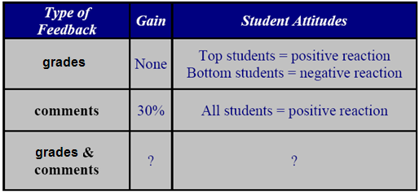
PROVIDING FEEDBACK TO LEARNERS
What do you think happened for the students given both grades and comments?
Slide copyright 2012 Charles A. Dana Center at the University of Texas at Austin, Learning Sciences Research Institute at the University of Illinois at Chicago, and Agile Mind, Inc.
26

Slide 27
Overall improvement after two rounds of feedback
+50
+40
+30
+20
+10
Comments and grades
Change in grades (percent)
Grades
0
Comments
-10
-20
-30
-40
Ruth Butler‘s research was published as “Enhancing and Undermining Intrinsic Motivation; the Effects of Task-involving and Ego-involving Evaluation on Interest and Performance,” British Journal of Educational Psychology, vol. 58, pp. 1-14.
-50
Slide copyright 2012 Charles A. Dana Center at the University of Texas at Austin, Learning Sciences Research Institute at the University of Illinois at Chicago, and Agile Mind, Inc.
27

Slide 28
WHAT STUDENTS RECALLED
Comments group
Comment and grade group
Slide copyright 2012 Charles A. Dana Center at the University of Texas at Austin, Learning Sciences Research Institute at the University of Illinois at Chicago, and Agile Mind, Inc.
28

Slide 29
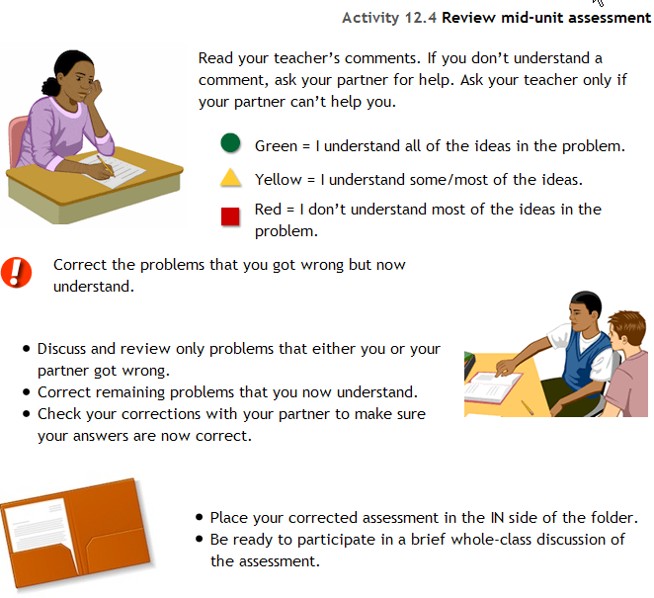
A routine for reviewing assessments
Copyright 2012 Charles A. Dana Center at the University of Texas at Austin, Learning Sciences Research Institute at the University of Illinois at Chicago, and Agile Mind, Inc.
29

Slide 30
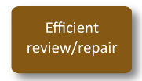
INTENSIFICATION STRATEGY
Correcting misconceptions versus remedial learning
A study by Alan Bell and Malcolm Swan found that students whose teachers addressed and corrected misconceptions, rather than simply using remedial measures, achieved and maintained higher long-term learning results.
Bell, A. & Swan, M. Some experiments in diagnostic teaching. Educational Studies in Mathematics, 24, pp. 115-137. See also www.toolkitforchange.org
Slide copyright 2012 Charles A. Dana Center at the University of Texas at Austin, Learning Sciences Research Institute at the University of Illinois at Chicago, and Agile Mind, Inc.
30

Slide 31
A STRATEGY FOR EFFECTIVE REVIEW: DISTRIBUTED PRACTICE
Strong positive effects of spaced practice have been found in a wide variety of contexts. Carlous Caple summarized this body of research as follows:
The spacing effect is an extremely robust and powerful phenomenon, and it has been repeatedly shown with many kinds of material. Spacing effects have been demonstrated in free recall, in cued recall of paired associations, in the recall of sentences, and in the recall of text material.… Also the effect of spaced study can be very long-lasting (Caple, 1996, p. 22).
Slide copyright 2012 Charles A. Dana Center at the University of Texas at Austin, Learning Sciences Research Institute at the University of Illinois at Chicago, and Agile Mind, Inc.
31

Slide 32
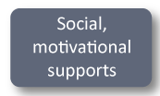

Intensification Strategy
Social, emotional, motivational supports help students develop:
Academic identities as learners who recognize, value, and seek out high-quality education
Motivation and commitment to high achievement
Skills to help create and contribute to a learning community.
Copyright 2012 Charles A. Dana Center at the University of Texas at Austin, Learning Sciences Research Institute at the University of Illinois at Chicago, and Agile Mind, Inc.
32

Slide 33
STUDENTS’ BELIEFS ABOUT INTELLIGENCE IMPACT ACADEMIC ACHIEVEMENT
Fixed mindset:
Avoid learning situations if they might make mistakes
Try to hide, rather than fix, mistakes or deficiencies
Decrease effort when confronted with challenge
Growth mindset:
Work to correct mistakes and deficiencies
View effort as positive; increase effort when challenged
Slide copyright 2012 Charles A. Dana Center at the University of Texas at Austin, Learning Sciences Research Institute at the University of Illinois at Chicago, and Agile Mind, Inc.
33

Slide 34
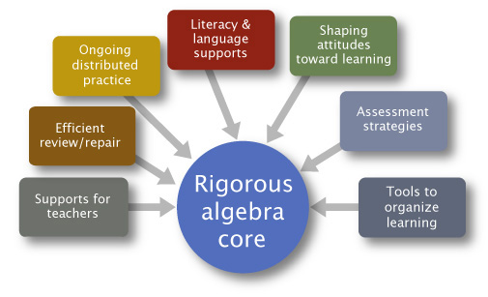
Our intensification approach: intensified algebra I
Copyright 2012 Charles A. Dana Center at the University of Texas at Austin, Learning Sciences Research Institute at the University of Illinois at Chicago, and Agile Mind, Inc.
34

Slide 35
INTENSIFIED ALGEBRA
35

Slide 36
WHY INTENSIFIED ALGEBRA?
New state requirement is three years of math
We have had an Algebra 1 support class for three years, with disappointing results
The support class teacher didn’t have all of the students in their regular Algebra 1 class
Students in the support class were learning different things at different times
36

Slide 37
WHO WOULD TAKE Intensified Algebra?
Initial Plan
Maximum class size of 24
Limit the class to incoming freshmen
How students were selected
Grades
Test scores
Teacher recommendation
Parent letter
Parents could opt-out
Additional students based on need
Counselors added several late registrants
37

Slide 38
THIS YEAR’S INTENSIFIED ALGEBRA CLASSES
Class Counts
First semester: 26 and 19
Second semester: 26 and 25
Several upper-classmen added
Currently, one class has one sophomore and the other class has eight sophomores and one junior
ELL and SPED
My class: three students with IEP’s and one receiving ELL services
38

Slide 39
Structure of the class
Two 50-minute periods
One class 1st & 2nd periods, the other 5th & 6th
Basic Day
Opener
Core activity and homework review (or vice versa)
Consolidation activity
39

Slide 40
Why intensified algebra works for us
Teaching algebra while reviewing pre-algebra skills
IA students learn what their non-IA peers learn
Pre-algebra skills practice is embedded in classwork and homework (staying sharp)
Sequence and pace
Appropriate development of skills
40

Slide 41
WHY INTENSIFIED ALGEBRA WORKS FOR US
Visuals
There is color and action on the screen—solving steps are shown in detail
You can pause and replay sequences
Several interactive options
Examples: Algebra tiles, skateboarder
Attitude work
Biggest challenge for students is believing they can do math
Every third lesson
Examples:
How the brain grows (they loved this!)
What quality group work looks like
Strategies for solving problems
Being givers and getters of information
41

Slide 42
WHY INTENSIFIED ALGEBRA works for us
Full program materials
Classwork
Homework
Assessments
Teacher support
Advice for instruction
Knowledgeable and helpful by phone and email
42

Slide 43
changes
Workbook
Occasionally students need a change of scene/pace
Formatting
Often not enough space to do the work (e.g., solving systems of equations)
Difficult to graph in a workbook
Summarizing in notebooks
Assessments
Available in Word format
Multiple versions
43

Slide 44
summary
First semester pass rate was higher in Intensified than my other Algebra 1 class
It’s exhausting teaching a two-period block class to struggling learners
It’s rewarding teaching a two-period block class to struggling learners
The program works—but takes dedicated teachers who believe that all students can learn math
44

Slide 45
QUESTIONS & ANSWERS
45

Slide 46
FOR FURTHER DISCUSSION
Visit the School Turnaround Learning Community Discussion site: http://www.schoolturnaroundsupport.org/content/discussions.
Get real-time feedback on the unique challenges facing your school/district until 5pm on Friday, April 27.
Pose questions and/or share promising practices employed in your school/district on the discussion board.
46

Slide 47
Office of Elementary & Secondary Education
TEL 1.800.872.5327
400 Maryland Avenue, SW, Washington, D.C. 20202
www.ed.gov
TEL 617.728.4446 FAX 617.728.4857 info@jff.org
88 Broad Street, 8th Floor, Boston, MA 02110
122 C Street, NW, Suite 650A, Washington, DC 20001
WWW.JFF.ORG

