Slide 1
Week 1
Introduction

Slide 2
Agenda
Class objectives: understand & practice the art of software engineering
About the instructor / the role of the instructor – customer & mentor
Teams & competitive team-oriented grading
Written & oral presentations, class participation
Project specification
Syllabus & schedule
Team assignments & near-term action items
Milestone #1 – requirements doc – week 3
Lecture: Software Engineering (overview)

Slide 3
Class objectives
Analyze a complex computing problem and apply principles of computing and other relevant disciplines to identify solutions.
Design, implement, and evaluate a computing-based solution to meet a given set of computing requirements in the context of the program’s discipline.
Communicate effectively in a variety of professional contexts.
Recognize professional responsibilities and make informed judgments in computing practice based on legal and ethical principles.
Function effectively as a member or leader of a team engaged in activities appropriate to the program’s discipline.
Apply computer science theory and software development fundamentals to produce computing-based solutions.

Slide 4
About the instructor
Career background
SUNYA BS CS grad, MS CS UDel
Professional programmer since 1988 – seen many trends come & go
Worn many hats – programmer, team lead, department lead, QA, architect
Process "evangelist"
Big companies, medium companies, growing small companies
Inherited / joined existing teams, launched new ones
Currently @ GE Research, architect, team lead
Dual roles: "customer" (i.e. evaluator) & "mentor" (i.e. helper)

Slide 5
Project teams
Quick poll... employed as dev? MS plans vs. work?
Teams: X, Y, Z
Teams formed by matching student declared roles of interest to needs
This is a competitive class.
Presentations, process artifacts, & software product will be ranked
Cross-team testing “in the round”: X --> Y --> Z --> X
Presentations are public & are an opportunity to “borrow” ideas
What about non- or under-performing team members? "See HR"

Slide 6
Process Artifacts & Presentations
At scheduled intervals – requirements docs, design, test plans, etc.
Docs should be clean, clear, "professional"
Should be based on industry best practices (to be discussed in class & researched on your own)
Written artifacts submitted for customer/instructor review
In-class presentations with supporting visuals (PowerPoint, etc.)
Interim product demos & final demo (with team cross-testing), source code submitted for review

Slide 7
Class participation – graded!
Scheduled presentations
In-class discussion based on class content, reading material
Per-team weekly meetings with the instructor-as-mentor
Instructor reserves 10% of grade for individual participation
Team reserves 10% for individual participation in team activities
Potential –20% penalty, can adjust your grade by two whole letters...

Slide 8
Project Summary
A portfolio tracking application – stocks, (bonds, forex, crypto, etc.)
Publicly hosted app – e.g. cloud deployment
Evolving requirements – periodically reviewed with the customer
Visually "appealing" & functional user interface
Supporting back end structures, logins, persistence, etc.
Periodic interim demos – teams pick what they will demo, graded
Periodic software process artifacts & presentations thereof
Product & process artifacts assessed by the customer & ranked
Inter-team testing at the final milestone

Slide 9
Project Details
<insert project spec here>

Slide 10
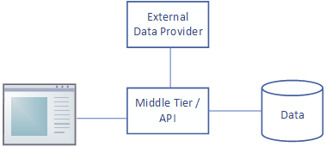
Major Software Constructs (Back-of-napkin conceptual design)
GUI
Login, new user creation
Make, view, see analysis results of portfolio(s)
Back-End / Middle-Tier / API
User & portfolio persistence
API calls to external stock quote providers, w/ persistence(?)
API calls exposed to GUI for fetching raw & processed stock info (assume processing on server side?)
DB
User
Portfolios
Stock info

Slide 11
Syllabus
<go to syllabus doc>

Slide 12
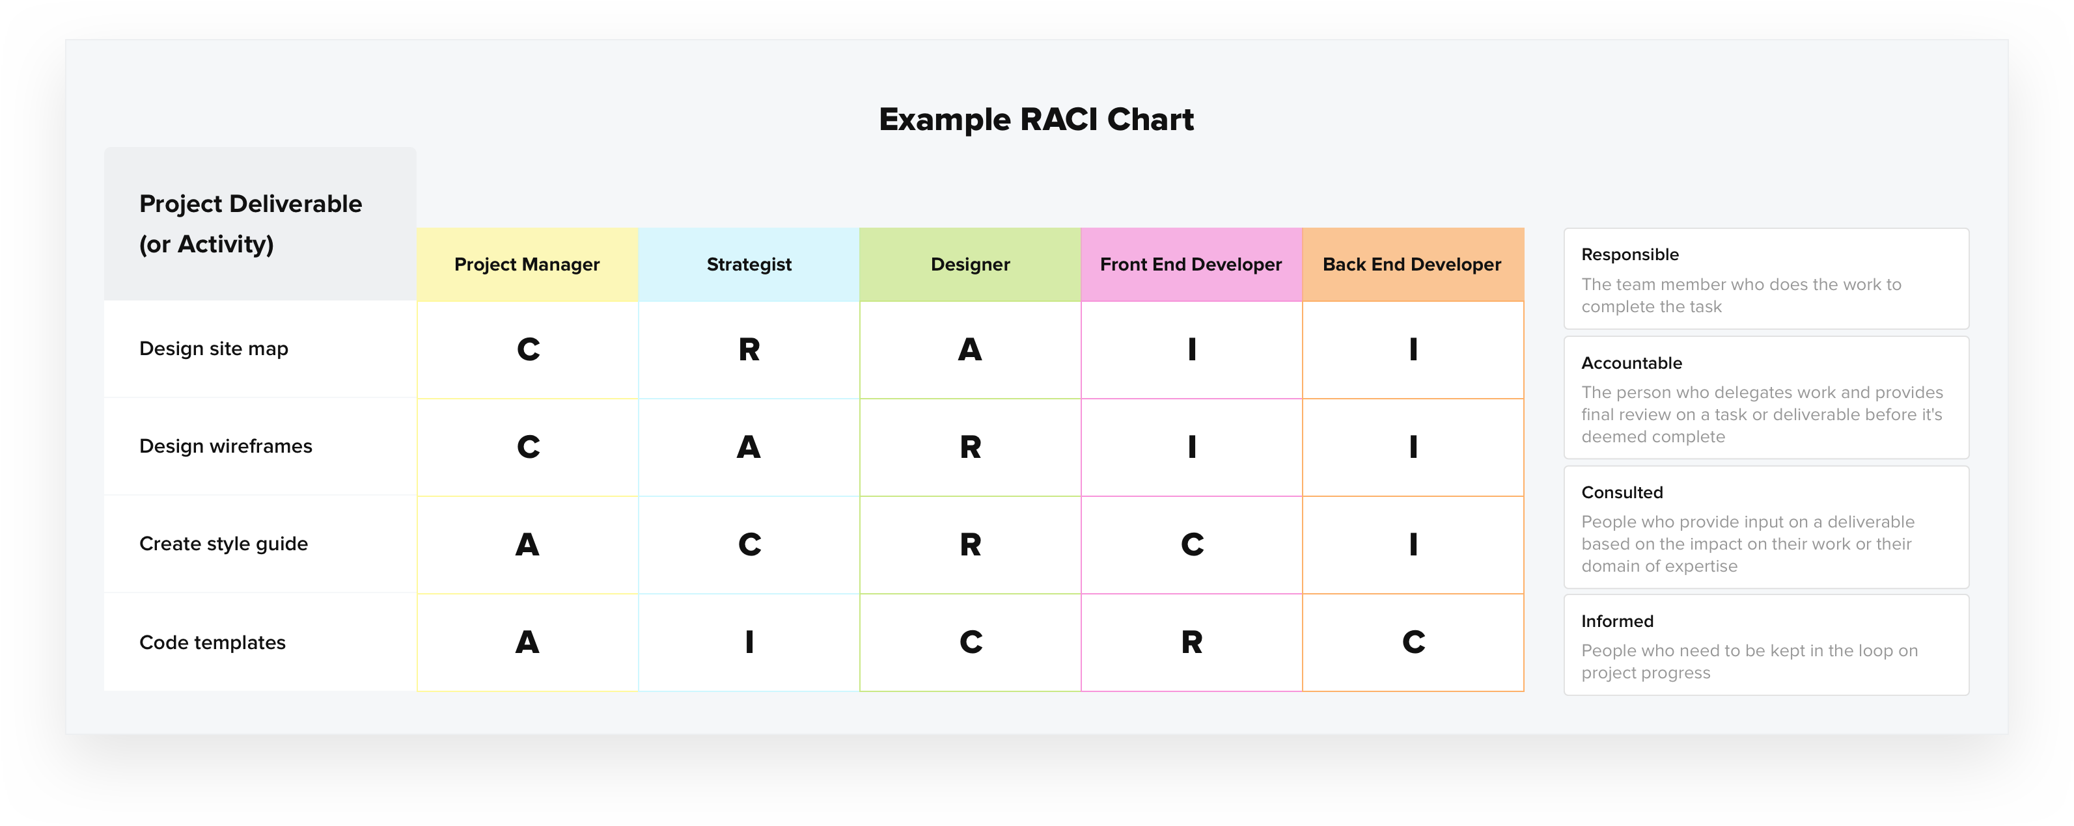
Team Roles & RACI
Different models of software engineering (e.g. see chapter 14) call for some number of roles to be played by team members
Some models have just a few roles, some have many
Models with small numbers of roles tend to have overloaded roles
Even small teams need to cover all roles, some wearing many hats
RACI – a technique to determine responsibility / coverage for team functions
Responsible – does the work
Accountable – owns the work, reviews it before delivery
Consulted – can be brought in on the work, but is not responsible
Informed – is kept in the loop
https://www.teamgantt.com/blog/raci-chart-definition-tips-and-example

Slide 13
Team Roles Enumeration (1) (Suggested, w/ loose definitions)
Project Manager – this is not the team’s de facto leader – this is the person who keeps the team on track, owns the project plan and/or other project tracking data, and adjusts (negotiates) plans accordingly
Product Manager – responsible for planning the delivery of features to users in a manner which is impactful to the market / customer; owns the product requirements; is not the team leader
Business Liaison – the recognized point of contact for the customer; might own pricing negotiations, etc.; is not the team leader
Architect – responsible for the overall high-level system design, system decomposition; not responsible for all low-level design, but ensures the details are consistent with the overall technical vision
Ops Engineer – owns the deployment platform administration

Slide 14
Team Roles Enumeration (2) (Suggested)
UI/UX Designer – responsible for the look & feel of the user interface & the overall user experience
Front-End Developer – performs detailed design & implementation of front-end user interfaces
Back-End Developer – performs detailed design & implementation of back-end system services
DBA – performs detailed design & implementation for data storage
QA Lead Engineer – ensures the product is consistent with requirements, is testable; owns the test plans & leads the test execution (does not own all testing, all quality assurance! - all team members should test)
QA Process Analyst – ensures the team is following a well-formed process for software engineering
QA Configuration Manager – responsible for implementing code & deployment configuration, version management, CI/CD tools

Slide 15
Team Form-up: pick 3 roles in order of preference
Project Manager
Product Manager
Business Liaison
Architect
Ops Engineer
UI/UX Designer
Front-end Dev
Back-end Dev
DBA
QA Lead Engineer
QA Process Analyst
QA Configuration Manager

Slide 16
What should teams be doing NOW ("Iteration 0") https://www.infoq.com/articles/what-are-self-organising-teams/
Form up your self-organizing team – exchange contact info, establish a rhythm for communicating, meeting, delivering, holding each other accountable
Determine & document your process – roles, processes, tools (due week 4)
Who plays which role(s)?
What is our adopted model for software engineering?
Where will we store documents, plans, etc.?
Where will we store code? How do keep in-development code separate from tested/deployed?
What's our high-level design for this system? (do just enough req & design to start thinking about tech stack)
How do we delegate coding responsibilities? What languages / technologies?
How will we break the project down into tasks, how will the tasks be ordered, scheduled? tracked?
How do we integrate the work of different developers?
How & where do we build & deploy? Where do we deploy? How many deployments do we need?
How do we distribute project documents & source code to the customer for evaluation?
How do we test? How and when do we internally peer review? Code/product? Process artifacts?
Write a requirements document (due week 3) - how will we interrogate the customer?
Read the textbook (chapters 1, 2, 12, 13, 14, & 4) plus supplemental links & be prepared to discuss
(Provisionally) Selecting the team's SE tool stack (based on first pass of req & design)

Slide 17
Tools you need NOW
Document repository (One Drive? Github?)
Source code repository (Github? Gitlab?)
(learn how to make source code "private" to a specific set of users)
Languages, IDEs (Java? Python? JavaScript?) - what does the team know?
Build system (Maven? Gradle?)
Deployment platform(s) / cloud provider (Amazon? Google? Azure?)
(don’t use your credit card! use a gift card...)
(one platform for individual "dev", another for "integration", another for "release"?, or just 2?)
Email list & team calendar, chat room? Other collab tools? (Slack?)
Task / defect tracking tool (Trello? Spreadsheet?)
Project planning tool (some free gantt tool? fancy spreadsheet?)
Diagramming tools – system diagrams, UI wireframes, UML, etc.

Slide 18
Software Engineering
An Introduction
Text chapters 1, 2, and a skim of 12, 13, 14
More in lecture week 3...

Slide 19
What is Software Engineering?
“An organized, analytical approach to the design, development, use, and maintenance of software.”
Software developed using engineering discipline - defined, repeatable, verifible
Much like "regular" engineering, but not bound by the laws of physics
Can build almost anything given enough time & desire
Flexibility is a blessing & a curse...
Software flexibility implies there is more than one possible "engineering process" - easier to be flexible process too...

Slide 20
Typical SE overall process tasks "things/aspects to think about" As per the CMM: http://sunnyday.mit.edu/16.355/cmm.pdf
Requirements management – define the needs (design would fit in here)
Project planning – schedule & cost the work
Project tracking – follow the work relative to the plan
Quality assurance – monitor the engineering process (e.g. testing done)
Configuration management – of the software source, docs, deployment
Organizational process focus – org awareness of eng quality
Training – to perform roles on the team, for technology adoption
Peer review – of all requirements, designs, docs, code
(Measurement – of the product, of the process which produced it)

Slide 21
Typical SDLC phases One big waterfall or iteration upon...
Requirements – state the customer needs
(Analysis) – name the nouns & verbs in the space, their relationships
(Planning) - now that the problem is understood, estimate
Design – high level system deconstruction thru low-level details
Implementation – coding
Test – validate relative to requirements
Deployment – to production
Maintenance – support, fix

Slide 22
Lifecycle variations (1)
Predictive models: we assume we know things up front
Clear customer vision & sponsorship
Manageable & realistic scope
Experienced development team & leadership
Using established technologies
Common in physical engineering... we don't usually build a bridge "experimentally"
Adaptive models: assume we don't know everything up front... that information, priorities & goals can & do change
Ambiguous or evolving requirements
Limited resources
Experimental prototyping

Slide 23
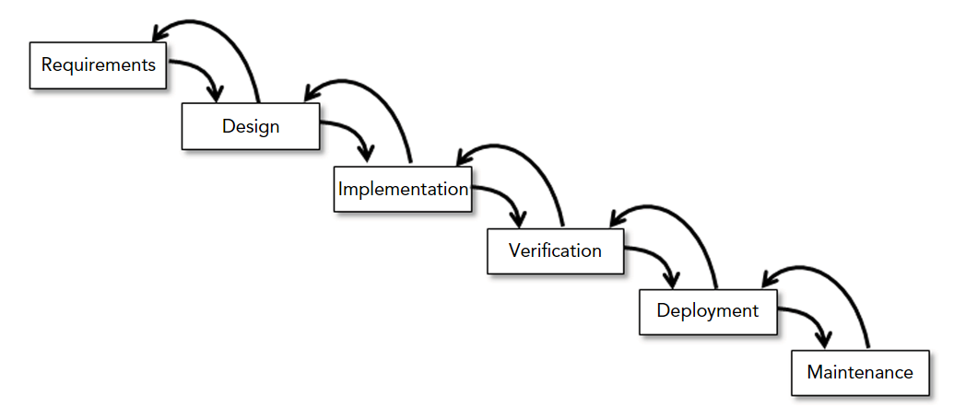
Lifecycle variations (2) Predictive
Waterfall – all requirements gathering & major design up front
Feedback allowed if defects in upstream artifacts discovered
Can be circular – maintenance loops back to (more) requirements
Sashimi variation – phases overlap slightly
Can also use as a framework for the steps which occur during one iteration of a larger effort

Slide 24
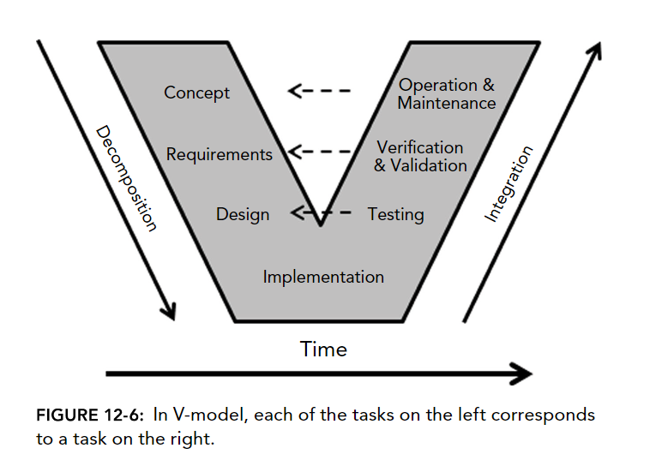
Lifecycle variations (3) Predictive
Physical engineering likes waterfall...
V model – common in physical engineering – a redrawn waterfall relating verification steps to their origin

Slide 25
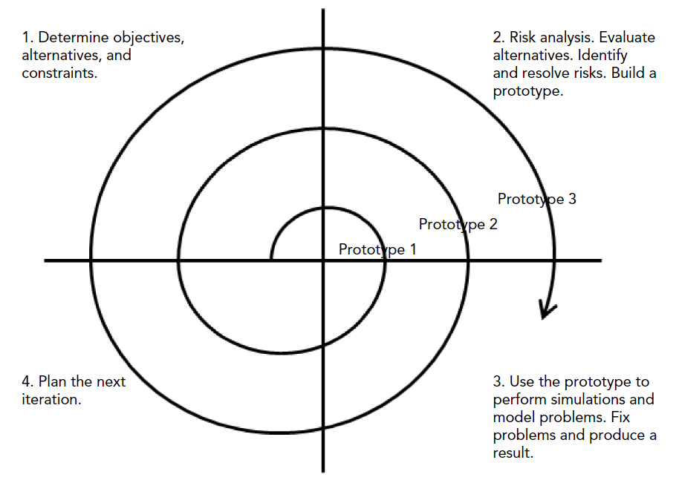
Lifecycle variations (4) Adaptive
We admit we don't know everything up front!
Agile – iterate on MVPs (minimum viable product)
Does not mean there is no plan nor an overarching design – it means we agree to adopt those plans & designs provisionally until proven, else adapt
In each iteration, we do
"just enough":
Requirements
Design
Implementation
Test
Deploy

Slide 26
Lifecycle variations (5) Adaptive
Test-driven – write the test cases first, iterate on code until it passes
Can be used in conjunction with Agile & other models (incl. Waterfall)
Various per-language & build system frameworks & tools exist
Pair programming / XP – "two heads, one keyboard"
Scrum
A form of "agile"
Product owner, team members, & "Scrum master" meet daily
Scrum master's job is to remove obstacles for the team
Timeboxed iterations aka "sprints"
Fib sequence estimation, measure "velocity" (capacity) & "burndown" (use)

Slide 27
Agile Manifesto http://agilemanifesto.org/principles.html
Early & continuous product delivery, short iterations
Embrace change
Small, sustainable, motivated teams working together daily
"Face-to-face" (though video chatrooms can work too...)
Adaptable
Self-reflective
Self-organizing
Technical excellence & attention to detail; focus on quality
Document "just-in-time" & "good enough", doc != product
Success = working product

Slide 28
Feature delivery: Predictive, Iterative, Incremental, Agile
"Fidelity" - how "complete" is a given feature?
Low fi – a thumbnail or limited functionality implementation
Hi fi – fully realized / full featured
Predictive: all is known up-front = all features at same time at high fi
Iterative: provide all features at low fi, then iterate increasing fidelity
Incremental: minumum number of features, but each at high fi
Agile: provide fewest possible features at low fi (MVP!)

Slide 29
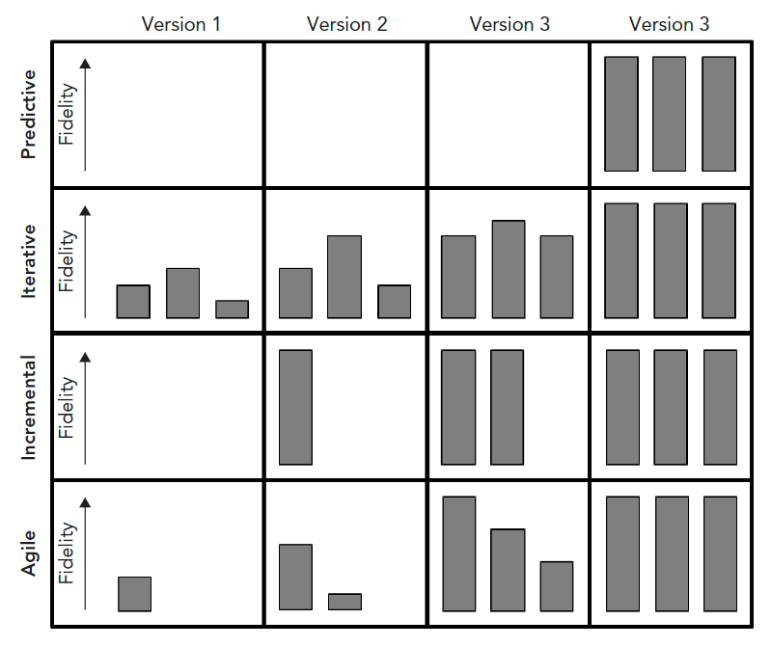

Slide 30
Plan of attack... "Iteration 0"
Form up the team, operating rhythm
Understand & prioritize the requirements & tasks at hand
Make an (iterative?) plan
Study the problem & make some basic process & tech decisions, tool selections
Think about the requirements you need clarified
Roll out, checking in as a team frequently – use this time wisely!
Next class: Monday Sept 9

