Slide 1
Week 3
Project Management

Slide 2
Agenda
[15 min] General Q&A
[3 x 15min] Team Presentations: Requirements
[1 hour] Lecture: Project Management (text Ch. 3, 12, 13, 14)
[3 x 15min] Team meetings
Next week:
Project plan & process docs – artifacts & presentations
Lecture: high level design
Team meetings

Slide 3
Overview
Project management (generally) – roles, task deconstruction
Tools – Gantt charts, Kanban boards
Lifecycle variations
Tracking & risk management

Slide 4
Roles (non-technical)
Executive sponsor – budget, air cover
Customer stakeholders – define requirements, acceptance testing
Project manager – plan, track, mitigate risk, communicate status
Technical skills – perhaps a former developer
Organizational (& clerical) skills
People skills – interface between tech & non-tech audiences
Customer liaison – sometimes the project manager
QA process analyst – studies / measures & helps refine the process

Slide 5
Project planning in the abstract
Track your estimation accuracy... how can it improve?
Is similar in some ways to system design...
Can be performed at high & low levels
Rough blocking – major milestones?
What can generally get done in the allotted timebox?
Fill in details later
Lots of moving parts, dependencies – some maybe outside your control!
Can / should be agile / iterative – agile does not mean no plan!
Plans should be reviewed with stakeholders, incl. & especially the tech team
You will often be asked to plan based on insufficient data!
You will often be asked to commit to delivery based on a high-level plan!
A plan usually doesn't survive first contact with the enemy
And the enemy R us! Revisit often, update planning artifacts

Slide 6
Typical project tasks Some things/aspects to think about, make time for
Requirements management
Project planning – schedule & cost the work
Quality assurance – monitor the engineering process (e.g. testing got done)
Configuration management – of the software source, docs, deployment
Organizational process focus – org quality awareness, introspection
Training – to perform roles on the team, for technology adoption
Peer review – of all requirements, designs, docs, code
Design
Implementation
Test – internal, external, reviews (e.g. security audit)
Release / Operational handoffs

Slide 7
Gantt Charts
Show tasks in time – estimated in duration, start / end time
How many hours per working day? How many working days per month?
What are the units on estimates? How accurate & precise are we / can we be?
Show dependencies between tasks – illustrate "critical path" - minimum time needed to complete all tasks
Assign to resources (persons & other)
Multiple views:
Task view
Resource-specific view
Some tracking tools will produce Gantt
nice to not maintain the data in two places!
As tasks are completed, Gantt can show tracking of project actual vs. Plan
Show % complete
Fibs sequence?

Slide 8
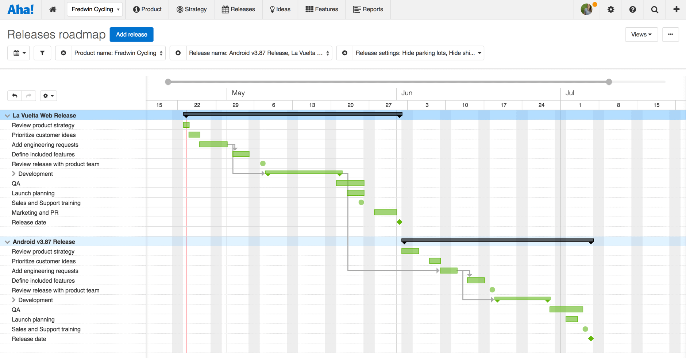
Project planning in the details – Gantt charts

Slide 9
Kanban boards
From Toyota
Principles
Visualize your work
Limit your work in process
Focus on optimizing flow: work "in progress" = capacity of system
Practice continuous improvement
Formerly implemented with actual cards / sticky notes on a wall
Numerous digital versions exist
Multiple views – macro (project view), micro (per iteration view)

Slide 10
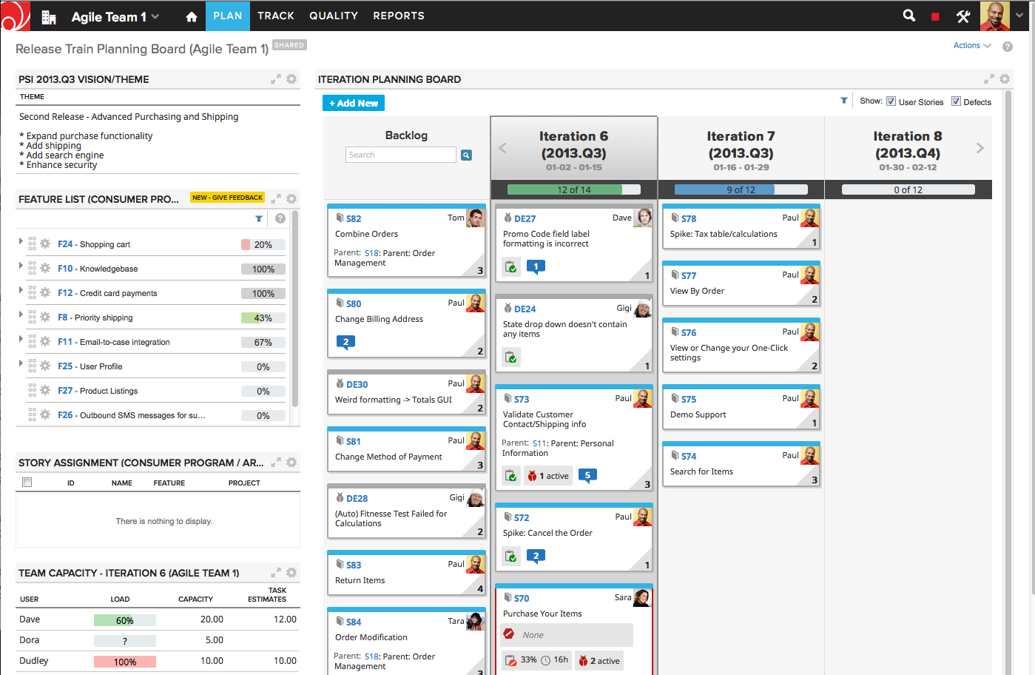
Iteration
View

Slide 11
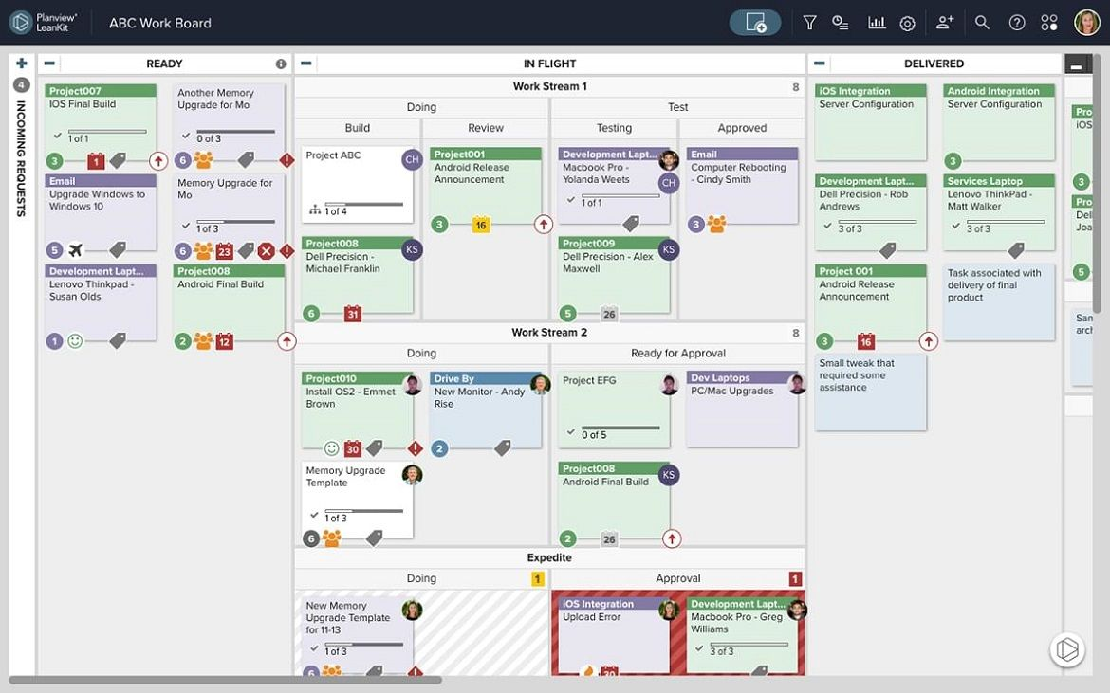
Iteration
View

Slide 12
Bug tracking
Project tasks can be planned or discovered
Defects / bugs can (& should) be tracked in the same tool
Reviewed, prioritized, scheduled, assigned
Ideally customers would have a mechanism to report defects
Subject again to review before action

Slide 13
Project (& Iteration?) Planning: Lifecycle variations (1)
Predictive models: we assume we know things up front
Clear customer vision & sponsorship
Manageable & realistic scope
Experienced development team & leadership
Using established technologies, established processes ("rinse & repeat" jobs)
Common in physical engineering... we don't usually build a bridge "experimentally"
Adaptive models: assume we don't know everything up front... that information, priorities & goals can & do change
Ambiguous or evolving requirements
Limited resources
Experimental prototyping

Slide 14
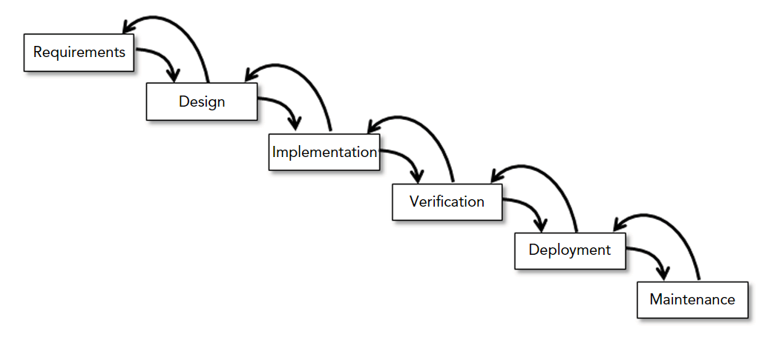
Lifecycle variations (2) Predictive
Waterfall – all requirements gathering & major design up front
Feedback allowed if defects in upstream artifacts discovered
Can be circular – maintenance loops back to (more) requirements
Sashimi variation – phases overlap slightly
Can also use "mini-waterfall" as a framework for the steps which occur during one iteration of a larger effort

Slide 15
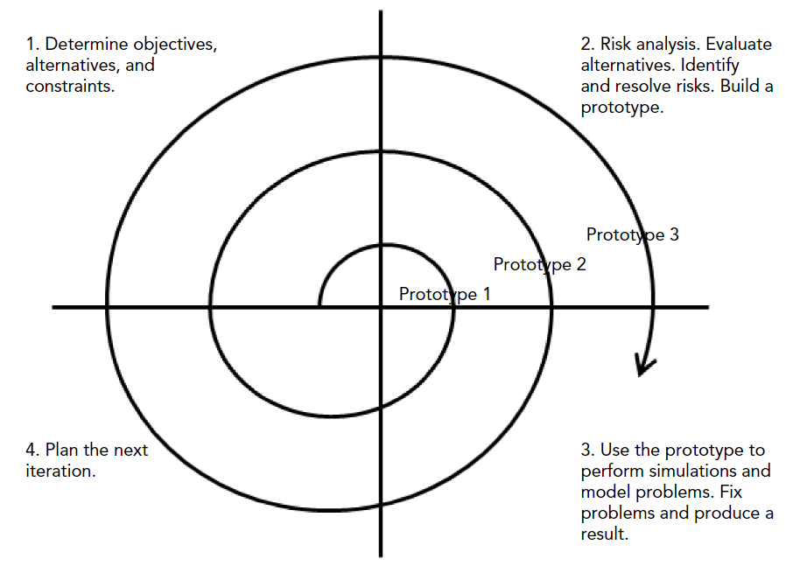
Lifecycle variations (3) Adaptive
We admit we don't know everything up front!
Agile – iterate on MVPs (minimum viable product)
Does not mean there is no plan nor an overarching design – it means we agree to adopt those plans & designs provisionally until proven, else adapt
In each iteration, we do
"just enough":
Requirements
Design
Implementation
Test
Deploy

Slide 16
Agile Manifesto http://agilemanifesto.org/principles.html
Early & continuous product delivery, short iterations
Embrace change
Small, sustainable, motivated teams working together daily
"Face-to-face" (though video chatrooms can work too...)
Adaptable
Self-reflective
Self-organizing
Technical excellence & attention to detail; focus on quality
Document "just-in-time" & "good enough", doc != product
Success = working product

Slide 17
Scrum (1)
One application of agile principles
Roles
Product owner – writes user stories, plans releases, communicates status
Scrum master – runs daily meetings, clears obstacles to executing the plan
Team members – self-organizing, perform design, implementation, test, etc.
Time divided into iterations aka sprints of 1 to 4 weeks in length
Goal of the timebox is a shipped product / new feature(s)
Sprint starts with planning – whole team is involved in stocking the sprint & committing to the objective
Tasks are estimated with the Fibonacci sequence & added to the sprint
What is the capacity of the team? Are all team members created equal?

Slide 18
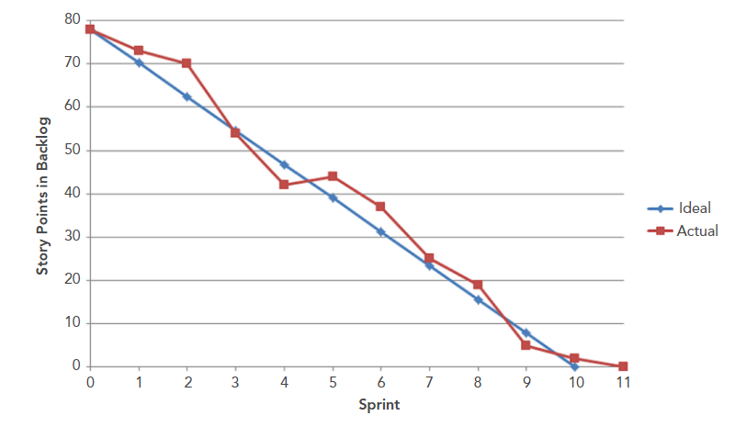
Scrum (2)
Daily project tracking (15-minute stand-up meeting)
What was accomplished since last stand-up?
What will be accomplished before the next stand-up?
What obstacles need clearing to accomplish the goal?
Progress is tracked in the tracking tool & burndown measured
Will we meet the objectives at this rate of progress?
Sprint ends with reflective meeting – what went well / not well?
Actual performance is used to drive the estimation in the next sprint
Did we over-estimate our capacity? Under-estimate specific tasks?
See www.scrum.org - get certified!

Slide 19
Feature delivery: Predictive, Iterative, Incremental, Agile
"Fidelity" - how "complete" is a given feature?
Low fi – a thumbnail or limited functionality implementation
Hi fi – fully realized / full featured
Predictive: all is known up-front = all features at same time at high fi
Iterative: provide all features at low fi, then iterate increasing fidelity
Incremental: minimum number of features, but each at high fi
Agile: provide fewest possible features at low fi (MVP!)

Slide 20
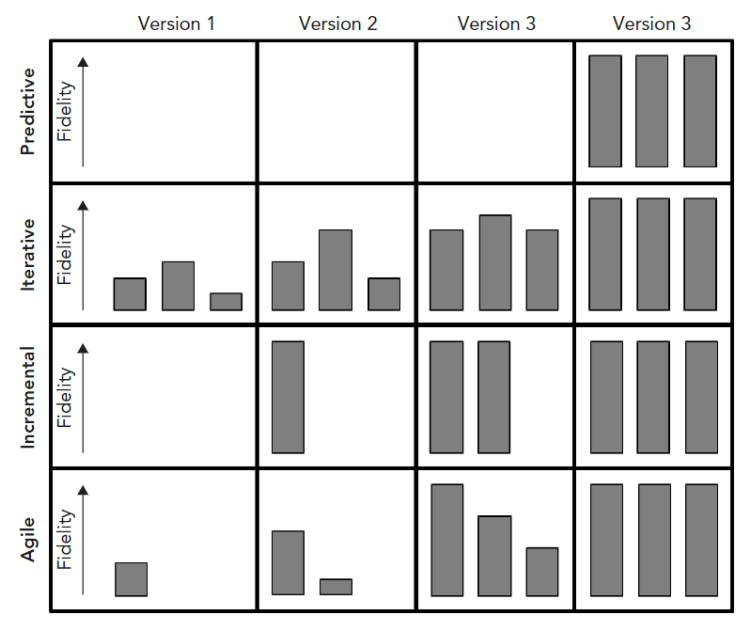

Slide 21
Pros & Cons
Of predictive
Of adaptive
Homework: For discussion in opening Q&A next week (see chapters 12 & 13)

Slide 22
Project Tracking Needs doing no matter what the SDLC model
Tracking frequency is a matter of some debate...
Some like daily stand-ups, some prefer less frequent
Sometimes it’s a meeting, sometimes it’s a walk-around / Skype-around
Sometimes time zones are a factor
Face-to-face vs. video vs. status reports
Tracking tool of choice should be the single source of truth for status
Team members can update status in the tool & avoid inquisitions
Large teams: "scrum of scrums" rollup status / rolldown planning
See Scott Ambler "Scaled Agile":
https://pdfs.semanticscholar.org/5fba/5b24d01bfb4956232e82b1129b7bd07f783a.pdf

Slide 23
Risk Management – rules of thumb (1)
Break work into small tasks – estimates are more likely to be accurate
No task > (5, 8, 13) days, if so, decompose
Fibonacci sequence estimation – 1, 2, 3, 5, 8, (13, …)
Frequent status checks – catch drift from schedule early
Expect the unexpected – pad estimates to account for error (25% to start?)
Insist on peer review of important project artifacts – catch defects early
Assign the right task to the right resource
Budget for training, pad estimates of new resources accordingly
Don’t continuously overload the same people... make effort to build a team
Promote a culture of keeping it real - who needs fake project plans & status theater...

Slide 24
Risk Management – rules of thumb (2)
Don't overpromise – under-promise, over-deliver
Don't over-engineer – don't build a Cadillac when a Yugo will suffice
Rank requirements / features by complexity
Will it require some new technology? Might the new technology not work?
Get good at workarounds (watch MacGyver...)
Review the project plan – are their critical tasks which if they slip / fail there could be broad ramifications?
Should we apply extra resources / attention to this task?
Assess your executive sponsorship
How important is the project to management? Is it properly funded? Clear vision?
Be realistic!
Web time!

Slide 25
More project management maxims (1)
The right project management technique / lifecycle model depends on the organization
Bank? Military? Garage start-up?
Rarely is the textbook process applied as-is
Most project management / tracking tools are customizable enough to bend to the particulars of an organization
A happy team mitigates project risk (turnover is disruptive)
Hire good people, train them, let them work
Get over trying to be in control – learn to surf the chaos, exert influence
Big bang integrations almost never work
Iterate the integration of components into the finished system even when using waterfall!
Strive to "integrate continuously" (CI / (CQ) / CD tooling)

Slide 26
More project management maxims (2)
The prototype almost always becomes the product
Build in quality from the start, in small feature increments
Set reasonable expectations for delivery with management
Be careful of accumulating "technical debt" from hacking demos
Three most important aspects (according to Gallo) of the software engineering process
Requirements management – know what you are building
Configuration management – manage what you are building
Peer review – more brains makes better product
Adding staff does not scale productivity linearly
There is complexity in larger systems of humans
"Mythical Man Month" - Brooks, 1975 - for discussion next week – pick one maxim from the Brooks book (Wikipedia...)

Slide 27
Scrappy Project Management More maxims...
Scrappy Project Checklist
https://scrappyprojectmanagement.com/wp-content/uploads/2015/04/Scrappy-Project-Management-Checklist.pdf
For next week – read & discuss
See also:
https://www.ted.com/talks/simon_sinek_how_great_leaders_inspire_action
https://www.ted.com/talks/simon_sinek_why_good_leaders_make_you_feel_safe
For a minute forget how or what... Why? why do we exist as a company / team / product?

