Slide 1
Week 4
High Level Design

Slide 2
Agenda
[15min] General Q&A
[3 x 10min] Presentation: Project & Process Plan
[60min] Lecture: High level design (text Ch. 5)
[3 x 15min] Team meetings
Next week: no class (religious holiday)
Following week: bidder's conference #2, presentation: high level analysis & design (see artifact checklist), lecture: detailed design

Slide 3
Main aspects of high-level design
Analysis: convert the requirements into a model of objects (nouns), their relationships, & their behaviors (verbs)
Establish a common glossary of terms
Show the nouns in action realizing important use cases
Architecture: the blueprint, the conceptual system to be built – subsystems, components within subsystems, interfaces between them
Diagrams & an enumeration of the subsystems / components with their charter <-- more nouns! OO!
Physical deployment (conceptual) - major physical resources, external services, networks, etc.
Human interfaces specified at high level
Technical plan: identification of tech stack, dependencies between components (which may imply an ordering in the project plan, creation of sub-teams, etc.), assessment of technical risks

Slide 4
What the high-level design is not:
It is not a requirements document
...although the high-level design / architecture is not to be ignored by the detailed design
If the analysis / design reveals additional requirements, loop back & update / re-review that artifact & its downstream impacts
It is not a project plan
If it impacts the plan, loo back & update
It is not a detailed implementable design
That is best delegated to the person/team closest to the work (agile!)
Is not necessarily object oriented (individual components might be OO, or functional languages, or whatever...)

Slide 5
Analysis
Can be performed as part of requirements and/or high-level design
Very important often neglected step
Level sets the team on the terminology
Often leads directly to the identification of components, specific detailed data objects
Activity diagrams exercise the components / objects in important use cases
Helps validate the requirements

Slide 6
Analysis document forms
In its most basic form, it is a glossary
Various UML (or similar ERD) diagrams can assist in documenting the model
Should be understandable by a technical & non-technical audience

Slide 7
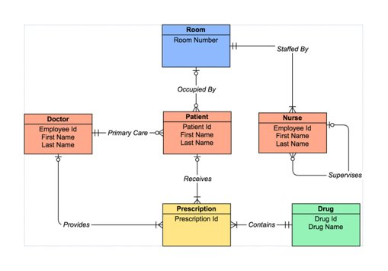
UML static class diagram / ERD

Slide 8
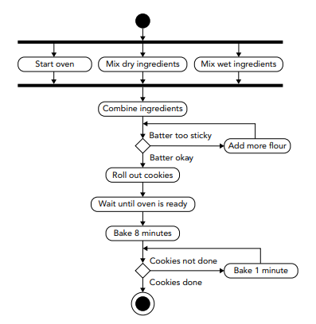
Activity diagram (A flowchart by another name...)

Slide 9
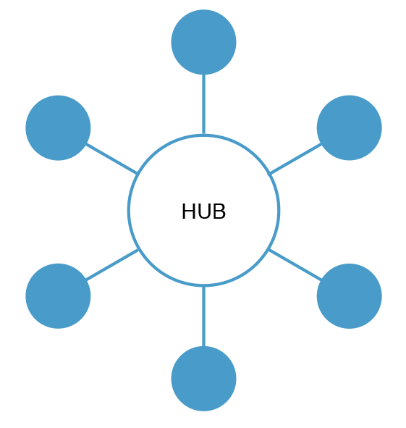
Software Architecture
Establish the overarching "architectural pattern" (e.g. MOM)
Define major subsystems & major components in each subsystem
The definitions of subsystem & component are blurred...
The point is decomposition
Interfaces between subsystems / components / external systems
"Message" specification (e.g. JSON)
"Message" transport (e.g. HTTP)
Security paradigm
UI/UX concept

Slide 10
Software Architecture is Architecture
Definition:
1. the art or practice of designing and constructing
2. the complex or carefully designed structure of something
Software architecture... hardware architecture... network architecture... security architecture...
Borrows concepts / approaches from physical building architecture
Patterns - "put the bathrooms near the elevator"
Disciplined engineering processes w/ validation
Total quality management

Slide 11
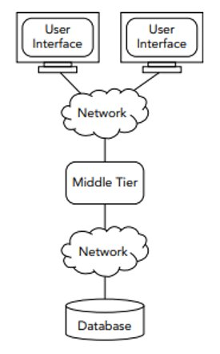
Software Architecture Patterns (1)
Monolithic – one big fat application (e.g. fat Windows app)
Client-server – two tier (e.g. fat Windows app w/ server-side data)
Can extend to N-tier
Typical Web app is a kind of N-tier
Keep presentation layer separate from business logic
Keep business logic separate from persistence
Put external dependencies behind façades

Slide 12
Software Architecture Patterns (2)
Message Oriented – hub & spoke communication w/ message passing
Event-driven – system activities emit "events" which one or more other services "subscribe" to & act upon
Like MOM, common in GUIs
Service Oriented (SOA) - loosely collaborating components which expose services to each other via well-defined interfaces
"Microservices" - small (stateless) services with a clear & limited mission – scale functions independently
Rule-based (e.g. "expert systems")

Slide 13

Software Architecture Patterns (3)
Model-View-Controller (MVC) - common in GUI
Model – the data structure
View – a representation of the data (e.g. a chart)
Controller – action handler for the model (or view)
Reactive
At architecture level means – loosely coupled microservices, concurrent, elastic, asynchronous, message-driven, responsive, resilient, scalable
At programming level means – a development paradigm (compare to "functional")
e.g. A = B + C --> in reactive, if B or C changes after this assignment, A changes

Slide 14
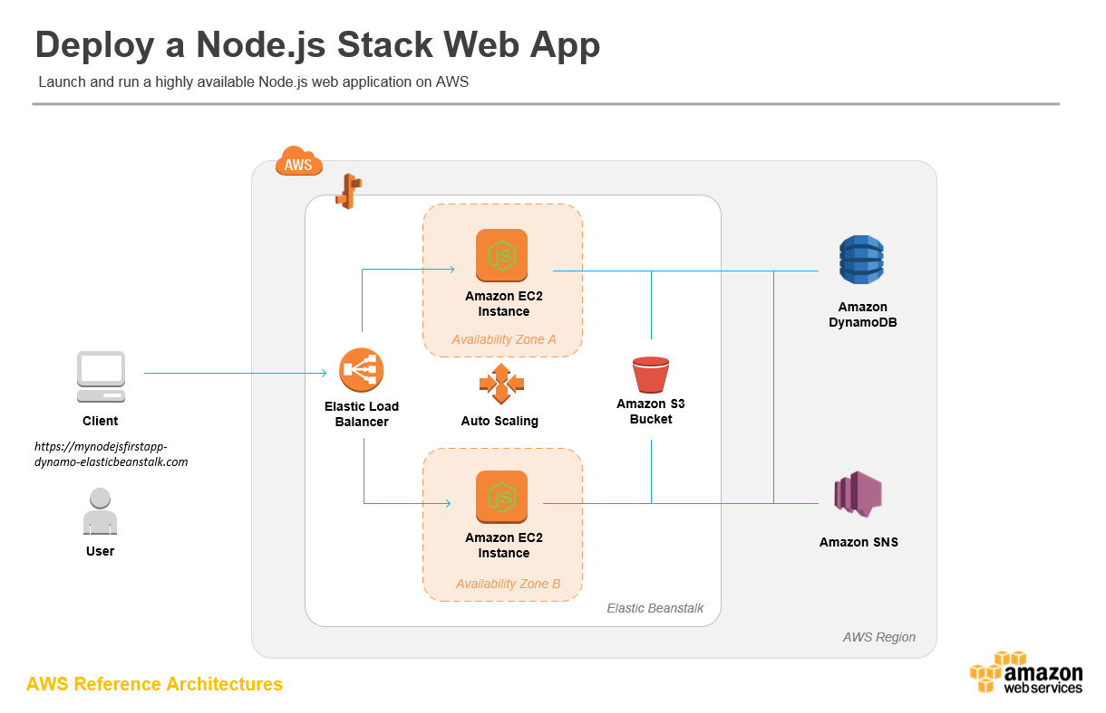
Diagrams – logical deployment / reference architectures (abstract architectural pattern)

Slide 15
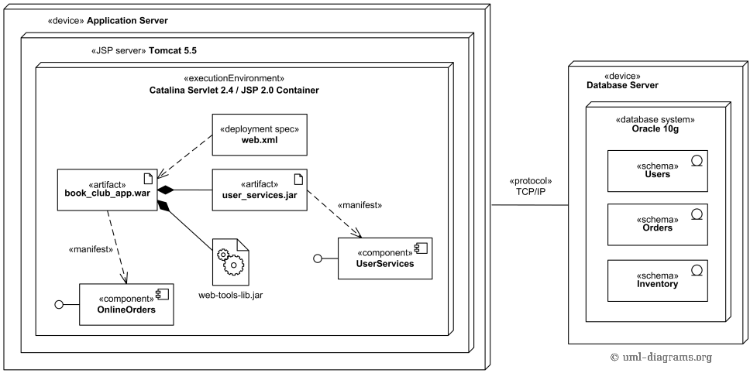
UML deployment diagram: Components & physical nodes
Diagrams - logical deployment

Slide 16
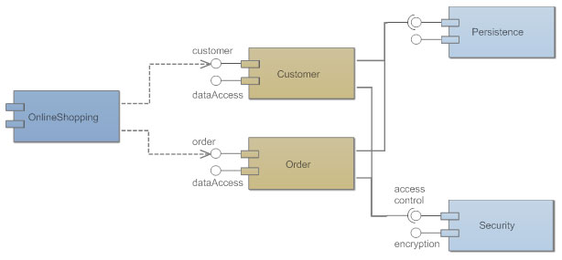
Component diagram
Diagrams – specific components & dependencies

Slide 17
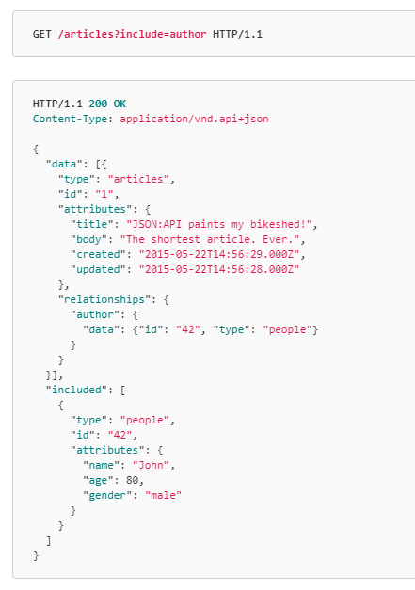
HTTP GET w/ JSON response
Interfaces – message format & transport

Slide 18
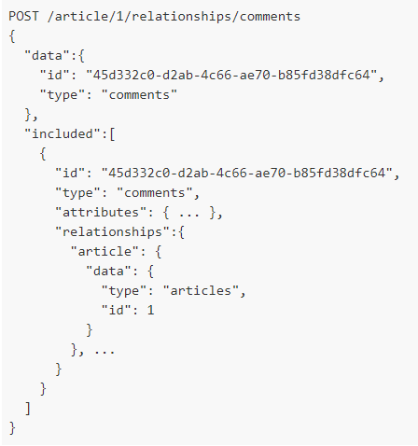
HTTP POST of JSON payload
Interfaces

Slide 19
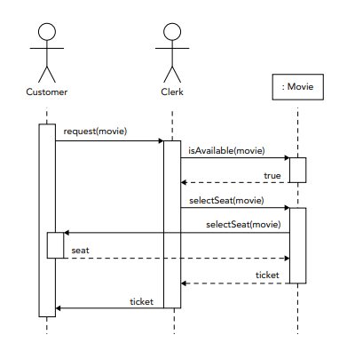
Sequence Diagram Show the components in action / call sequence, w/ returned data objects
Diagrams – sequence diagrams

Slide 20
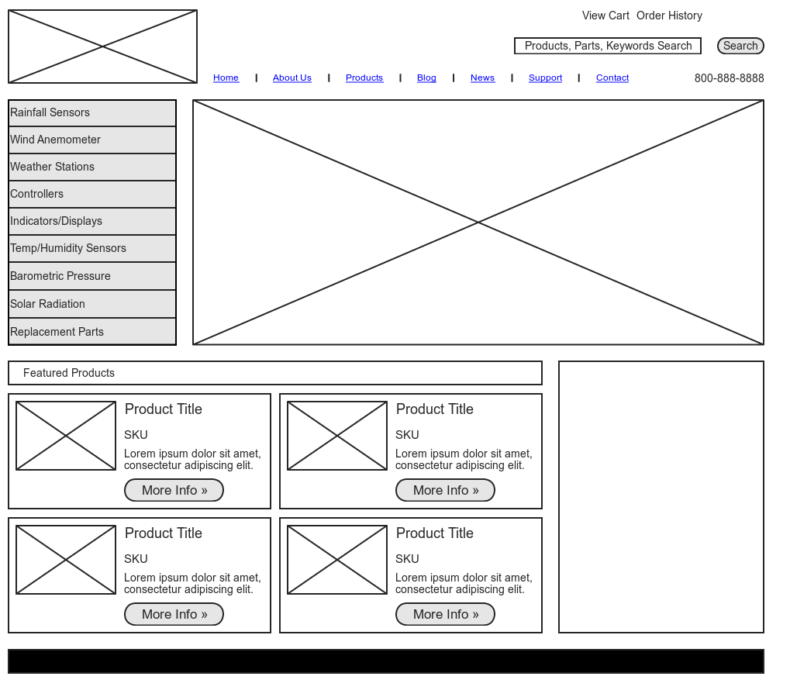
Wireframe: GUI mock-up
Diagrams - GUI wireframes

Slide 21
Architecture is politics...
Architecture must take into consideration organizational factors:
The history / legacy of the organization
The nature of the team(s) & their still sets (e.g. technologies, languages)
The SE process maturity of the team
The management's tolerance for risk
The architect is a salesperson...
Horse trader...
Politician...
Chief technologist...
Rides the corporate elevator to the penthouse & to the boiler room...
https://martinfowler.com/articles/architect-elevator.html

Slide 22
Technical plan
The architecture, being the blueprint, will likely also guide project planning
Sub-teams may be created to own major subsystems
Dependencies between sub-teams / subsystems may imply an ordering to the work, indicate which work streams can be performed in parallel
Your prior project plan may be impacted / revised by new architectural thinking
Identify the tech stack, technical standards, ensure the team can adhere (is trained, equipped with tools, etc.)
Is the organization structured properly to adopt the architecture? Do we need to re-engineer the people constructs too?
Identify major technical risks which could impact the plan (e.g. things we don't yet know how to do!)

Slide 23
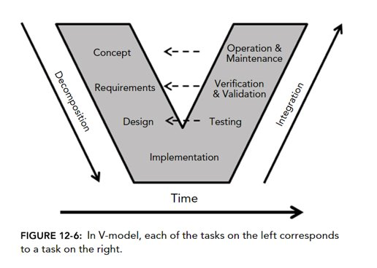
Design validation
Design review ensures each requirement is addressed
Activity / sequence diagrams show the design realizing use cases
Detailed designs are reviewed relative to the master plan
Test plans validate component interfaces

Slide 24
Architectural qualities Evaluating the design along many axis
Performance – speed
Reliability – mean time between failures
Availability – proportion of time system is "up", how quick to recover
Security
Modifiability – small changes quickly?
Variability – what if new requirements / businesses are discovered later?
Portability – to other OS/platforms
Functionality – works as intended?
Sub-setability – are subsystems independent / standalone useful?
Conceptual integrity – exhibits the hand of a single maker, the QWAN?

Slide 25
Architect's Tools
UML & round-trip IDEs
UML formalism allows code stubs to be auto-generated from the model
If the code changes the model, the model diagram gets auto-updated
Other diagramming tools, PowerPoint – execs don't dig on UML...
Interface specifications (i.e. the component's contract with the outside world) can be written as machine-readable signatures w/ auto-generated API documents
e.g. Swagger for RESTful endpoints with Java / JSON (creates an interactive document page which can drive API testing)
Programming languages & other dev tool – good architects get dirty

Slide 26
Design in the agile / iterative lifecycle
All requirements may not be known up front
No waterfall – full design may not be able to be (or even want to be) performed up front
Agile does not imply no master plan – it implies the master plan is taken provisionally until proven otherwise, iterated upon
Downstream detailed design (or implementation, or test) might expose defects in the high-level design – loop back!
Best to catch design defects early else they result in costly rework

Slide 27
Project high level design doc & presentation Should include:
Analysis / conceptual data model
nouns & their relationships, verbs
could be part of requirements deliverable
Activity diagrams (or the equivalent)
Activity diagram for fetching, storing, presenting a stock quote w/ or w/o analytic applied
Activity diagram for fetching, storing, updating list of possible stocks
Activity diagram for creating a new user & logging in
Component-level – components, interfaces, logical deployment
Major user interface constructs / pages / navigation (wireframe)
Tech stack
Impact on prior project plan (if any), major technical risks
Considerations of architectural "ities"

