Slide 1
Week 5
Detailed Design

Slide 2
Agenda
[15min] General Q&A
[45min] Bidders Conference #2
[3 x 15min] Presentation: High level design
[60min] Lecture: Detailed design (text Ch. 6)
Backend components
Databases
User interfaces
Operational considerations
Next week: no class (fall break)
Following week: product demo #1 & plan update, bidders conference #3

Slide 3
Detailed Design – components & objects
High level design (& analysis) has identified the major domain constructs (nouns, verbs, relationships), subsystems & components & their interfaces
Detailed design iterates (usually just-in-time) on specific components into either:
A formal document – an implementable specification
Best for farming out development to other teams
Best if the design is particularly gnarly
An implied detailed design performed by the developer ad hoc during coding
Can be used if the design is small & well understood

Slide 4
Design Patterns
Like architectures, there are patterns for detailed design
e.g. Façade – provide a simplified interface to a complex system
e.g. Observer – notify registered subscribers when an event happens
"Gang of Four" book
https://en.wikipedia.org/wiki/Design_Patterns

Slide 5

UML in High-level vs. Detailed design
UML static class diagrams (of data objects, of components) can be used in high-level design but are often expressed in abstract or incomplete terms
Detailed design would iterate upon the high-level objects fleshing out their attributes & methods, specific cardinalities on aggregate objects, details of inheritance & interfaces, etc.
The high-level design may have simply illustrated dependencies between objects without specifying their kind (aggregation vs. composition) or the cardinalities

Slide 6
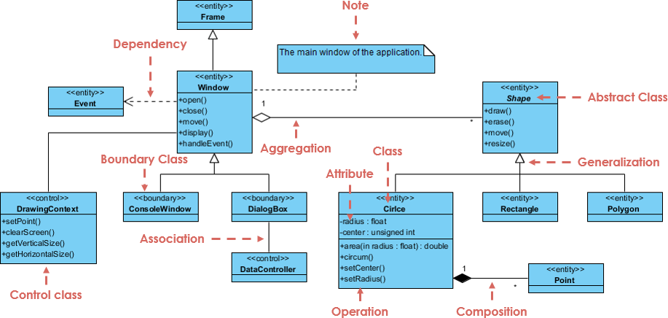

Slide 7
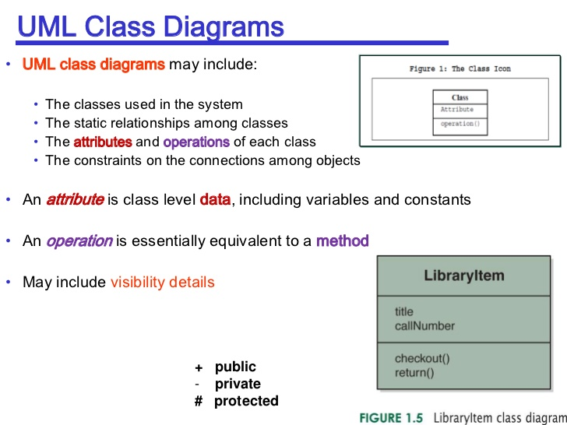

Slide 8




Common Relations
Generalization (B extends A)
Dotted line for interfaces
(B implements interface A)
Aggregation
"A has-a B" which is sharable
Composition
"A has-a B" which is not sharable

Slide 9
Validating detailed designs
Exercise the design by showing an activity diagram expressed in terms of components / objects (rather than business workflow)
Use a sequence diagram to show calls and returns between objects to realize the scenario
State diagrams can be used if the design calls for tracking of object state (e.g. an order processing system where orders go from "pending" to "fulfilled" or "cancelled", etc.)

Slide 10
Detailed design – build vs. buy / borrow
At a high level, there is a build vs. buy decision
Buy an application which is customizable, or bend yourself to one which isn't
Or build a custom app
At a detailed level, there are additional build vs. "buy" decisions
Buy a framework or widget library
Borrow an open source framework or library – before writing code, Google...
"Good artists borrow, great artists steal." - Pablo Picasso

Slide 11
Detailed design formats
The audience for the detailed design is a technologist / implementor
Use terminology tailored for that audience
Size the wording accordingly - "just enough"
Outsourced (e.g. offshore) engagements require more rigor...
UML (static class, sequence) perhaps augmented with verbiage
Code stubs / signatures can be used instead of diagrams (round-trip UML-to-code tools are useful)
Database design often uses its own visual grammar (ERD – very similar to UML)

Slide 12
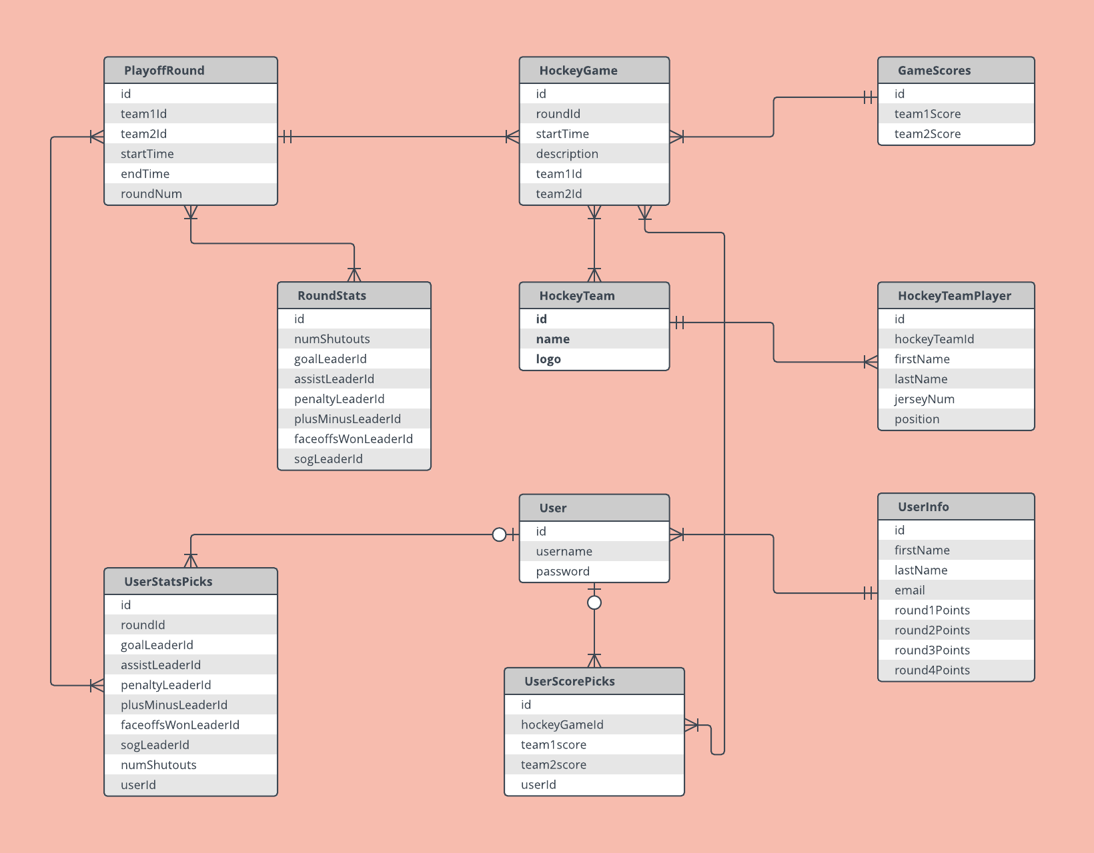
Entity-Relation Diagram (ERD)

Slide 13
Detailed design – databases
“Create a separate table for each set of related data”
e.g. a “zip code table to map zip to city & state”
“Identify each set of related data with a primary key”
uniquely specify a tuple (row) in a relation (table)
e.g. student id represents the primary key to (all) student tables

Slide 14
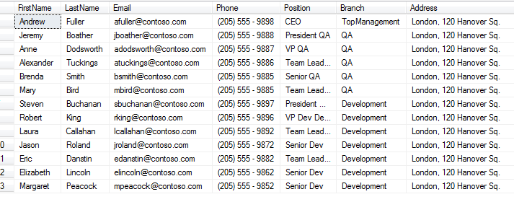
In SQL everything looks like a table…

Slide 15
“First Normal Form”
Database normalization is the process of representing a database in terms of relations in standard normal forms, where first normal is a minimal requirement.
Is in 1st normal formal if “none of its domains have any sets as elements”
First normal form enforces these criteria:
Eliminate repeating groups in individual tables (e.g. city, state --> zip)
Create a separate table for each set of related data
Identify each set of related data with a primary key

Slide 16
“Eliminate repeating groups in individual tables”
Don’t repeat information in the same table
e.g. zip code reference is (usually) enough to represent city & state
Therefore don’t repeat the data…
“Denormalization” – purposefully not optimizing the data in terms of space to improves search performance in terms of time
A “reporting database” – optimize one DB for transactions, another for search

Slide 17
Don’t repeat yourself) – “normalize” – “decomposition”
Street | CityStateZipID
123 Main St | 1
234 Elm St | 1
345 Oak Dr. | 1
Street | City | State | Zip
123 Main St | Albany | NY | 12202
234 Elm St | Albany | NY | 12202
345 Oak Dr. | Albany | NY | 12202
CityStateZipID | City | State | Zip
1 | Albany | NY | 12202

Slide 18
Creating a table
Every table should have a “primary key” – a single value that uniquely specifies this row (can be auto-generated)
This enables easy deleting of a row (“delete from myTable where key=7”)
On a rare occasion, you might want to use a “natural key” or a compound key – something in the data itself, when this makes sense.

Slide 19
Relations
Tables can relate to another – this usually mirrors some relationship in the real world. These "foreign keys" can be enforced by the database system.
StudentId | TestId | Grade
1 | 1 | 82
1 | 2 | 75
1 | 3 | 67
2 | 1 | 92
2 | 2 | 88
2 | 3 | 96
3 | 1 | 45
StudentId | FirstName | LastName
1 | John | Smith
2 | Betty | Jones
3 | Alice | Thompson
TestId | TestName
1 | Quiz 1
2 | Quiz 2
3 | Midterm

Slide 20
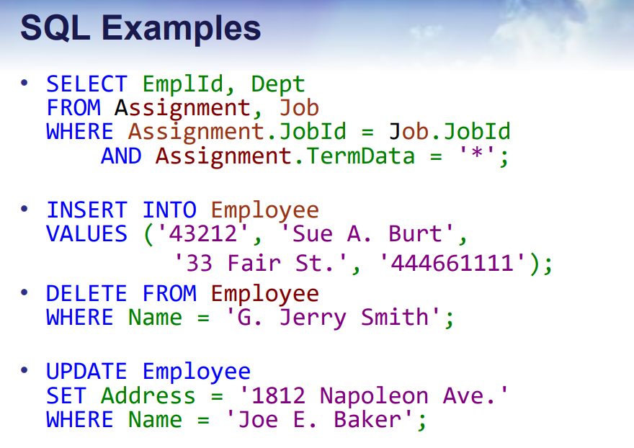

Slide 21
“Live demo” (we leave it to the student to verify)
CREATE TABLE persons (
personId int NOT NULL,
lastName varchar(255) NOT NULL,
firstName varchar(255),
PRIMARY KEY (personId) );
insert into persons values (0, 'Wells', 'Mary');
insert into persons values (1, 'Roberts', 'Bob');
insert into persons values (2, 'Orlando', 'Tony');
select * from persons order by lastName, firstName;
select lastName from persons where firstName like 'T%';
select count(*) from persons;
update persons set firstName='Julia' where lastName='Roberts';
select * from persons order by lastName, firstName; -- show all again
https://www.tutorialspoint.com/execute_sql_online.php

Slide 22
“Live demo” - search
https://www.w3schools.com/sql/trysql.asp?filename=trysql_asc
SELECT * FROM Customers
where country="Germany"
ORDER BY CustomerName ASC;

Slide 23
Create table / Insert / Select – in Java JDBC (Java Database Connectivity)
See link to "Apache Derby" example in GitHub
https://github.com/agallojr/csi311-spring2019-project2.5/blob/master/src/main/java/csi311/SqlDemo.java

Slide 24
NoSQL
Poorly named – should be called unstructured database.
- MongoDB, ElasticSearch, Apache Cassandra, AWS DynamoDB,…
No tables, just “bags of data” – JSON, often
Data can have ANY structure that you choose at run time
- This is convenient when your data structures are wildly variable due either to code changes or different needs
- e.g. free text search, arbitrary name=value pairs – think: “search on ‘War & Peace’”
Automatic sharding – adding more servers is handled automatically

Slide 25
NoSQL
When to use NoSQL
I want to store Word-type documents in the database
I need to scale pretty big (maybe not huge…) without thinking about it
I have a very complex nesting structure that is really hard to model in SQL
I don’t need transactions or joins
No transactions???
Google "mongodb is webscale"

Slide 26
ElasticSearch – insert via HTTP
POST localhost:9200/accounts/person/1 {
"name" : "John",
"lastname" : "Doe",
"job_description" : "Systems administrator and Linux specialist"
}

Slide 27
ElasticSearch – query via HTTP
POST localhost:9200/shakespeare/scene/_search/ {
"query": { "bool": { "must" : [
{ "match" : { "play_name" : "Antony" } },
{ "match" : { "speaker" : "Demetrius" } }
] } } }
Can perform “fuzzy” search, “boost” one or more clauses as the expense of others, etc. – get a “score” for how well each row matched the query

Slide 28
Detailed design – user interfaces
Select a framework – borrow base widgets & functionality
When is a wireframe useful & when is it not?
When it the right time to transition the wireframe to code-generated mockup? A prototype to iterate upon?
Back-end components usually make lousy demos...boring... good to have static documentation of those items
But front-end components are the stuff of demos – the sooner it looks real the better
Detailed design for a GUI might be highly iterative with the customer

Slide 29
Detailed design – operational considerations
Detailed design (if not sooner) is a good time to consider the technical details of operating the system in production
Requirements should also speak to these concerns
Such as:
Deployment – physical platform, tooling required to deploy
Data backups & restore
Ability to inspect log files, determine incident root cause
Performance monitoring
Mechanisms for scaling up
Online help, user forums, other mechanisms for supporting customers – customer bug reporting tool & process

