Slide 1
Week 07
Testing & Maintenance

Slide 2
Agenda
[90 min] Lecture: Testing & Maintenance (chapters 8 & 11)
[20 min x 3] Team scrums
Next week
Lecture: deployment
Team scrums
Deliverables: updated Requirements doc, updated Project Plan

Slide 3
Outline
What is a bug? Not just in code...
Cost of fixing bugs – not all bugs get fixed
Testing, tools, techniques
Maintenance activities

Slide 4
What is a "bug"?
A defect in an artifact – any artifact
Bugs in requirements (e.g. overlooked requirement, conflicting requirements)
Bugs in analysis (e.g. incomplete)
Bugs in design (e.g. design doesn't meet the requirements)
Bugs in code
Bugs in test plans / harness / test cases – the act of finding imperfections is imperfect
Bugs in deployment & operational design / plans
Bugs in the project plan (e.g. overlooked tasks)

Slide 5
Cost of bugs
Since SDLC artifacts often build upon each other (e.g. requirements to design) bugs can have a cascading impact
It is cheaper to find defects sooner than later!
~10x increase in cost of bugs at each transition as we move from requirements, to design, to implementation
e.g. bug in requirements found during coding is 100x more costly to fix than a requirements bug caught at time of requirements review
Bugs cost time, money, & can cost lives!

Slide 6
What is testing?
The act of identifying defects in artifacts
Can include many kinds of review:
Testing by the author (e.g. proof-reading your own work, "developer testing")
Peer review (e.g. editor reviews the document / code)
Group peer reviews – formal review boards, ad hoc team meetings
Independent / external review (e.g. contract testing company)
User / customer acceptance test
Shipping the product and letting the users test (e.g. Microsoft!)

Slide 7
QA is Engineering
Includes the entire lifecycle, all artifacts
Designing tests is like designing software
Designing processes is like designing systems
QA roles make good career progressions for tech support persons
Developer & manager roles make good career progressions for QA

Slide 8
Software Fact of Life: "Bugs Happen"
Industry average ~10-15 (or more) bugs per 1,000 software lines of code (SLOC)
Windows 2000 = 29 million lines of code = ~29,000 bugs!
NASA "CMM Level 5" quality standards drive bugs / KLOC to 0.1 (Windows 2000 would still have 2,900 bugs!)

Slide 9
Cost of fixing bugs (1)
Fixing bugs == writing code --> more bugs!
You are quite likely to introduce new bugs in the act of fixing old ones
Some suggest that writing code to fix bugs is more bug-prone than writing new code
Some bugs easier / cheaper / faster to fix than others
All bugs are not created equal
Deadline overruns
At some point you must ship! Your code will never be bug free!
Bug fixes can introduce breaking changes
Fixing a bug after the product ships might impact existing systems & data
User churn
Fixing bugs --> releasing new software --> potentially impacting users (e.g. app updates)

Slide 10
Cost of fixing bugs (2)
Bugs can be co-opted as features by users - "fixing" them can break the expected (incorrect) behavior
"Any sufficiently advanced bug is indistinguishable from a feature."
"Opportunity cost"
Time spent fixing bugs is time not spent doing something else...
…like writing new killer features

Slide 11
Which bugs to fix? Do a cost / benefit analysis
Severity – cost to users in time / money
Work-arounds – is there one?
Frequency – how often does the bug occur – mainline, corner case
Difficulty – to fix
Riskiness – to fix
Use these questions to drive prioritization & LoE estimation

Slide 12
Kinds / levels of testing
Unit testing – class / method level
IMHO of minimal value – assertions are often trite / trivial
Almost all meaningful tests will require at least some aspects of a component / subsystem / system to be meaningful
Component testing – e.g. of API (potentially private to the subsystem)
Subsystem testing – e.g. of exposed API
System / integration testing – execute end-to-end use case scenarios
Performance / stress / load / endurance / destructive testing
Security / "ethical hacking"
Installation & operation – exercise deployment & failure scenarios
User acceptance testing

Slide 13
Black box vs. White box (or Grey box)
Black box – we do not know how the software works internally, only the input spec & expected output
White box – we have full knowledge of the internals & can design specific tests
Grey box – we know some things
e.g. sort() uses quicksort(), so we can test the corner case, but we can't test all heuristics because we don't know

Slide 14
Test tools
Unit test frameworks
e.g. JUnit driven from Maven builds triggered on Git check-in by Jenkins
Test harness – a framework for describing & executing tests repeatably & at scale
Batch processing tools – e.g. drive an API, assert on return value
GUI tools – capture & replay mouse movements, be able to assert on page contents
Code coverage
Builds an auditor into your code, watches the code execute the test corpus, produces a report on what code was exercised or not (e.g. Jacoco)
Automated testing works most efficiently when paired with automated build & deploy.
Best for stable GUIs

Slide 15
Ways to implement the testing function
Developer testing – always needed, but not a good idea exclusively
Peer / cross-test – small team may need to use a buddy system
Embedded QA role – team includes developers & testers
Independent QA team – adversarial "red team / blue team"
Outsourced QA – independent
Make your users to it – alpha / beta stages of release
Extension of technical support role
QA needs close access to the user experience information tech support has
Serves as a means for transferring to production / operationalizing

Slide 16
Test cases
Test cases should be:
Enumerated
Clearly stated – e.g. terse title with short description
Tied back to an enumerated requirement
Some test cases might read a lot like the requirement...
"As an end user, I login with an invalid password and am told 'access denied'"
Comprehensive of the requirements – functional & non-functional
Categorized & prioritized
Implementable
Repeatable

Slide 17
Test cases may include:
Pre-conditions – e.g. the system must be in a specific state
Execution steps
Post-conditions – what can be asserted about change in system state?

Slide 18
Test plans
Regression (full) - a complete rerun of all test cases
Per subsystem (test cases should be classified!)
"Smoke test" - a partial set of test cases, a "sanity check" (test cases should be prioritized)
Can be used by technical support in production to diagnose system problems
A regression test corpus is a strategic asset

Slide 19
Test-driven development – roll up a corpus
Pick a requirement
Write the test case first
Run the test case – it will fail
Write code
Re-run the test case, fix & repeat until the test case passes
Rinse & repeat to the next requirement
Each test case becomes part of the regression corpus

Slide 20
Maintenance
Troutman’s Second Programming Postulate: The most harmful error will not be discovered until a program has been in production for at least six months.
e.g. Elastic Search has a maximum number of unique keys per collection – in a system where keys can be user-defined...

Slide 21
Maintenance costs
Must be factored into the "total cost of ownership" of the product
The only constant is change – the world around the product will change, and the product needs to be updated accordingly
How long is the product lifetime?
Need to maintain a team with knowledge of the product
Not easy in the face of other projects, people moving around
Programmers are notoriously bad at documentation

Slide 22
Maintenance activities
Perfective – improving existing features
Adaptive – modifying to changing environment
Corrective – fixing bugs
Preventive – refactoring for maintainability (only when needed!)
75% of a project cost might be maintenance,
and perfective maintenance 50% of that

Slide 23
Perfective maintenance
Treat like fixing a bug
Understand the code first
Write requirements, test cases
Understand you will likely introduce more bugs
Treat like writing a new feature – do requirements, analysis, design, etc.
You will sometimes, but not often, be allowed to "throw one away"
Very expensive
Will introduce a new crop of bugs & problems
More often the prototype becomes the product, so do it "right" the first time (agilely)
If you plan to "throw one away", you might end up "throwing two away", third time's a charm...
Do it right the first time – build the MVP but build it "right", then iterate

Slide 24
Bug triage
Not all bugs are bugs – users report incidents
Incidents analyzed by the technical team (1st, 2nd, 3rd tier support)
Is it a bug or a feature? Is the user confused?
Can we reproduce the error? Do we need more information?
What do the logs say around that time?
Prioritized, classified, estimated

Slide 25
Egoless Engineering
You will make mistakes
You are still a good person even if your product/code is bad
No matter how smart you are, someone can always be smarter
Be patient with those less smart than you
The only constant is change – product/code often has a short shelf life
Argue your point, but accept defeat – the "right" answer "depends"
Critique ideas, not people
Collaborate

Slide 26
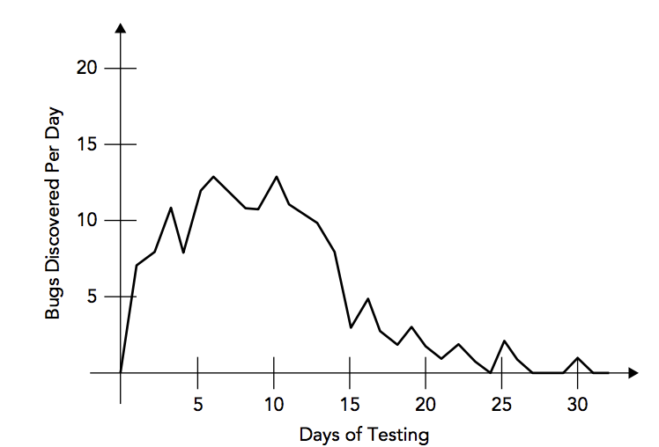
Other words of wisdom
Eat your own dog food
Understand & fix root cause
Test the tests
Be reflective – what could we do to prevent this kind of bug in future?
Track the bugs found – as the frequency declines, the app is stabilizing
You'll probably feel it happening...

