Slide 1
Week 09
Metrics

Slide 2
Agenda
Q&A
Presentation [3 x 15min]: product internal test plan
Brainstorm [15 min]: what can be measured?
Lecture: metrics [45 min]
Team scrums
Next week: product demo! + team scrums (no other deliverables, no formal lecture)

Slide 3
Brainstorming session
[Student "volunteer" to record & keep conversation on track]
What can be measured? (i.e. is implementable)
What kinds of things can be measured? Think broadly.
What's the relative priority of each?

Slide 4
When to measure
Philosophy #1: measure first
Six Sigma methodology - "Design for Six Sigma" says measure before & after
Applies to product & process
Philosophy #2: measure when your ready
"Build it, then make it { fast, secure, measurable }" - "cuz Agile"
CMM model introduces formal metrics at level 4

Slide 5
What to measure
How much / many:
Product code - # git projects, SLOC counts
Deployed system - # nodes, size of disk / DB, time per transaction, etc.
System uptime, mean time between outages
Users / logins / transactions / etc.
Errors / defects & other incidents, mean time to fix (by kind – by feature / part of system, by lifecycle step which introduced it e.g. design)
Customer support inquiries (by kind) - measurements of customer satisfaction
Size of team, # hours invested (by lifecycle activity, e.g. peer review)
Test corpus size, test coverage %; # cases failed over time
Cost to { produce, maintain, etc. }
% of product roadmap / feature set realized
We never measure people; we measure the process or the product
If people are the target, people will cook the books
Don't use metrics as a weapon – use it for self-reflective team study & improvement

Slide 6
How to measure
Be objective, fact-based, numeric – not "feelings"
Pick measurements which are relevant
To the business
To the maturation of the product
To the maturation of the process / team
Pick measurements which are easily measurable (at first)
Automate the measurements
Avoid human error
Not manual --> write code --> test code

Slide 7
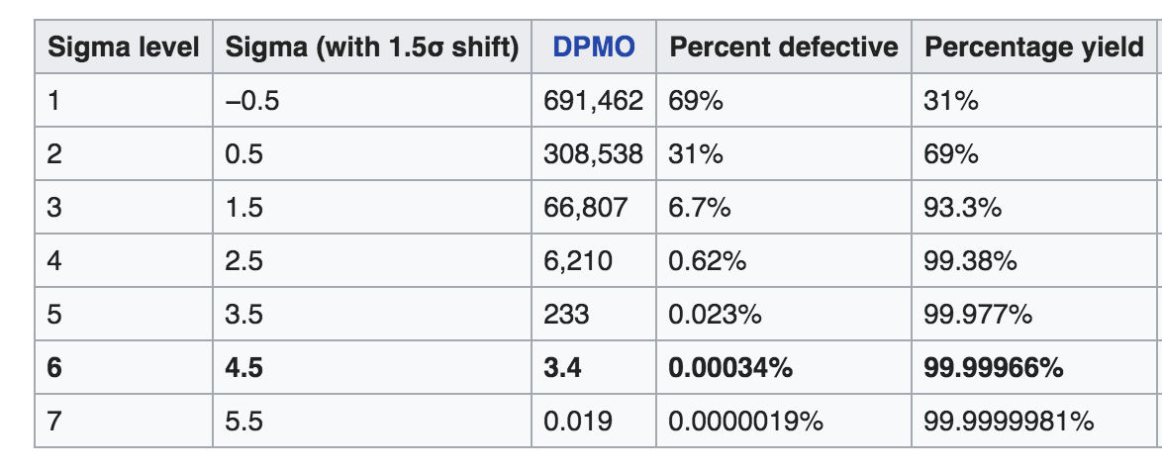
Funny numbers "Measuring programming progress by lines of code is like measuring aircraft building progress by weight." - Bill Gates
Count "defects per opportunity". What is an "opportunity"?
Each line of code? Each user transaction?
"Function points" instead of SLOC? Not all functions (or lines of code) are equal
Need some priority or complexity fudge factor? Is that objective?
How big is the thing being measured? Large enough to be statistically significant?
Can I get even remotely close to Six Sigma? "five nines", 3.4 defects per million?

Slide 8
Interpreting (& selling) numbers
Don't mis-appropriate numbers outside of the domain
e.g. measurements from waterfall projects likely don't apply as rules of thumb to agile products
big teams vs. small teams (normalize the data)
mature teams vs. new startups
Have a basket of indicators – don't fixate on one number
Gut check the numbers – do they jive with "experience"?
Some larger organizations may impose measurements
Scrum-of-scrums rollups of burndown rates
Reports for executive consumption

