Slide 1

Event-Booking
Basic login with email and password
Overview
Event-Booking server
Git Repo URL : https://github.com/agambalonga/techweb-events-booking.git
Members:
Alberto Gambalonga 0124002583
Fabio Cosentino 0124002490
Paola Caiazzo 0124002674
signup
Login via Google with OAuth2.0
login
update profile
User
book event
create event
(only for admin)
cancel booking

Slide 2





Event-Booking
Technologies
Front-end
Back-end
Persistence-layer
*
*Libraries:
express v4.18.2 (to build a web server application)
mongoose v7.5.3 (to connect nodejs server to MongoDB Atlas)
ejs v3.1.3 (view template engine)
jsonwebtoken v9.0.2 (to handle JWT in cookie browser)
multer v1.4.5-lts.1 (to handle upload images with multipart form-data
bcrypt v5.1.1 (to crypt/decrypt password from/to database)

Slide 3
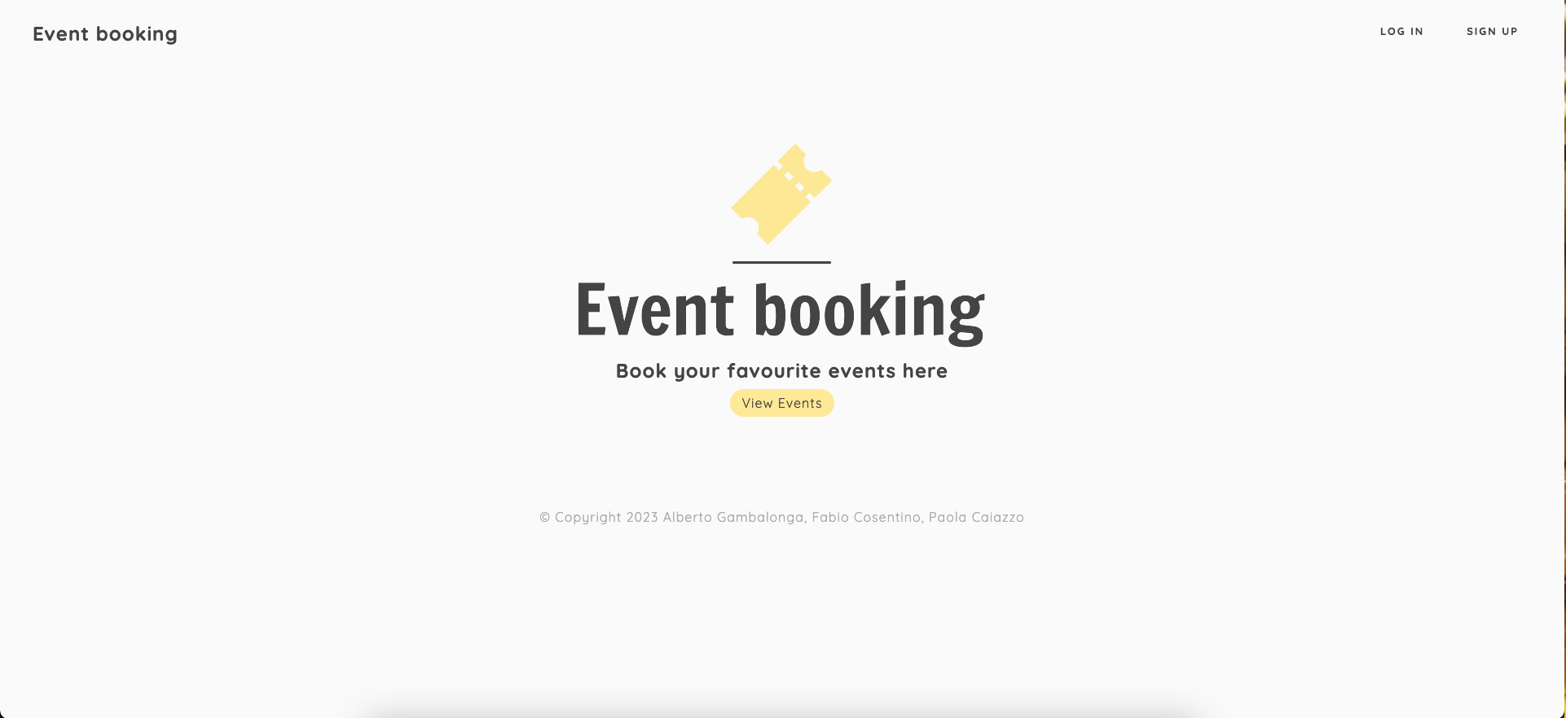
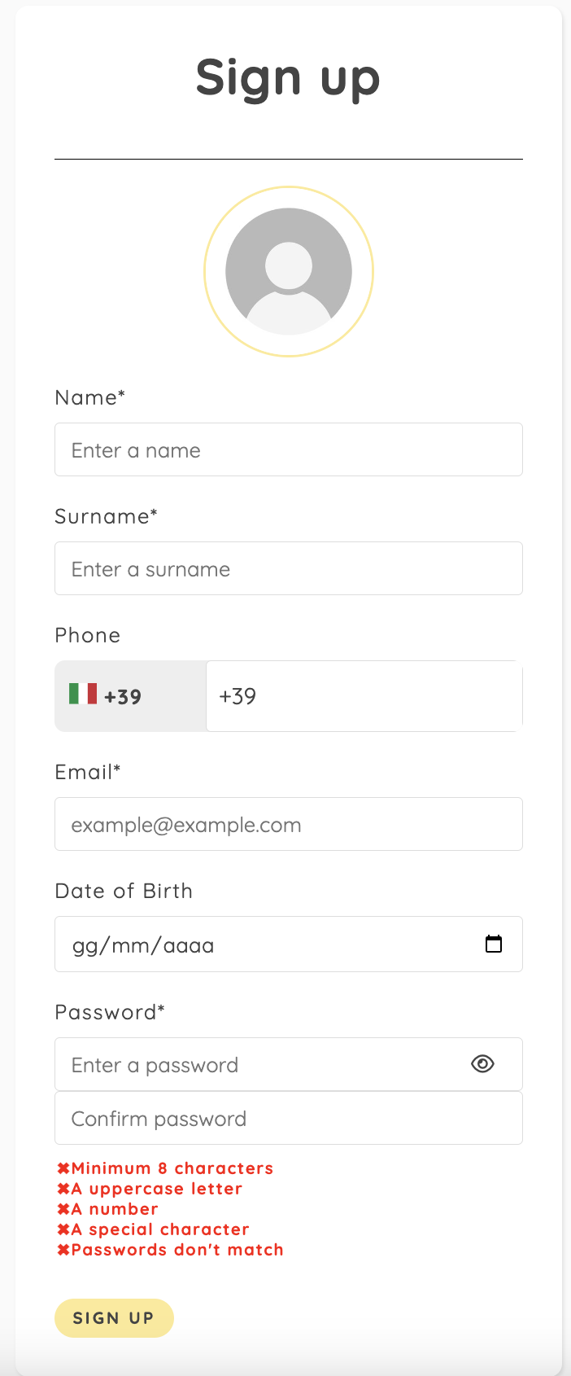
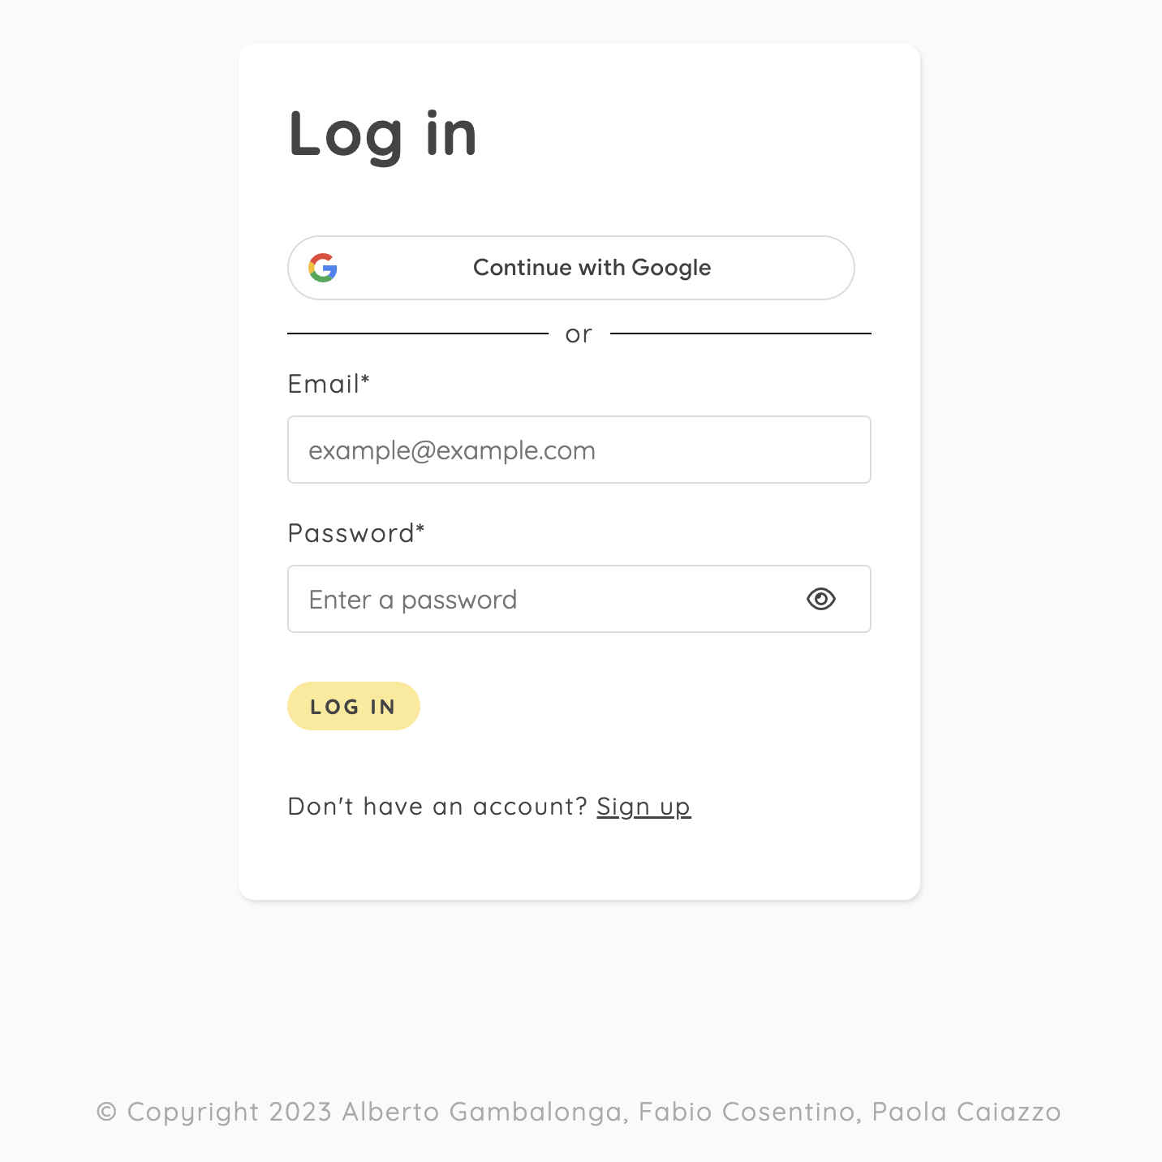
Event-Booking
Screenshot up to date

