Slide 1
BOOGEYMAN
Single and Multiplayer Interactive GAME!!
Let the WAR begin!!
ONLY THE BEST CAN WIN….
SHOOT , DEFEAT AND REPEAT

Slide 2
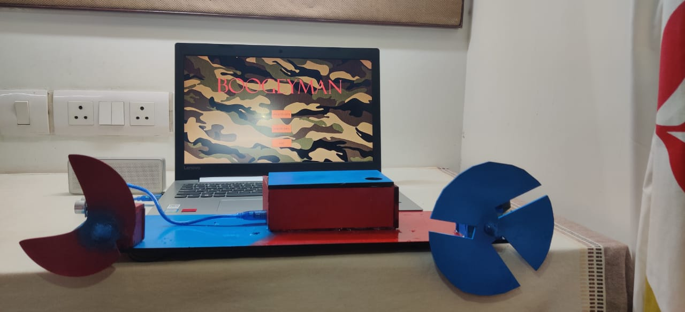
GAME DESCRIPTION
This game is human interactive. It involves their physical movements.
Single Player
The BoogeyMan has to defend himself from the enemies which aappear in front him one after another.
BoogeyMan has to survive just for 50 secs which not an easy task. Few have survived….
Multiplayer
Now the BoogeyMan will face only one enemy….the defender.
The other has to save himself from the BoogeyMan for 50 secs while the BoogeyMan has to shoot him. Making this difficult is the fact that the defender is highly evasive and has an ability to block bullets.

Slide 3
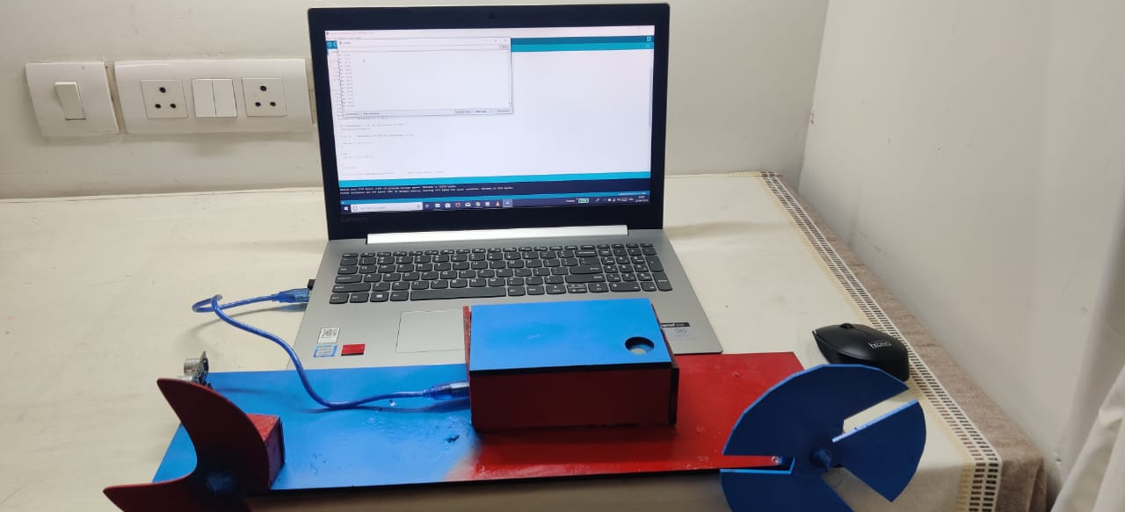
GAME IS MADE ON PROCESSING AND THE SENSORS’ DATA IS COLLECTED AND SENT TO THE DEVICE USING ARDUINO
Sensors used
1X Touch sensor
1X Ultrasonic
2X Potentiometers
Output Modalities
Visual
Audio
Team Members:- Agamdeep Bains , Ajay Kumar , Saurav Ranjan

