Slide 1
Clearscore
Agam Jain
agamjain14@gmail.com
9075275194

Slide 2
Architecture
Akka Cluster
Send message: GetScoredCards
Endpoint to outer world
http://localhost:/8080
AkkaHTTPServer
Send message: GetCSCards
CardsServiceProxyActor
Sends the list of cards received and updates the map as the state of the Actor
Forwards message
Forwards message
CSCardService
CSCardService
Sends the list of cards received and updates the map as the state of the Actor

Slide 3
Steps to run the project
Import the project in IntelliJ
Locate the file RunCardsNode.scala in cs-core-service project and run the main function OR At the top right corner of IntelliJ IDE find the run configuration as Core Node. Click the run button.
This will start the services and Akka HTTP server at http://localhost:8080
From Postman fire the post request as follows:
http://localhost:8080/creditcards

Slide 4
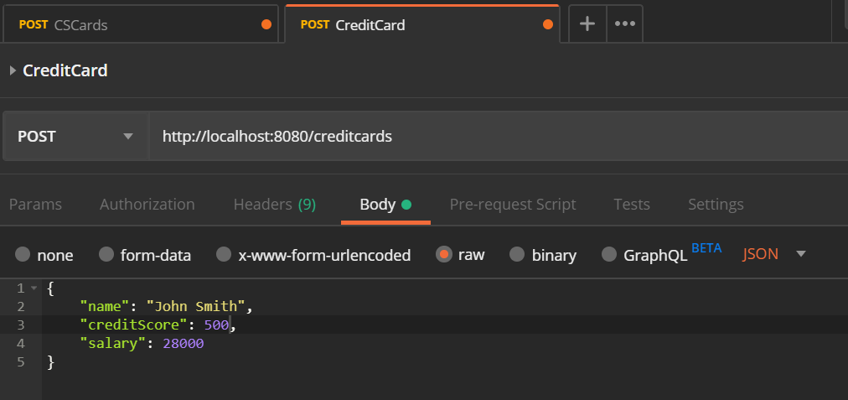

Slide 5
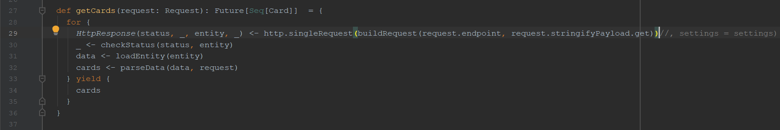
NOTE – This project was built on proxied network. If you do not wish to run on proxy network, locate the file AkkaClient.scala at location net.cs.core in cs-common project and remove the settings variable on line 29 as shown:
However, if you wish to run on proxy network, locate the file RunCardsNode.scala at location net.cs.core in project cs-core-services and in line 26 mention your proxy address.

Slide 6
Tools and Technology used
Scala – 2.12
Akka – 2.5
Akka HTTP – 10.0
IntelliJ

Slide 7
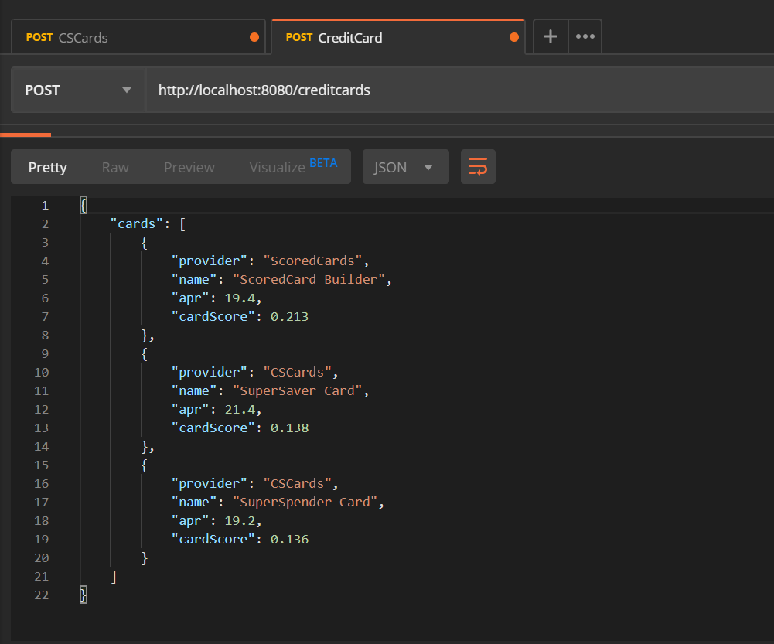
Result

Slide 8
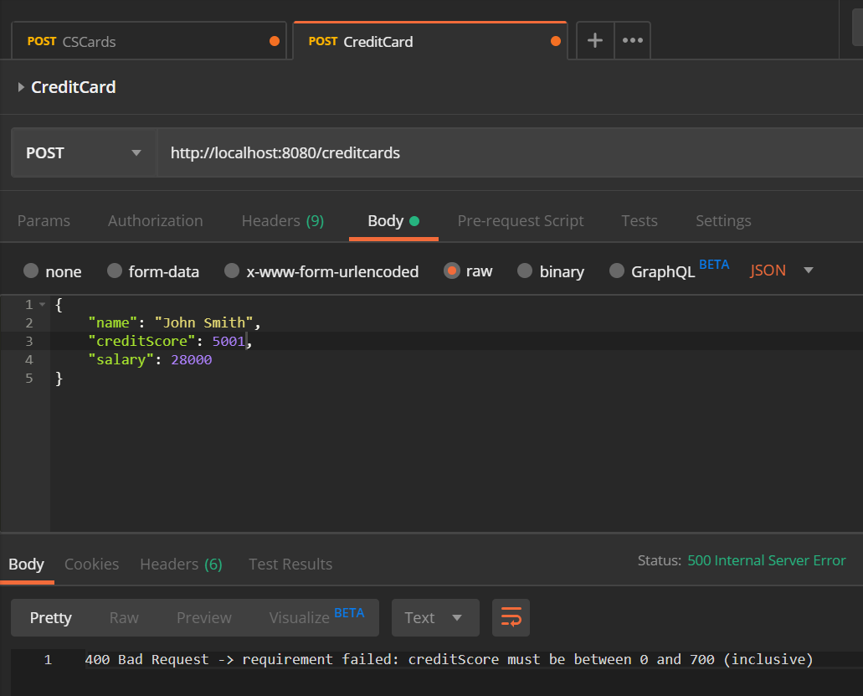
Result

Slide 9
Thank You
Agam Jain
5/2/2020

