Slide 1
AI COURSE PROJECT · 2ND YEAR
Loan Approval Prediction
Predicting whether a loan will be approved, using machine learning on applicant data
Presented by: <Your Name> · Roll No: <...>
Guide: <...> · <College name> · <Date>
1 / 14
Notes:
Greet the panel. One line: 'My project predicts whether a loan application will be approved or rejected using machine learning on a public dataset of 614 applications.' Keep this slide short.

Slide 2
The problem
Banks receive thousands of loan applications. Checking each one by hand is slow, inconsistent and subjective.
Mistake 1: approve a risky applicant
Mistake 2: reject a good applicant
The customer defaults and the bank loses money (a false positive).
The bank loses a good customer and the business (a false negative).
OUR GOAL
Learn from past applications and predict Approved / Rejected automatically, and explain which features drive the decision.
2 / 14
Notes:
Stress the two kinds of mistakes. They cost different amounts, and that is why we report precision AND recall instead of just accuracy. Technically this is supervised binary classification on tabular data.

Slide 3
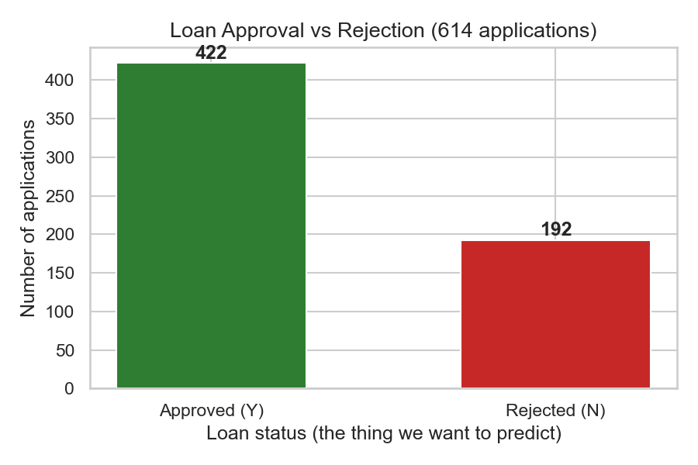
The dataset
614
13
68.7%
149
loan applications
columns (11 used as inputs)
approved: imbalanced classes
missing cells in 7 columns
Source: Analytics Vidhya "Loan Prediction" practice problem (public; also on Kaggle).
Data: fictional "Dream Housing Finance" sample data, not a real bank's records.
Target: Loan_Status, Y = approved (422) / N = rejected (192).
Inputs: 6 categorical (Gender, Married, Dependents, Education, Self_Employed, Property_Area) and 5 numeric (2 incomes, LoanAmount, Term, Credit_History).
3 / 14
Notes:
Say where the data is from before anyone asks: a public teaching dataset. The 69/31 imbalance means a model that always says 'approve' already gets 69% accuracy, so accuracy alone is not enough.

Slide 4
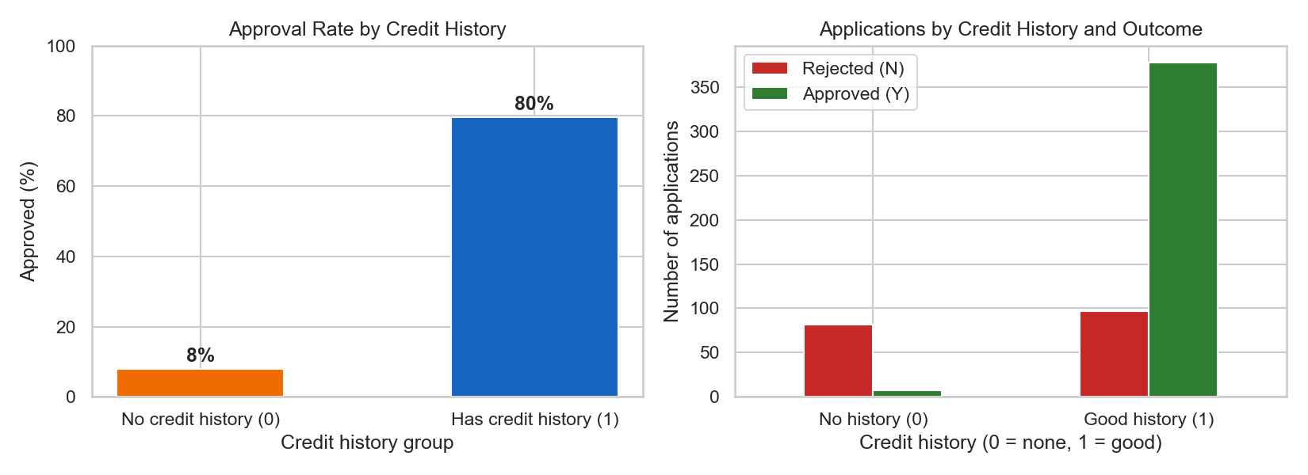
What the data told us (EDA)
80% vs 8%
approval rate with vs without a credit history (10× difference)
Income is very skewed: median ₹3,812, mean ₹5,403, max ₹81,000 (skew 6.54).
Property area has a mild effect: Semiurban 77%, Urban 66%, Rural 61%.
Income alone barely separates the classes, but income compared with the loan size does. This led to our engineered features.
4 / 14
Notes:
Tell the story: credit history dominates. Skewed income means we fill missing values with the MEDIAN, not the mean. Raw income on its own is weak, which motivated the affordability features.

Slide 5
Features used: the 11 raw inputs
Feature | Type | Meaning | Signal
Credit_History | 1 / 0 | Repaid past loans on time? | Very strong
ApplicantIncome | ₹ / month | Main applicant's income | Medium
CoapplicantIncome | ₹ / month | Co-applicant's income (0 if none) | Medium
LoanAmount | ₹ thousands | Amount requested | Medium
Loan_Amount_Term | months | Repayment period (mostly 360) | Low alone
Property_Area | 3 categories | Urban / Semiurban / Rural | Weak
Married · Dependents | categories | Family situation | ≈ none
Education · Self_Employed | yes / no | Graduate? Self-employed? | ≈ none
Gender | M / F | Sensitive attribute | ≈ none
5 / 14
Notes:
Walk down the table quickly. Point out the last column: it comes from our measured permutation importance (slide 12), not guesswork. Loan_ID is dropped because a unique ID has no meaning and could only be memorised.

Slide 6
Features we created: affordability
A loan officer asks: "Can this household afford the monthly instalment?" So we built 5 new columns that answer it.
1
TotalIncome
2
EMI
3
BalanceIncome
Applicant + Co-applicant income
LoanAmount × 1000 ÷ Term
TotalIncome − EMI
The bank lends to the household
Approx. monthly instalment in ₹
Money left after paying the EMI
4
LoanToIncome
5
LoanAmountLog
Did it help?
LR test ROC-AUC 0.852 → 0.870. LoanToIncome & BalanceIncome are the Random Forest's #2 and #3 columns.
LoanAmount × 1000 ÷ TotalIncome
log(1 + LoanAmount)
Loan size in months of income
Tames very large loans
Computed inside the pipeline (src/features.py), so the app sends only raw values.
6 / 14
Notes:
This is our main modification. The formulas use only the applicant's own row and learn nothing from the data, so there is no leakage. Evidence: LR's ROC-AUC improved and two engineered features ranked right after Credit_History in the forest.

Slide 7
How the data flows: one leakage-safe pipeline
1
2
3
4
5
6
Raw row
Engineer
Impute
Transform
Model
Output
11 columns
+5 features
median / mode
StandardScaler
OneHotEncoder
LR · DT · RF
Approved?
+ probability
Split first: 80% train (491 rows) / 20% test (123 rows), stratified, random_state = 42.
Fit on train only: imputers, scaler and encoder learn their values from the 491 training rows and are then applied unchanged to test rows. No data leakage.
One object: preprocessing + model are saved together (pickle), so the app processes inputs exactly like training did.
7 / 14
Notes:
Define data leakage in one line: 'information from the test set sneaking into training and inflating the score.' The Pipeline makes it impossible because .fit() only ever sees X_train.

Slide 8
Three models compared
Logistic Regression
Decision Tree
Random Forest
Linear baseline
Rule-based (max depth 4)
Ensemble of 300 trees (new)
Weighted sum → sigmoid → probability
Needs scaled features
Easy to interpret (weights)
Learns yes/no questions using Gini impurity
Depth capped to avoid memorising
Human-readable rules
Each tree sees random rows + features
Trees vote: their errors average out
Usually beats one tree
★ Selected model
All three share the same features and preprocessing, so the comparison is fair.
8 / 14
Notes:
Sigmoid: the S-curve mapping any score into 0 to 1, read as a probability. Gini: how mixed a node is; the tree picks splits that make nodes purer. Random Forest = bagging + random feature subsets. We added it as a modification.

Slide 9
How we evaluate fairly
5-fold cross-validation (new)
1
Accuracy
% of all decisions correct (misleading with a 69/31 imbalance)
2
Precision
Of loans we approved, how many were truly good? Protects the bank
3
Recall
Of truly good loans, how many did we approve? Protects customers
4
F1-score
Gold = validation fold, green = training folds. Five rounds on the 491 training rows; the average F1 picks the winner. The test set is only used once, at the end.
Balance of precision & recall (our selection metric)
5
ROC-AUC
How well applicants are ranked (0.5 = coin flip, 1 = perfect)
9 / 14
Notes:
Why cross-validation? One test set of 123 rows is a single lucky or unlucky draw. CV gives an average and a spread. We pick the model on CV F1 so the test set never influences the choice.

Slide 10
Results on the unseen test set
87.8%
test accuracy of the Random Forest (F1 0.918, CV F1 0.867 ± 0.028)
Random Forest is best on CV F1, test accuracy and test F1.
The gap is small: all three CV F1 scores are within one standard deviation.
No overfitting: test accuracy ≥ train accuracy for every model.
10 / 14
Notes:
Quote the numbers from the chart. Be honest that the three models are close (CV F1 0.863 to 0.867), so the forest wins narrowly. Logistic Regression has the best test ROC-AUC (0.870) and is simpler, which is a fair alternative choice.

Slide 11
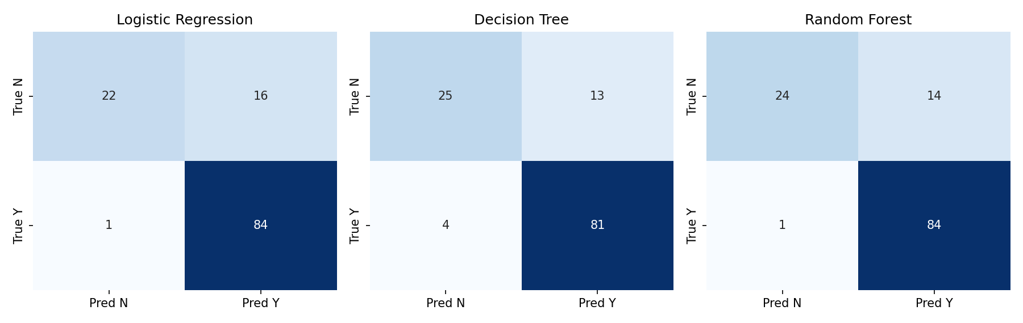
Where the models make mistakes
Random Forest: 84 of 85 good loans approved (only 1 missed), 24 of 38 risky loans rejected.
Weak spot: about 1 in 3 risky applicants is still approved (14 false positives). The models are lenient, because the data has twice as many approvals.
11 / 14
Notes:
Read one matrix aloud: rows = truth, columns = prediction. Admit the weakness yourself. The model rarely rejects a good customer but lets some risky ones through. Fix ideas: class weights or a higher decision threshold.

Slide 12
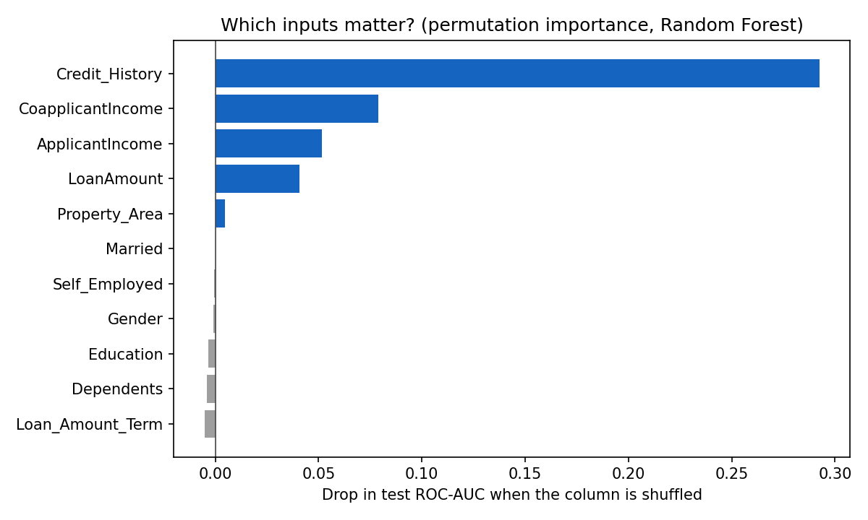
Which features really matter?
Permutation importance
Shuffle one column and see how much ROC-AUC drops. A big drop means the model relies on it.
Credit history: by far #1 (−0.29 AUC).
Affordability next: co-applicant income, applicant income, loan amount.
Gender, education, marital status, dependents: ≈ 0.
The model decides on credit + affordability, not demographics.
12 / 14
Notes:
This answers 'explain the features'. Shuffling a raw income column also scrambles the engineered features built from it, so each bar is the total value of that input. Fairness point: sensitive attributes contribute nothing and could be dropped.

Slide 13
Live demo: Streamlit web app
1
Enter details
RUN IT
streamlit run src/app.py
Try this:
1. Keep the defaults → all 3 models APPROVE (LR 82%, RF 79%, DT 75%)
2. Set credit history to 0 → all 3 REJECT
One toggle flips every model: credit history in action.
A form with the 11 inputs a bank officer would fill in
2
3 models predict
Approved / Rejected with a confidence %; best model starred
3
See affordability
Shows the EMI, income left after EMI and loan-to-income ratio
Academic demo only, not a real lending decision.
13 / 14
Notes:
Run the app live if allowed. Flip Credit History to 0 and show every model switching to REJECTED. That connects the demo to the feature-importance slide.

Slide 14
Conclusion & future scope
What we achieved
Limitations
Future scope
End-to-end ML system: 87.8% test accuracy, F1 0.918
5 affordability features that measurably help
Fair comparison of 3 models using cross-validation
Working web app
Small dataset (614), not from a real lender
Lenient: ~1 in 3 risky applicants still approved
Sensitive attributes still in the inputs
Class weights / threshold tuning
Drop sensitive features; fairness audit
Try gradient boosting (XGBoost)
Larger, real-world data
Thank you. Questions welcome.
14 / 14
Notes:
Mention a limitation before anyone asks; examiners reward self-awareness. Then thank the panel.

