Slide 1
Loan Approval Prediction
AI Mini Project · Semester 2
Predicting Approved / Rejected loan applications for HDFC Bank Ltd. using supervised machine learning
Group members: ______________________________
GitHub: https://github.com/agamjotdhingra/MINIPROJECT1
Notes:
Introduce the project: HDFC Bank wants faster loan processing. We built an ML model that predicts if a loan application should be approved or rejected. Introduce group members.

Slide 2
Step 1 — Defining the problem
1
PROBLEM
2
OBJECTIVE
Which ML type?
Manual loan checking is slow and inconsistent. HDFC Bank wants to process applications faster.
Build a model that predicts whether an application should be Approved or Rejected.
CLASSIFICATION
The output is a category (Approved / Rejected), not a number.
We have past labelled examples → supervised learning.
Target variable: Loan_Status
3
INPUTS
4
OUTPUT
Income, co-applicant income, loan amount & term, credit history, employment, education, marital status, dependents, property area.
Loan_Status → Approved (Y) or Rejected (N).
Notes:
Explain the four things we wrote before coding: problem, objective, inputs and output. Since the output is a category, this is classification, not regression or clustering.

Slide 3
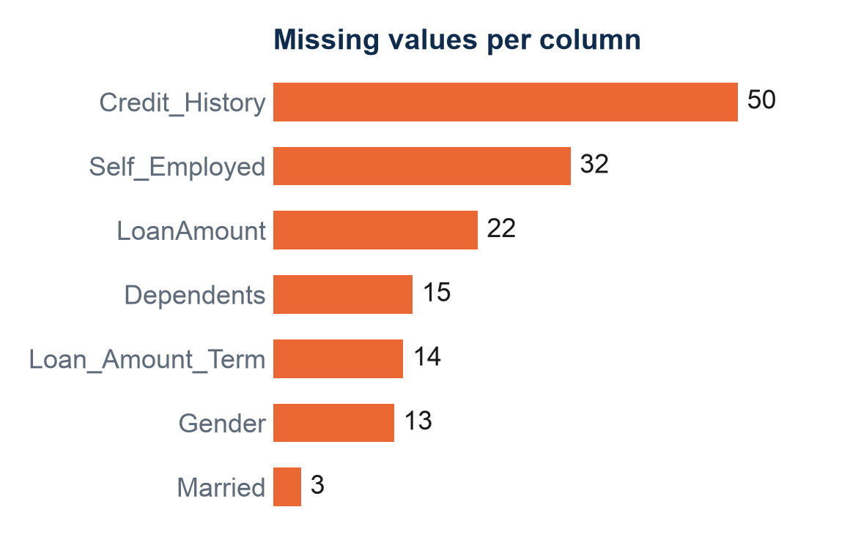
Step 2–3 — Dataset collection & understanding
614
13
69%
0
loan applications
columns (12 inputs + target)
approved → imbalanced
duplicate rows
Source: Loan Prediction Dataset (Kaggle / Analytics Vidhya) — public GitHub copy
Personal
Gender, Married, Dependents, Education, Self_Employed
Financial
ApplicantIncome, CoapplicantIncome, LoanAmount, Loan_Amount_Term, Credit_History
Location
Property_Area (Urban / Semiurban / Rural)
Target
Loan_Status (Y / N)
Notes:
Dataset has 614 past applications. Before using it we checked columns, target, number of records, missing values, data types and outliers. 7 columns have missing values; Credit_History has the most. Target is imbalanced: 69% approved.

Slide 4
Project workflow (flow diagram)
1
2
3
4
5
Problem Definition
Data Collection
Data Understanding
Preprocessing
Visualization / EDA
Approve / reject = classification
Kaggle loan dataset, 614 rows
Shape, types, missing, target
Impute, encode, scale
6 question-driven charts
10
9
8
7
6
Conclusion
Interpretation
Evaluation
Model Development
Feature Engineering
Best model + limitations
Feature importance
Accuracy, Precision, Recall, F1, CV
LogReg · Decision Tree · Random Forest
TotalIncome, EMI, Loan-to-Income
Highlighted: preprocessing and visualization — the steps that shape the data before modelling.
Notes:
This is the complete pipeline, following the 10 steps. Preprocessing and EDA are highlighted as the teacher asked. Walk through each box briefly.

Slide 5
Steps 4 & 6 — Preprocessing and feature engineering
Issue | What we did | Why
Missing categories | Filled with mode | Most common value; few rows missing
Missing LoanAmount | Filled with median | Skewed data — median ignores outliers
Text categories | Yes/No → 1/0, Property_Area one-hot | Models need numbers
Income outliers | Kept + log transform | Real high earners, not errors
Different scales | StandardScaler (LogReg only) | Trees don't need scaling
Loan_ID | Dropped | Just an ID, no meaning
Ask: “Can the raw variables represent the problem well?”
TotalIncome
Applicant + co-applicant income = household income
EMI
LoanAmount ÷ Term = monthly repayment burden
Loan_to_Income
LoanAmount ÷ TotalIncome = how big the loan is vs income
Removed raw income columns after creating these → avoids redundant features.
Notes:
Key line: the question is not 'did I preprocess' but 'why did I preprocess this way'. Explain each row's reason. Then explain the 3 new features: a bank cares about the ability to repay, so loan size compared to income is more meaningful than raw income.

Slide 6
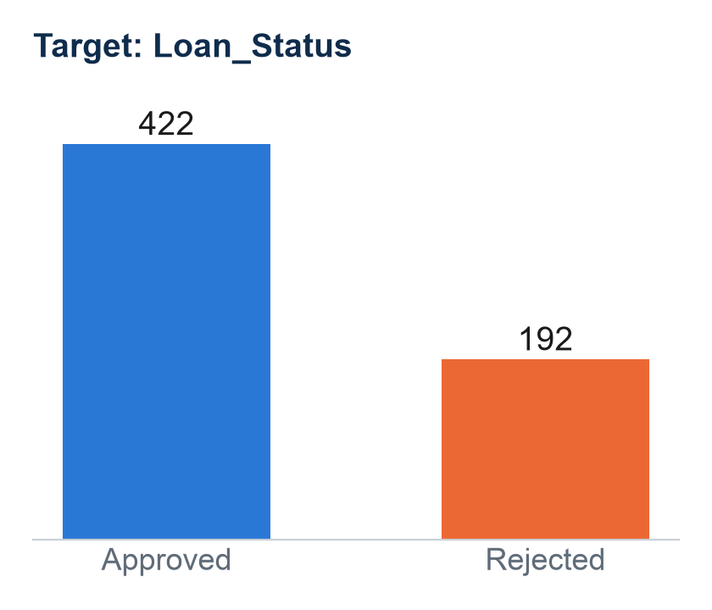
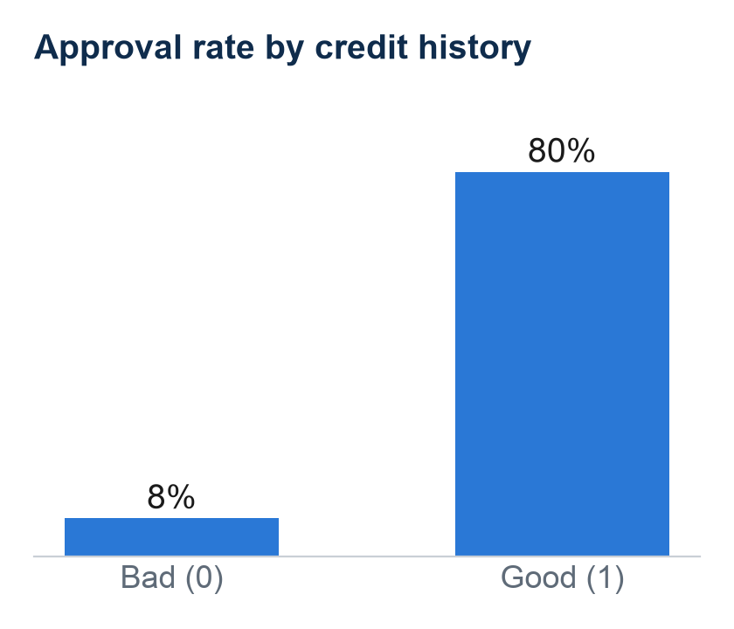
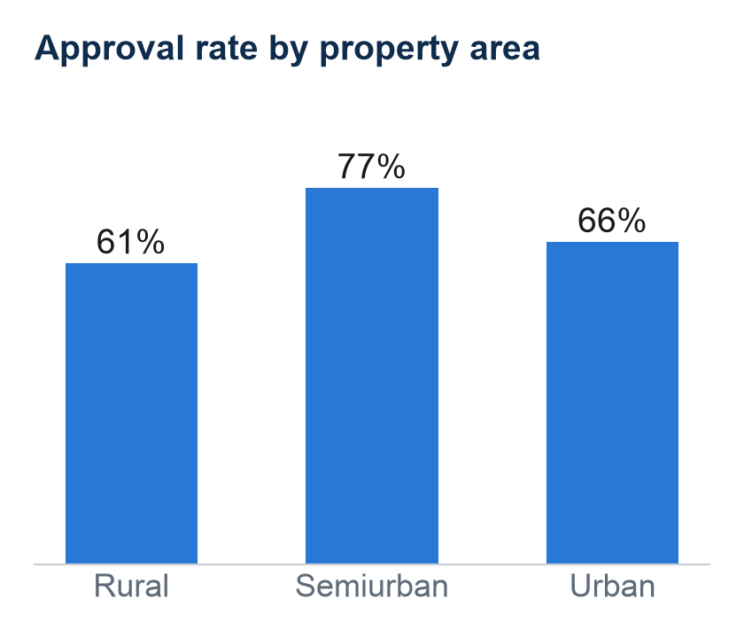
Step 5 — EDA: what the data tells us
Imbalanced: approving everyone already gives 69% accuracy — our model must beat that.
Strongest signal: good credit history → 80% approved, bad → only 8%.
Semiurban applicants are approved most often; rural least.
Surprise: approved and rejected applicants have almost the same income distribution — income alone does not decide approval.
Notes:
Every graph answers one question. Target chart shows imbalance. Credit history chart shows the strongest relationship (correlation 0.54 with Loan_Status). Property area matters a little. The income histogram in the notebook shows approved and rejected overlap, so income alone is not enough. Outlier boxplots and correlation heatmap are in the notebook/report.

Slide 7
Steps 7–8 — Model development & evaluation
Logistic Regression
Decision Tree
Random Forest
Confusion matrix — Random Forest
Simple, explainable baseline for yes/no
If-then rules, like a loan officer
Many trees vote → more stable
Predicted →
Rejected
Approved
23
15
Model | Accuracy | Precision | Recall | F1 | 5-fold CV
Logistic Regression | 85.4% | 83.2% | 98.8% | 0.903 | 80.6%
Decision Tree | 85.4% | 85.3% | 95.3% | 0.900 | 79.3%
Random Forest | 87.0% | 84.8% | 98.8% | 0.913 | 81.3%
Baseline (approve all) | 69.1%
Actual
Rejected
Correct reject
Wrongly approved
1
84
Actual
Approved
Wrongly rejected
Correct approve
80/20 stratified train-test split · metrics on the test set (123 applicants)
Never trust one number: accuracy is high, but check the confusion matrix →
Approves 84 of 85 good applicants, but catches only 23 of 38 rejections.
Notes:
Why these models: LogReg is the standard simple classifier, the Decision Tree mimics a loan officer's rules, Random Forest combines many trees. All beat the 69% baseline. Random Forest is best on accuracy (87%), F1 and cross-validation (81%). Precision = of loans we approved, how many were truly good (protects the bank). Recall = of good applicants, how many we approved (keeps customers). The confusion matrix shows the weakness: 15 risky applicants were wrongly approved.

Slide 8
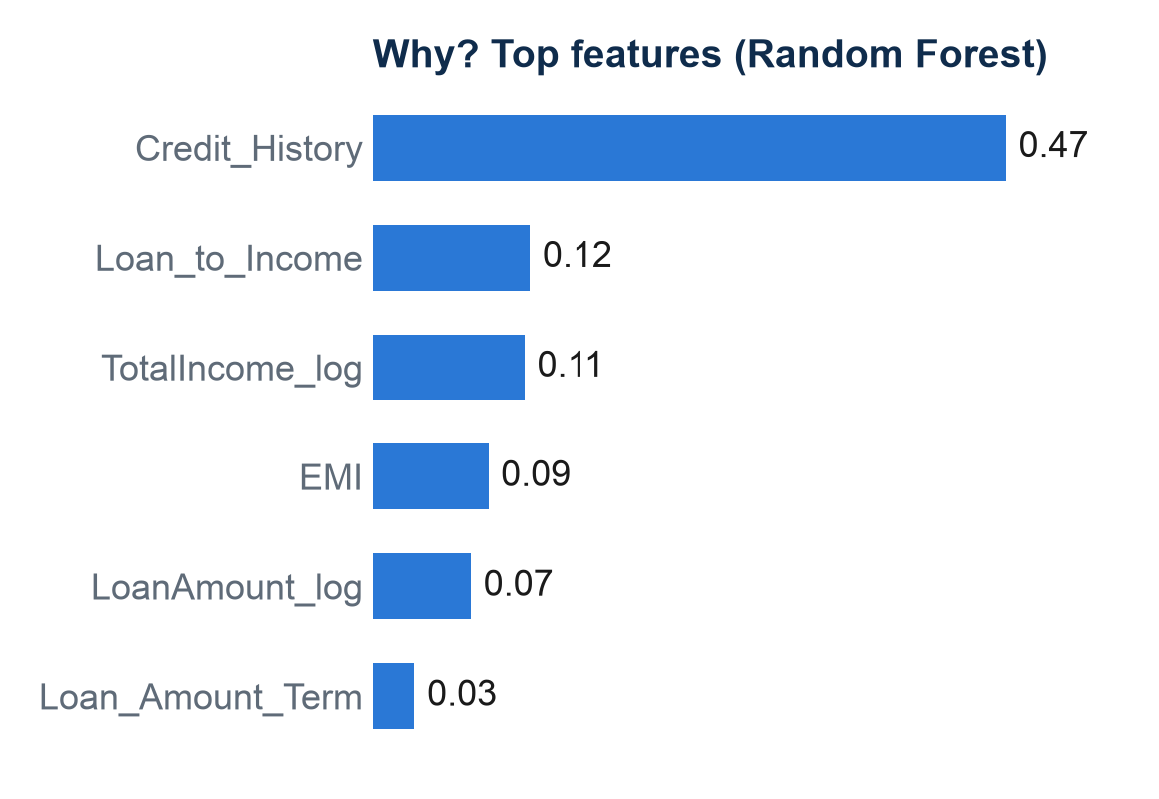
Step 9 — Interpretation, limitations & conclusion
Limitations → improvements
Small dataset (614 rows) → collect more data
Imbalanced target misses rejections → class weights / SMOTE
Over-reliance on credit history → unfair to first-time borrowers
No CIBIL score, existing debts or age → add these features
Conclusion
Random Forest predicts loan approval with 87% test accuracy (81% cross-validated), well above the 69% baseline. Credit history is the deciding factor, followed by loan size relative to income.
So what? Good credit history can be fast-tracked; others go to manual review. The model is a first-level screening tool for loan officers — not a replacement.
Notes:
What happened: Random Forest performed best. Why: credit history dominates (47% of importance), then loan-to-income and total income. So what: prediction → insight → decision; the bank can fast-track safe applicants. Mention limitations honestly. End with the conclusion and the GitHub link.

