Slide 1

Applications of data science (COMP 8240) Major project proposal
Group S:
Agam Kachhal (45762643)
Rohit Manral (45710864)
Shubham Rana (45812713)
Kripali Gandhi (45712158)

Slide 2
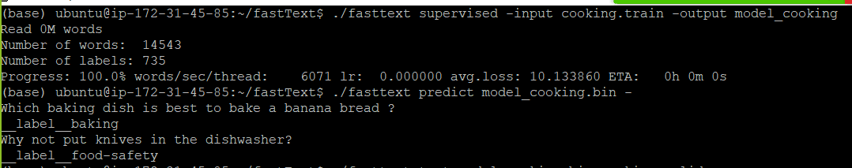
fastText
fastText is a library for efficient learning of word representations and sentence classification.
It is an open-source, lightweight, free library that allows users to learn text classifiers and text representations. It works on standard, generic hardware. Model size can later be reduced to fit on mobile devices.
Environment and Current Status of fastText
We are running fastText using a VM (ubuntu 18.04 LTS) with t2.micro instance along with a 30 Giga bytes of RAM.
We are able to train the tutorial dataset i.e., cooking dataset (cooking.stackexchange.txt) and classify labels as well. In this, we are exploring the Bigrams language model and would like to check if claims made by original data still holds for new datasets. (below screenshot is for the model training & classification).

Slide 3
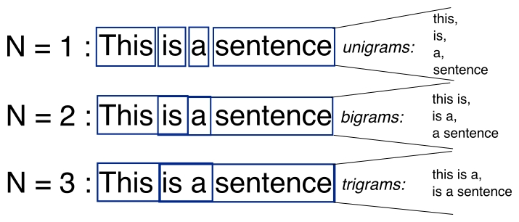
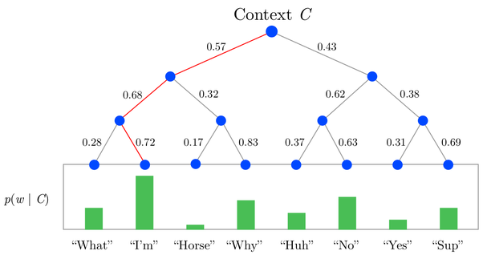
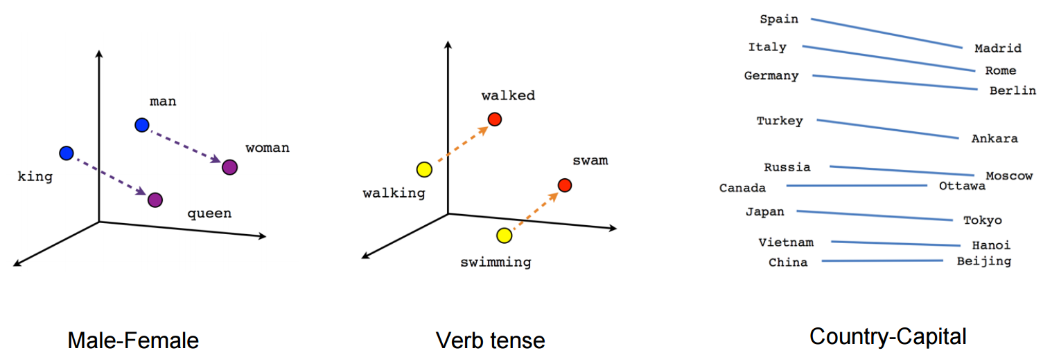
Types of Language Models used:
Bigrams : N-grams is the sequence of N words as explained in a diagram. The performance of the model improves when we increase the N. Bigrams are particularly interesting because you can reconstruct the order of the words just looking at a bag of n-grams. For instance: ‘This is a sentence’ >> ‘this is’, ‘is a’, ‘a sentence’.
Hierarchical Softmax : It is a loss function for much faster computation of a large datasets. H-Softmax essentially replaces the flat softmax layer with a hierarchical layer that has the words as binary tree format, as can be seen from the Figure . Here , we observe fastText has used Huffman tree.
Pretrained Word Embeddings: Pretrained word embeddings are the embeddings learned in one task that are used for solving another similar task. These embedding are trained on large datasets, saved and then used for solving other tasks. For instance: Word2Vec and fastText.
Bigram
Hierarchical Softmax
Pretrained Word Embeddings

Slide 4
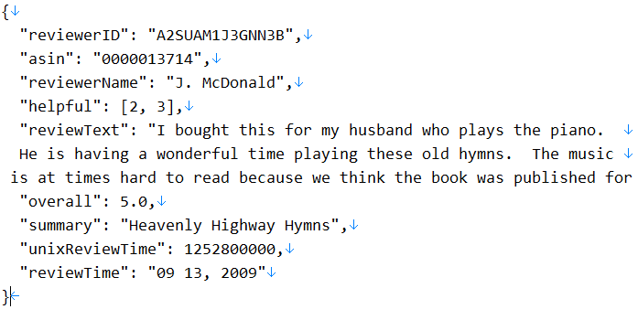
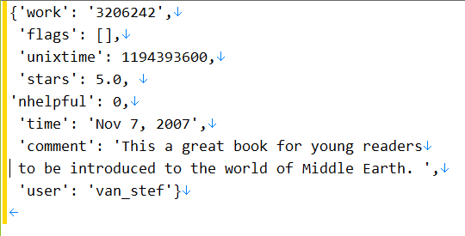
New Datasets
Glimpse of dataset
1) Amazon product data: We extracted amazon product data(i.e., health care, etc.) which contains 0.34 Million user reviews. This dataset includes reviews (ratings, text, helpfulness votes), product metadata (descriptions, category information, price, brand, and image features), and links (also viewed/also bought graphs) and presented in JSON format.
Source:
https://jmcauley.ucsd.edu/data/amazon/
2) Social recommendation data (LibraryThing reviews): This dataset includes ratings as well as social (or trust) relationships between users. Data are from LibraryThing (a book review website). Moreover, this is a multi label classification data and is currently been presented in JSON format with 1.7 Million reviews.
Source: https://cseweb.ucsd.edu/~jmcauley/datasets.html#google_local

Slide 5
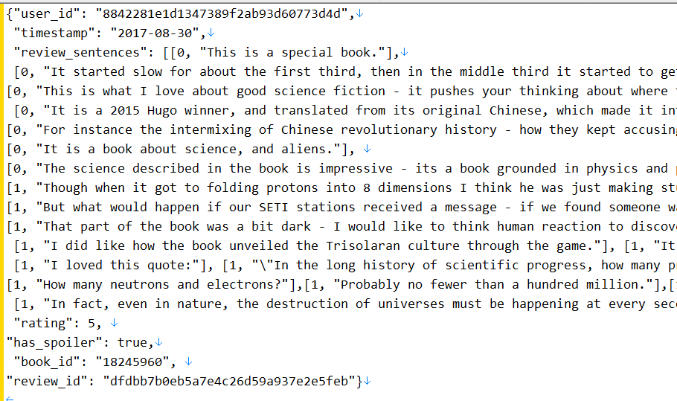
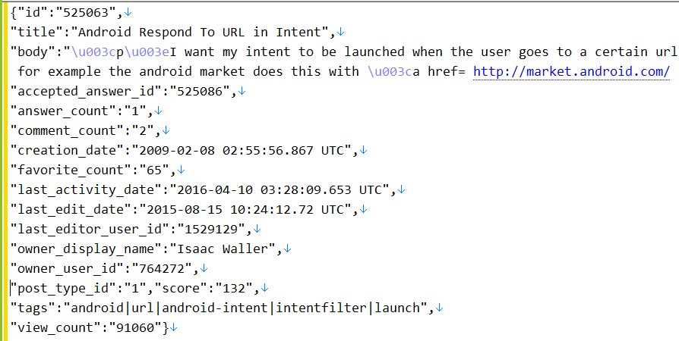
Cont.
Glimpse of dataset
3) Good Read Reviews Spoiler: We extracted this concentrated English review subset dataset for spoiler detection, where each book/user has at least one associated spoiler review. This dataset contains more than 1.3 Million book reviews presented in JSON format.
Source:
https://sites.google.com/eng.ucsd.edu/ucsdbookgraph/reviews
4) Stack Exchange posts : This is multi label dataset of the stack exchange posts, retrieved by querying the google cloud platform. It has 0.5 Million rows with text and tags, and it requires pre-processing as well because this is in semi-structured (JSON) format.
Source:
https://bigquery.cloud.google.com/dataset/bigquery-public-data:stackoverflow

Slide 6
Thank you!!

