Slide 1
Credit EDA Case Study
By Agam Kushwaha and Aditya Mangani

Slide 2
Univariate Analysis for Categorical Variables from application_data.csv

Slide 3
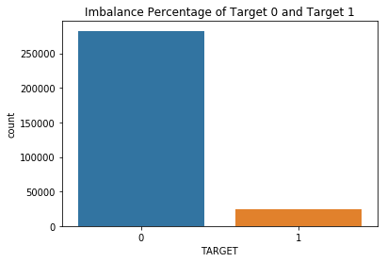
Data Imbalance Ratio between Target 0 and Target 1
Straight forward inference from the above plot is that most of the loan applicants (around 91.93%) are likely to pay their loan/EMI on time (Target 0) and only around 8.07% of the applicants are expected to default on their loans.
The imbalance ratio is hence: 91.93:8.07

Slide 4
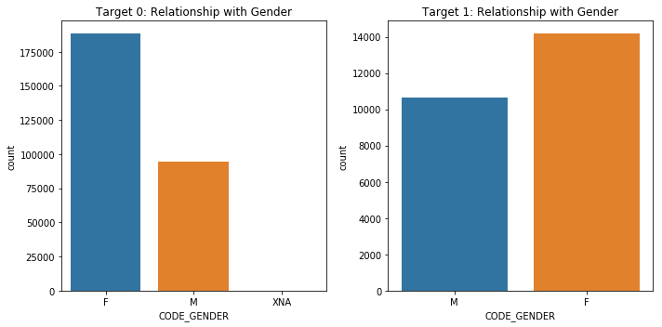
Target relationship with Applicant Gender
One of the five categorical variables chosen for univariate analysis, which is a fairly important factor, is gender of applicant.
The above plot clearly indicates that in either case (i.e. Target 0 and Target 1), the number of Female applicants is higher than males.

Slide 5
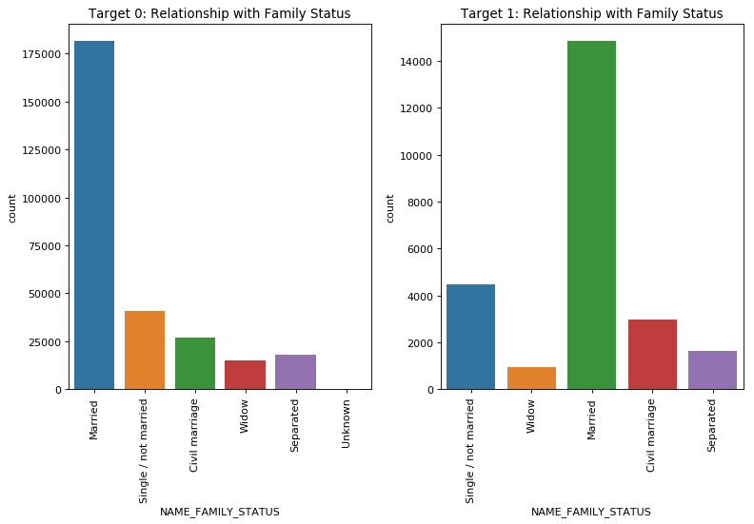
Target relationship with Family Status
Target 0/1 plot against Family status shows that married people make up the highest number of applicants. This makes sense as married people have a lot of financial responsibilities and hence need monetary help.

Slide 6
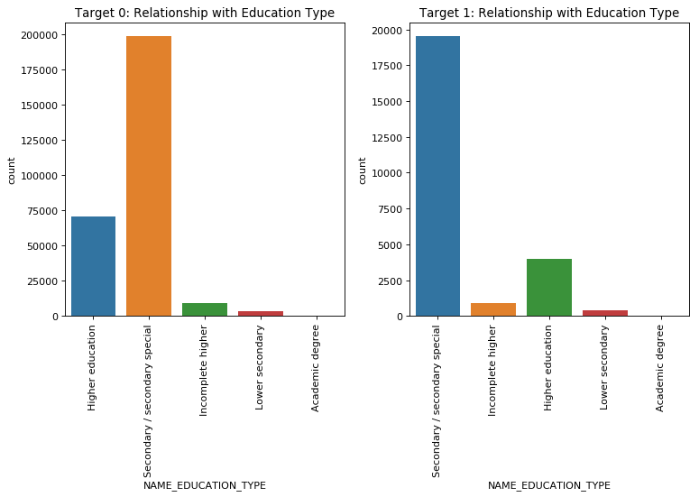
Target relationship with Education Type
The above plot clearly shows that clients with Secondary/Secondary special education submit the most loan applications.

Slide 7
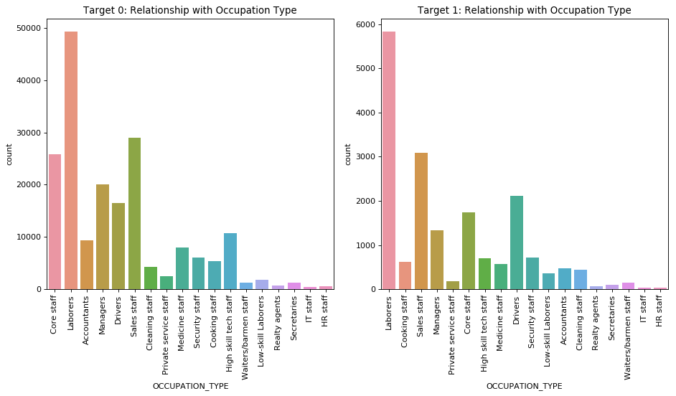
Target relationship with Occupation Type
Among all applicant occupation types, most of the applications are received from the laborer class; Laborers do tend to need financial assistance to set themselves up, make their ends meet and, to look after their families and also be able to send some money back home.

Slide 8
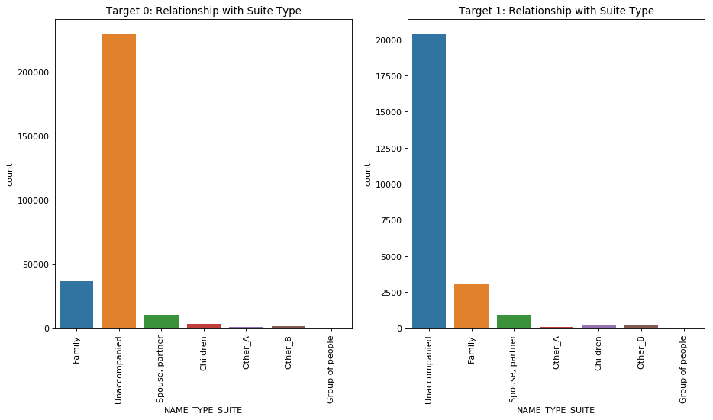
Target relationship with Suite Type
Suite type column indicates who accompanied the applicant when they approached the bank for loan. What the graph shows is exactly what happens; most people go on their own to apply/submit for loan.

Slide 9
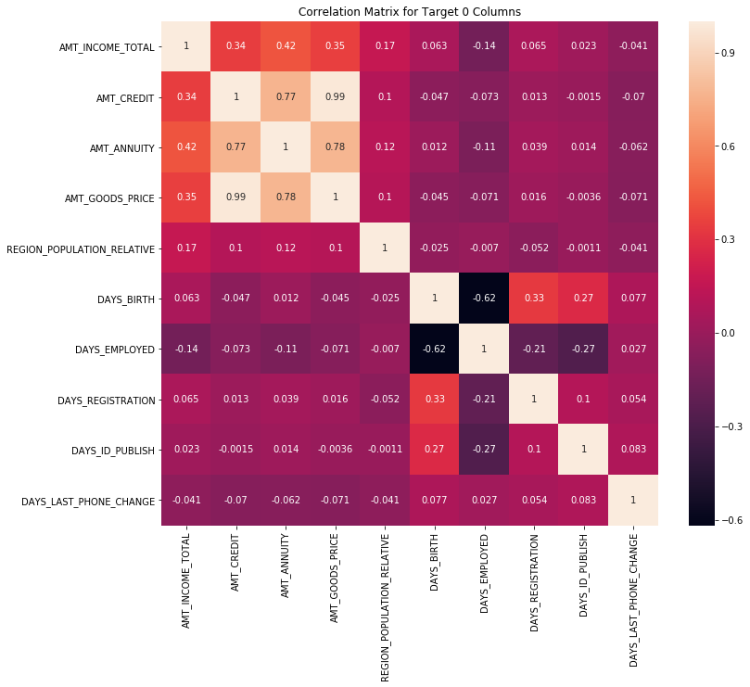
Correlation Matrix Plot for Target 0

Slide 10
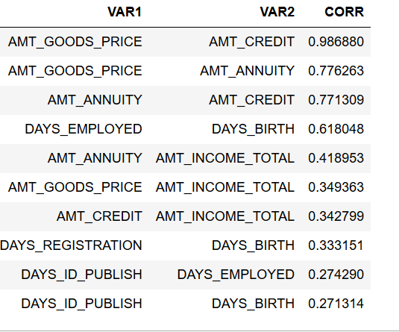
Table above shows top 10 correlation for Target 0 (i.e. applicants who are likely to pay on time)

Slide 11
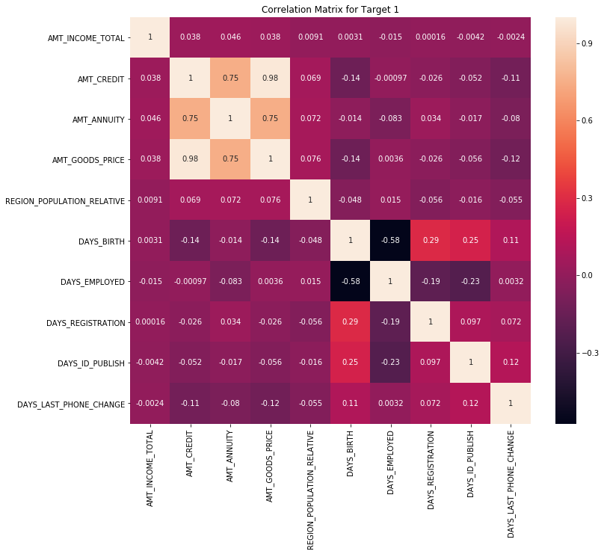
Correlation Matrix Plot for Target 1

Slide 12
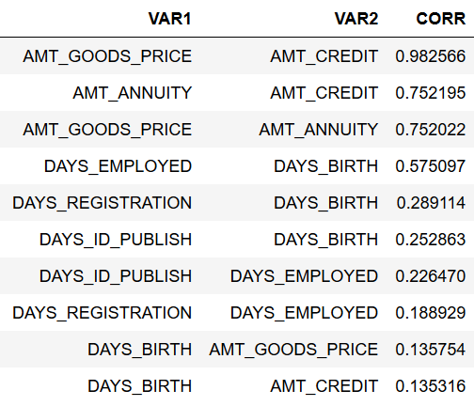
Table above shows top 10 correlation for Target 1 (i.e. applicants who are likely to default)

Slide 13
Univariate Analysis for Numerical Variables from application_data.csv

Slide 14
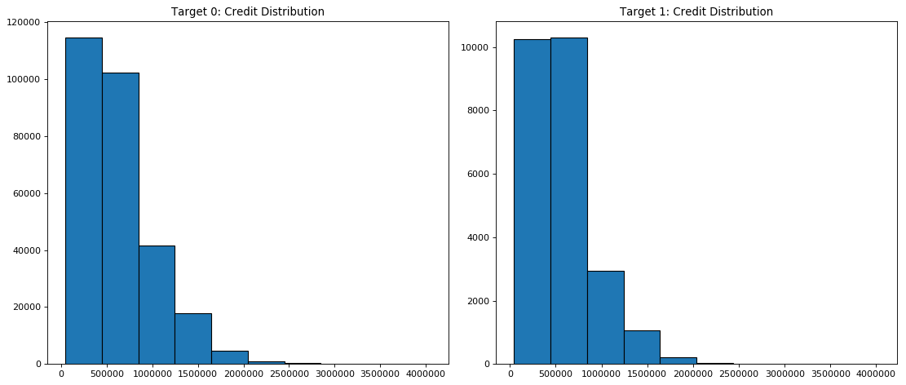
Target relationship with Credit Amount
Above histogram plot shows credit amount distribution; i.e. the amount of the loan credited is more in range 0-1000000

Slide 15
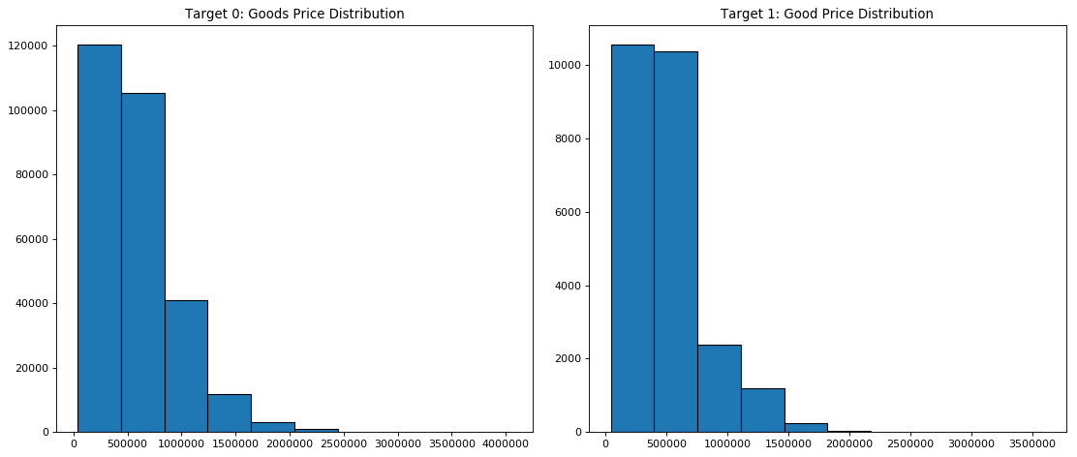
Target relationship with Goods Price Amount
Plot of Target with Goods Price shows that the number of loan application received is highest for Goods Price in the range 0-750000

Slide 16
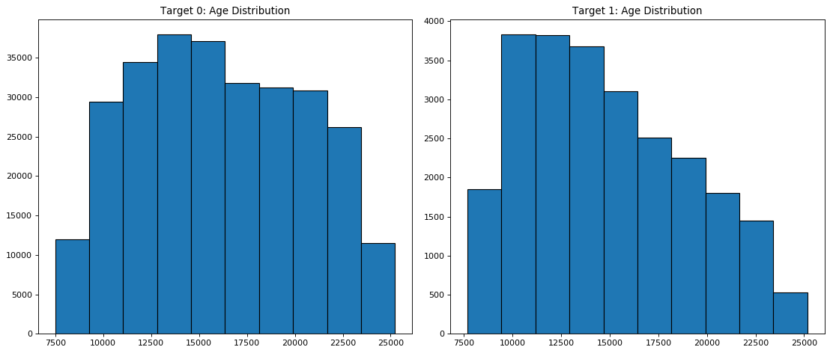
Target relationship with Age (i.e. days of birth)
The plot of age very clearly shows that the highest number of loan applications are received from people between age group 27 – 35 (i.e. 10000 to 12500 days)

Slide 17
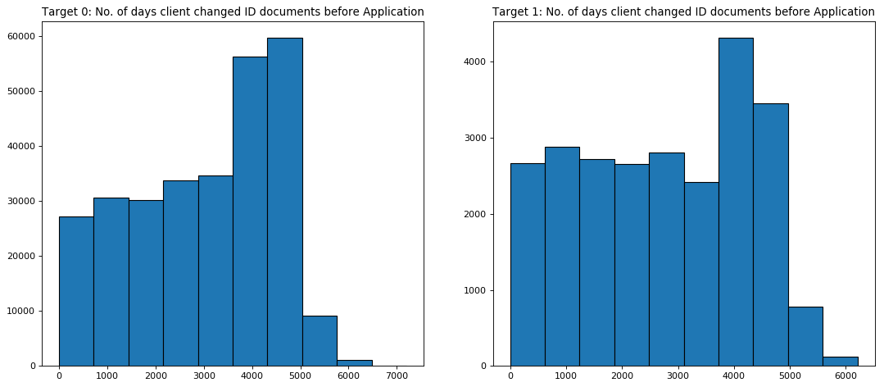
Target relationship with DAYS_ID_PUBLISH
Plot shows number of days before which client changed the submitted ID document. Data shows highest change between (approximately) 11 years to 14 years

Slide 18
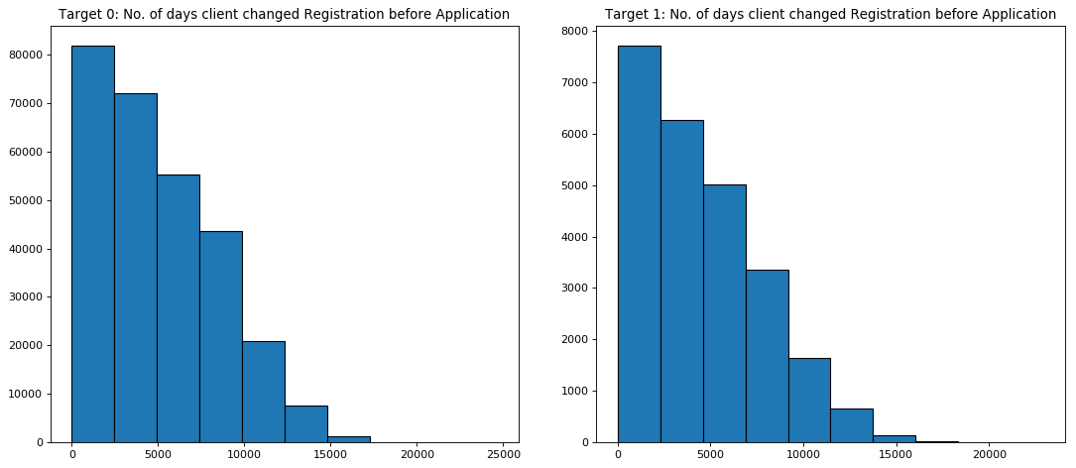
Target relationship with DAYS_REGISTRATION
Plot shows most clients changed their registration 2500 days (approx. 7 years) back

Slide 19
Bivariate Analysis for Numerical Variable

Slide 20
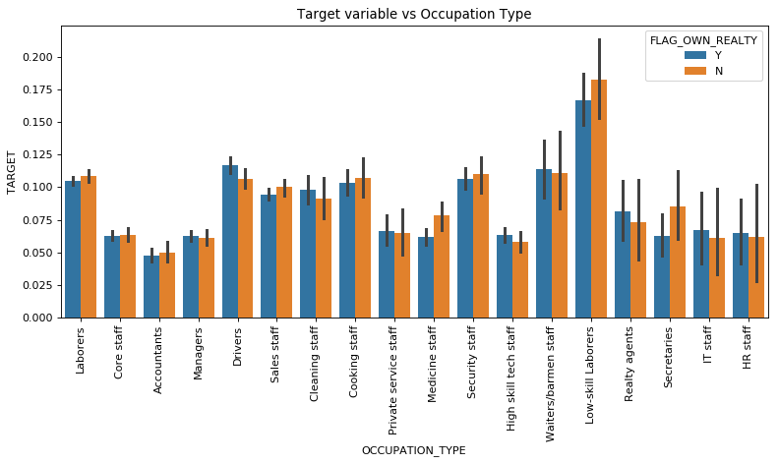
Target versus Occupation Type w.r.t. Own Property
Bivariate plot of target against type of client occupation tells us that Low-skilled labourers who do not have own property tend to skip paying their loan on time

Slide 21
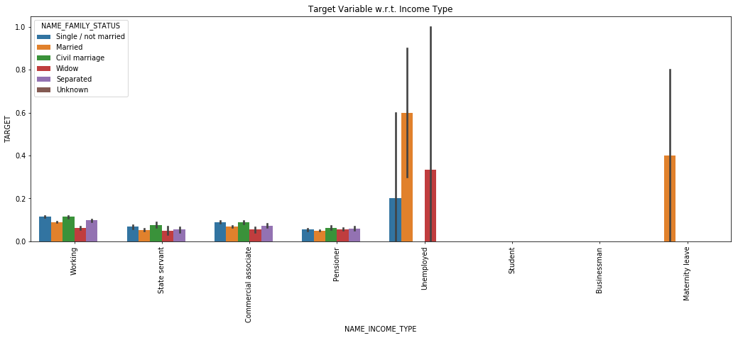
Target versus Income Type w.r.t. Family Status
Above plot shows that Unemployed Married clients show the most tendency to default

Slide 22
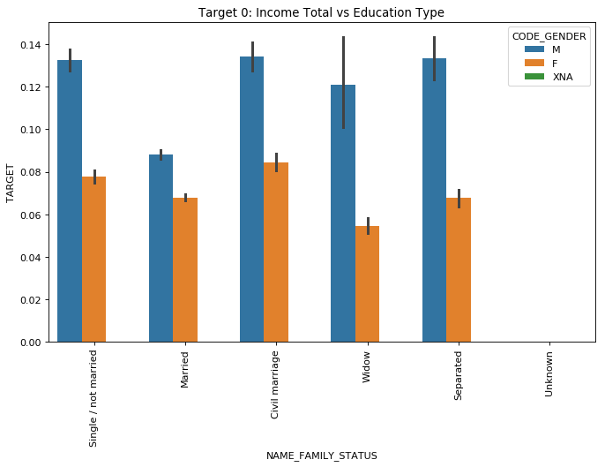
Target versus Family Status w.r.t. Gender
Civil Married males are more likely to not pay their loans on time

Slide 23
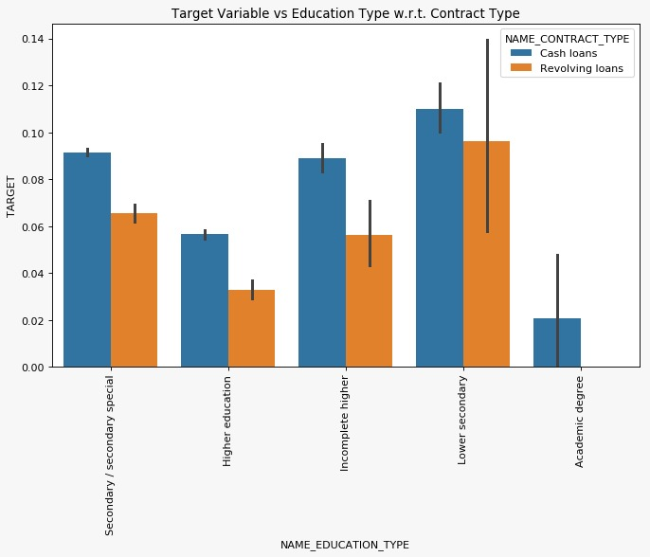
Target versus Education Type w.r.t. Contract Type
Clients with lower secondary Education taking cash loans are more likely to not pay on time

Slide 24
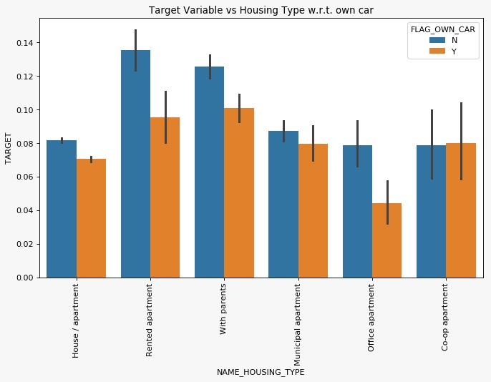
Target versus Housing Type w.r.t. car owned
Those stating in rented apartments and not owning a car are more likely not to pay their loans

Slide 25
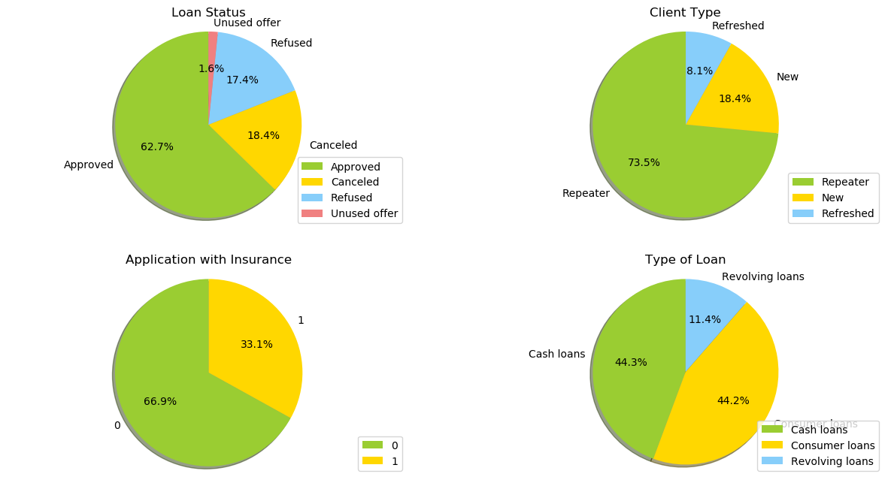
Analysis of data from previous application records

Slide 26
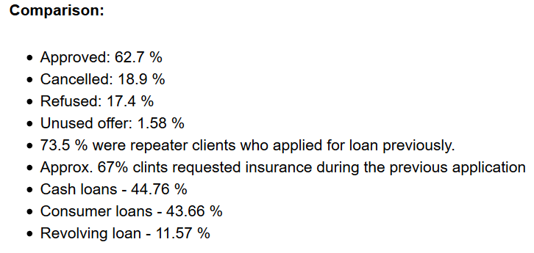
Below are the Statistics and analyses of records from previous applications

Slide 27
Bivariate Analysis on merged data set (application data and previous data)

Slide 28
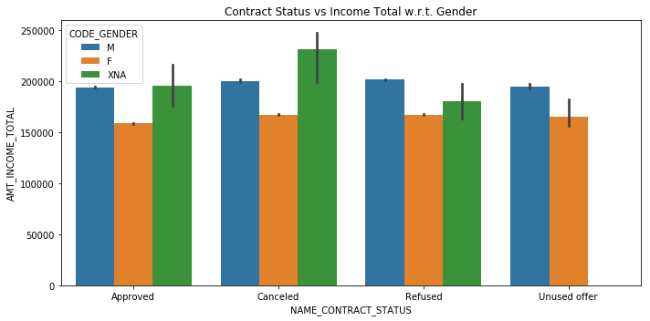
Contract Status versus Income Total w.r.t. Gender
Visualization shows that all four contract statuses for male applicants tend to round off at the 200000 income mark

Slide 29
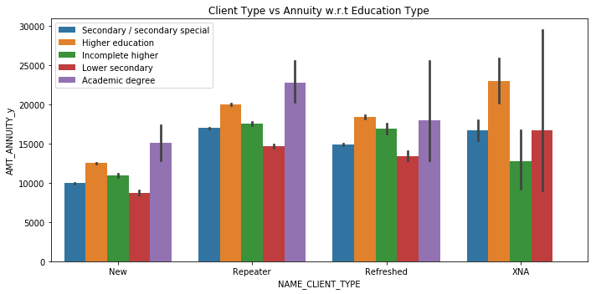
Client Type versus Annuity w.r.t. Education Type
Loan repeaters with an Academic Degree are more likely to pay the highest Annuity amount

Slide 30
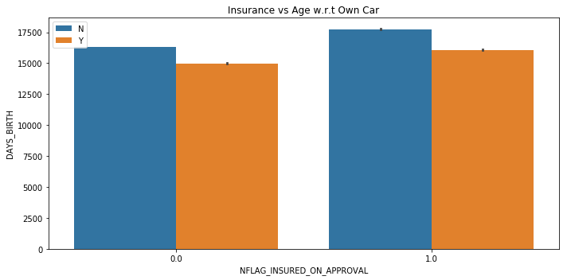
Client Type versus Annuity w.r.t. Education Type
Older applicants not owning a car tend to opt for insurance during the application/approval process

Slide 31
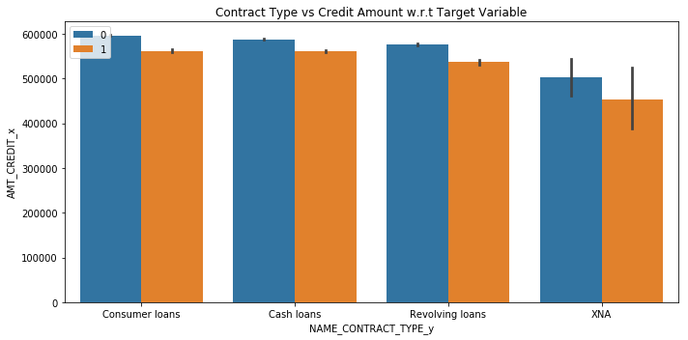
Contract Type versus credit amount w.r.t. Target Variable
People taking consumer loans of close to 600000 are likely to both pay on time and default compared to other types

Slide 32
Conclusion
From all our analyses and visualizations so far, the following have emerged as variables that contribute most towards a borrower defaulting:
Occupation Type
Education Type
Income Type
Age
Family Status
Days employed
Own Realty
Count of children

