Slide 1
POTATO DISEASE DATASET

Slide 2
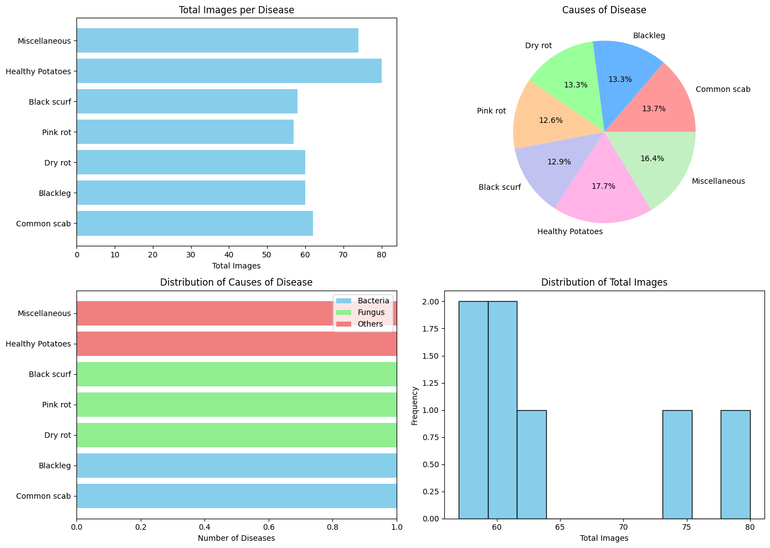
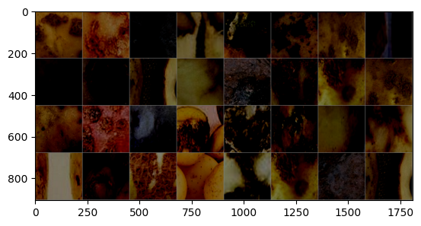
Phase 1:
In Phase 1 of our project we have performed pre-processing methods to our dataset. Which involved
Data cleaning
Normalization
Data augmentation
Data splitting
Image resizing and resampling
Visualization
Dataloading

Slide 3
Phase 2:
We have performed different modeling methods to out processed data, they are:
Convolutional Neural Network (CNN)
Efficient Net
Resnet50

Slide 4
Phase 3:
We have added additional layers and methods to our processed data and models for:
Convolutional Neural Network (CNN)
Efficient Net
Resnet50

Slide 5
CONVOLUTION NEURAL NETWORK
For this notebook we tried using different base_models such as: MobileNet, ResNet50 and InceptionV3 but all seemed to overfit on the training data and never performed about 55% on the validation data. Using VGG16 with 100 epochs and the Adam optimizer's learning_rate at 0.0001 seems to give me the best results of between 55% - 65%.

Slide 6
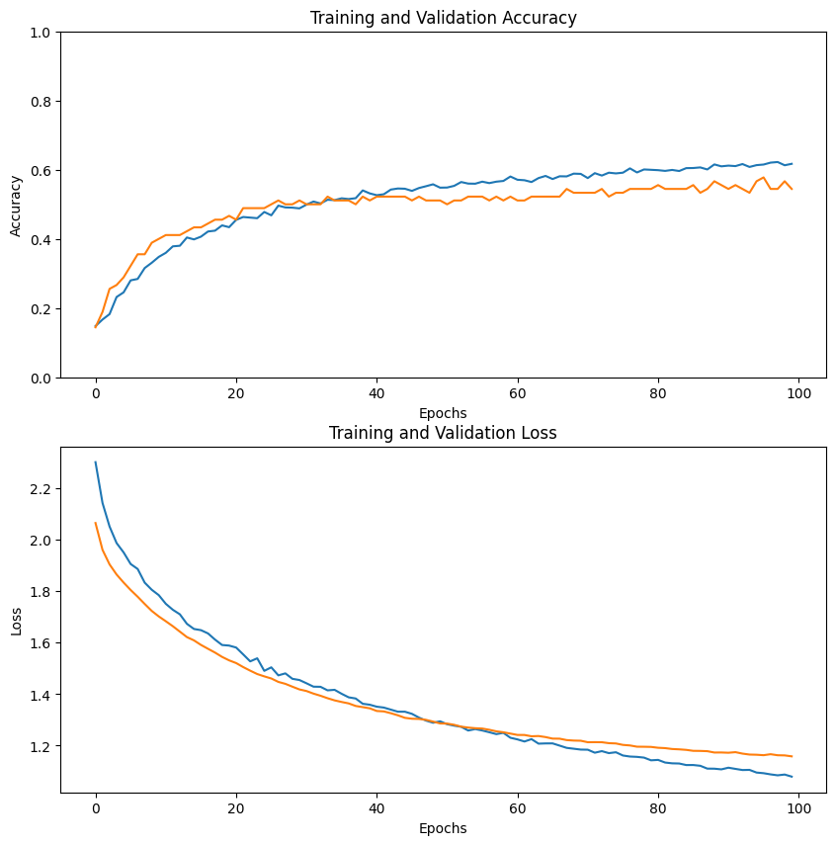
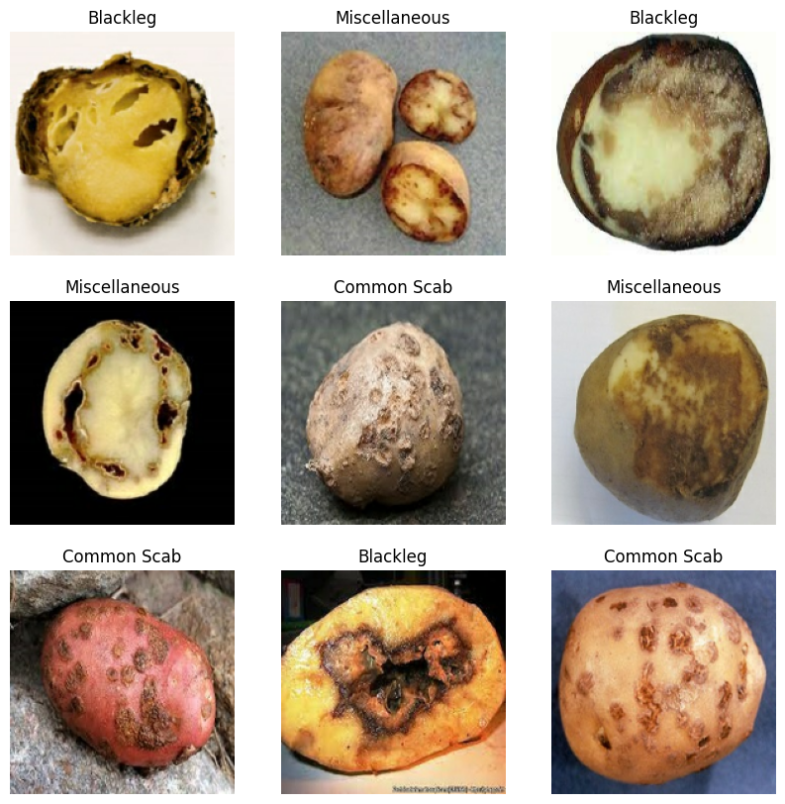
CNN MODEL OF PHASE 2:

Slide 7
EfficientNet:
A EfficientNet-v2 image classification model. Trained on ImageNet-21k and fine-tuned on ImageNet-1k in Tensorflow by paper authors, ported to PyTorch by Ross Wightman.
EfficientNet is an image classification model family. It was first described in EfficientNet: Rethinking Model Scaling for Convolutional Neural Networks.

Slide 8
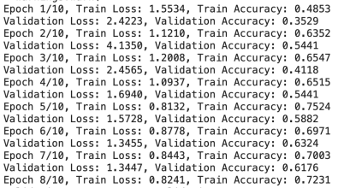
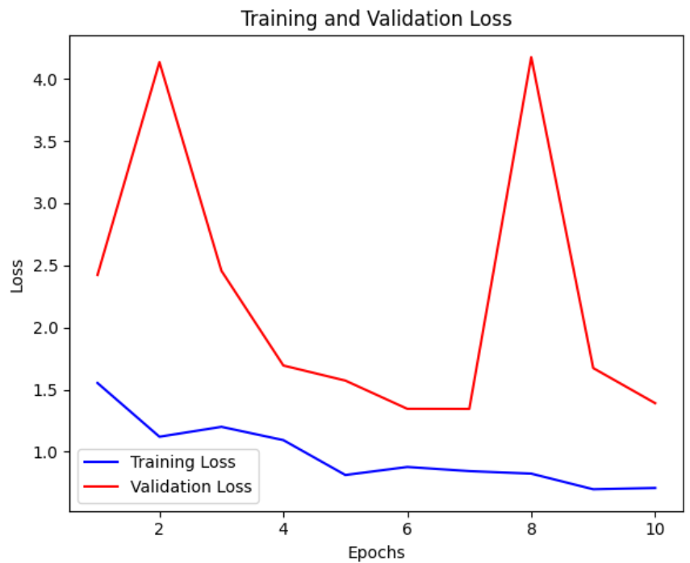
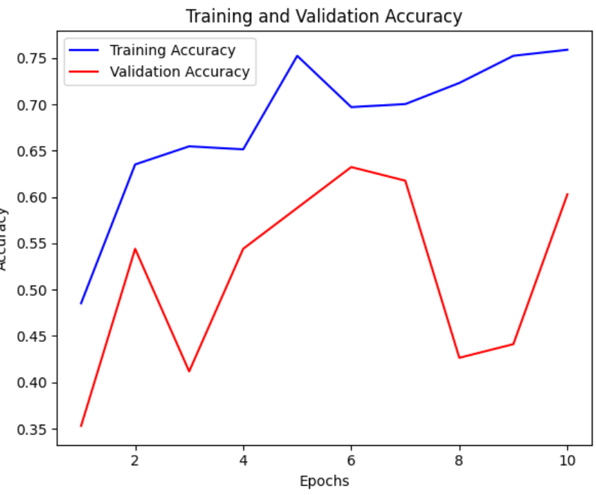
EfficientNet Model Phase2:

Slide 9

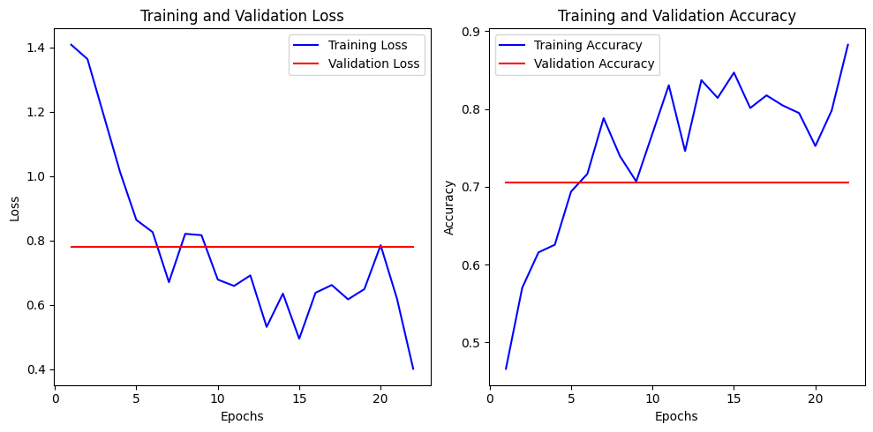
EfficientNet Phase3:

Slide 10
RESNET50
ResNet (Residual Network) is a convolutional neural network that democratized the concepts of residual learning and skip connections. This enables to train much deeper models.
This is ResNet v1.5, which differs from the original model: in the bottleneck blocks which require downsampling, v1 has stride = 2 in the first 1x1 convolution, whereas v1.5 has stride = 2 in the 3x3 convolution. This difference makes ResNet50 v1.5 slightly more accurate (~0.5% top1) than v1, but comes with a small performance drawback (~5% imgs/sec) according to Nvidia.

Slide 11
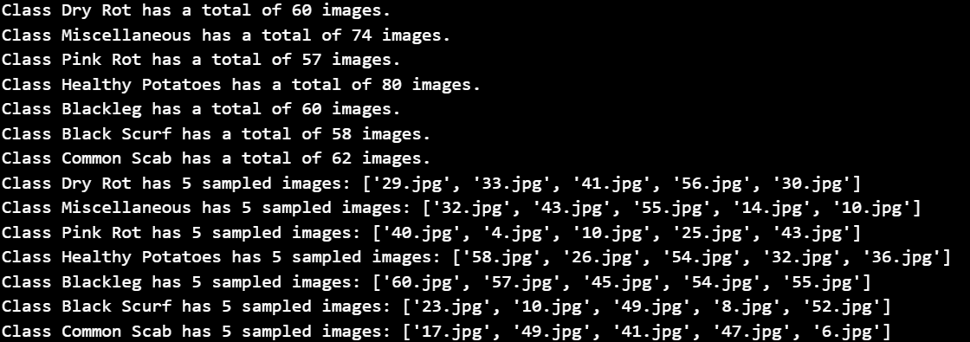
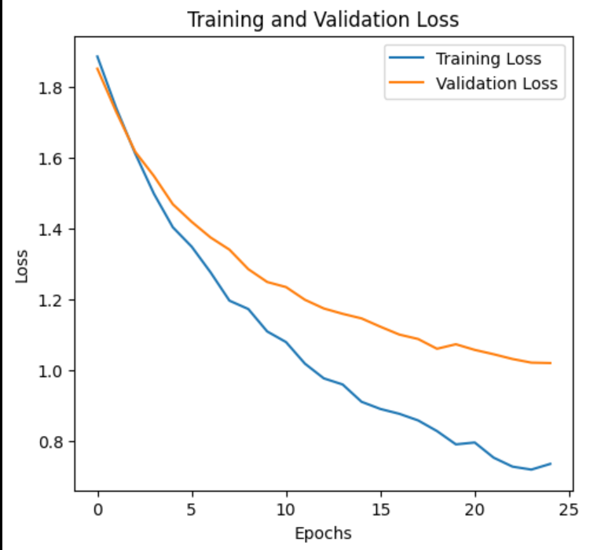
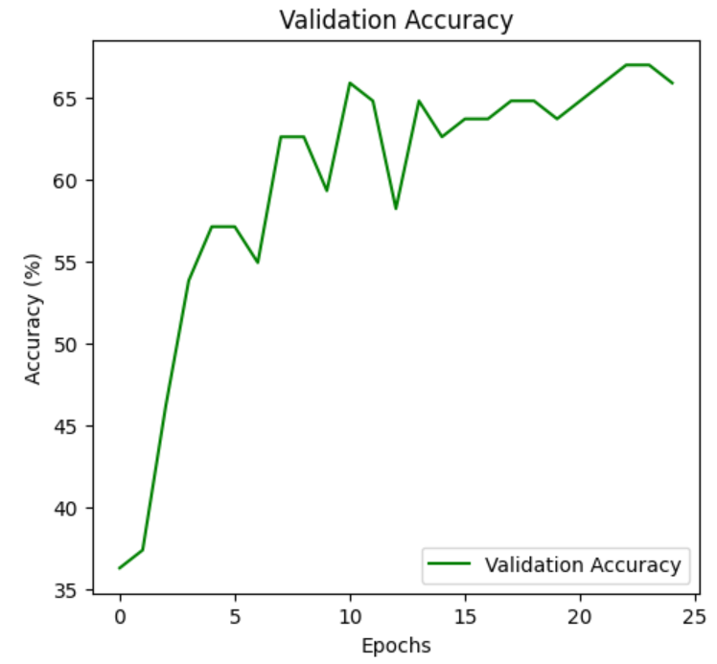
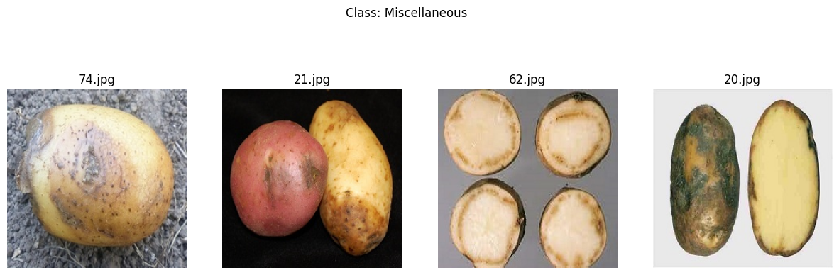
Resnet50

Slide 12
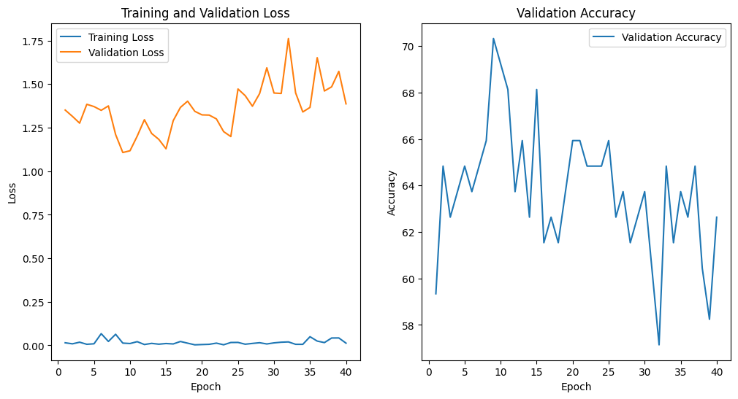
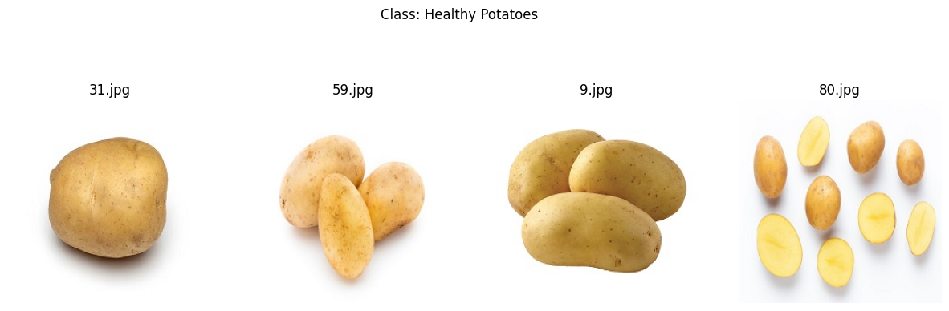

Resnet50 Phase3:

Slide 13
QUESTIONS?

