Slide 1
Hydroponic System

Slide 2
8 billion. To feed 8 billion people we used
In the year 2022 earth’s population reached
almost 2,571.22 million metric ton food.
By the next 2 decades earth’s population
will reach 9 billion and to feed 9 billion
Crisis in
India
people we need to produce 55% more food
than we do right now.
Conventional farming is not a right way is to
do it sustainably by accounting all
environmental and economical factors.The
best way to farm is to switch to hydroponic farming systems which are quite more efficient and economical than conventional farming .

Slide 3
Hydroponic System
Plants today produce roughly what they produced 10-20 years ago; we have just managed to pack more of them onto a field and there is a limit to that type of yield gain.
Our job is to build a low cost smart hydroponic setup that unlocks
nutrition for everyone on a scale that no one has ever seen.
Conventional farming is not a right way is to do it sustainably by accounting all environmental and economical factors.The best way to farm is to switch to hydroponic farming systems which are quite more efficient and economical than conventional farming .

Slide 4
Our system is airmed on High productivity low-cost consumer-based farming system. In this unique method of vertical farming
Methodology includes
I) first we mix water with the liquid
concentrate according to need
II) required amount of nutrients are mixed
into irrigation tank
III) water is pumped from irrigation tank to water supply network which goes to each vertical tower which consists of 2-3 pots.
Our Way of Hydroponic System

Slide 5
Specified sensors to get readings for our software.
Soil moisture monitoring, NPK for nitrogen, potassium and phosphorus.
Temperature and weather-related sensors
Tech Stack
Vertical rigid beams and specially designed
pots for vertical alignment
Pots corners are curved and made with high-strength plastic material to sustain all the load.

Slide 6
Control System
We are using API called Mycodo in Pi OS which enables to control and monitor our hydroponic setup first we set all input sensors we are using and outputs with respect input now you have to control over everything like irrigation, nutrient supply, harvesting cycle etc, so you can set these parameters and you can go straight weeks without looking at your farm. Our setup also takes photos of plants every two hours and by that data plants health graph is formed and if there is any problem with plant growth it will also notify you through mail about irrigation timings, nutrient supply timing. so our software integrated with our hardware system provides full control over your farm and full control to automate it.

Slide 7
We are using three tanks one is underground tank which is collecting used water
one is main irrigation tank and
another one is nutrients supply
Structure of Our Hydroponic System
tank
we also use chemicalizer for
mixing liquid concentrate.
We will be using IOT based self
developed software which will monitor and control the whole system according to required needs

Slide 8
Decreasing Greenhouse Gases
Carbon Footprints
Volatile food prices
Less waste and Effective waste management
Software Based 24/7 Monitoring (Pest
detection, fertilization requirement, irrigation requirements based on data collected from our sensors)
Low Cost Setup
Low maintenance and low time consuming process
Small set up space (300 acres>7000 acres 23 times less than the area of conventional farming hydrop)
Rapid Growth speed and Increased
production
Key Features of Our System

Slide 9
Any individual can take this up
easily
Much higher crop yield
The farmer is free from poor soil constraints
A lump some amount of money is
saved
The saving are further relinquished
Plants grow faster which can greatly minimize their harvesting cycle
Soil-borne pests and weeds are no
longer a problem
Our Solution is providing solution to the following problems

Slide 10
Our Solution is providing solution to
the following problems
The saving can then be utilized in expanding the system or in increasing the profit margins
Crops or cultivars are way easier to
change if the market demand fluctuates for certain crops
Better waste Management
Less word = Greater Output
Easy to use for all
Easy to use software interface
Fully automated

Slide 11
Control System for
INPUT SYSTEM
our Hydroponic
System
OUTPUT SYSTEM

Slide 12
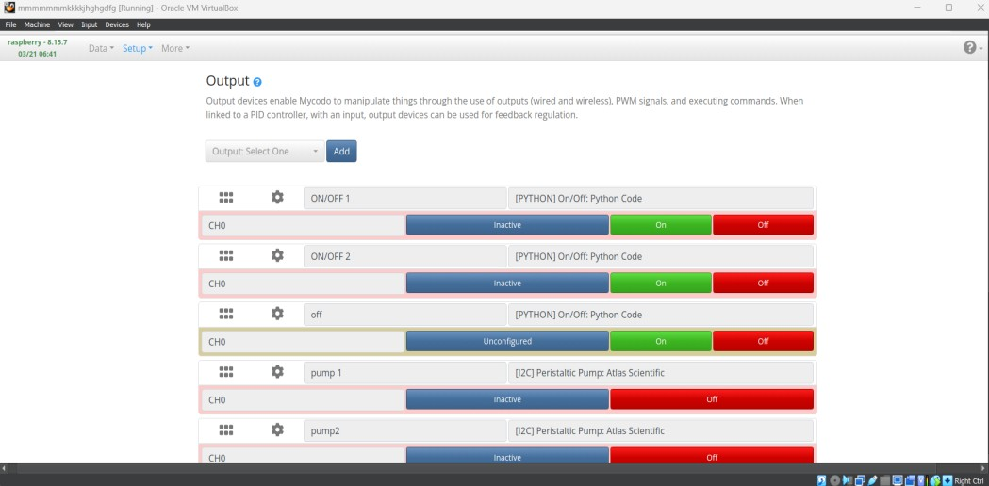
Input System

Slide 13
Output System these are some
outputs which we are
getting and some actions which will be performed accordingly

Slide 14
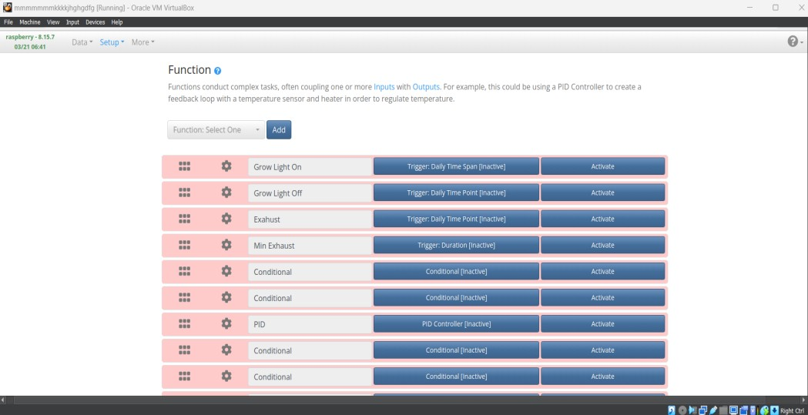
Function
these are some functions which will be performed according to input and also some functions which will activate with time and we wrote conditional statements for every required action and for automation also

Slide 15
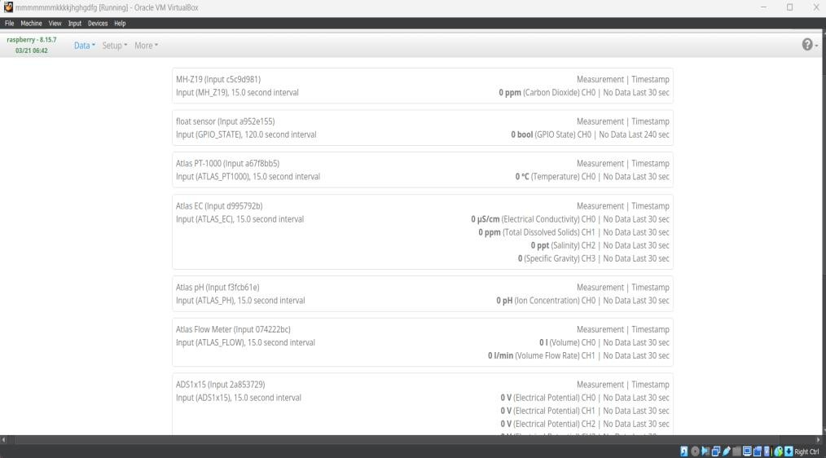
live measurements :-
this tab shows you all live measuring data of sensors

Slide 16
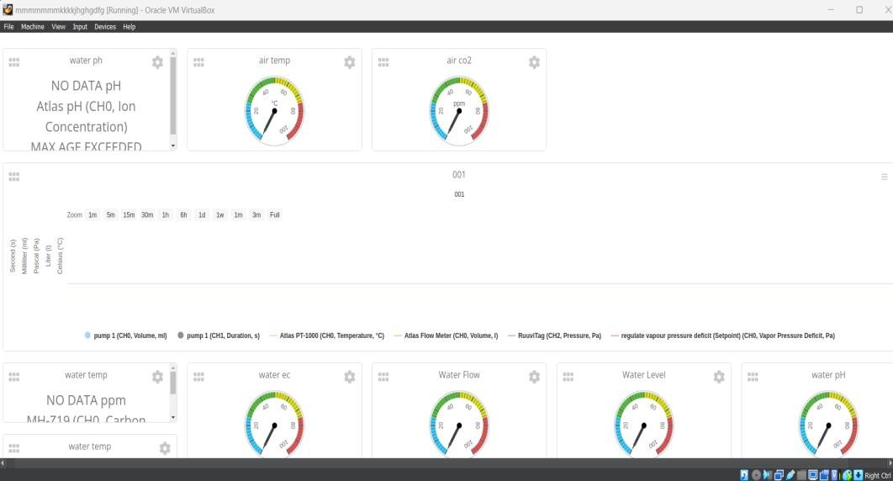
Dashboard
it only shows required or important data, graphs, live measurements in interactive way

