Slide 1
Parallel Computing Toolbox - Matlab
Shelley Knuth
shelley.knuth@colorado.edu
www.rc.colorado.edu
Slides: https://github.com/ResearchComputing/Parallelization_Workshop

Slide 2
Outline
Profiling
Vectorization
Multi-threading
Parallel Matlab
Parallel Computing Toolbox
Prepping your GUI
Submitting jobs
Parfor
Spmd

Slide 3
My code is sloooowwww
What is the problem I have with my serial code?
Is it too slow? Where is it too slow?
Can I vectorize my code to improve speedup?
Can I use a function that implicitly uses parallelism?
Can I use multi-threading?
Do I have a for loop I am trying to speed up?

Slide 4
Step One…
Where is my code slowing down?
Tic and Toc
Can’t tell you exactly what within that code is slowest
Let’s use the profiler
Simple_loop.m
Code analyzer is another good tool to use
Take five minutes and use the profiler on some code you have
Does it make sense to reduce any loop iterations?

Slide 5
Step Two…
Are there any places where my code could benefit from vectorization? Pre-allocation?
Pre-allocation: initialize arrays ahead of time to avoid dynamic resizing
And if not, can I implement some type of parallelization?
Making use of existing functions
Multi-threading
The Parallel Computing Toolbox

Slide 6
Vectorization
Process of revising loop-based, scalar-oriented code to use MATLAB matrix and vector operations
Do this because:
Appearance: looks like textbook math, so easier to understand
Less opportunity for error
Usually runs much faster than code that contains loops
Great option in Matlab because its optimized for operations involving matrices and vectors
https://www.mathworks.com/help/matlab/matlab_prog/vectorization.html

Slide 7
Example of Vectorization
The code below demonstrates how a loop could be vectorized in Matlab
% Non-vectorized
a= rand(1,4);
b= rand(1,4);
for k= 1:length(a)
c(k)= a(k) + b(k);
end
% Vectorized
a= rand(1,4);
b= rand(1,4);
c= a + b;
Notes:
Two sets of code give the same result, but the code is behaving differently to get that same answer. The vectorized optimized functions under the hood
Data parallelization – working on multiple data at the same time

Slide 8
Existing Functions
Certain functions in Matlab utilize the programming constructs of parallel computing implicitly to run the functions in parallel on a multi-core system
These functions are automatically multi-threaded
Little work, but potentially lots of gain
No control over the processing
Examples:
Fft, fmincon, ode, and many others

Slide 9
Before we go further…
Let’s look at running Matlab on the supercomputer
The best way to do this is to call the Matlab program from a bash script
Within the bash script should be several

Slide 10
Notes on Running Matlab on a Cluster
The number of workers you get is defaulted to either the total number of cores available if less than 12 or 12
You can ask for more cores/workers (if available)
Use the Matlab “parpool” command

Slide 11
Matlab vs Slurm – who wins?
You can open a parallel pool of workers in Matlab
You also request a specific number of cores
If the two are the same then no issue
What if you ask for more cores than workers?
The number of workers asked for in Matlab will over-ride
What if you ask for less cores than workers?
The code will fail
Notes:
Can’t oversubscribe in Matlab

Slide 12
Threads
A thread is a sequence of instructions within a program that can be executed independently of other code
It is a component of a process
Every line in a program is a thread
This is called your main thread, or your serial thread

Slide 13
Multi-threading
Multi-threading occurs when you reach a point in your program where these instructions can be executed not only independently but also simultaneously
On multiple cores
Multi-threading is a form of parallelism, but lighter than distributed computing
Programming constructs such as OpenMP use multi-threading as their basis
One of the biggest differences between multi-threading and distributed computing or larger-scale parallelism is that multi-threading uses shared, rather than distributed, memory

Slide 14
Multi-threading Real World Example
Say you have a project: building a subdivision
There are ten houses that will be built in this subdivision
There are several components of the project that need to be completed on each of the houses
Pouring the foundation
Framing the house
Putting in the kitchen
Laying the carpeting
Landscaping
Etc, etc

Slide 15
Multi-threading Real World Example – Cont.
Each component requires individual tasks to complete it
For example, when landscaping one must pour the driveway, lay the grass, select shrubs, etc to plant, put in lighting, etc.
There is a general contractor in charge of the entire project
The general contractor has ten workers

Slide 16
Multi-threading Real World Example - Continued
The general contractor divides up the tasks in the subdivision based on skill set or time
The five workers work on each of the tasks
The general contractor is the client
The workers are the cores
The tasks for each individual project are the threads
When the tasks are worked on at the same time by the crew members it is multi-threading

Slide 17
Multi-threading Programming Example
Say you have a program that does a matrix multiplication of two 2x2 square matrices
Each part of the calculation, where a row element is multiplied by a column element, can be thought of as a thread
You can implement multi-threading implicitly or explicitly
In Matlab, implicit occurs by using certain functions
Explicitly might mean implementing multi-threaded flags in slurm

Slide 18
Built-in Multi-threading functions
In Matlab, there are several built-in functions that are multi-threaded
You can use more cores in multi-threading by asking for more ntasks in Slurm
fft
sort
eig
svd
These functions automatically execute on multiple computational threads in a single Matlab session
Implicit parallelism

Slide 19
Multi-threading example
multi_threading.sh
multi_threading.m

Slide 20
Explicit parallelism
Several instances of Matlab run on several cores or computers
May have shared or distributed memory
Simultaneously execute a single Matlab command or function
In explicit parallelism, programmers can create and manage their parallelism to suit their needs
Can choose the processors to run on

Slide 21
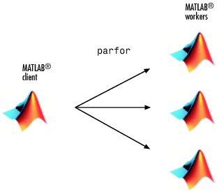
Parallel Matlab
When you start up a Matlab session by opening Matlab, you are starting a client session
Creates workers, receives results, distributes work
Move to a parallel session requires the client to pass some of its computational work along to Matlab workers
https://www.mathworks.com/help/distcomp/how-parallel-computing-products-run-a-job.html

Slide 22
Parallel Matlab
A Matlab worker is an individual Matlab session
Usually have one worker per core on your system
Same as client without front end – just computation
Workers can communicate with each other and to the client
Workers complete tasks to help speed up job completion
Must run independently
https://www.mathworks.com/help/distcomp/how-parallel-computing-products-run-a-job.html

Slide 23
Parallel Computing Toolbox (PCT)
Matlab offers explicit parallelism within the Parallel Computing Toolbox
Perform parallel computations on multicore computers, GPUs, and computer clusters
Mimics OpenMP in many ways
Many Matlab functions work in concert with the PCT
Simple to utilize with just the use of certain commands

Slide 24
Requirements to Run PCT
Access to Matlab
The PCT add-on
Prohibitively expensive for individuals
Likely accessing through institution
At CU you have access to a Matlab site license
Where can I run PCT?
On cluster (Summit)
On your laptop
On your desktop/workstation

Slide 25
Parallel and the GUI
You can set parallel constructs either in your script or in the Matlab Desktop
In order to utilize the PCT, you must open up a pool of parallel workers
You can do this explicitly by running the command parpool
You can also set this explicitly in the GUI

Slide 26
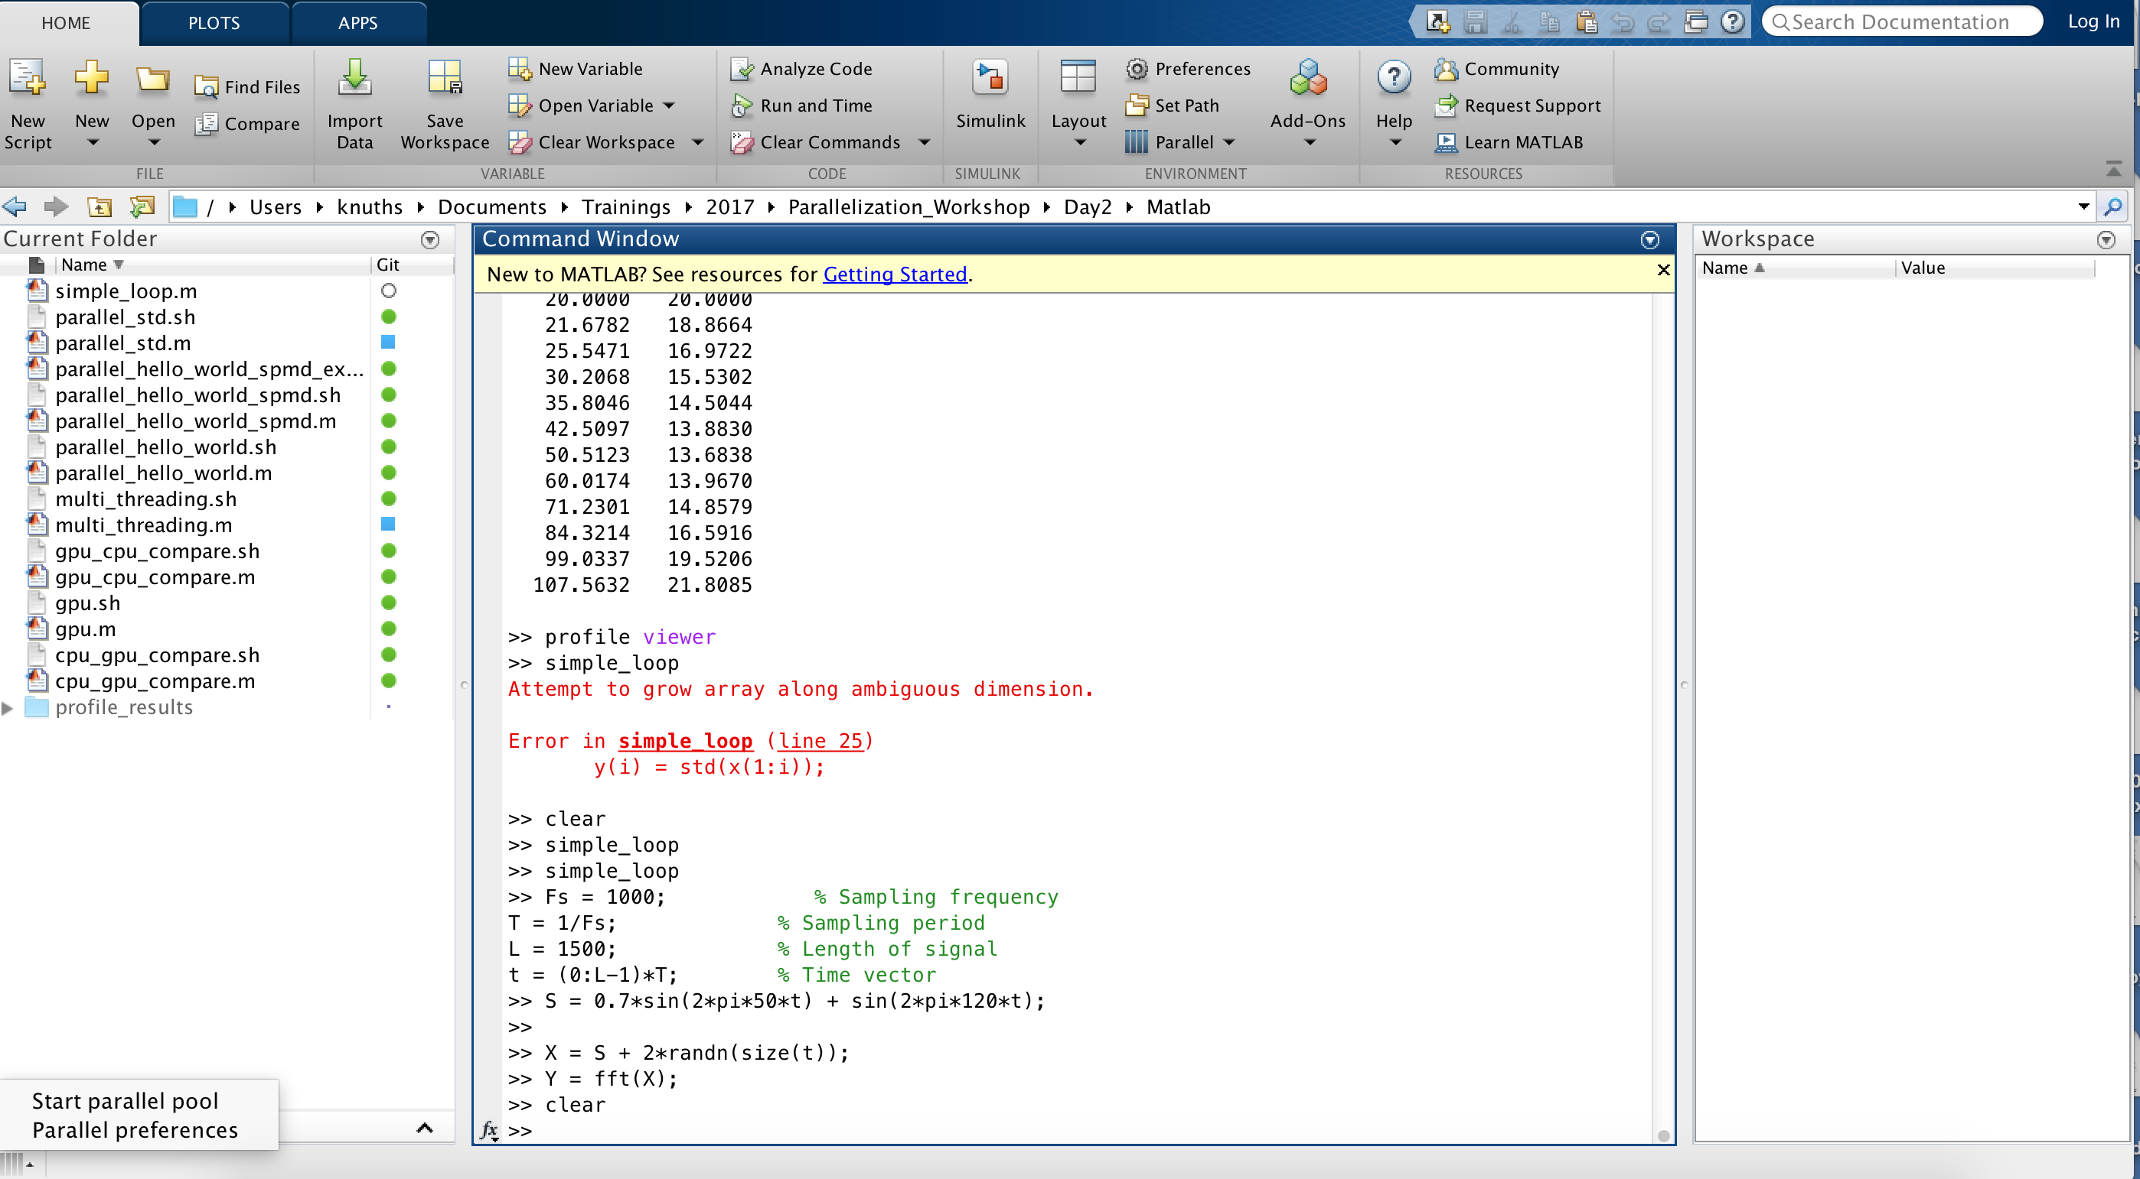
Starting a parallel pool from GUI

Slide 27
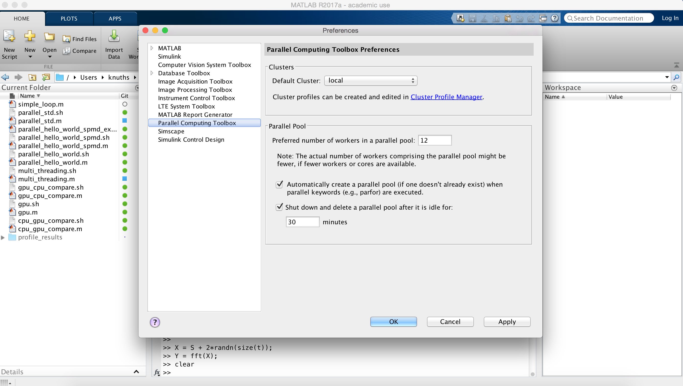
Parallel Preferences

Slide 28
parfor
Matlab workers execute loop iterations in parallel on workers in parallel pool simultaneously
Matlab client issues the parfor command and coordinates with workers
Must have a parallel pool to use
Cannot nest parfor loops

Slide 29
Parallel and Not Parallel
Not Parallel:
for i=1:10
x=x(i)+1;
end
Parallel:
parfor i=1:10
x=x(i)+1;
end

Slide 30
When to Use Parfor
If you have determined your for loop is causing a bottleneck
If your loop iterations are completely independent
Many iterations of the same calculation
If you are not making any global variable declarations
Your loop does not contain any break or return statements
If you have the PCT

Slide 31
Running Matlab in Parallel
Let’s take a serial for loop and convert it to run in parallel
parallel_std.m

Slide 32
Variables in parfor loops

Slide 33
Running Matlab in Parallel On Lots of Cores
See a significant speed up when using parfor vs. when not
However, this might not always be the case
Might spend more time in overhead
If code isn’t parallelizable
If code isn’t that complicated
Matlab_matlabpool_tests.m

Slide 34
Speed Up
https://www.mathworks.com/help/distcomp/scale-up-parfor-loops-to-cluster-and-cloud.html
http://www.sal.ufl.edu/NewComers/matlab_optimization.pdf

Slide 35
Spmd Command
Single process, multiple data
The spmd command ensures more control
Like a very simplified version of MPI
More flexibility than parfor
In parfor the workers are anonymous
All memory is shared
Don’t know how iterations are divided and which workers are doing the work
http://matlabaddict.blogspot.com/2013/02/function-spmd-how-and-when.html

Slide 36
Spmd Command
In spmd, have one client process
Supervises workers who work on a single problem
Workers are called labs
Assigned at the beginning of execution; only exists for job time
The client keeps tracks of the labs via identifiers
Each worker runs on a separate core but uses a common program
Meet and talk to each other at certain synchronization points
Two workers can communicate

Slide 37
Spmd Environment
MATLAB sets up one special worker called the client
User requests workers
Matlab sets up workers
Each worker receives a copy of the program
Each worker knows who the workers are and how many

Slide 38
Spmd
Client and workers share a single program
Have code that can reside within spmd blocks
Client executes code outside of blocks
Workers execute within
Workers can access variables defined by client, but cannot change
Client can change worker variables

Slide 39
Spmd Code
pool=parpool(4);
spmd
c=zeros(1000,10);
for j=labindex:numlabs:1000
for k=1:10
c(j,k)=j*(j+1)*(k-1);
end
end
end

Slide 40
Spmd Code
Can have several spmd blocks in one program
Workers workspace remains intact even if pause execution
Variables will be shared between blocks

Slide 41
Parfor vs. Spmd
spmd command:
Worker communication if necessary
Pass data between different labs (workers)
LabSend and LabReceive
Parfor command:
Runs for loops in parallel
No worker communication
Simpler

Slide 42
Parfor vs. Spmd
spmd command:
Data is broadcast to workers at beginning and remains there until you pull it back
Parfor command:
Data is broadcast to workers at start of every parloop
Starts from scratch

Slide 44
Questions?
Email rc-help@colorado.edu
Twitter: CUBoulderRC
Link to survey on this topic: http://tinyurl.com/curc-survey16
Slides: https://github.com/ResearchComputing/Parallelization_Workshop

Slide 45
References
https://www.bu.edu/tech/files/2015/09/matlab_pct_slides.pdf

