Slide 1
File Transfer Protocols – Transferring your Data
Shelley Knuth and David Stone
Research Computing
University of Colorado-Boulder

Slide 2
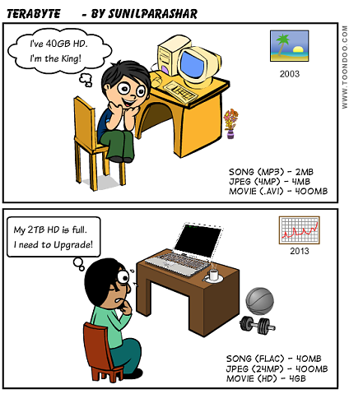
Outline
The meaning of data transfer
How much is too much data?
Data sizes
Various Transfer methods
Globus

Slide 3
Transferring Data
This talk will outline the various and most common methods of transferring data between locations
What is data?
Anything!
Text documents, Excel spreadsheets, Powerpoint files, binary files, images…anything that is being moved
What is important for data transfer?
Speed
Security
Integrity

Slide 4
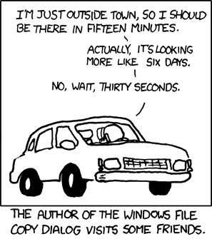
Transferring Data
Here we are discussing the movement of a file or files from one location to another
Generally one computer to another computer at a remote location
Either on the same network or
separate
The files are converted to packets
then transferred over the network
XKCD

Slide 5
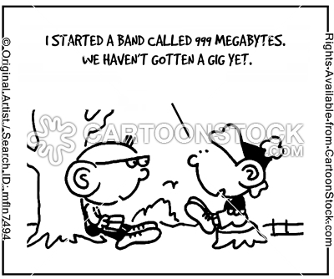
Data Sizes
What’s a GB? TB?
1 byte: 8 bits, the size of one
alphanumeric character
1 KB: 1024 bytes
1 MB: 1024 KB
1 GB: 1024 MB
1 TB: 1024 GB
1 PB: 1024 TB

Slide 6
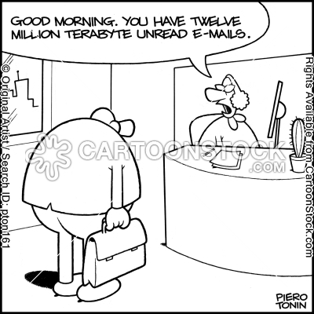
Data Sizes - Representation
The average size of a single keystroke is 1 byte (8 bits)
A line of text is 70 bytes
5 page word document is ~30 KB
A typical iPhone photo: 500 KB
1 minute of CD quality audio: 1 MB
Typical maximum email size: 10 MB
MODIS Level 1B satellite
file: 700 MB
http://www.gn.apc.org/support/understanding-file-sizes

Slide 7
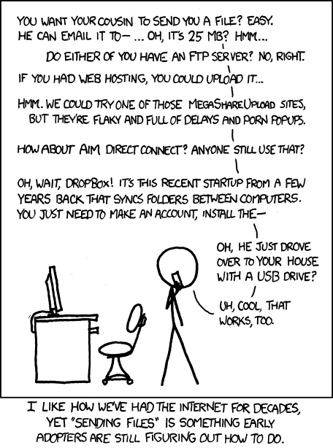
Typical Data Transfer Rates
Morse code: 0.05 kbit/s
Dial up modem: 40 KB/s
DSL: 40 MB/s
Cable modem: 100 MB/s
Ethernet: 1 GB/s
Wifi: 60 MB/s
4G Cell phone: 12 MB/s
Science DMZ: 100 GB/s
XKCD

Slide 8
Various Transfer Methods
There have been many means for transferring data over the years:
rcp
scp
ftp
wget
Some are in still in use and some are past their lifetime
Let’s cover these protocols in more detail
sftp
Bit torrent
rsync

Slide 9
Rcp/cp
Remote/copy command
Not used much anymore due to security issues
Sends unencrypted information over network
Hack passwords
Allow systems to appear to be legit when not
However is (slightly) faster than scp
If not careful, will lose info like time stamps, etc.
rcp file.txt username@remote_host.com:/home/username
Where I am transferring the file file.txt (which is in the directory where I currently reside) to the /home/username directory on remote_host.com

Slide 10
scp
Secure copy
Transfers files using encryption
Example code:
scp file.txt username@remote_host.com:/home/username
Or, in reverse:
scp username@remote_host.com:/home/username/file.txt
/home/username/

Slide 11
Scp – other useful parameters
-v: gives you a verbose output
-r: copies over a directory instead of just a file
-c: compresses the file you are transferring
-P: specifies the port you want to use (case sensitive)

Slide 12
FTP
File Transfer Protocol
Transfer files, plus:
List files in directories
Resume uninterrupted transfers
Remote file manipulation
Web browser:
ftp://amrc.ssec.wisc.edu (Univ. WI Antarctic atmospheric data)
Command line:
ftp amrc.ssec.wisc.edu
FileZilla

Slide 13
SFTP
Secure File Transfer Protocol
Like scp uses ssh to transfer files
More secure and encrypted
Becoming the standard
Difference from scp:
Scp only allows transfer of files
FTP can list files, delete, etc

Slide 14
SFTP/FTP commands
Below, some commonly used commands:
get file.txt (pulls one file from a remote location)
mget *.txt (pulls multiple files from remote location)
ls, cd, pwd (general Linux commands)
put (copy file from local to remote machine)
mput (copy multiple files from local to remote
machine)
delete (remove files)
bye (exit ftp)

Slide 15
Bit Torrent
Commonly associated with illegal music/movies downloads
A data sharing tool
Fast and efficient
Say a software patch comes out that is 100 MB
Bit Torrent divides up the file into pieces and utilizes the computers downloading the data to share their downloaded pieces to those that need it
Peer to peer (most file chunks come from peers)
Verifies data integrity
Can download from multiple locations at same time
Science use: disseminate academic publications

Slide 16
Bit Torrent - Downsides
You need to participate in uploading data as well as downloading
Might not be the most secure route
Might not be necessary for many science downloads
Data is shared between everyone participating in the transfer
http://www.makeuseof.com/tag/8-legal-uses-for-bittorrent-youd-be-surprised/
www.bittorrent.com

Slide 17
Rsync
Rsync is a way to copy and synchronize two computers
Faster than scp because it downloads only the differences between files (after initial download)
Can use encryption
Uses compression to move files
Tons of options
If lost connection, will resume where left off
Scp will not
Rsync options source destination

Slide 18
Wget
Combination of “World Wide Web” and get
Non-interactive download of files from the web
Supports HTTP, HTTPS, and FTP
Allows downloads from scripts when user is not logged on
Robust over slow or unstable network connections
Will keep trying until file is downloaded
Can continue download from where it left off
wget <URL>
http://linux.about.com/od/commands/l/blcmdl1_wget.htm

Slide 19
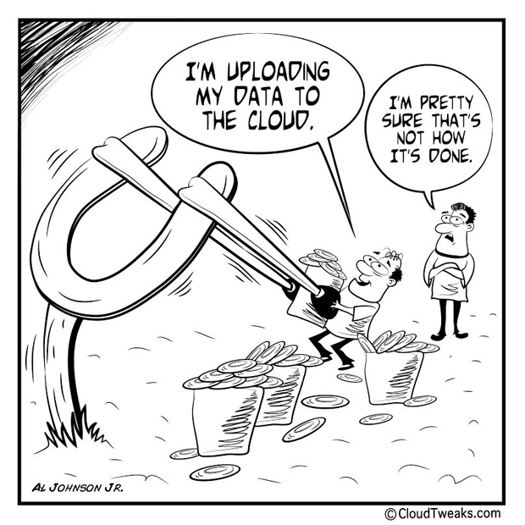
“The Cloud”
What is this ambiguous cloud?
It’s a network of servers that run applications, deliver services, or store data
It is a good way to keep costs down
and have data available wherever,
whenever
Security issues?
Who owns your data?
Cost savings
Hardware, buildings, IT staff

Slide 20
Globus
Globus is Research Computing’s preferred method of data transfer
Designed with researchers in mind
End points between computers make for easy data transfer with an easy to use interface
Endpoints are different locations that data can be moved to/from
Personal or multi-user
Scripting in use also if don’t want to use GUI
www.globus.org

Slide 21
Globus
Preserves the integrity of data
Compares checksums
Resumes data transfer if interrupted
Fast transfer of large data sets
Globus can be set up to easily share data among collaborators

Slide 22
Globus Connect Personal and Servers
Globus Connect Personal
GUI interface
Connects your computer to other computers
Will demonstrate account set up
Globus Connect Servers
Sets up a GridFTP server
Those with access to the data can then move data to/from this server

Slide 23
Globus Sign Up
The next series of slides will demonstrate how to:
Create an account at Globus.org
Make your personal computer an endpoint
Transfer data

Slide 24
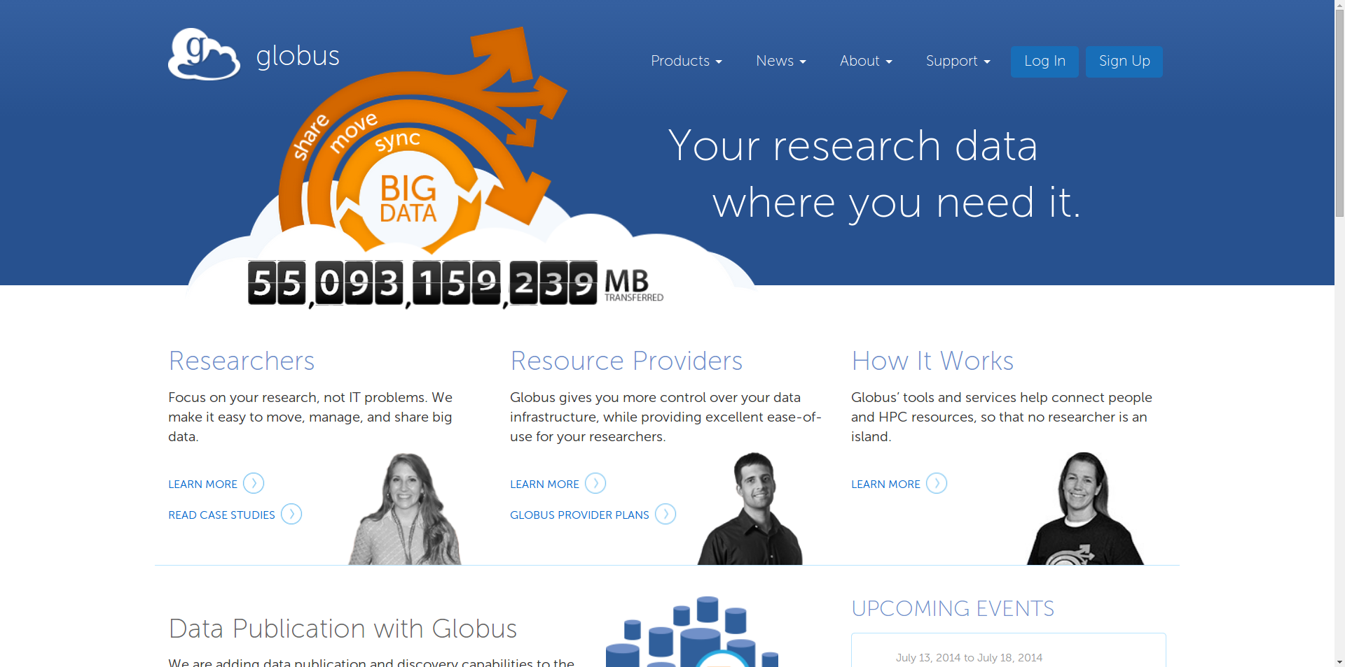
Click Sign up in the upper right hand corner

Slide 25
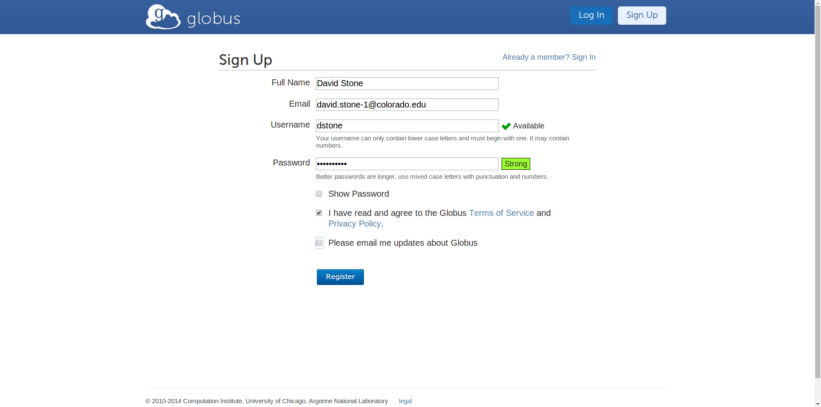
Fill in the boxes with the corresponding information

Slide 26
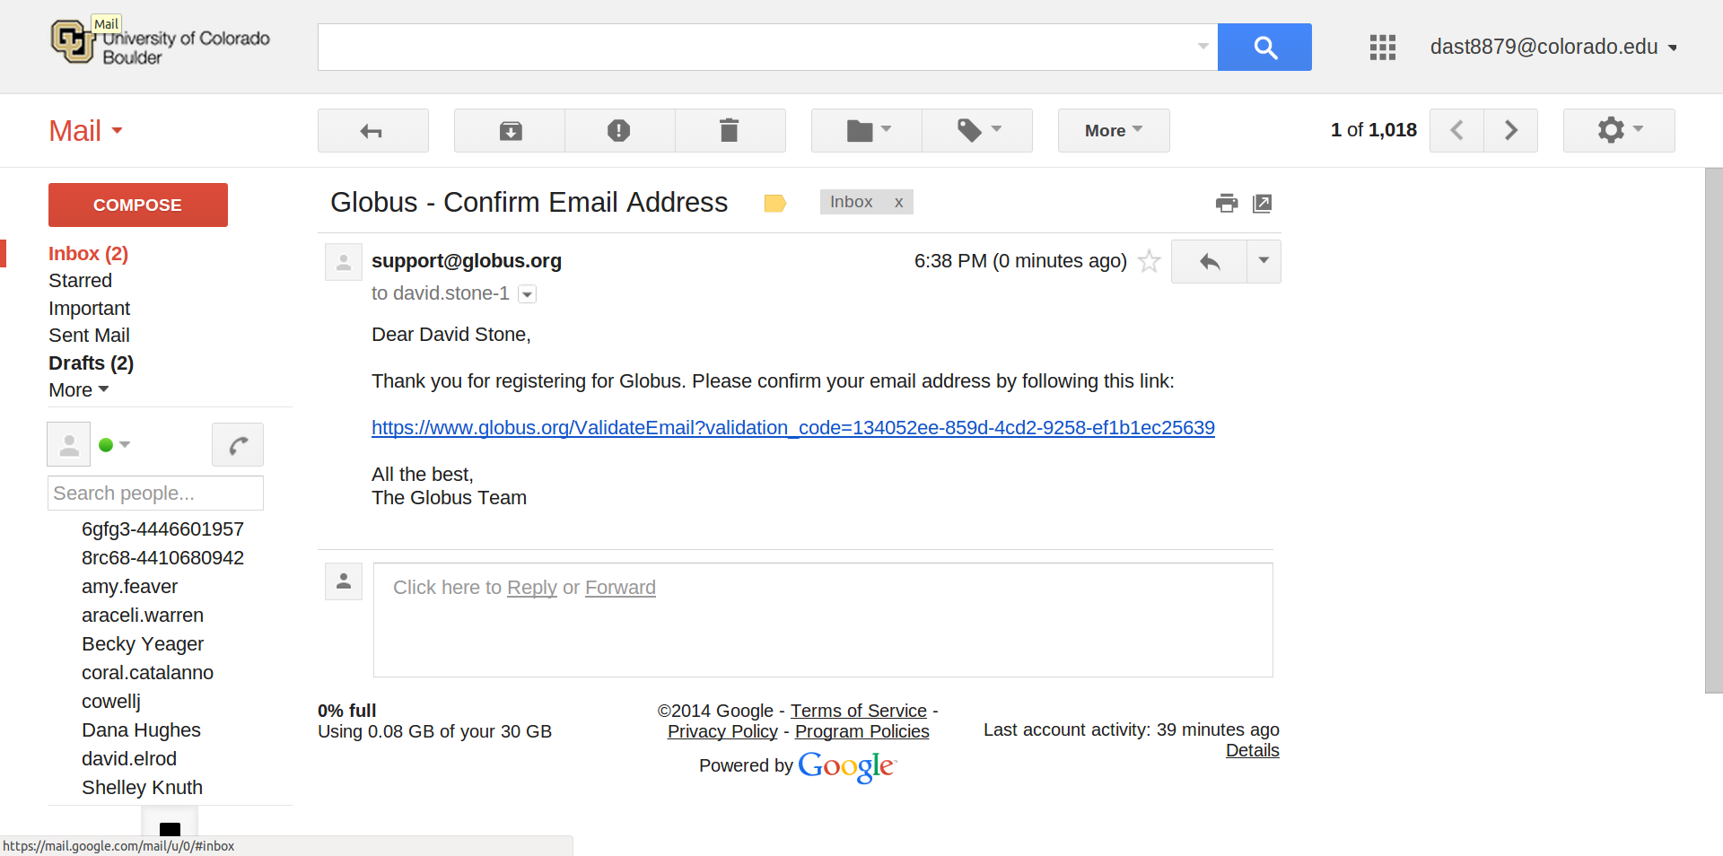
Login to the account you filled in on the previous page and click on the link

Slide 27
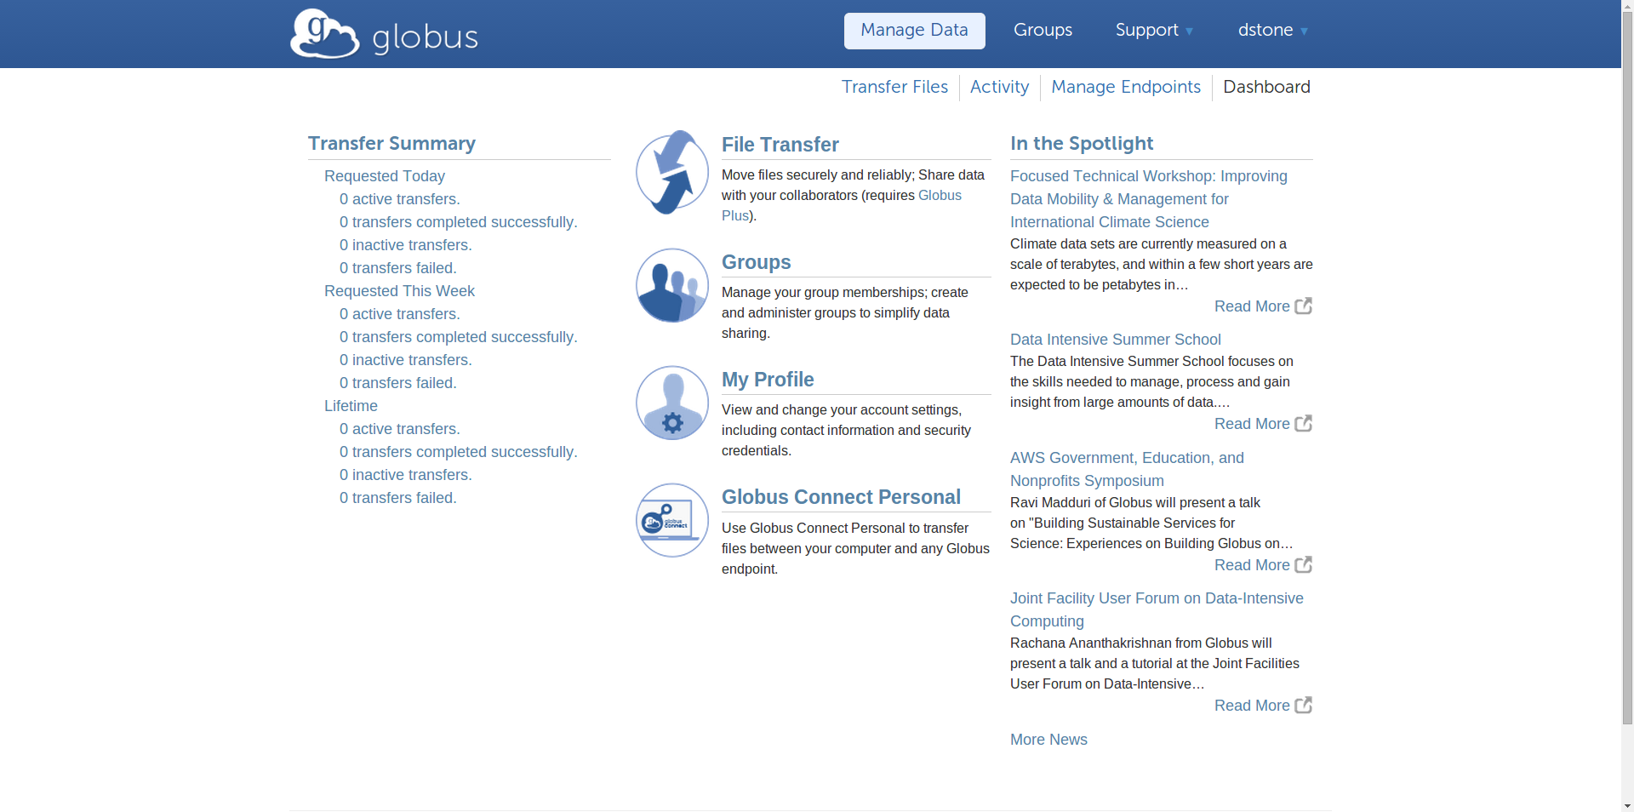
You are now logged into your Globus account, this is your dashboard.
To create your own endpoint, click Manage Endpoints near the upper middle part of your screen

Slide 28
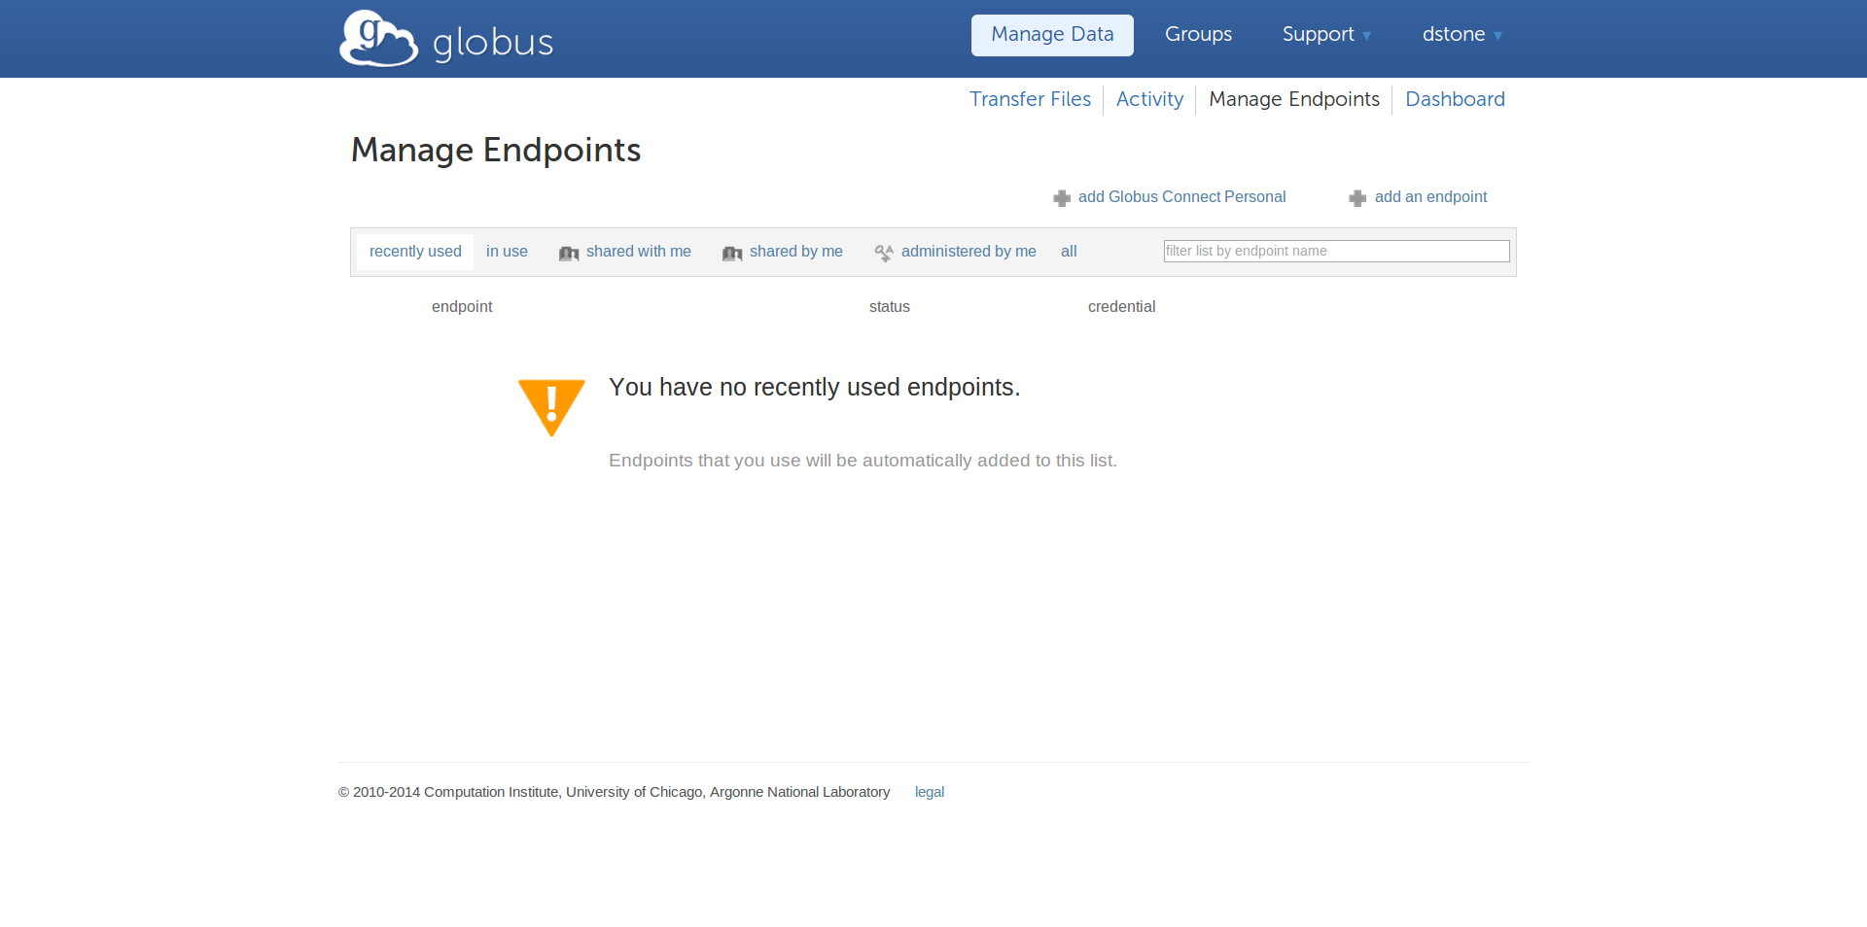
By making your own computer and endpoint, you are able to transfer files to your computer from anywhere.
Start by clicking on add Globus Connect Personal

Slide 29
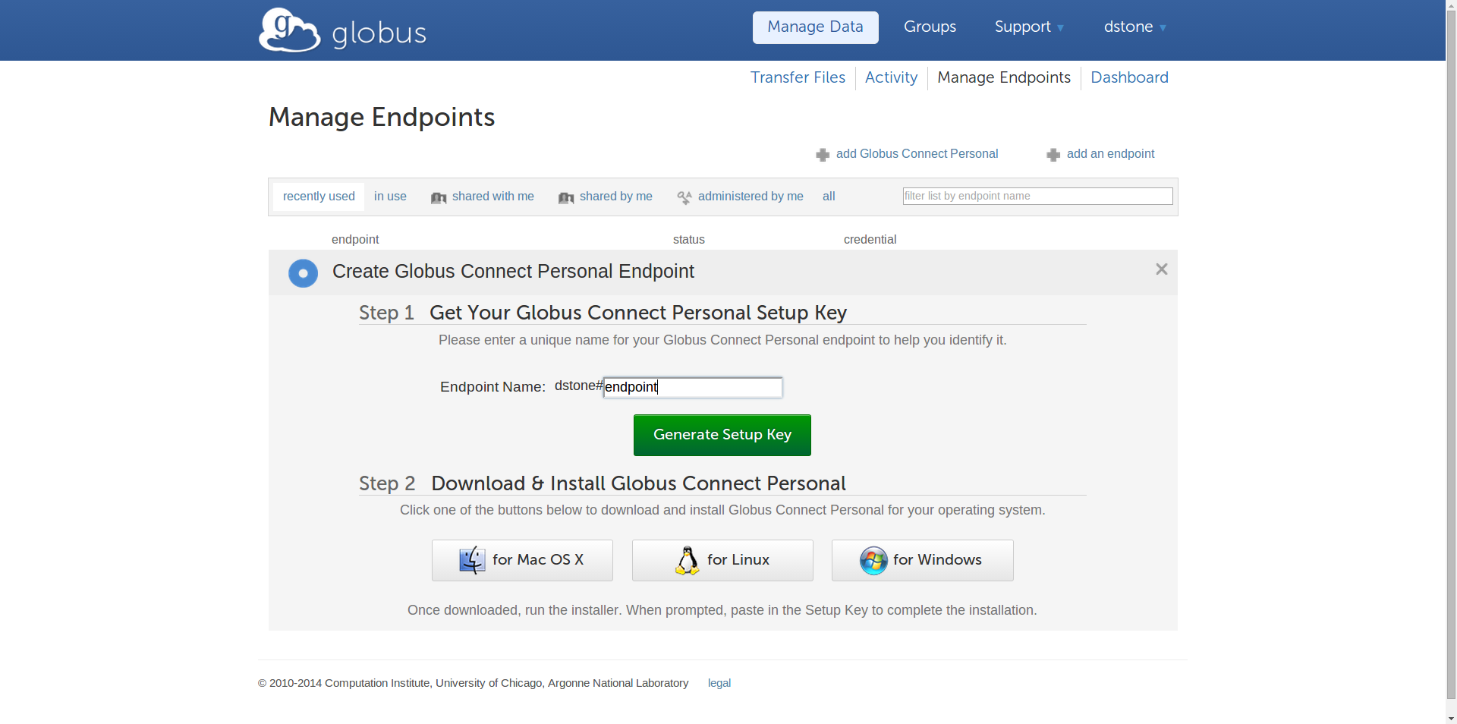
Pick a name you will remember for your endpoint and click Generate Setup Key
Copy this key and leave this page up throughout the next steps so you can copy it again if needed
Then click on the operating system you will be using Globus with

Slide 30
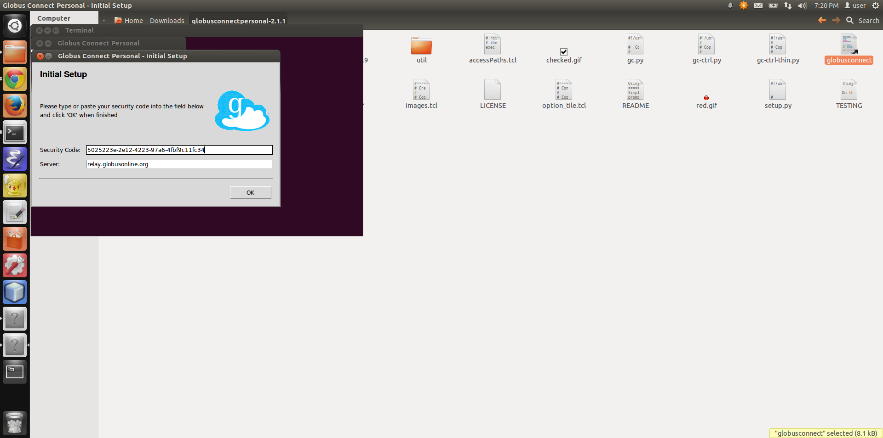
Paste the security code into the box and click ok

Slide 31
To start transferring files, click on Transfer Files near the upper middle part of your screen

Slide 32
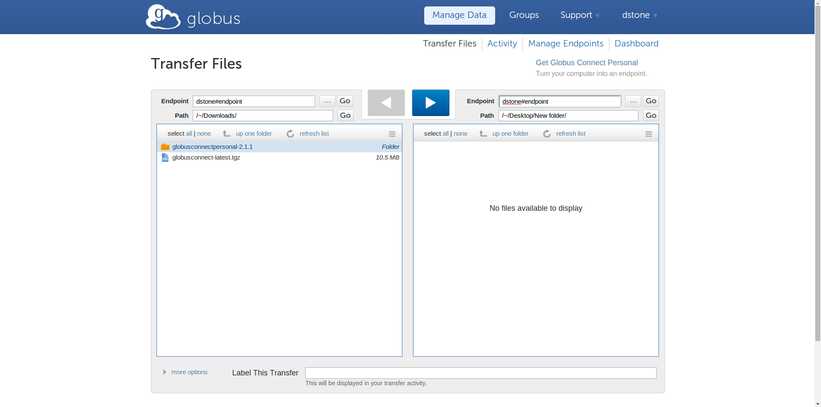
You should now be able to find the endpoint you just created and start transferring files right to your computer

Slide 33
Questions?
More examples to come after presentations!
Shelley.Knuth@colorado.edu

Slide 34
References Used:
http://www.tecmint.com/rsync-local-remote-file-synchronization-commands/
http://www.admin-magazine.com/HPC/Articles/Moving-Your-Data-It-s-Not-Always-Pleasant
http://www.gn.apc.org/support/understanding-file-sizes
compnetworking.about.com
http://dem.nv.gov/uploadedFiles/demnvgov/content/NCSC/LTE-BroadbandAndPublicSafetyPrimer.pdf

