Slide 1
An Introduction to Git
Shelley Knuth
Research Computing

Slide 2
Outline
What is version control?
What is git?
Let’s manage some code!
Differences between git and other version control systems?

Slide 3
What is Version Control?
Version control records changes to a file or to code
Keeps track of:
What changes are made
Who makes them
By keeping track of changes, you can recall previous versions later

Slide 4
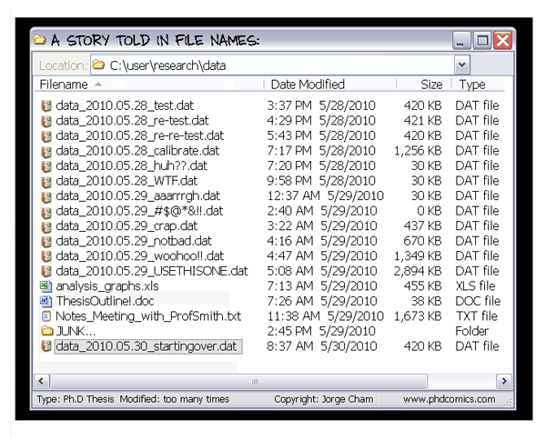
Version Control and You
Probably already using version control
Rename files
Copy into
another directory
Easy to overwrite
Which version is
newest?

Slide 5
Version Control Advantages
Revert files back to a previous state
Easy recovery
Multiple backups
See who might have changed a file that is causing issues
History of changes by who and when
More efficient tracking of documents, code

Slide 6
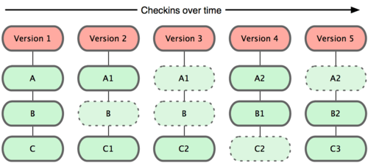
Distributed Version Control Systems
Git is a distributed version control system
Instead of checking out the latest version of the file, checks out a snapshot of all files at that time
Easier to recover from loss
Only needs local resources to operate, generally
git-scm.com

Slide 7
How Does Git Operate? – Typical Work Flow
General work flow of a project:
Create a file
Make changes to the file
Save the changes to the file
Make more changes
…
How does this fit into git?

Slide 8
How Does Git Operate? – Typical Work Flow in Git
Start tracking a project
Create a file
Track the file
Make changes to the file
Save the changes to the file
Track those changes
Make more changes
…
Commit changes to a local repository
Push to a remote repository

Slide 9
Git Lingo
Repository
A folder that houses all the files that are part of a project
Files are tracked or untracked
Tracked
Git is monitoring a file as part of a project
Staged
Files that are kept in a cache before committing
Build next commit step by step
Commit
A snapshot of the project at a single point in time

Slide 10

How Does Git Operate? – Sections of a Project
Git directory
Where the metadata is located
Very important
Working directory
Contains a checkout of a version of your project
Staging area
Contains a file that has information about what goes into your next commit
git-scm.com

Slide 11
A Few Key Items About Git
Git operates so that each working copy carries its own repository with it (found in .git)
Can have local and remote branches
Svn has a single repository for each project at a remote central location
Git identifies revisions with long hexadecimal numbers
Svn defines revisions with growing decimals

Slide 12
Let’s Work on Some Code
Git_tutorial_doc.txt

Slide 13
Remote Repositories
One of the great things about version control systems is that you can push/pull changes to/from remote locations
This allows many things:
Making public something really great you’ve done!
Grabbing something really great that’s been done!
Group collaboration on a specific project

Slide 14
Remote Git Repositories
You never write directly to a remote repository
You need to create a corresponding local branch which tracks the remote branch
You can push or pull changes to or from the remote branch
git pull
git push
Usually you have a public repository where everyone pulls changes from
You push your changes there

Slide 15
Getting Another Git Repository
Get a repository from either copying one that exists or importing an existing project to git
You import the existing project based on what we’ve already done
To copy an existing git repository, type
git clone https://github.com/mlunacek/meetup_d3_2014.git
Receive a copy of all the data the server has
Not a checkout of the latest version of code

Slide 16
Group Collaborations
Perhaps you and your collaborations at a single or multiple institution need to collaborate on a project
Changing model code, for example
You can push and pull to a remote repository
Have to make sure you aren’t writing over the top of each other
For more information:
http://git-scm.com/book/en/Git-Basics-Working-with-Remotes

Slide 17
Git Vs. SVN
Task | Git | SVN
Tracking someone else’s project | Git clone url Git pull | Svn checkout url Svn update
Committing | Git commit | svn commit
Check status | Git status | Svn status
Check changes in files | Git diff | Svn diff
Restore a file from the last version | Git checkout path | Svn revert path

Slide 18
Questions?
git-scm.com (Lots of great information in this talk was found here!)
try.github.io/levels/1/challenges/1 (Learn git in 15 minutes!)
Git.or.cz/course/svn.html
Shelley.Knuth@colorado.edu

Slide 19

Centralized Version Control
Collaborations
Single server
Holds all versions of files
Different people can check out files from a central location
git-scm.com

