Slide 1
How to Use a Supercomputer
Shelley Knuth Peter Ruprecht
shelley.knuth@colorado.edu peter.ruprecht@colorado.edu
www.rc.colorado.edu
Notes:
Introduce yourself and other RCers! Goal is to introduce the range of services we provide to researchers at CU, some of which may be familiar and others that are fairly new.
Ask about their backgrounds. Outline schedule.

Slide 2
Outline
Today we will discuss:
Who Research Computing is
Resources provided
Accessing resources - Stampede
Data Storage and access
Notes:
We’ll hang around afterwards if you would like to work with any of us one-on-one.

Slide 3
What does Research Computing do?
We manage
Shared large scale compute resources
Large scale storage
High-speed network without firewalls – ScienceDMZ
Software and tools
We provide
Consulting support for building scientific workflows on the RC platform
Training
Data management support in collaboration with the Libraries
Notes:
“We support computing needs beyond the desktop”. These are either free or provided at-cost. Most of the hardware was funded by external grants.
700 users across 30 institutes and departments on campus

Slide 4
How Does CU-RC Compare to Other HPC Centers?
Generally, we’re a bit smaller than most supercomputing centers!
Staff of ~10-15 (including students)
Operate the Janus supercomputer, a large data repository, and other large scale computing resources
Have 700 users across 30 institutes and departments on campus
Notes:
“We support computing needs beyond the desktop”. These are either free or provided at-cost. Most of the hardware was funded by external grants.
700 users across 30 institutes and departments on campus

Slide 5
Supercomputer resources

Slide 6
What Is a Supercomputer?
Many supercomputers are one large computer made up of many smaller computers and processors – a “cluster”
With a supercomputer, all these different computers talk to each other through a communications network
On Janus and Stampede – InfiniBand
Each different computer is called a node
Each node has processors/cores
Carry out the instructions of the computer
Notes:
Infiniband – allows each node to see the memory in other nodes; allows the ensemble to act as one big computer.

Slide 7
Why Use a Supercomputer?
Supercomputers give you the opportunity to solve problems that are too complex for the desktop
Might take hours, days, weeks, months, years
If you use a supercomputer, might only take minutes, hours, days, or weeks
Useful for problems that require large amounts of memory

Slide 8
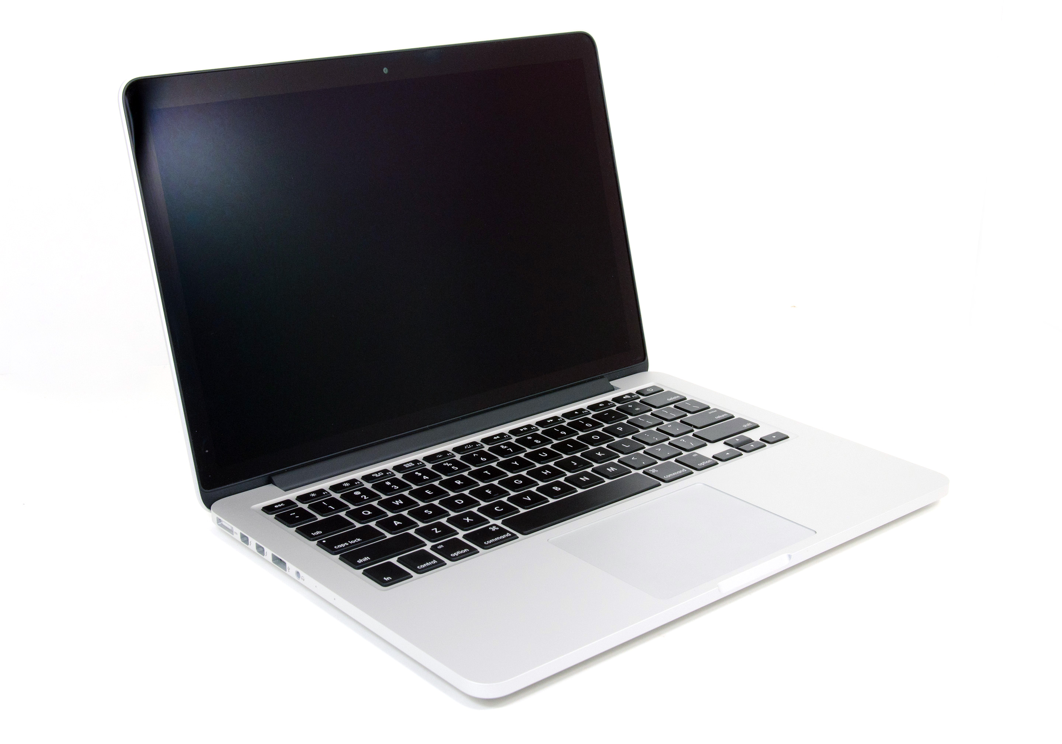
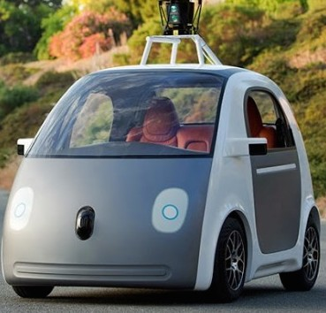
Computers and Cars - Analogy
≈
Notes:
Your personal computer is like a Google car – pretty much operates itself, quite reliable, but only goes 25mph.

Slide 9
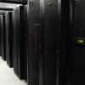

Computers and Cars - Analogy
≈
Notes:
Supercomputer is like an Indy car - way faster but takes some special skills/training to operate, requires a dedicated maintenance crew, and can crash if not used properly.

Slide 10
World’s Fastest Supercomputers
www.top500.org
Rank | Site | Name | TeraFlops
1 | National Super Computer Center (Guangzhou, China) | Tianhe-2 | 54902.4
2 | Oak Ridge National Laboratory (United States) | Titan | 27112.5
3 | DOE/NNSA/LLNL (United States) | Sequoia | 20132.7
4 | RIKEN Advanced Institute for Computational Science (Japan) | K | 11280.4
5 | DOE/Argonne National Lab (United States) | Mira | 10066.3
6 | Swiss National Supercomputing Centre (Switzerland) | Piz Daint | 7788.9
7 | Texas Advanced Computing Center (United States) | Stampede | 8520.1
8 | Forschungszentrum Juelich (Germany) | JUQUEEN | 5872.0
9 | DOE/NNSA/LLNL (United States) | Vulcan | 5033.2
10 | Government (Undisclosed) (United States) | Undisclosed | 3143.5

Slide 11
What Does It Mean to Be Fast?
Titan can do 27 trillion calculations per second
A regular PC can perform 17 billion per second
Not enough for some people!
Size of a basketball court
Computers this size require lots of electricity and are expensive to run and maintain!
Notes:
Since supercomputers are so expensive, it’s important to use them properly so as not to waste the resource.
TeraFlops are not an appropriate measure of speed for some applications.

Slide 12
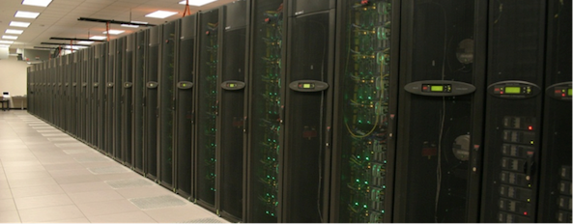
Stampede
6400 nodes
250 TB of aggregate memory
The nodes have 2 Intel Xeon E5 processors and an Intel Xeon Phi Coprocessor
32 GB memory
16 Large memory nodes with 32 cores/node and 1 TB of memory
Credit:
TACC
Notes:
Stampede – designed as “a multi-use cyberinfrastructure resource” (something for everyone!) Note the availability of a coprocessor (Phi or GPU) on nearly every node.

Slide 13
Stampede
128 compute nodes have single GPU
Designed for visualization
Connected to 14 PB file storage
Tape archive system with 60 PB capacity
Designed to provide large memory, large data transfer, and GPU capabilities
Nodes connected by Infiniband

Slide 14
Stampede
4 Login nodes
Three locations for storage
$HOME, $WORK, $SCRATCH
Lustre
Modules are used to access software available on the systems

Slide 15
Supercomputing Resources
With appropriate connections, researchers at USGS can get access to some of the large supercomputers around the world
The Extreme Science and Engineering Discovery Environment (XSEDE) can provide assistance with setting up accounts (Janice and Jeff are “Campus Champions”)
Today we will use Stampede

Slide 16
Supercomputer Applications
Climate modeling
Predict seismic activity
Forecast hurricanes
Mapping the universe
Notes:
And many more!

Slide 17
EXAMPLE

Slide 18
Login and Modules example
Log in:
Login to XSEDE User Portal (portal.xsede.org)
Go to accounts and access specific machines from User
Can also access from command line
ssh username@stampede.tacc.xsede.org
Talk to Campus Champion about getting accounts
List and load modules
module list
module avail
module load netcdf/4.2.1.1
module load ncview/2.1.1

Slide 19
Data STORAGE and TRANSFER

Slide 20
Storage Spaces - Stampede
Home Directories
Store source code
Not for direct computation
5 GB quota on stampede
Backed up
$WORK Space
400 GB quota
Start job runs from here
Large file storage
Not backed up
Notes:
Different spaces are appropriate for different kinds of data and I/O

Slide 21
Storage Spaces – Stampede – Continued
Lustre Parallel Scratch Filesystem
8.5 PB
Output from running jobs should go here
Store large files briefly
Files purged after 10 days
Notes:
Different spaces are appropriate for different kinds of data and I/O

Slide 22
Keeping Lustre Happy
Janus Lustre is tuned for large parallel I/O operations.
Creating, reading, writing, or removing many small files simultaneously can cause performance problems.
Don’t put more than 10,000 files in a single directory.
Avoid “ls –l” in a large directory.
Avoid shell wildcard expansions ( * ) in large directories.
Notes:
Have seen 10x speedups by improving I/O patterns! We have a usage guide that you should peruse. Remember, file systems on supercomputers are shared resources.

Slide 23
Data Repositories
New initiatives from funding agencies to make data publicly available
Recent push in development of data repositories across the globe
Wide range – for geosciences:
National Water Information System
Earth Resources Observation and Science
South Florida Information Access
http://www.usgs.gov/datamanagement/preserve/repositories.php

Slide 24
Research Data Storage: PetaLibrary
NSF Major Research Instrumentation grant
Long term storage option
Keep data on spinning disk or tape
Provide expertise and services around this storage
Data management
Consulting
No HIPAA, FERPA data
Infrastructure guaranteed for 5 years
Notes:
Tell them about it but make clear that some special setups would need to be made for them to have access

Slide 25
Data Sharing and Transfers
Globus tools: Globus Online and gridftp
https://www.globus.org
Web-mediated drag-and-drop transfers
Extremely efficient for large transfers to distant locations
Easier external access for collaborators
SSH: scp, sftp, rsync
Adequate for smaller transfers
Notes:
Globus is preferred transfer method not just at RC but also at XSEDE.

Slide 26
Questions?
More examples to come after presentations!
Peter.Ruprecht@colorado.edu
Shelley.Knuth@colorado.edu

