Slide 1
Voting System
CSS

Slide 2
TABLE OF CONTENTS
01
04
Introduction
Created Files
02
The Modules
03
Images

Slide 3
ABOUT THE PROJECT
Voting systems are digital platforms that allow users to cast their votes remotely through the internet, without the need to visit a physical polling station.
This application is made in PHP and MySQL.
PHP is used in the Back-End and on the other hand CSS and HTML has been used as Front-End.
It is divided into two modules.

Slide 4
The modules

Slide 5
Voter module
#Voter Registration
#Voter Login
#Voter Dashboard - Voter can see his profile info, voting status, and list of groups
#Voting - Voter can choose to vote to anyone group
listed in his dashboard
#Logout

Slide 6
Group Module
#Group Registration
#Group Login
#Dashboard - Group can see its profile info, voting status, and list of groups
#Voting - Group can choose to vote to anyone group listed in his dashboard
#Logout

Slide 7
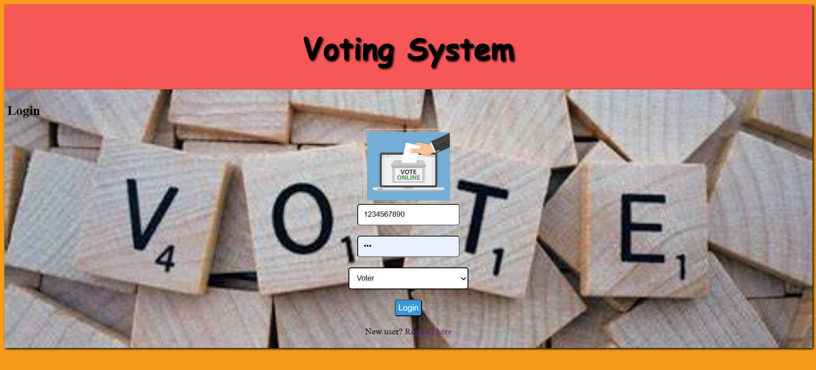
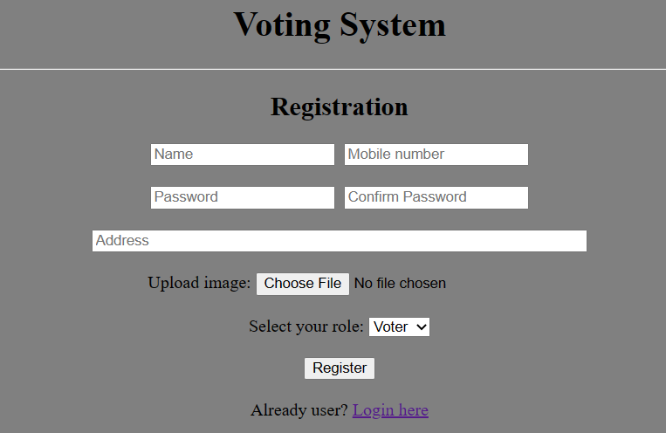
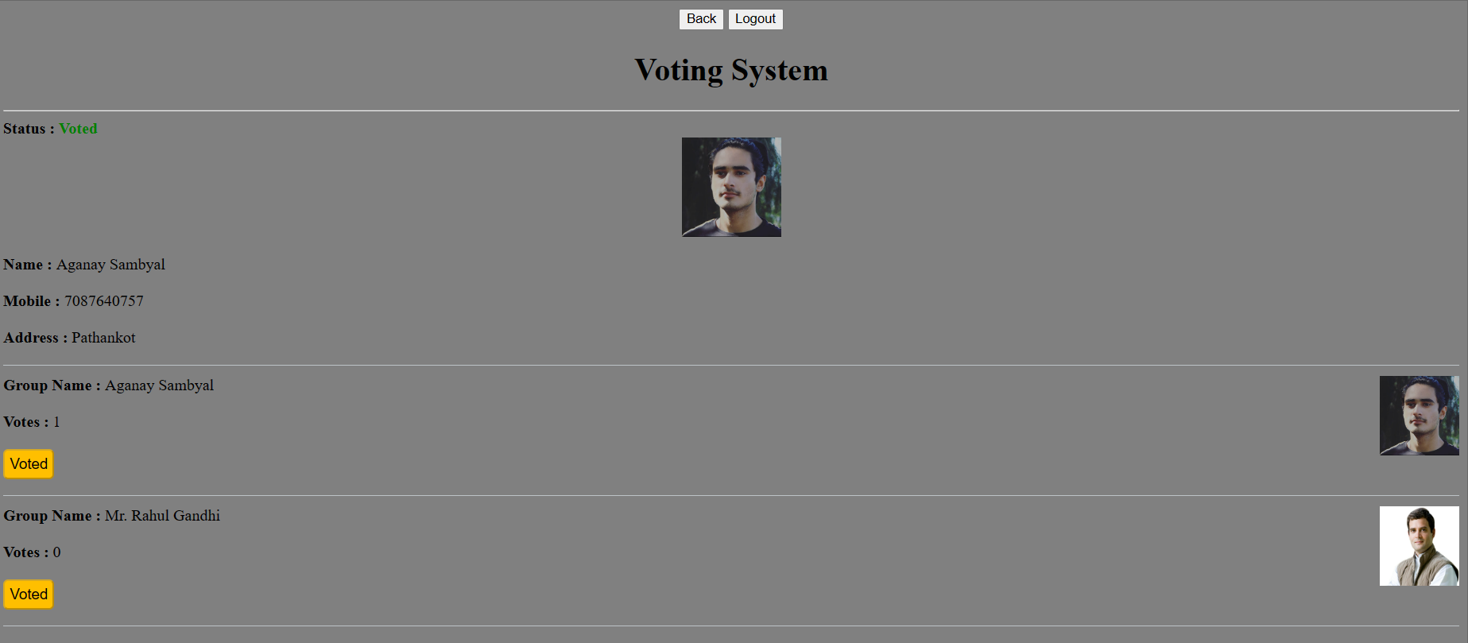
IMAGES
Login Page
Registration Page
Dashboard Page

Slide 8
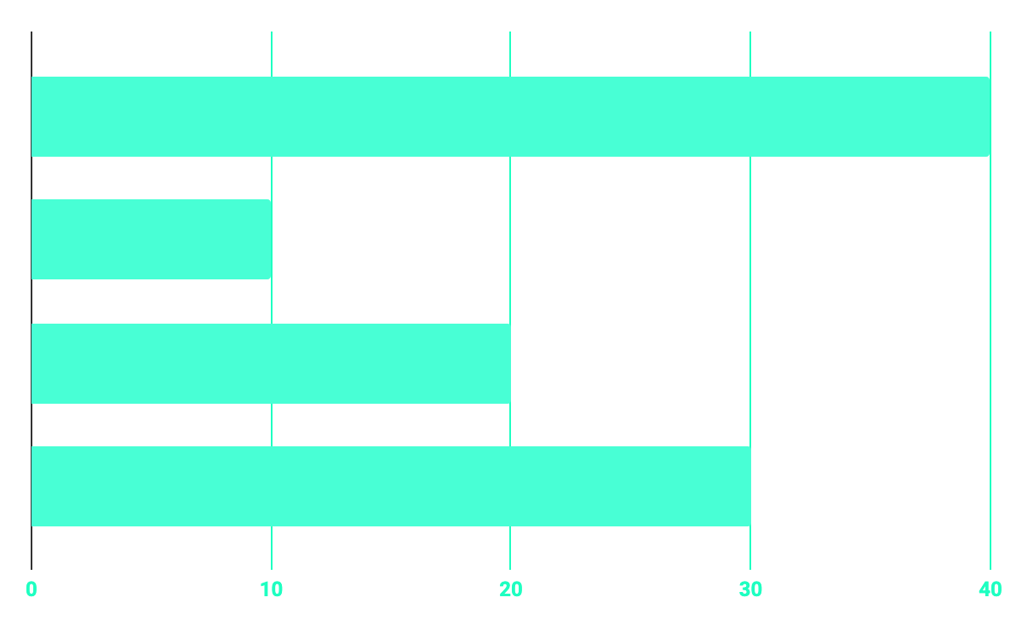
Files That have been created
HTML FILE: Register - This code is a HTML code for the registration page of an online voting system. It contains a form where users can fill in their personal details, such as their name, mobile number, password, address, and upload their profile picture. It also includes a drop-down menu for selecting the user's role, either a voter or a group. Index - This is an HTML code for a basic login page of a voting system website. The page has a header section with the title "Voting System" and a red background.
CSS FILE:
#Stylesheet - that is used to style and web pages in the project.
PHP FILES #Connection - The purpose of this PHP file is to establish a connection to a MySQL database server using the mysqli_connect function.
#Login - The purpose of this PHP file is to authenticate a user based on their credentials and redirect them to a dashboard page if the credentials are valid.

Slide 9
Files That have been created
#Register- The purpose of this PHP code is to handle
user registration and store the user’s
information in the database.
#Vote - The purpose of this PHP file is to handle a
user’s vote and update the relevant
information in the database.
#Dashboard - This is a PHP file that generates an HTML
page
#Logout -This is a PHP code that is used to destroy the
current session and redirect the user to the
login page.

Slide 10
REFERENCE
https://www.w3schools.com/php/
w3schools.com/html/
https://www.w3schools.com/w3css/defaulT.asp

Slide 11
THANKS!

