Slide 1
AMGPetAgency
Abel Gancsos
Boston University
Metropolitan College
CS665 Summer 2 2018

Slide 2
Requirements
Add or update animals and people
Display where each adopted pet is located
Display which pets are available
Place a specific pet with a particular household
End result must be usable on any machine within the local network

Slide 3
Assumptions
The animal breeds have already been breaded and are available for appropriate animals.
Animal types are predefined and no new animal can be created via combinations.
A person can only be either a male, female, or not specified.
The measurement used for height is in inches.
The measurement used for weight is pounds.

Slide 4
Assumptions (continued)
Additional nationalities will be added in the future.
Additional races will be added in the future.
Additional animal breeds will be added in the future.
Additional animal types will be added in the future.
Additional properties will be added and be configurable to people in the future.
Additional properties will be added and be configurable to animals in the future.

Slide 5
Prerequisites
C++ compiler with C++11 capability
CMake version 3.11 or higher
XCode command-line tools (MacOS only)
Visual Studio 2017 or higher (Windows only)

Slide 6
Introduction
More and more pets needing homes
Abandoned
Removed from abusive homes
Experienced pet adoption agency
Able to place pets in the home home
Personality traits
Work schedule
Family size
Lifestyle
Required help to maintain pet adoption records

Slide 7
Specifications (prototype)
In-memory database (collections)
Bulk of the basic functionality
Command-line interface
Prompt selections are based on collection index
Adoption prompt displays list of available pets
Future official CLI would require additional features to be built into it

Slide 8
Design Goals
Should be able to take user input from the command-line level and produce the complex types of an AMGAnimal or AMGPerson object.
Complexity here is referring to the number of properties that an object could contain,
Must be maintainable to handle any attributes that would be added to the complex types.
Should also be able to handle different derivatives of the complex types
It should not only be able to build AMGDog types, but should also be able to build AMGCat types if added to the infrastructure.
The components should be portable and able to be applied to other utilities.

Slide 9
Builder Design Pattern
Specifically used to help build complex types by parts
Components
Product (AMGAnimal)
Director (AMGAnimalDirector)
Builder (AMGAnimalBuilder)
Build (AMGDogBuilder)
Director responsible for final Product
Build contains actual attribute values

Slide 10
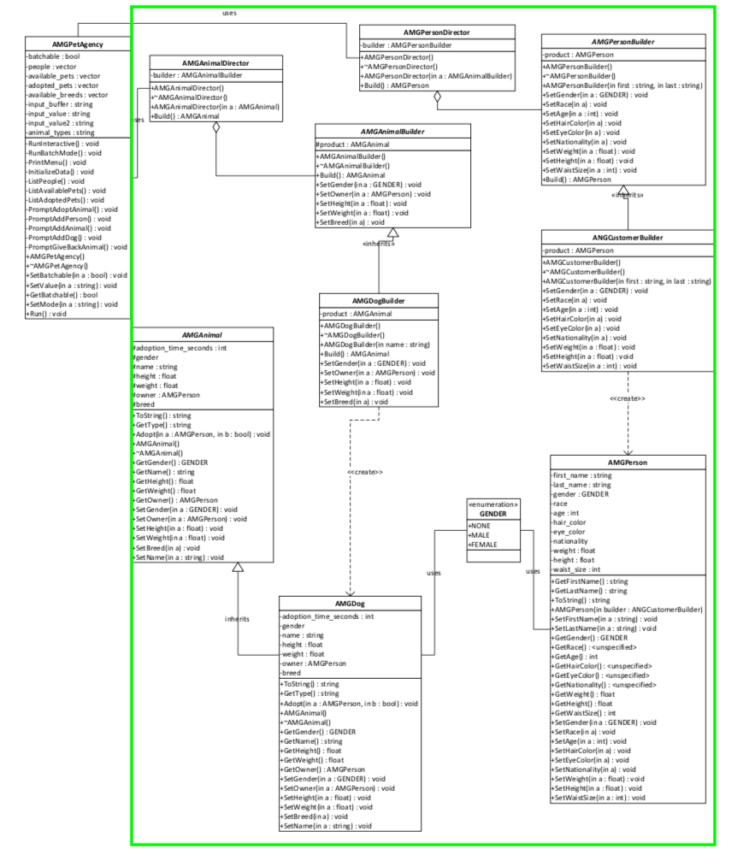
Implementation

Slide 11
Flexibility
Moduler components
New builders, just implement the builder in the builder package
New objects, implement the product in the common package
New product type, implement the builder package in the builder container, implement the product in the common package

Slide 12
Simplicity
Objects
Moduler
Small number of components
One main class to hold the values
One main class to produce the final object
Structure
Organized into class purpose
Small number of root level packages or containers

Slide 13
Duplicate Code Avoidance
Modifying the traditional Builder pattern
User interaction required multiple getters/setters
Used setters in the Builder mechanism
Methods for common operations
AMGSystem::ValidateInput()
AMGSystem::Sleep()

Slide 14
Alternatives
Decorator
CON: Large number of smaller classes
PRO: Classes can be applied to many product types

Slide 15
References
Döring, A. (2016, 11 07). minimal_cmake_example. Retrieved 07 03, 2018, from GitHub Web site: https://github.com/krux02/minimal_cmake_example
Geeks for Geeks Organization. (n.d.). Builder Design Pattern . Retrieved from Geeks for Geeks Web site: https://www.geeksforgeeks.org/builder-design-pattern/
Google Corporation. (2018, 06 19). Google C++ Style Guide. Retrieved 07 03, 2018, from Google GitHub styles: https://google.github.io/styleguide/cppguide.html
Kitware Corporation. (n.d.). Download. Retrieved 07 03, 2018, from CMake Web site: https://cmake.org/download/

Slide 16
References (continued)
Lucid Software Corporation. (2017). Class Diagram Tutorial. Retrieved 7 25, 2017, from Lucid Software Corporation Web site: https://www.lucidchart.com/pages/uml/class-diagram
Microsoft Corporation. (2010). Visio. (2010). Redmond, WA, USA.
Moser, M. (2018, 06 28). Patterns. Retrieved 07 04, 2018, from Java Patterns Web site: http://java-design-patterns.com/patterns/builder/
Oracle Corporation. (2017). VirtualBox. (5.1.18). Redwood City, CA, USA.
Pazdera, R. (2011). Example of `builder' design pattern in C++. Retrieved from GitHub Web site: https://gist.github.com/pazdera/1121152
Tutorials Point. (n.d.). Design Patterns Builder Pattern. Retrieved 08 01, 2018, from Tutorials Point Web site: https://www.tutorialspoint.com/design_pattern/builder_pattern.htm

Slide 17
Thank you!

