Slide 1

Restaurant data analytics
Group 1:
Akshay, Ashwin, Anvitha, Prince, Priyanka, Sarthak, Suraj, Yashasvi

Slide 2
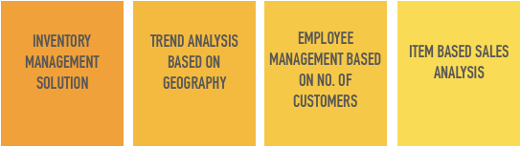
Introduction
Food byte aims to aid restaurants by increasing the efficiency of their daily operations with a central system to track major aspects of restaurant management.
FEATURES

Slide 3
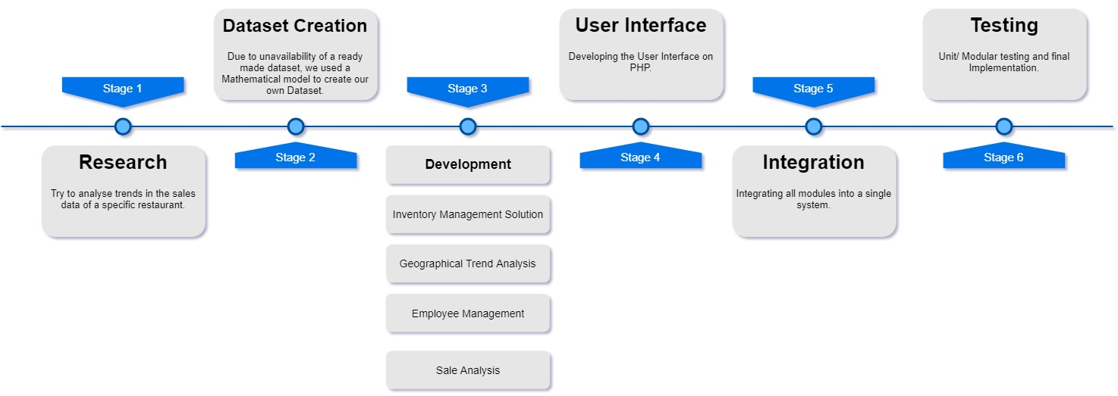
Roadmap

Slide 4

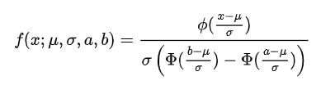
Dataset creation
Mathematical model
Truncated normal distribution
Food item Vs Ethnicity
Food item Vs Location
Number of customers Vs Time
Dataset Entry generation
Entry in database -
[ Food item, Cuisine Type, Location, Ethnicity, Time ]
Database

Slide 5
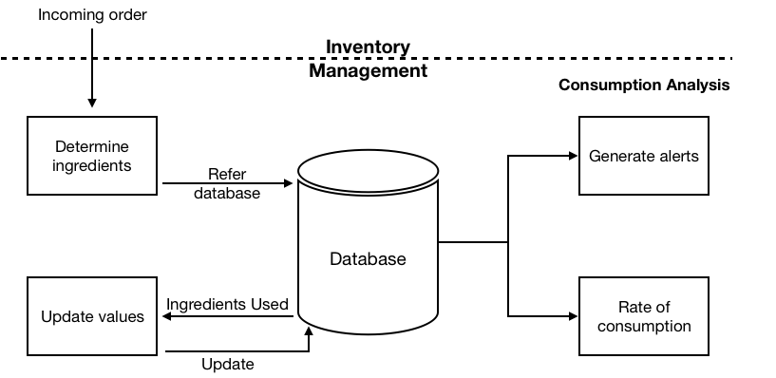
Inventory management

Slide 6
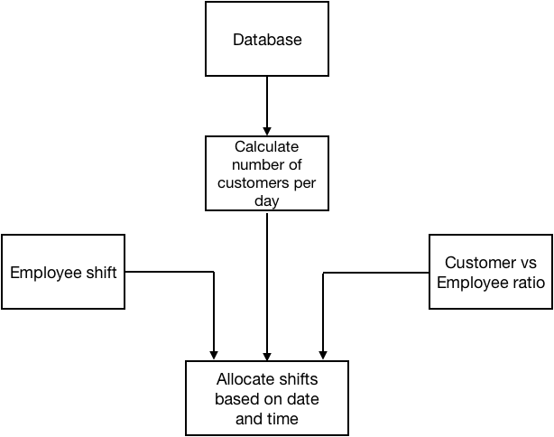
Employee management based on no. of customers

Slide 7

Item based sales analysis

Slide 8
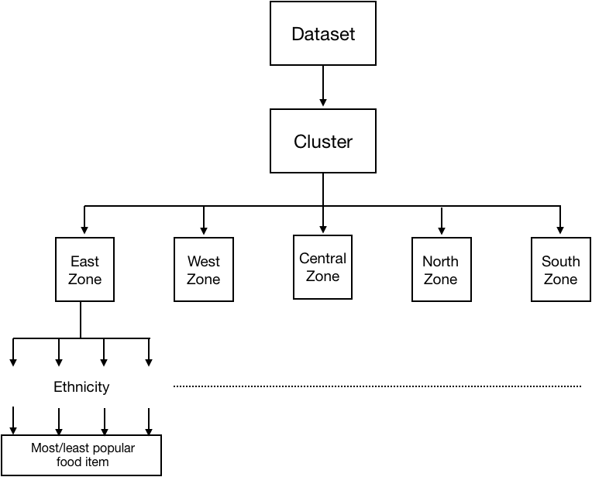
Trend analysis based on geography

Slide 9
Conclusion
Food byte helps the restaurant management in understanding the restaurant better and hence in managing it better.
Restaurant managers have a more informed idea of how to cut down on overheads and unnecessary expenditure, be it in staffing, inventory stocking or food preparation.
It can be used by both smaller restaurants as well as chain restaurants as it provides location based analytics.

