Slide 1


FOOD BYTE
Group#1
Akshay, Ashwin, Anvitha, Prince, Priyanka, Sarthak, Suraj, Yashasvi
PRESENTATION & DEMO

Slide 2

OUR BIG IDEA
We aim deliver an ubiquitous software solution to increase restaurant efficiency and profitability, using Data Analytics and cutting down on overheads.
Also, we aim to predict and suggest customer and sales trends.

Slide 3
Data Analytics
TREND ANALYSIS BASED ON GEOGRAPHY
ANALYSIS BASED ON CUSTOMER DENSITY
DATA ANALYTICS
INVENTORY MANAGEMENT
ITEM BASED REVENUE MAXIMISATION

Slide 4
Where we are now?
User Interface – (P.O.S. & Manager)
Dataset Creation
Setting up our Inventory

Slide 5
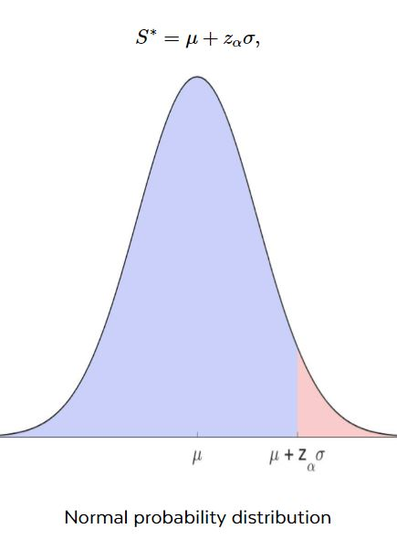

Coming Soon…
Clustering
Prediction Algorithms

Slide 6
THANK YOU

