Slide 1
Lead Scoring Case Study
Abhishek Gangisetty
Ritesh Kumar
Sanket Yadav

Slide 2
The problem statement
X Education sells online courses to industry professionals.
X Education gets a lot of leads, its lead conversion rate is very poor. For example, if, say, they acquire 100 leads in a day, only about 30 of them are converted.
To make this process more efficient, the company wishes to identify the most potential leads, also known as ‘Hot Leads’.
If they successfully identify this set of leads, the lead conversion rate should go up as the sales team will now be focusing more on communicating with the potential leads rather than making calls to everyone.

Slide 3
Business Objective
Objective 1
Objective 2
Objective 3
X education wants to know most promising leads.
X education wants us to build a Model which identifies the hot leads.
X education wants their model deployed for future use.

Slide 4
Goal
To achieve target lead conversion rate of ~80%

Slide 5
Implementation

Slide 6
Feature Scaling and Dummy variable creation
Data cleaning and manipulation
Evaluating the Model
Step-1
Step-2
Step-3
Step-4
Step-5
Step-6
Step-7
EDA on Cleaned data
Building a model using Logistic Regression.
Recommendations

Slide 7
Data Cleaning and Manipulation.
Dataset has 9240 rows and 37 columns
Dropped columns with more than 3000 of missing values counts.
X Education is an online education platform so the columns “City” & “Country” are dropped
‘Lead Profile’ and ‘How did you hear about X Education’ have lot of ‘Select’ level. Hence, dropped them as well
Many columns were dropped due to highly imbalance
For columns with less than 2% of missing values, only the rows containing the null values are dropped.

Slide 8
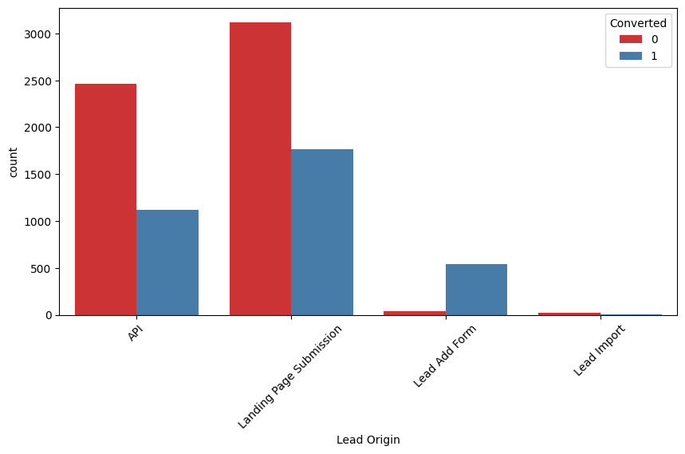
EDA - Univariate Analysis - Lead Origin
API and Landing Page Submission have 30-35% conversion rate but count of lead originated from them are considerable.
Lead Add Form has more than 90% conversion rate but count of lead are not very high.
Lead Import are very less in count.
To improve overall lead conversion rate, we need to focus more on improving lead conversion of API and Landing Page Submission origin and generate more leads from Lead Add Form

Slide 9
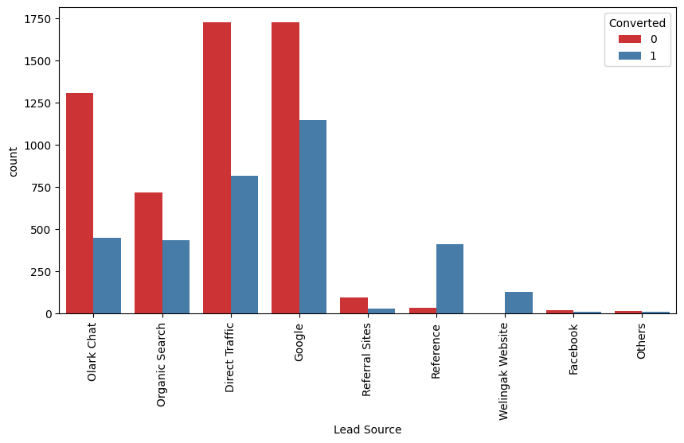
EDA - Univariate Analysis - Lead Source
Google and Direct traffic generates maximum number of leads.
Conversion Rate of reference leads and leads through welingak website is high.
To improve overall lead conversion rate, focus should be on improving lead conversion of olark chat, organic search, direct traffic, and google leads and generate more leads from reference and welingak website

Slide 10
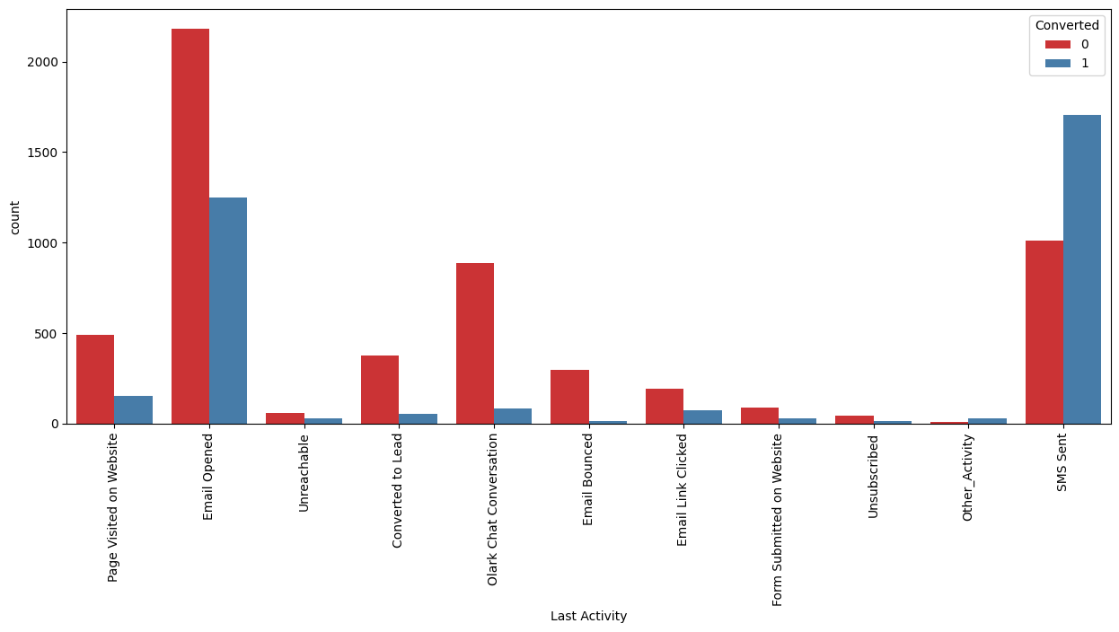
EDA - Univariate Analysis - Last Activity
Most of the lead have their Email opened as their last activity.
Conversion rate for leads with last activity as SMS Sent is almost 60%.

Slide 11
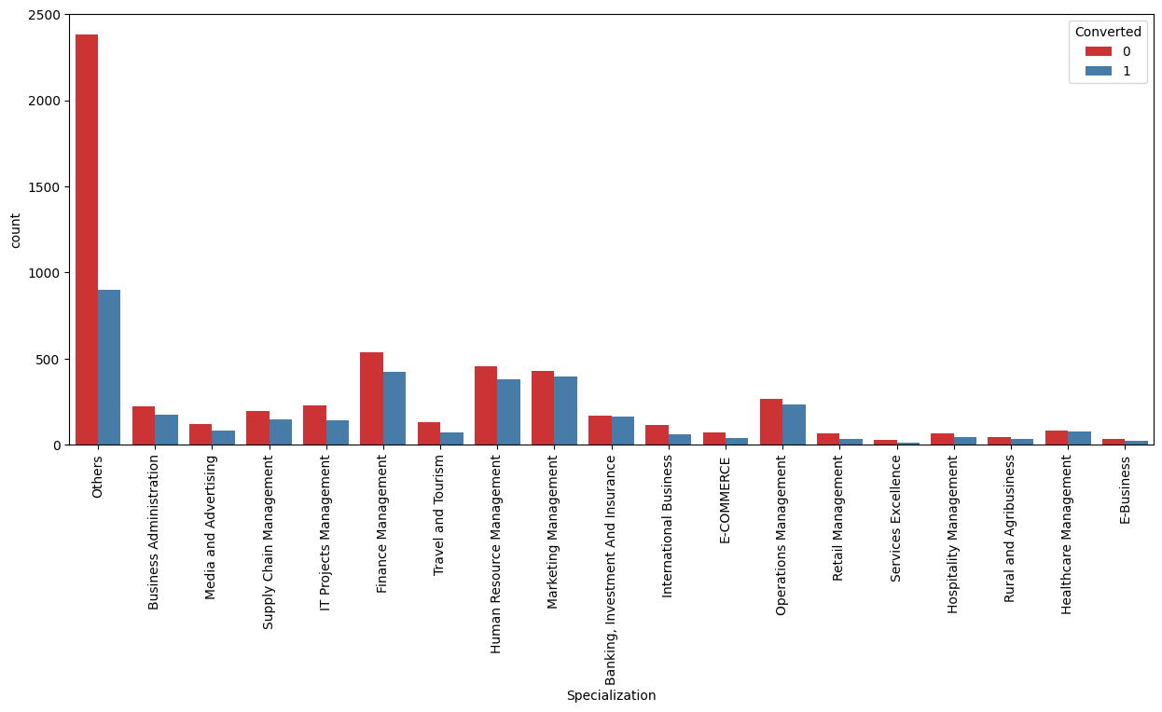
EDA - Univariate Analysis - Specialization
Focus should be more on specialization with high conversion rate

Slide 12
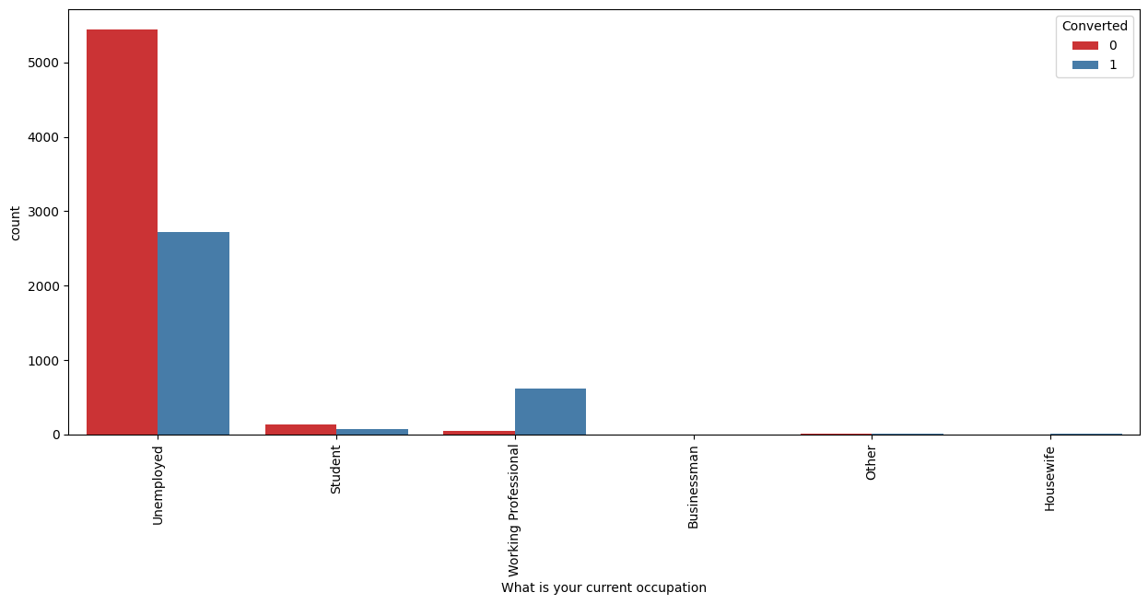
EDA - Univariate Analysis - What is your current occupation
Working Professionals going for the course have high chances of joining it.
Unemployed leads are the most in numbers but has around 30-35% conversion rate.

Slide 13
EDA - Conclusion
Based on the univariate analysis we have seen that many columns are not adding any information to the model, hence we dropped them for further analysis.
'Lead Number', 'Tags', 'Country', 'Search', 'Magazine', 'Newspaper Article', 'X Education Forums', 'Newspaper', 'Digital Advertisement', 'Through Recommendations', 'Receive More Updates About Our Courses', 'Update me on Supply Chain Content', 'Get updates on DM Content', 'I agree to pay the amount through cheque', 'A free copy of Mastering The Interview' are dropped.

Slide 14
Feature Scaling and Dummy variable creation
Numerical variables are normalised.
Dummy variables are created for Categorical variables.
'Lead Origin', 'Lead Source', 'Last Activity', 'Specialization', 'What is your current occupation', 'City', 'Last Notable Activity'
Total rows and columns for analysis: 9074 rows x 75 columns

Slide 15
Model Building and Evaluation
Data split into Train and Test sets
Split between Train and Test is 70:30
Recursive Feature Elimination (RFE) is used with 15 variables as output.
Model was built on Train data by removing the variables with P-Value greater than 0.05 and VIF greater than 5.
Once the model is built, Predictions were done on Train and Test data
Calculated Accuracy, Sensitivity, Specificity using an arbitrary value such as 0.5 as cut-off probability.
Overall Accuracy was 79%.

Slide 16
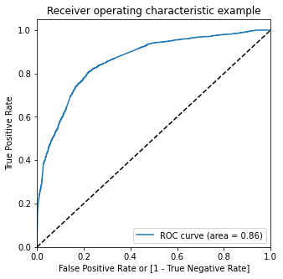
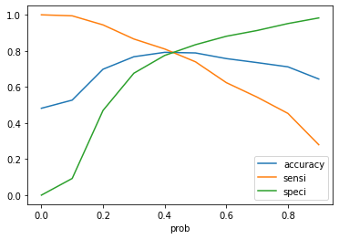
Model Evaluation
ROC area is 0.86 which indicates our model is good.
Optimal cutoff probability is a point where we get balanced sensitivity and specificity.
From the second graph, Optimal Cut-off is at 0.42.
Final predictions were done using above Optimal cut-off.

Slide 17
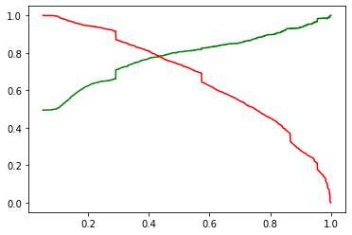
Model Evaluation
Plotted trade-off curve between precision and recall.
Assigned lead score to the test data.
Created confusion matrix for Train and Test data.
Comparing the values obtained for Train & Test:
Train Data:
Accuracy : 78.8%
Sensitivity : 73.4%
Specificity : 83.2%
Test Data:
Accuracy : 78.4%
Sensitivity : 77.9%
Specificity : 78.9%
Precision vs Recall

Slide 18
Observations
392 leads were hotleads whose lead score is greater than 85.
We have achieved our goal of getting a ballpark of the target lead conversion rate to be around 80% .
The Model seems to predict the Conversion Rate very well and we should be able to give the CEO confidence in making good calls based on this model to get a higher lead conversion rate of 80%

Slide 19
Impact
There are 392 leads which can be contacted and have a high chance of getting converted, whose lead score is greater than 85.
We have achieved our goal of getting a ballpark of the target lead conversion rate to be around 80% .
The Model seems to predict the Conversion Rate very well and we should be able to give the CEO confidence in making good calls based on this model to get a higher lead conversion rate of 80%
max growth

Slide 20
Recommendations
The company should make calls to leads from below sources as they are more likely to get converted:
The company should make calls to the leads who makes more number of visits on the educational platform
The company should make calls to the leads who spents more time on the websites
The company should make calls to the leads coming from the lead sources "Welingak Website" as these are more likely to get converted.
The company should make calls to the leads coming from the lead sources "Olark Chat" as these are more likely to get converted.
The company should make calls to the leads whose last activity was SMS Sent as they are more likely to get converted.
The company should not make calls to the leads from below sources as they are not likely to get converted:
The company should not make calls to the leads whose Occupation is "Students"
The company should not make calls to the leads whose Ocuupation is "Unemployed"
The company should not make calls to the leads who chose the option of "Do not Email" as "yes" as they are not likely to get converted.

