Slide 1
PROBABILITY THEORY
MM 4
MM 4: Special probability distributions
Topics: Discrete distributions:
Bernoulli, binomial, geometric, Poisson

Slide 2
Quizz
Suppose X has mean 2 and variance 3
Compute Var(3X)
  3
  9
  27
Compute Var(3X+4)
  27
  31
  43
Compute E[X^2]
  4
  7
Compute Var(X^2)
  9
  Can not be computed from infomration given

Slide 3
Quizz
Can the following be negative:
  A r.v. X
  E[X]
  E[X^2]
  Var(X)
  Cov(X,Y)

Slide 4
Quiz
If you have a pdf (pmf), can you find a cdf?
Is the opposite true?

Slide 5
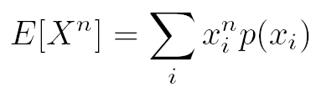
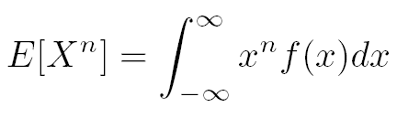
The nth moment of r.v. X
The mean value is sometimes called the first moment of X.
Definition. The nth moment of X is defined by

Slide 6
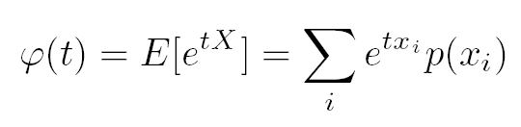
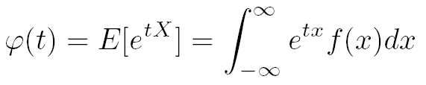
Moment generating function
Definition. The moment generating function of a r.v. X is defined for all values t by
This function is called moment generating function, because all moments of X can be obtained by successively differentiating it.
There is a one-to-one correspondence between the moment generating function and the distribution function of a r.v.: the mgf uniquely determines the distribution and vice versa.

Slide 7
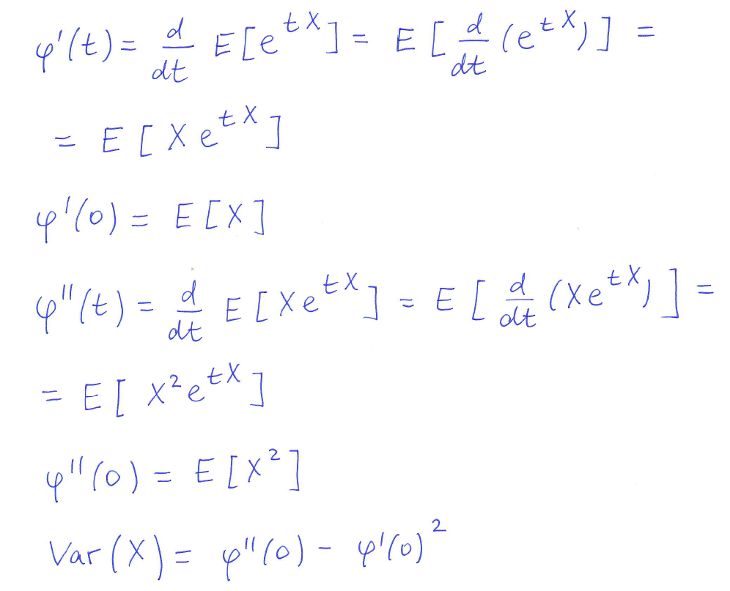
How to obtain E[X] and Var(X) from moment generating function?

Slide 8

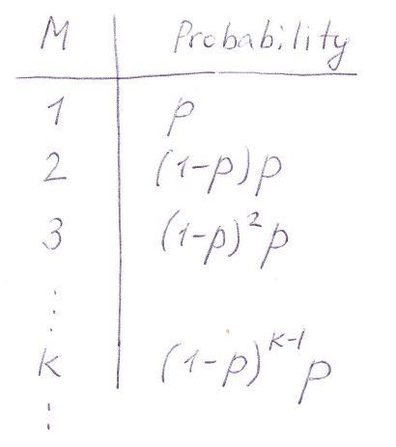
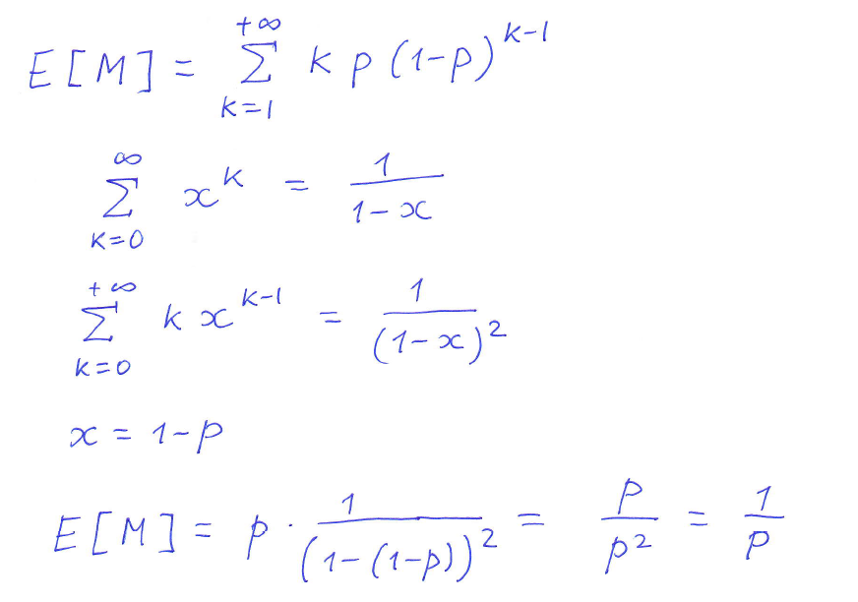
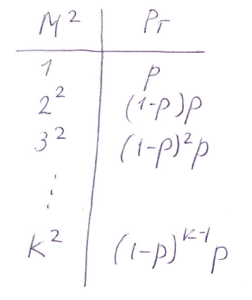
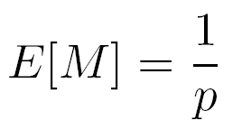
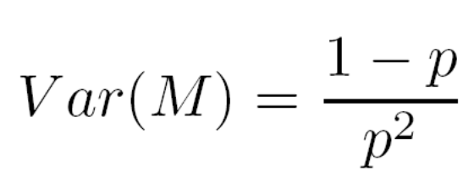
Example: packet retransmissions

Slide 9
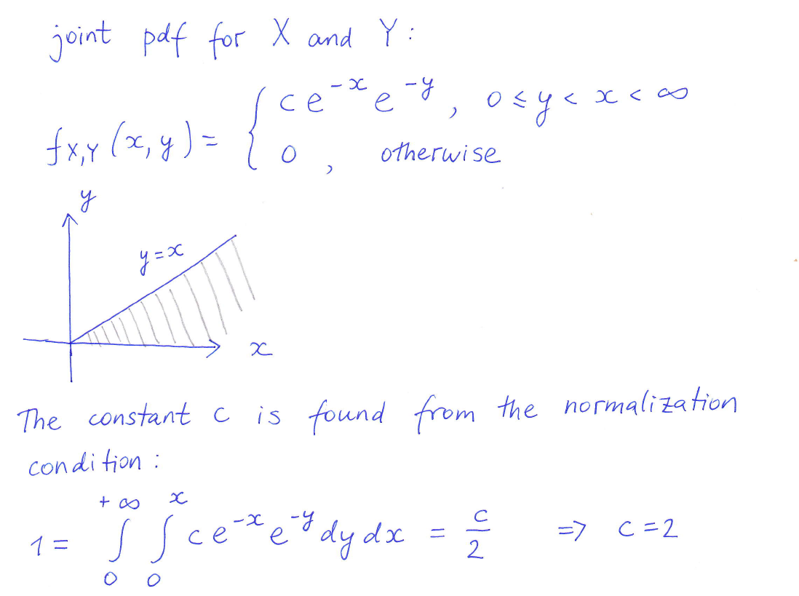
Example: covariance

Slide 10
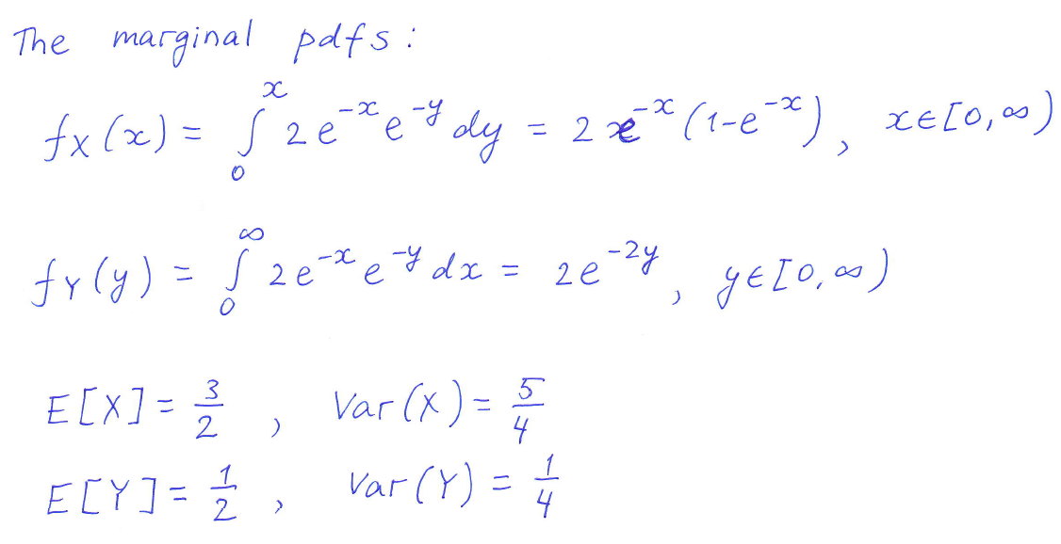
Example: covariance (ctnd)

Slide 11
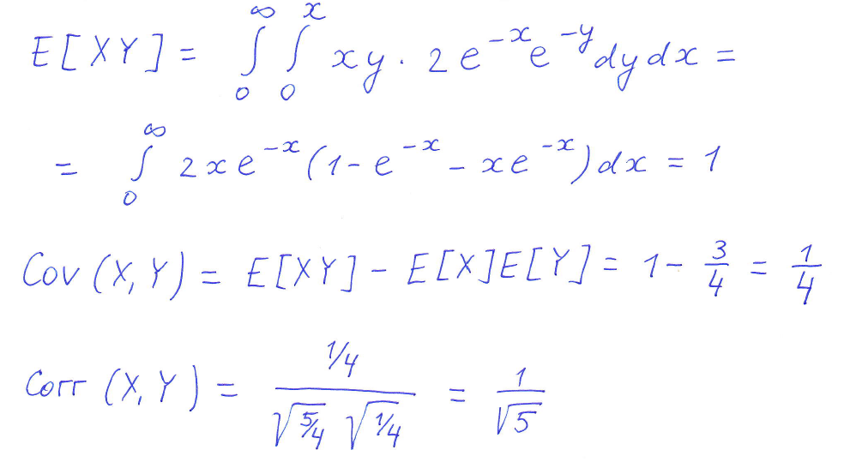
Example: covariance (ctnd)

Slide 12
What should we learn today?
A number of r.vs. arises in many diverse, unrelated applications → learn them
What are the main facts about these distributions:
  Their cdf and pdf
  Mean and variance
  Moment generating function
In which situations the special distributions arrise and how are they interrelated?

Slide 13

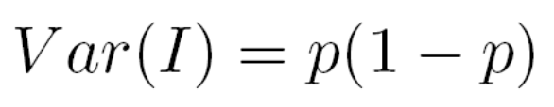
Bernoulli r.v.
An experiment with 2 possible outcomes (success or failure) is called a Bernoulli trial.
The indicator of event A is called the Bernoulli r.v., since it describes outcome of a Bernoulli trial.
Every Bernoulli trial, regardless of the definition of A, is equivalent to the tossing of a biased coin.

Slide 14
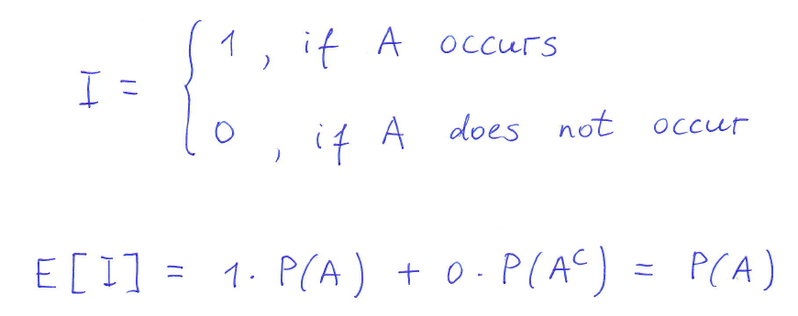
Example: indicator of an event
Example: a r.v. I is an indicator of the event A
The expected value of the indicator of an event is equal to the probability of the event

Slide 15
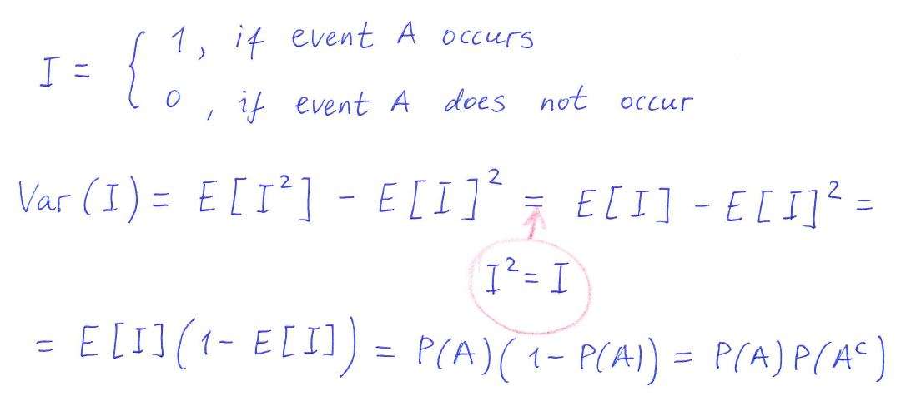
Example: indicator of an event

Slide 16
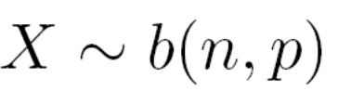
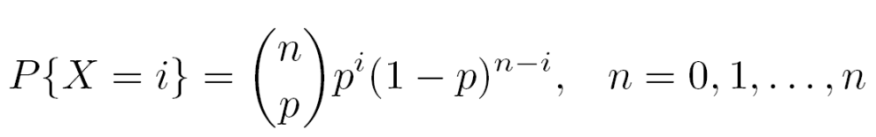
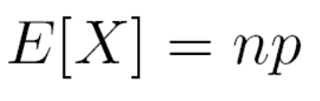
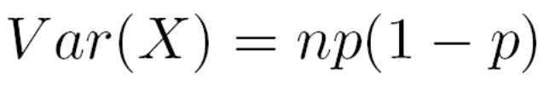
Binomial r.v.
Let X be a r.v. representing the number of times a certain event A occurs in n trials (number of success in n trials). Denote p probability of success.
Then X is said to be a binomial r.v. with parameters n and p
Pmf

Slide 17
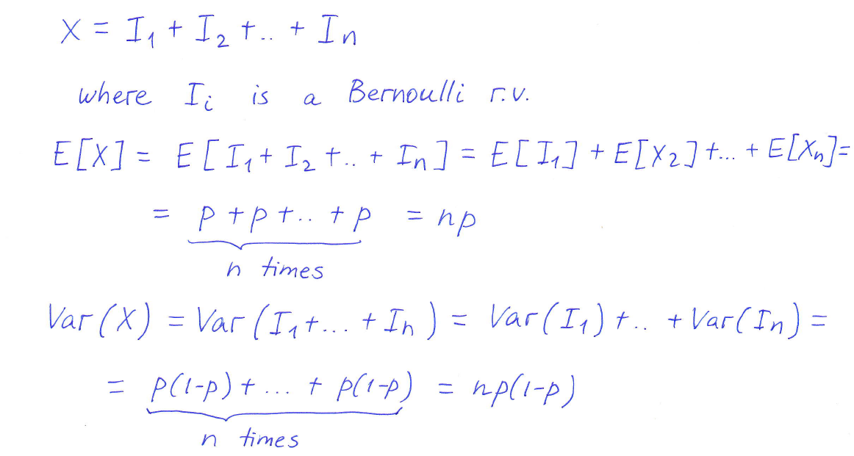
Binomial r.v.: mean and variance

Slide 18
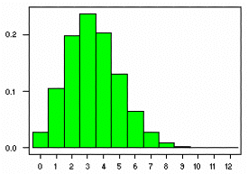
Binomial r.v.
Parameters n=20, p=1/6

Slide 19
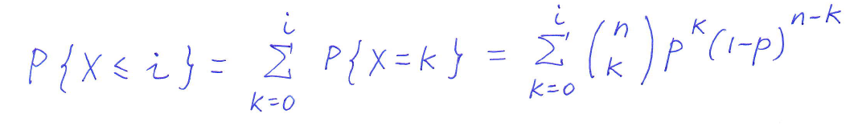
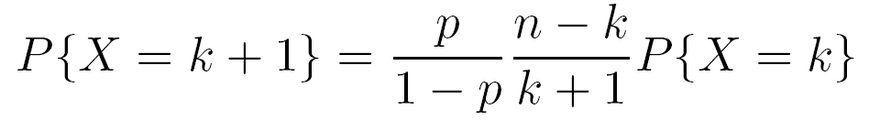
Computing the binomial distribution function
To optimize the computational process, we can utilize the following relationship between P{X=k+1} and P{X=k}:
Now starting from P(X=0) we can recursively find all other P(X=k)

Slide 20
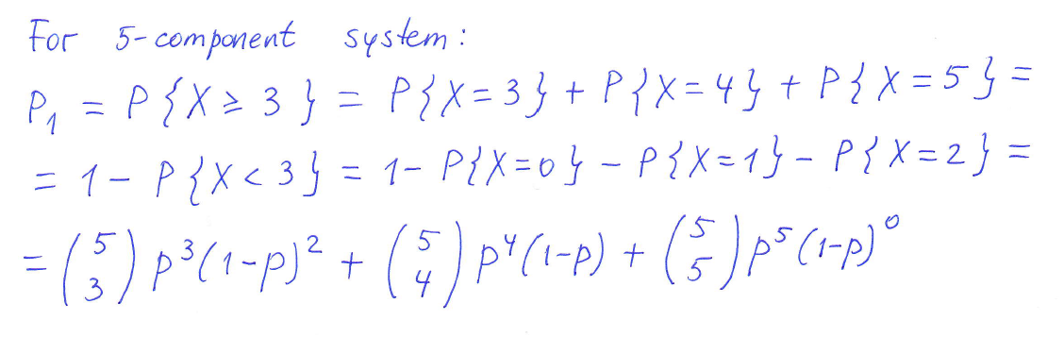
Example: n-component system
A system consists of n components. Each component functions independently with probability p.
Question: for which values of p is a 5-component system more likely to operate than a 3-component system?

Slide 21
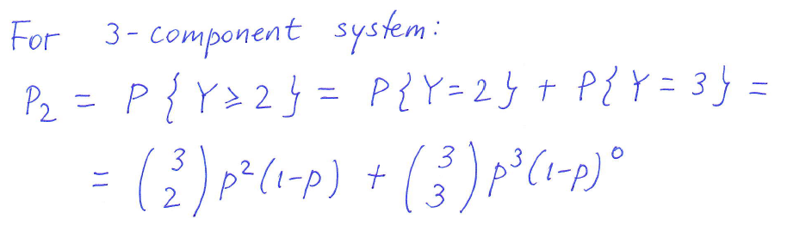
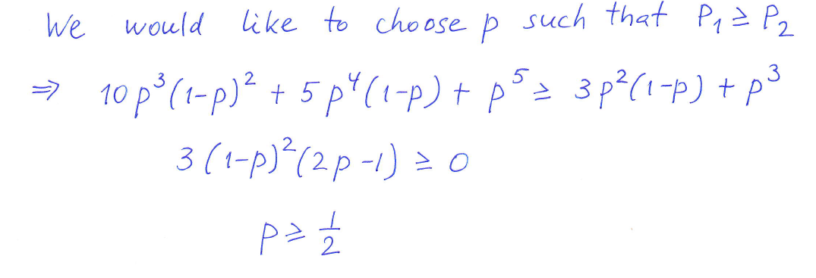
Example (cntd)

Slide 22
Why is it called binomial?
N / k | 0 | 1 | 2 | 3 | 4
1 | p | q
2 | p² | 2pq | q²
3 | p³ | 3p²q | 3pq² | q³
4 | p⁴ | 4p³q | 6p²q² | 4pq³ | q⁴
Coefficients are the same as in the binomial expansion (p+q)^{n}

Slide 23
The geometric r.v.
Let a r.v. M be a number of independent Bernoulli trials until the first occurence of a success. M is called a geometric r.v.
Pmf
Example: applications where we are interested in the time that elapses between the occurence of events in a sequence of independent experiments

Slide 24
Geometric r.v.: mean and variance

Slide 25
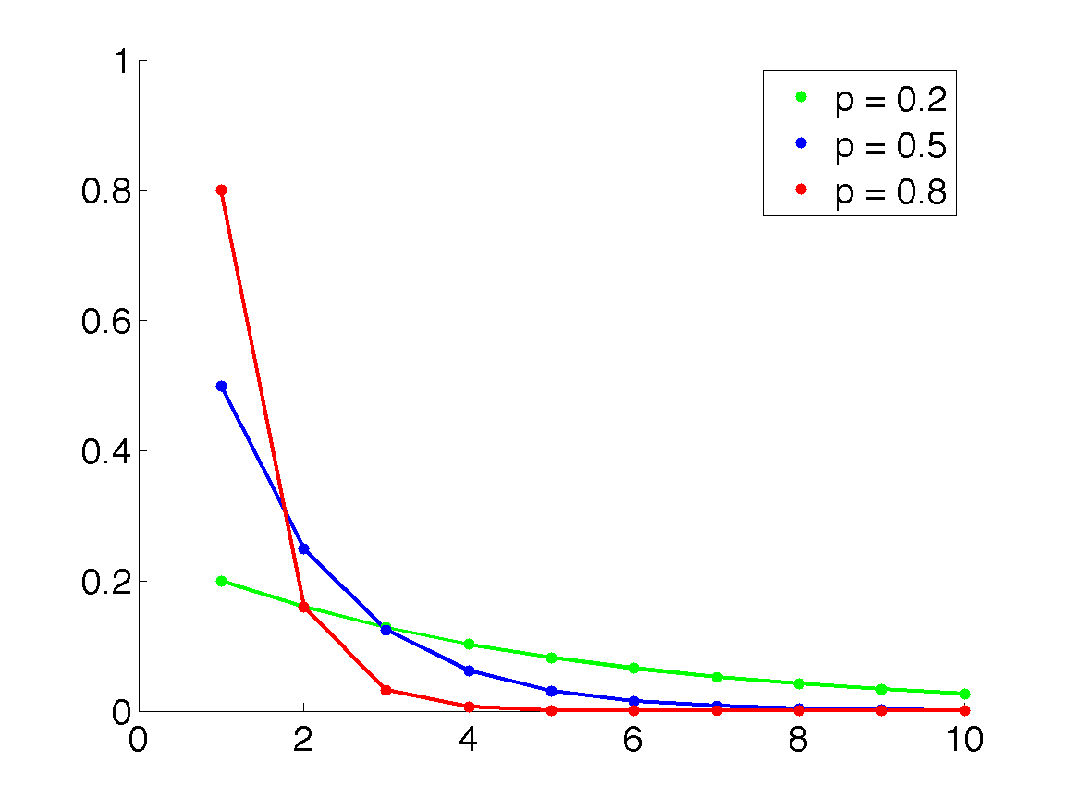
The geometric r.v.

Slide 26
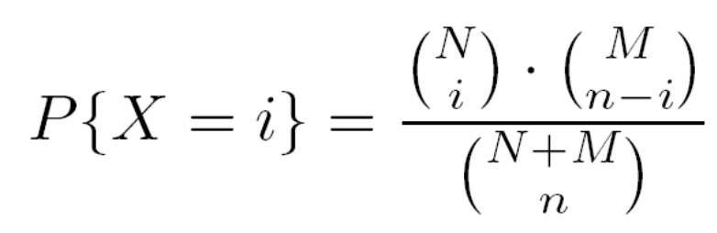
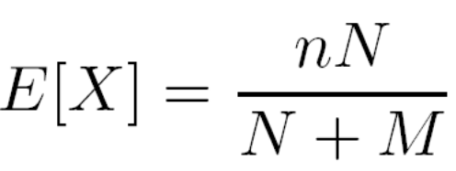
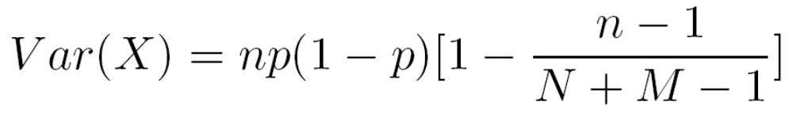
The hypergeometric r.v.
Suppose we have objects of two types: type 1 N objects (acceptable components) and type 2 M objects (defective components). A sample of n objects is randomly chosen without replacement.
A r.v. X represents a number of type 1 objects in the selection → hypergeometric with parameters (N, M, n)
Pmf

Slide 27

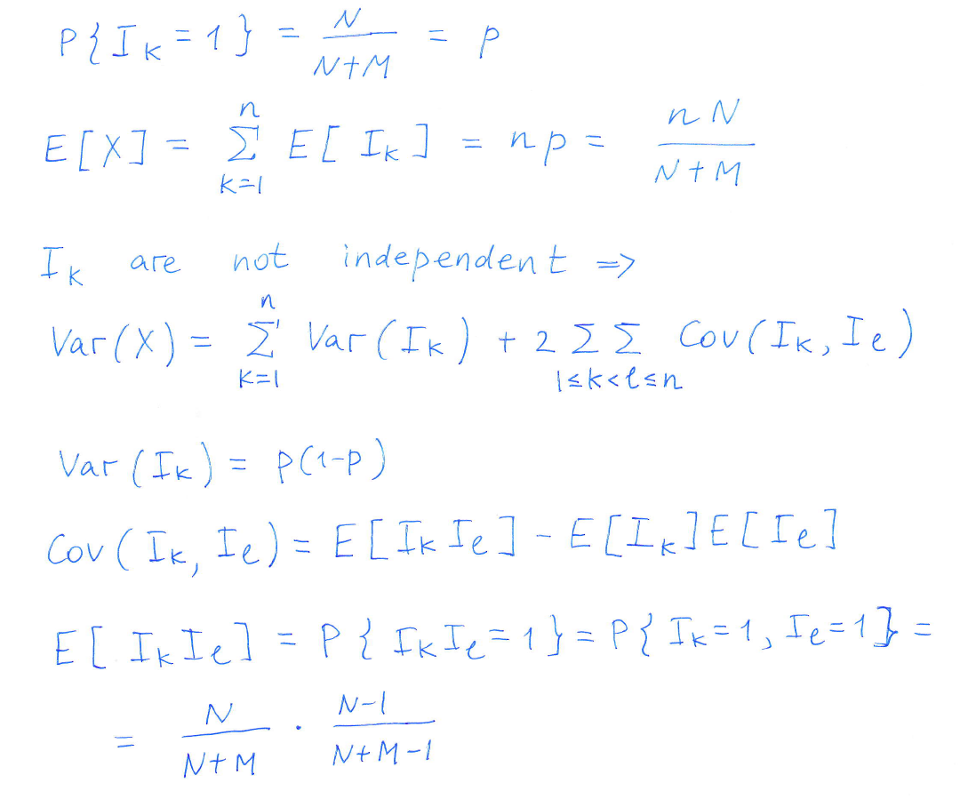
Derivation of formulas for mean and variance of hypergeometric r.v.

Slide 28
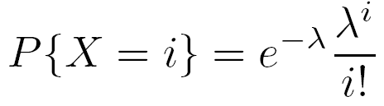
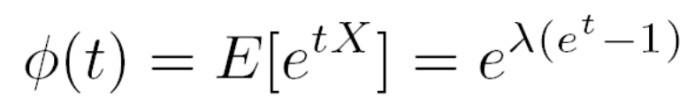
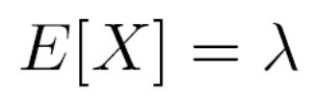

Poisson r.v.
A r.v. taking on one of values 0, 1, 2, … is said to be a Poisson r.v. with parameter λ (λ>0), if pmf is given by
Moment generating function:

Slide 29
Examples
Examples of events that can be modelled by Poisson distribution:
  Number of typos (misprints) on a page of a book
  Number of phone calls at a call center per minute
  Number of times a web server is accessed per minute
  Number of pine trees per unit area in a mized forest
  Number of stars in a given volume of space
  …

Slide 30
When is the Poisson distribution an appropriate model?
The occurrence of one event does not affect the probability that a second event will occur. That is, events occur independently.
The rate at which events occur is constant. The rate cannot be higher in some intervals and lower in other intervals.
The probability of an event in a small interval is proportional to the length of the interval.

Slide 31
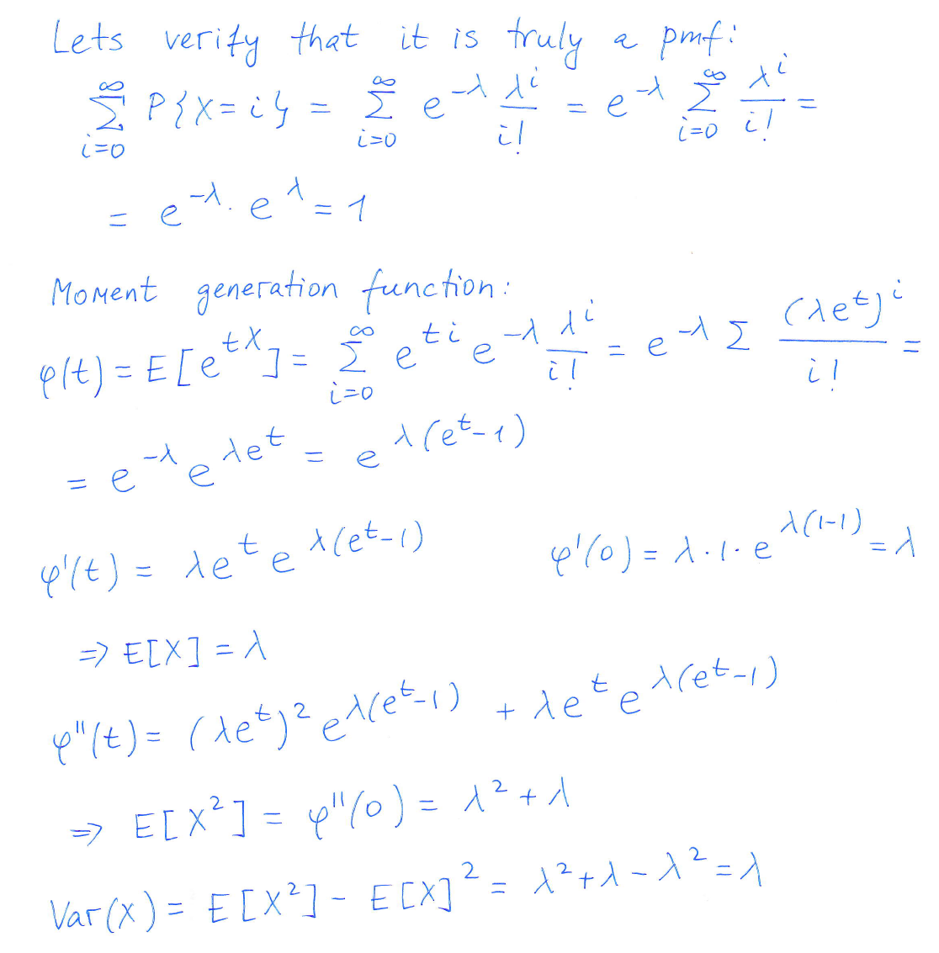
Poisson r.v.

Slide 32
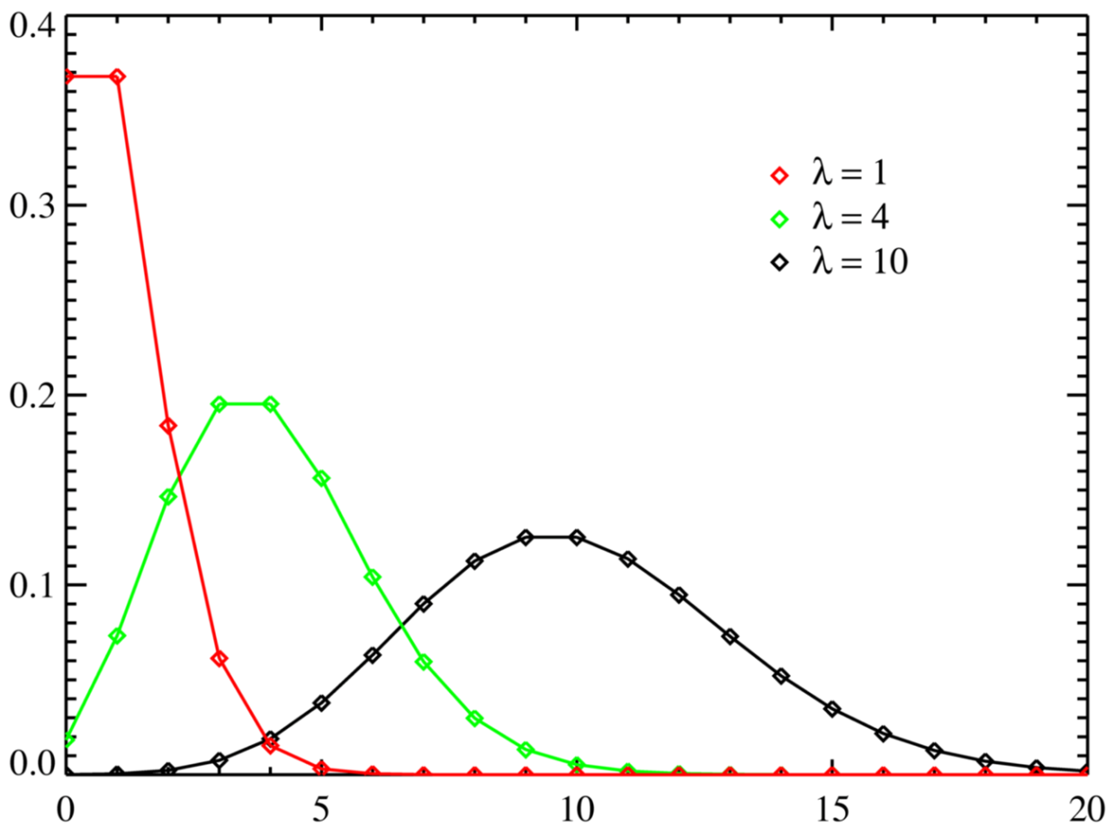
Poisson r.v.

Slide 33
Approximation for a binomial r.v.
One of the applications of the Poisson probabilities is to approximate the binomial probabilities – when n is large and p is small.
λ =np

Slide 34
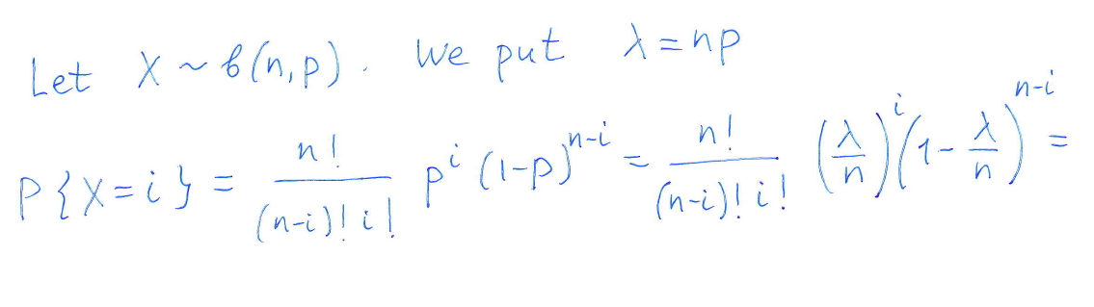
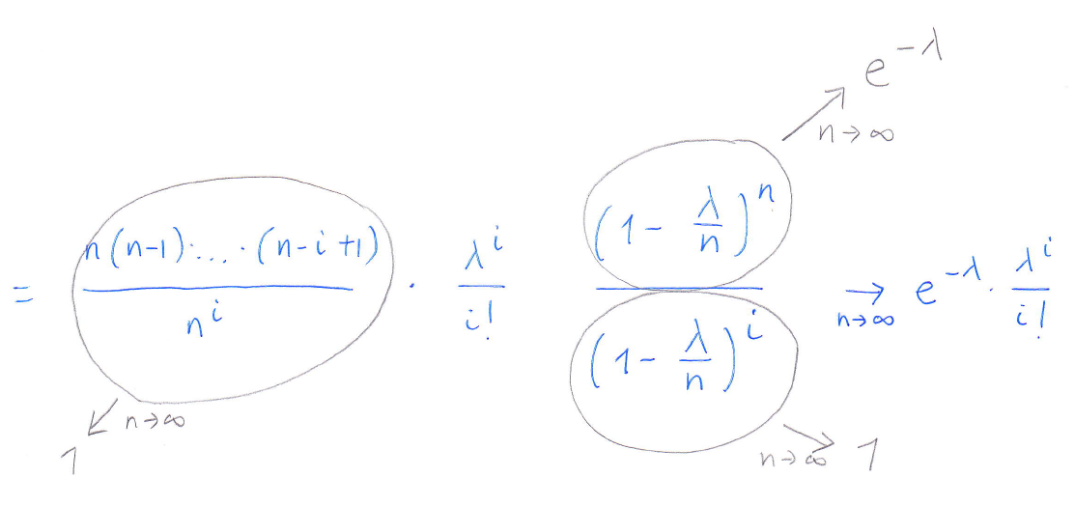

Slide 35
Properties of Poisson distribution
The probability of at least one occurrence of the event in a given time interval is proportional to the length of the interval.
The probability of two or more occurrences of the event in a very small time interval is negligible.
The numbers of occurrences of the event in disjoint time intervals are mutually independent.

Slide 36
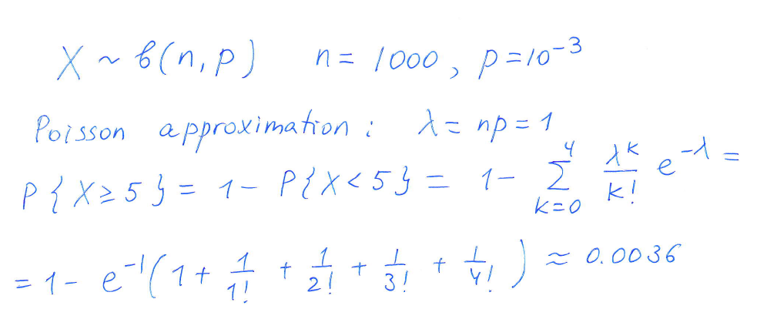
Example
The BER of a communication channel is 10^-3. What is a probability that a block of 1000 bits has five or more errors?

Slide 37
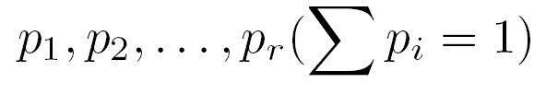
Properties of a Poisson r.v.
Reproductive property
Proposition.
1) The sum of independent Poisson r.vs. with parameters λ₁ and λ₂ is also a Poisson r.v. with parameter λ₁ + λ₂
2) If a Poisson event having mean λ can be independently classified as being of type 1, 2, … r with respective probabilities
then type i events are independent Poisson r.v. with means λ p₁ , λp₂… λp_{r}

