Slide 1
PROBABILITY THEORY
MM 5
MM 5: Special probability distributions
Topics: Continuous distributions:
uniform, exponential, normal

Slide 2
What should we learn today?
A number of r.vs. arises in many diverse, unrelated applications → learn them
What are the main facts about these distributions:
  Their cdf and pdf
  Mean and variance
  Moment generating function
In which situations the special distributions arrise and how are they interrelated?

Slide 3
Continuous r.vs.
We are always limited to measurements of finite precision → every random variable found in practice is in principle a discrete one.
However in many situations it is convenient and natural to work with an abstraction = continuous r.v.

Slide 4
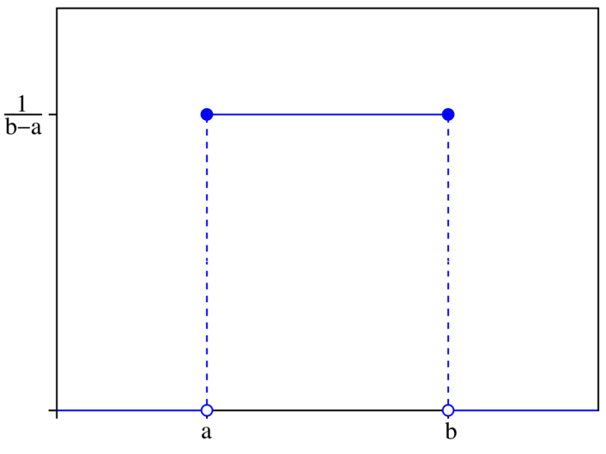
Uniform r.v.
The uniform r.v. arises in situations where all values in an interval of the real line are equally likely to occur. Its pdf is given by a constant.
We can also introduce a uniform distribution over 2-dimentional region: the random vector X, Y is said to have a uniform distribution, if its joint density function is constant for points in this region.

Slide 5
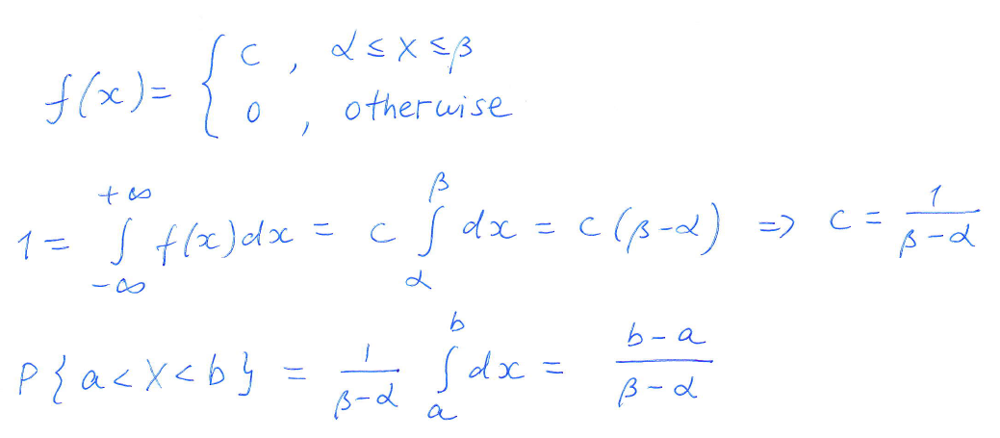
Uniform r.v.

Slide 6
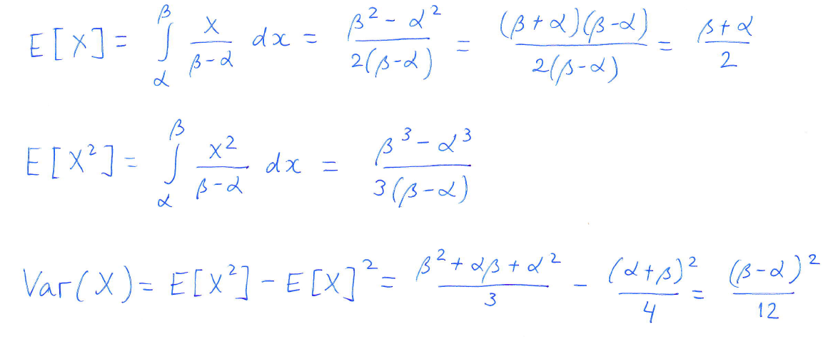
Uniform r.v.: mean and variance

Slide 7
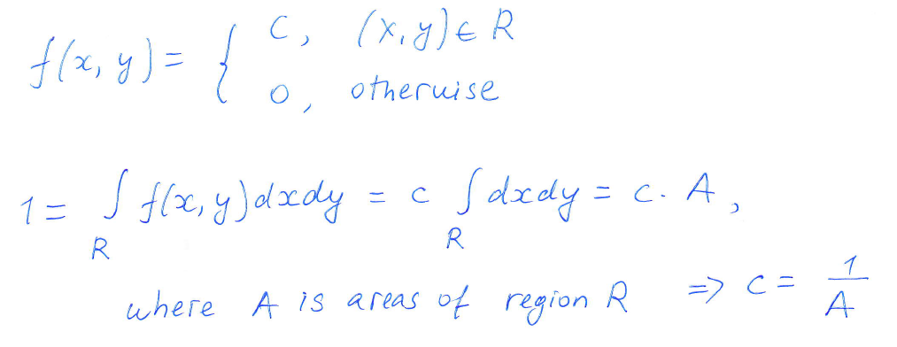
Uniform distribution over a 2-dimentional region

Slide 8
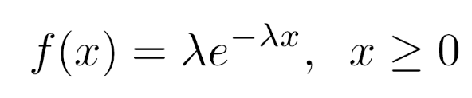
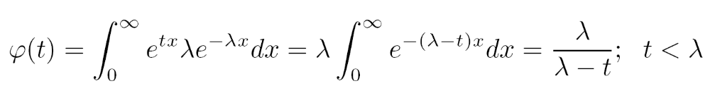

Exponential r.v.
Definition. X is an exponential r.v. with parameter lambda, if its pdf is
The moment generating function is
Memoryless property:

Slide 9
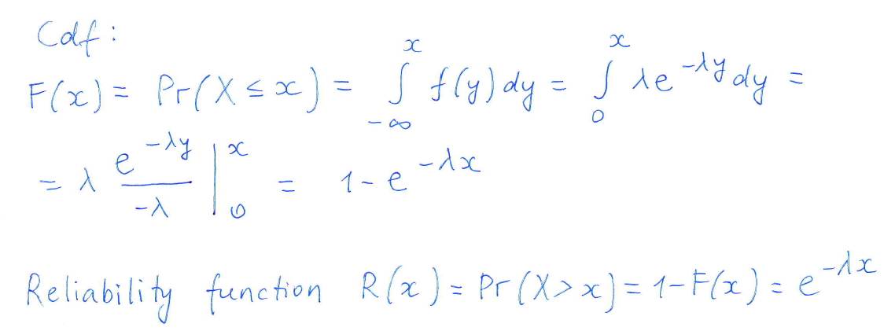
Exponential r.v.

Slide 10
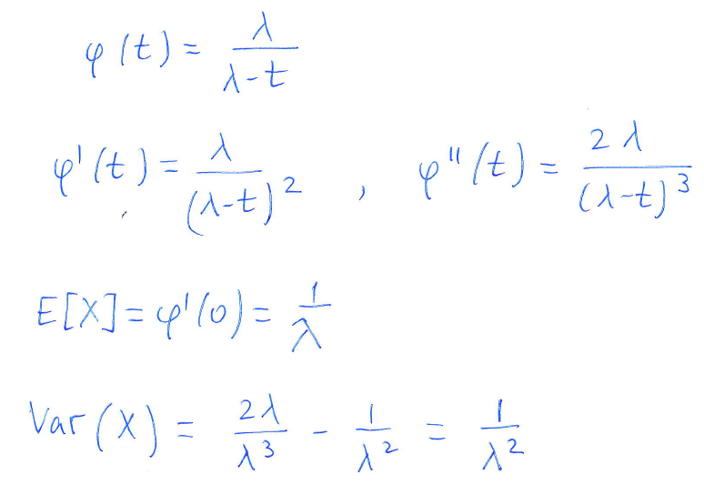
Exponential r.v.: mean and variance

Slide 11
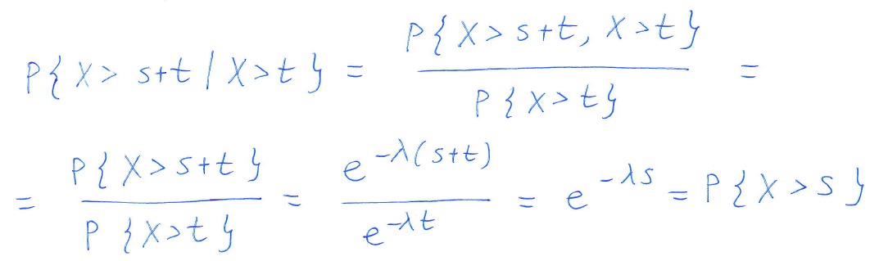
Exponential r.v. : memoryless property
→ Old item is as good as new. There is no need to remember the age of the functioning item.

Slide 12
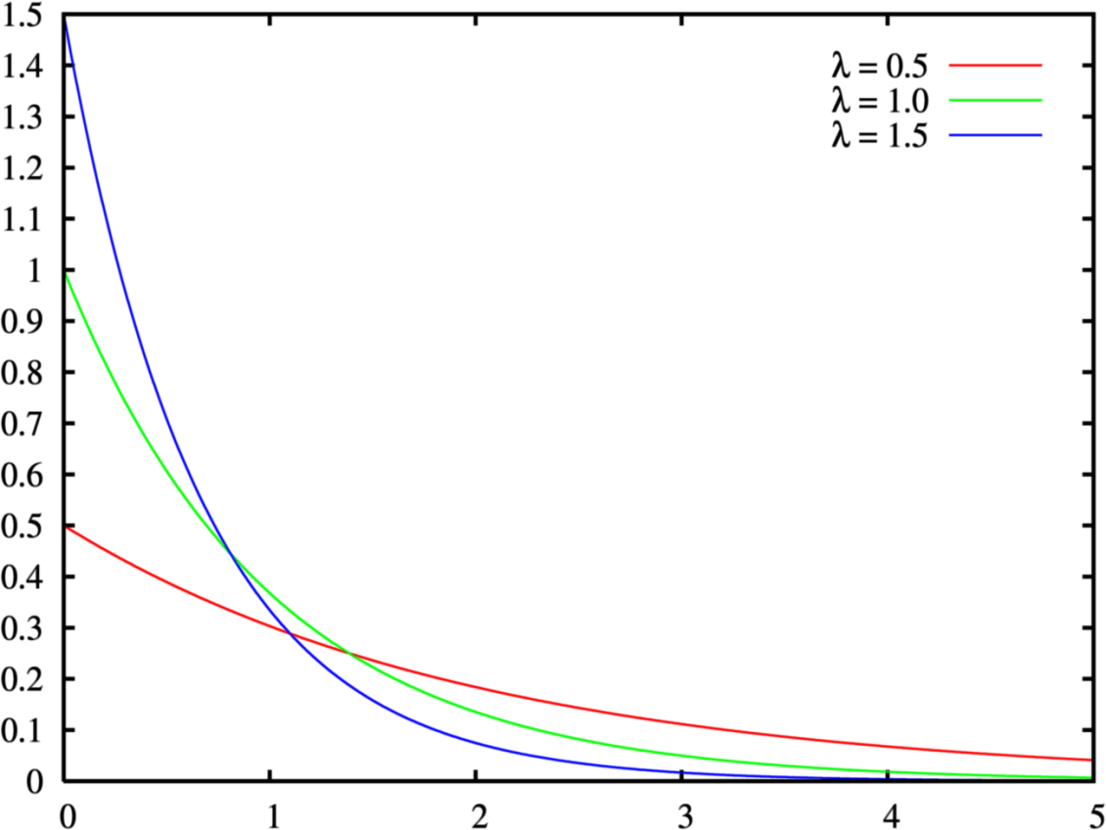
Pdf of exponential r.v.
Source: wikipedia

Slide 13
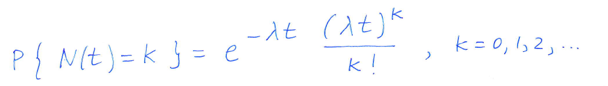
Poisson process
Suppose that events are occurring at random moments in time. N(t) is the number of events in a time interval [0,t].
The events are said to follow a Poisson process if

Slide 14
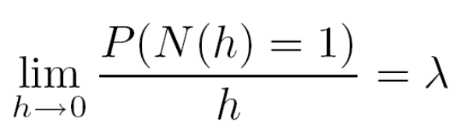
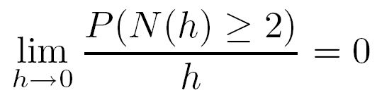
Poisson process
The events are said to constitute a Poisson process with rate lambda if
N(0)=0
The number of events occuring in disjoint time intervals are independent
The distribution depends only on the length of the interval
Under these assumptions, the number of events in any interval t has a Poisson distribution with mean λt.

Slide 15
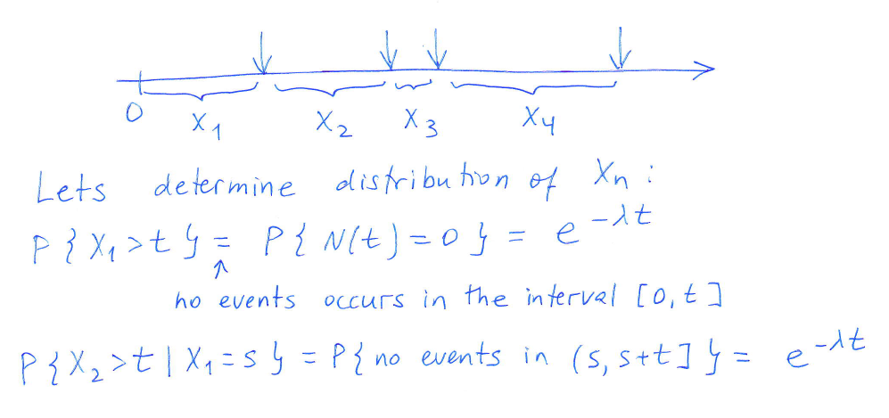
Poisson process: very important property
The interarrival times between the events of a Poisson process are independent exponential random variables each with rate λ.

Slide 16

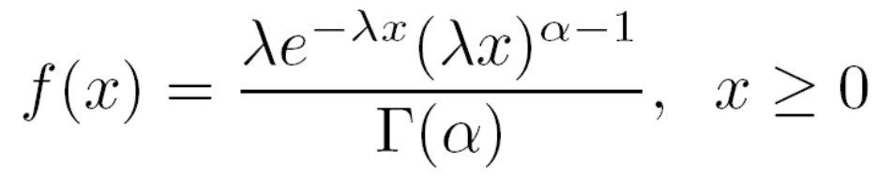
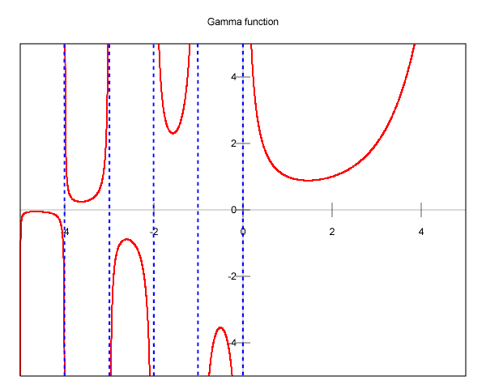
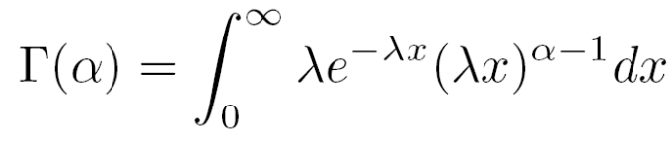
Gamma distribution
Definition. A r.v. is said to have a gamma distribution with paramaters if its pdf is given by
Source: wikipedia

Slide 17
Sum of exponential r.v.
Proposition. If X1, ..., Xn are independent exponential r.v. with parameters lambda, then their sum is a gamma r.v. with parameters (n, lambda) .

Slide 18
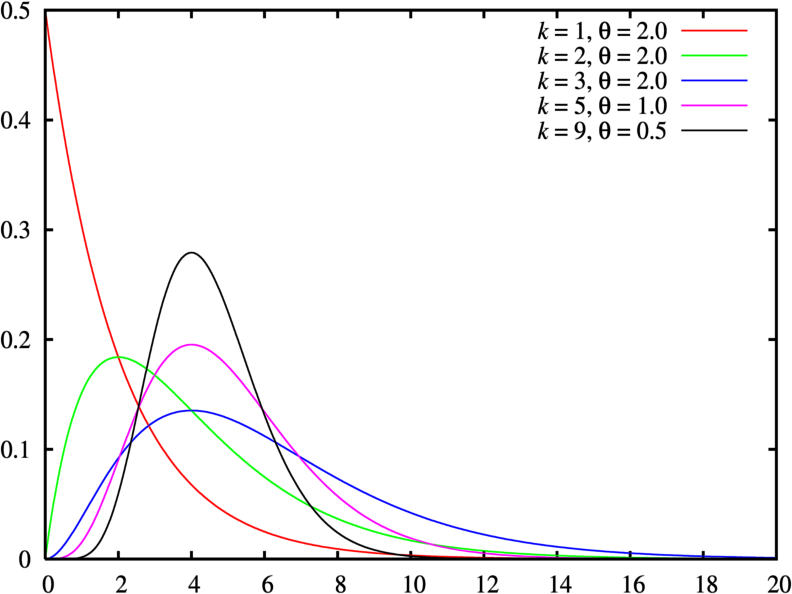
Gamma distribution
Source: wikipedia

Slide 19
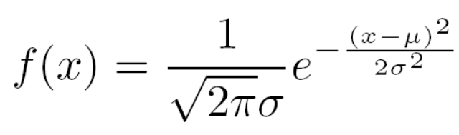
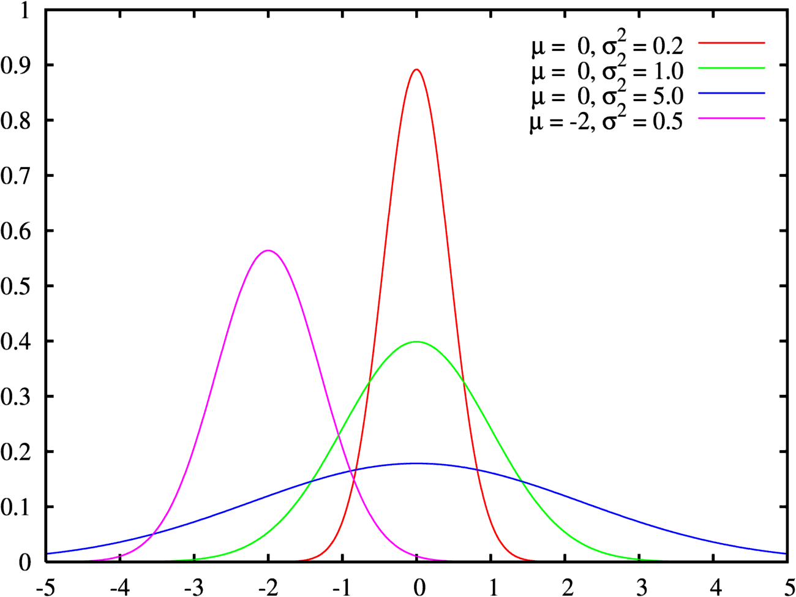
Normal r.v. (Gaussian r.v.)
Definition. A r.v. is said to be normally distributed if its pdf is
Source: wikipedia

Slide 20
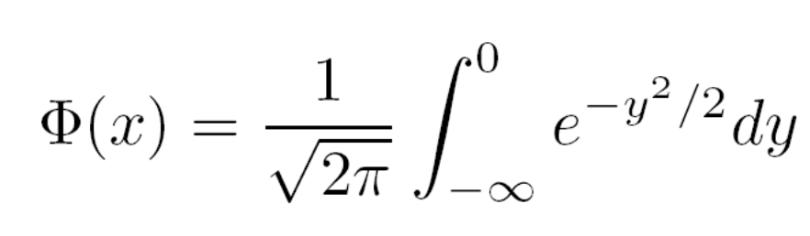
How to calculate normal distribution
In practise our goal is to find different probabilities. They can be calculated by finding a corresponding integral.
However, this integral does not have a closed-form expression → need numerically evaluate it every time
Nowadays:
E.g. Matlab P = normcdf(X,mu,sigma)
Old days:
Traditionally integrals have been evaluated by looking up tables → it is unrealistic to provide tables for all values of μ and σ → use tables for unit (standard) normal distribution μ=0 and σ=1

Slide 21
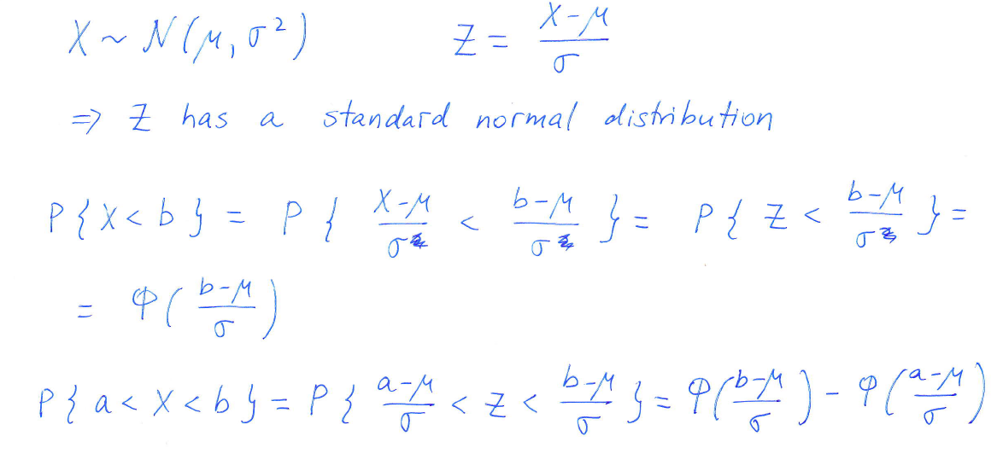
How to calculate normal distribution

Slide 22
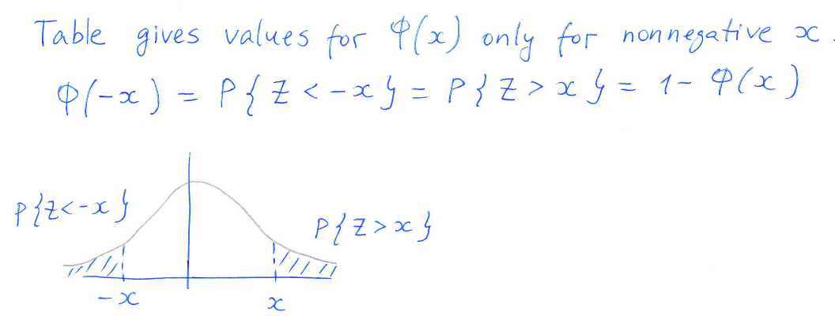
How to calculate normal distribution

Slide 23
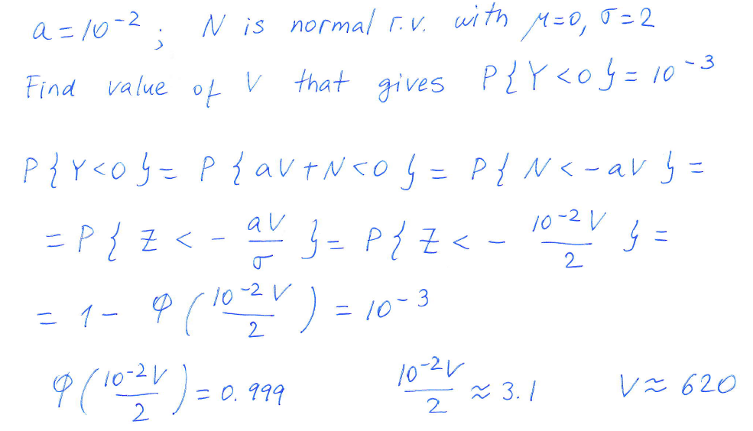
Example
A communication system accepts a positive voltage V as input, and outputs a voltage Y=aV+N, N is noise.

Slide 24
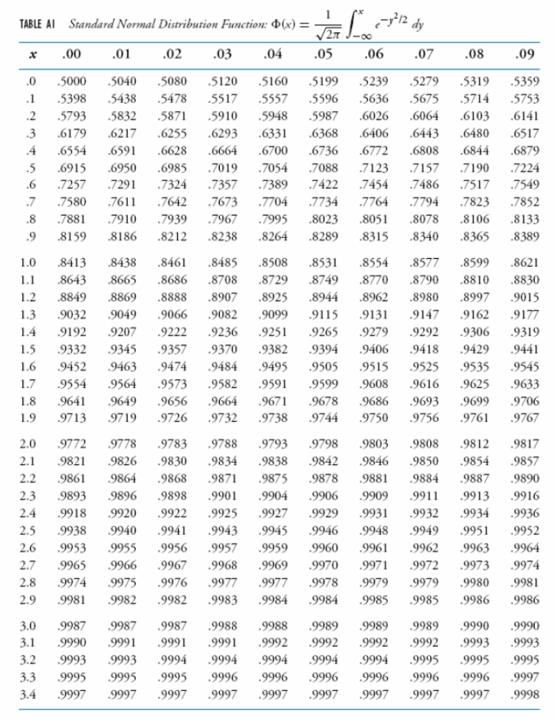
Table

Slide 25
Gamma distribution
Definition. A r.v. is said to have a gamma distribution with paramaters if its pdf is given by
Source: wikipedia

Slide 26
Sum of exponential r.v.
Proposition. If X1, ..., Xn are independent exponential r.v. with parameters lambda, then their sum is a gamma r.v. with parameters (n, lambda) .

Slide 27
Gamma distribution
Source: wikipedia

