Slide 1
ARM FIXED VIRTUAL PLATFORM
ANURAG SINGH
Last Semester Trainees – 2022
Notes:
Total time for presentation is 20 min, question answers for 10 min at the end.
Each team member has to present some part preferably in the order given on slide-2

Slide 2
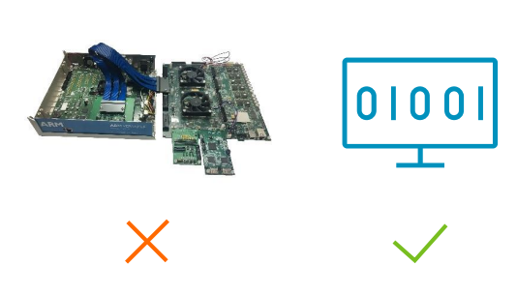

WHAT IS ARM FIXED VIRTUAL PLATFORM ?
Fixed Virtual Platforms (FVP) are simulation models used by engineers for software development before the equipment is delivered.
FVP are designed to emulate the work of a complete system, just as if it was physically connected to the programming environment.
The simulation models are developed and tested along with Arm IP, providing very accurate and proven virtual prototypes for software development.
Notes:
Write in bulleted points only and explain in detail while presenting. Mention here learnings from the Group Executive interactions, e.g. with Sanjay Singhal Sb, Suket Singhal Sb, Ananya Singhal Sb, Nandita Madam, Kaushik Ghosh, Hemant Gole, Amit Sharma, Shridhar Radhakrishnan.

Slide 3
TYPE OF ARM ENABLE VIRTUAL PLATEFORM
ARM FIXED VIRTUAL PLATFORM
Pre- built,
ready to use
ARM FAST MODEL TECHNOLOGY
Made- to- measure
CUSTOM VIRTUAL PLATFORM
Low cost software development platforms for Arm technologies
Comprehensive debug and trace
Available for Cortex-A, Cortex-R and Cortex-M
Flexible Virtual Platforms tailored to any system, Extensible, scalable.
Integration with Arm Cycle Models
Integrates into open source and proprietary System, simulators and EDA partner tools

Slide 4
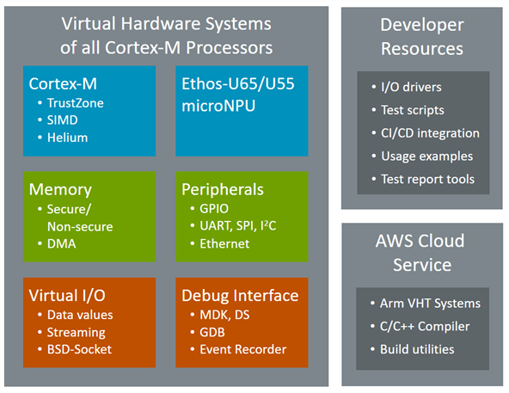
ARM FIXED VIRTUAL PLATEFORM COMPONENTS

Slide 5
ARM FIXED VIRTUAL PLATEFORM COMPONENTS
Arm Virtual Hardware Targets (VHT)
Simulation models of Cortex-M
Complex software verification and testing.
Simulation-based test automation
Arm Virtual Hardware Services
Cloud-native infra-structure for software test and validation.
Integrated into CI/CD and MLOps
AWS Marketplace
ARM VIRTUAL HARDWARE TARGET
ARM VIRTUAL HARDWARE SERVICES

Slide 6
ARM FIXED VIRTUAL PLATEFORM COMPONENTS
ARM VIRTUAL HARDWARE DEVELOPER
SOFTWARE DEVELOPMENT ENVIRONMENTS
Arm Virtual Hardware Developer Resources
Access to interface drivers map to virtual targets and physical hardware.
Audio processing, ML algorithm testing,
Software Development Environments
Hardware is an integral part of the Keil MDK Professional Edition.
In future, the next-generation Keil Studio will also integrate Arm Virtual Hardware.

Slide 7
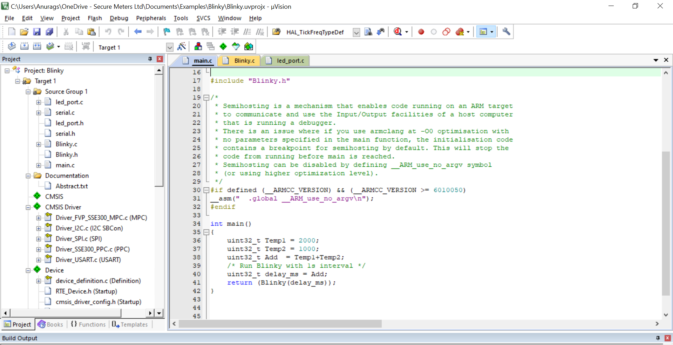
RUNNING SIMPLE BLINKY CODE IN FVP

Slide 8
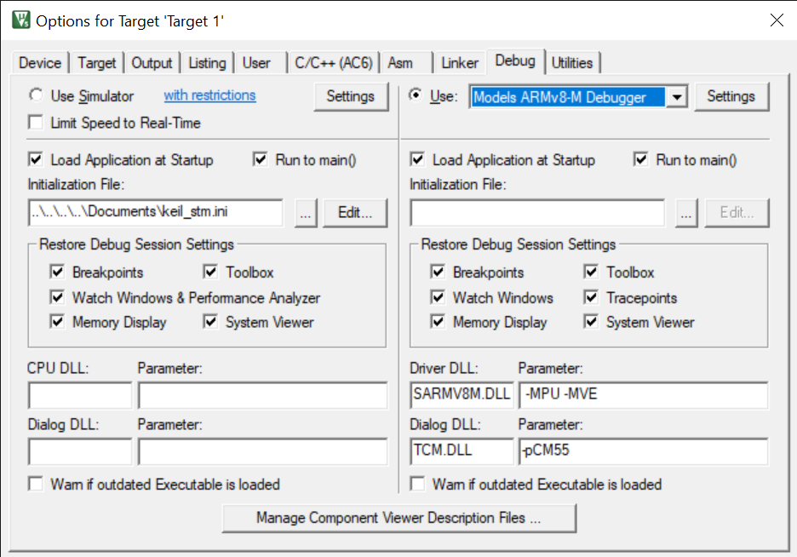
RUNNING SIMPLE BLINKY CODE IN FVP

Slide 9
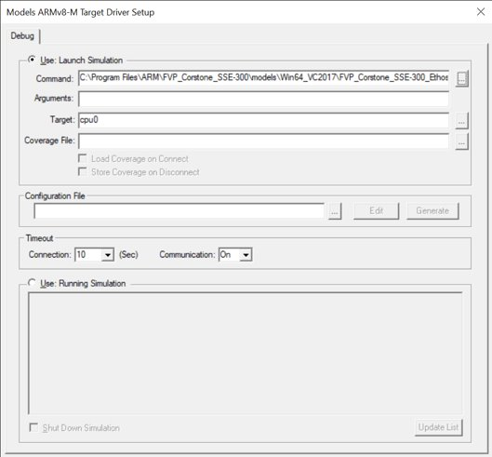
RUNNING SIMPLE BLINKY CODE IN FVP

Slide 10
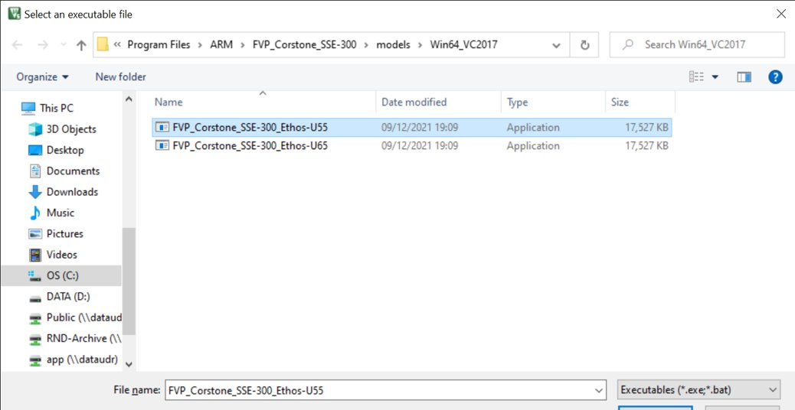
RUNNING SIMPLE BLINKY CODE IN FVP

Slide 11
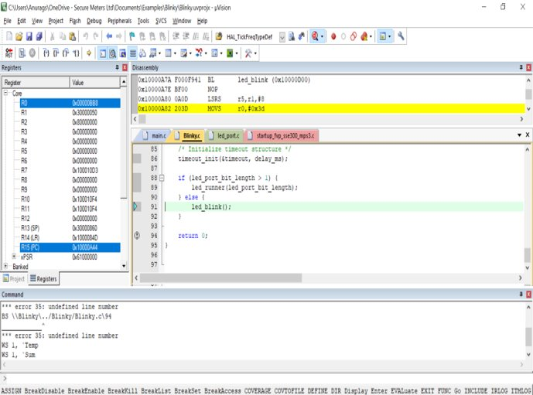
RUNNING SIMPLE BLINKY CODE IN FVP

Slide 12
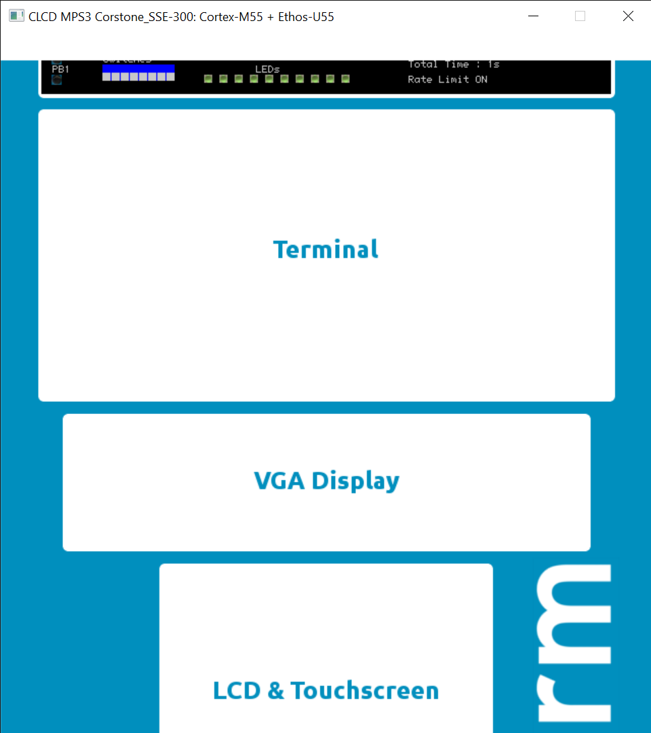
RUNNING SIMPLE BLINKY CODE IN FVP

Slide 13
Drawbacks of ARM FVP
The open source license scope is limited and we were not able to test many features of the Corstone-300.
In Corstone-300 we were not able to excess the terminals, VGA display, LCD and touch screen components provided in FVP.
In Corstone-300 we were not able to excess the push button on the FVP display layout.
The corstone-300 have also not provided definition on external peripherals support. with the FVP.

Slide 14
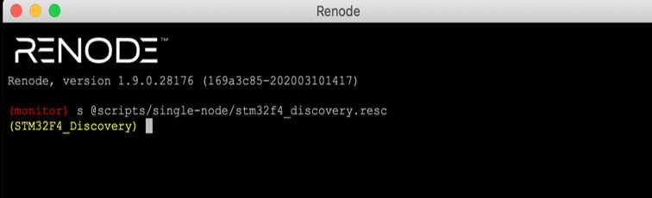
WHAT IS RENODE ?
Renode is an open-source Emulator for embedded platforms. Today, it supports x86 (Intel Quark), Cortex-A (NVIDIA Tegra), Cortex-M, SPARC (Leon), and RISC-V based platforms.
Renode can take the same firmware we are running in production, and run it against emulated cores, peripherals, and even sensors and actuators. Better yet, its extensive networking support and multi-system emulation make it a shoe in for testing systems made up of multiple devices talking together.
.
Notes:
Write in bulleted points only and explain in detail while presenting. Mention here learnings from the Group Executive interactions, e.g. with Sanjay Singhal Sb, Suket Singhal Sb, Ananya Singhal Sb, Nandita Madam, Kaushik Ghosh, Hemant Gole, Amit Sharma, Shridhar Radhakrishnan.

Slide 15
RUNNING SIMPLE FIRMWARE IN RENODE
Create a machine
A machine represents a device, which can have a number of cores. Renode can run multiple machines in a single run.
Configure our machine
we configure our machine. We could specify each bus and peripheral by hand, but instead we will load a prebuilt configuration.
Load our firmware
Before we start the machine, we want to do one last thing: open a terminal to display UART data. Some peripherals come with what Renode calls “Analyzers”, which are ways to display their state and data. We enabled UART2 in our firmware, so we will show the analyzer for UART2.

Slide 16
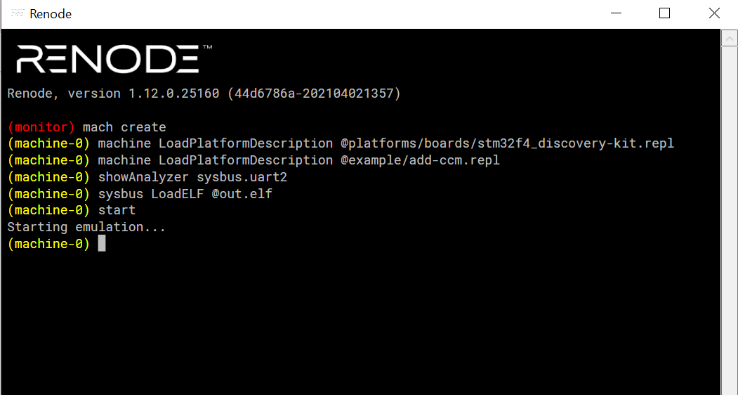

Slide 17


DEBUGGING IN RENODE
Inevitably things will go wrong, and you will need to debug them. This is one area where Renode really shines.
One of the advantages of emulators is that they make it much easier to introspect and trace the device state. One of the more useful hooks exposed by Renode is execution tracing. Provided as to fed the emulator an ELF file with debug symbols, Renode will print out log out every function being executed.

Slide 18
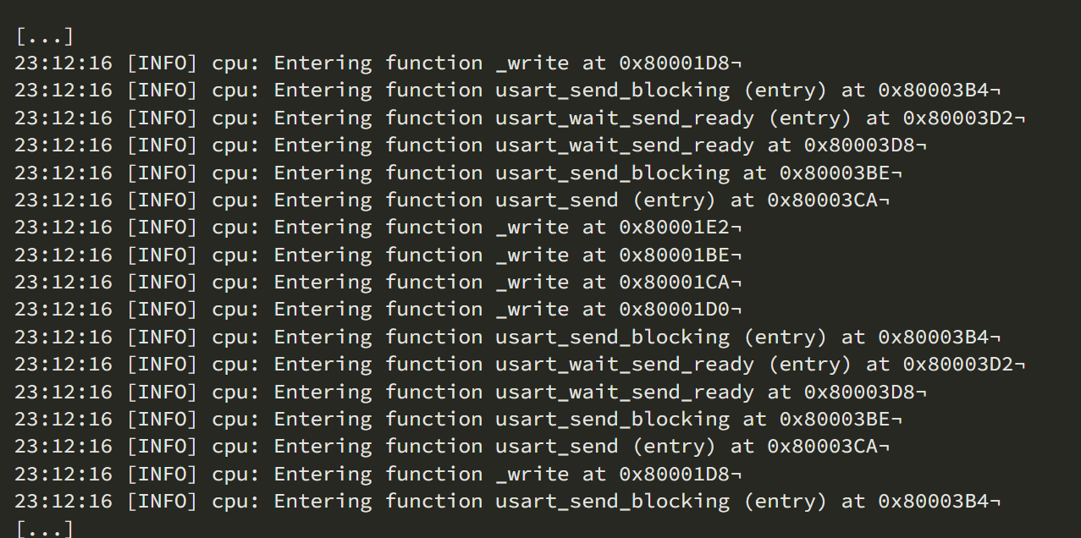

Slide 19
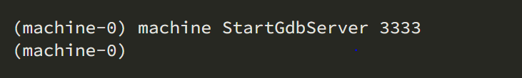
GDB INTEGRATION IN RENODE
A debugger is a program that runs other programs, allowing the user to exercise control over these programs, and to examine variables when problems arise. GNU Debugger, which is also called gdb, is the most popular debugger for UNIX systems to debug C and C++ programs.
GNU Debugger helps as in getting information about the following:
If a core dump happened, then what statement or expression did the program crash on?
If an error occurs while executing a function, what line of the program contains the call to that function, and what are the parameters?
What are the values of program variables at a particular point during execution of the program?
What is the result of a particular expression in a program?

Slide 20
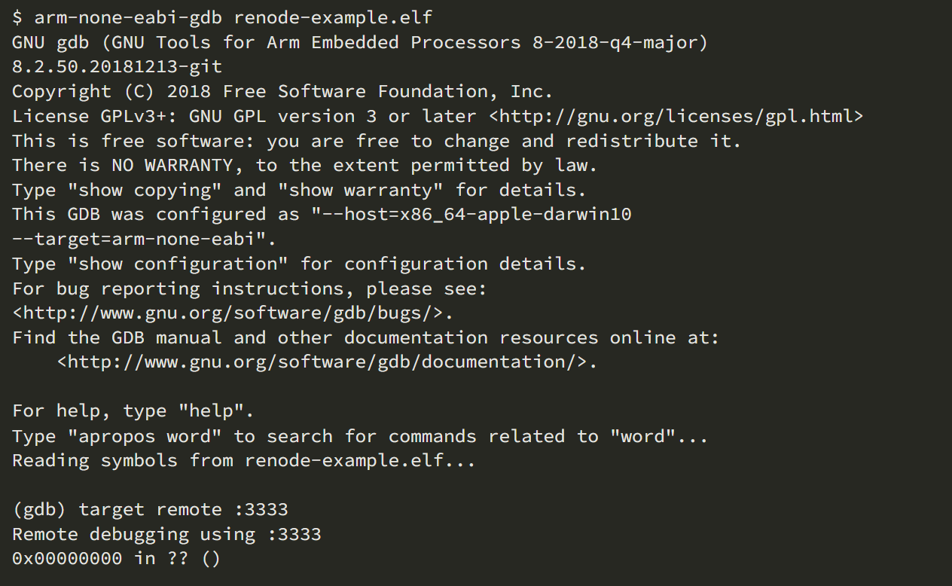
GDB INTEGRATION IN RENODE

Slide 21
Drawbacks of Renode
Renode is fully scripting mode of operation which make it less effective in case of user interface and running the peripherals.
It required the board ELF file for the initiation of the project. This board file is not available open source yet so that we can develop for our specific boards.
For running the project, we must provide virtual address for the memory else the code will not work as per the need .
It lack transparency during execution in debugging mode .

Slide 22
COMPARISON BETWEEN RENODE AND ARM FVP
S.NO | FACTORS | ARM FVP | RENODE
1. | Architecture | ARMv8-A and ARMv8-M | Data framework
2. | CPU Supported | Cortex-A, Cortex-M and Cortex-R | Cortex-M, Cortex-A,RISC-V
3. | Machine required | Single machine at a time | Multiple machine .
3. | Integration | Keil ide | No integration required
4. | Output Display | Visual Graphic mode | Script mode
5. | Debugging | Using Keil only | Online Gdb server
6. | Commerical Support | ARM | Antmicro

Slide 23


