Slide 1

Cyberbullying detection using Natural Language Process Team ARKA Rahul Muvvala Kalpana Chamala Ajay Kumar Ganipineni

Slide 2
Objective:
The project objective is to develop intelligent and self-learning systems that can automatically detect and signal potential cyberbullying attempts using natural language processing (NLP) and deep learning (DL) techniques.
However, it is impractical for moderators to manually monitor all user-generated content due to the vast amount of information on the web.
Intelligent systems are required to quickly process this information and automatically detect potential cyberbullying attempts.
The ultimate-goal of this research is to develop self-learning models that can improve manual monitoring for cyberbullying by automatically detecting textual signals of cyberbullying in various forms.

Slide 3
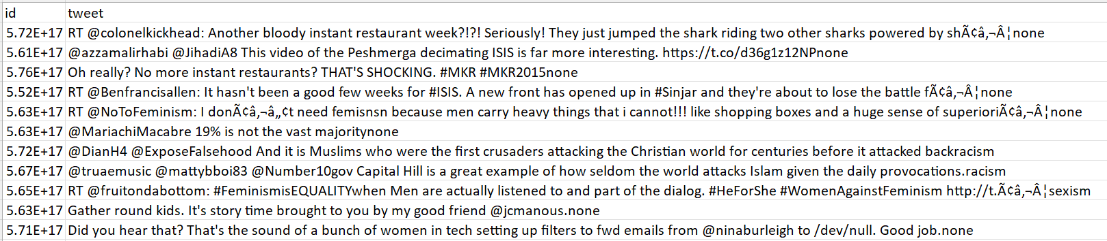
Data and Tools Used:
Data:​
Tweets Data
​
​
Tools we are going to use in this project:​
Python , Python Libraries (NumPy, Pandas, Matplotlib, scikit-learn, CSV)​
Kera's
Cuda

Slide 4
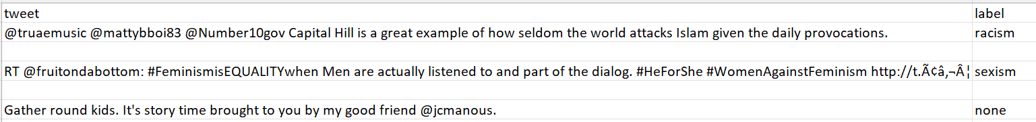
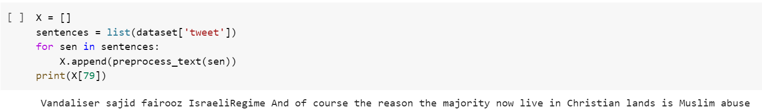
Data Preprocessing:
The raw data was preprocessed to extract the labels from the initials data.
In Data Preprocessing we Removed all non-alphabetic characters from the text using the regular expression [^a-zA-Z] and replaces them with a space character.
Removes single-character words from the text using the regular expression \s+[a-zA-Z]\s+ and replaces them with a space character.
Removes multiple spaces from the text using the regular expression \s+ and replaces them with a single space character.
Initial Sentence:
Updated Data:

Slide 5
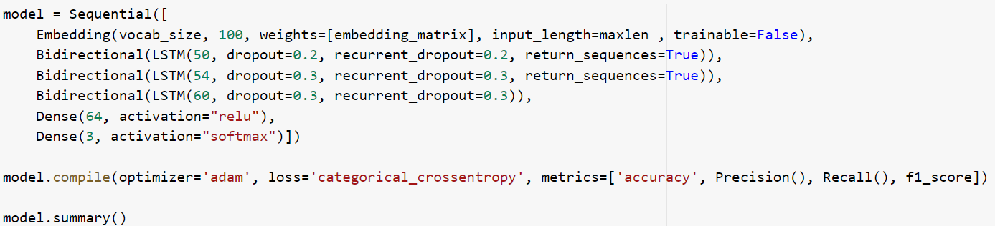
Model Implementation:
LabelBinarizer: It is used to convert the categorical labels into one-hot encoded vectors.
Tokenizer : It is used to create a word index.
Embeddings: Weights are initialized from a pre-trained Glove embeddings. We used glove.6B.100d.
Bidirectional LSTM:
It stands for Bidirectional long short-term memory neural network that process inputs in both forward and backward.
In This implementation to avoid overfitting we used three bidirectional LSTM layers with 50, 54, and 60 units respectively and dropouts at 0.2 and 0.3 respectively
Optimizer: we are using Adam Optimizer for optimization

Slide 6
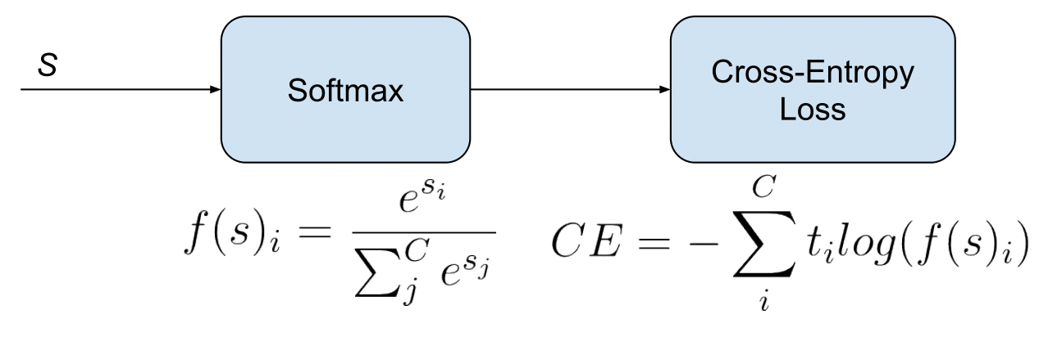
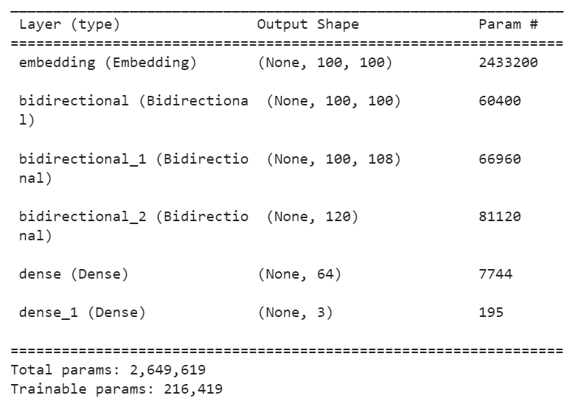
Model Implementation:
Loss function: categorical_crossentropy
We Split dataset into training and testing at 80% and 20% ratio and executed with batch size of 128 and 16 Epochs

Slide 7
Evaluation And Results:
Evaluation:
We used following metrics to check whether the performance of the model:
Accuracy
Loss
F1-score
Precision
Recall
model.compile(optimizer='adam', loss='categorical_crossentropy', metrics=['accuracy', Precision(), Recall(), f1_score])
model.summary()

Slide 8
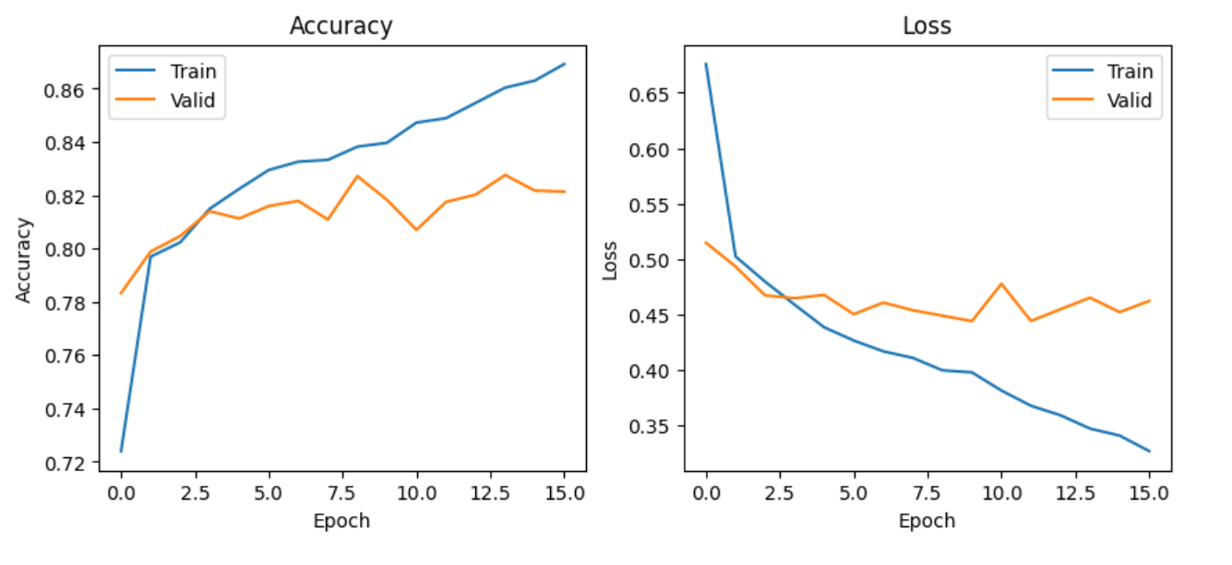
Evaluation And Results:
Accuracy and Loss:

Slide 9
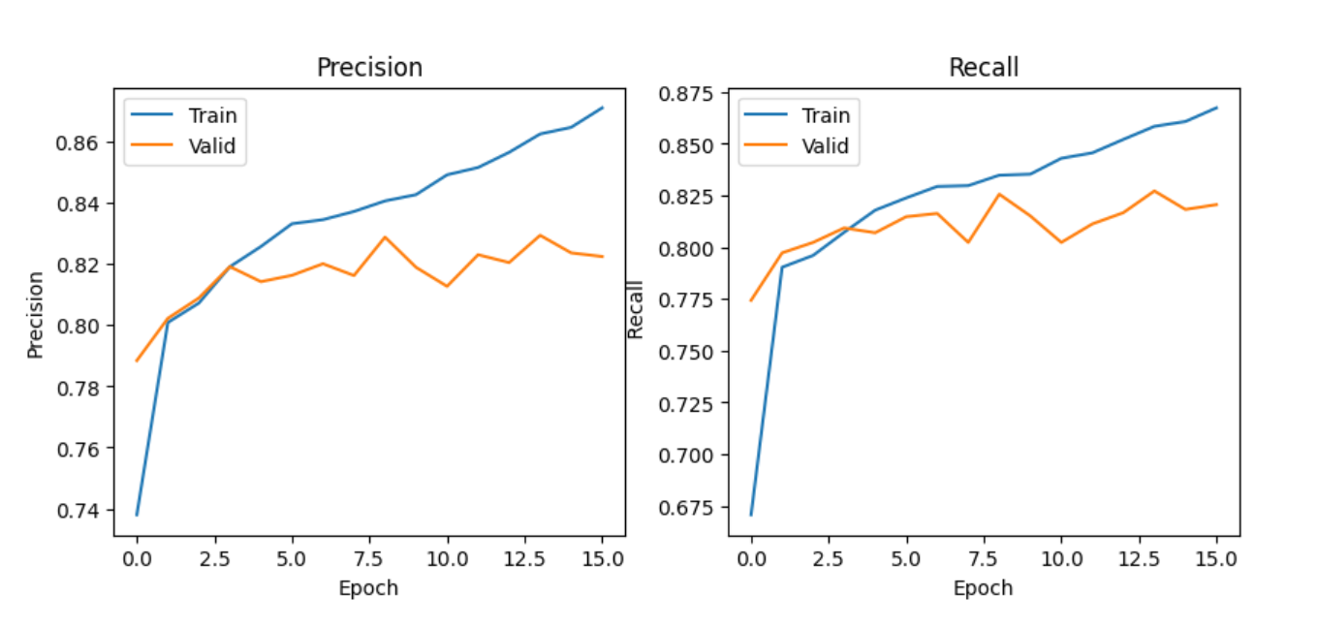
Evaluation And Results:
Precision and Recall:

Slide 10
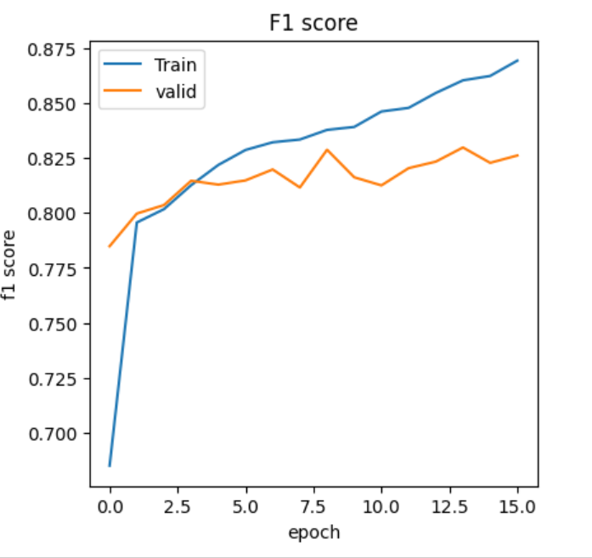
Evaluation And Results:
F1-Score:

Slide 11
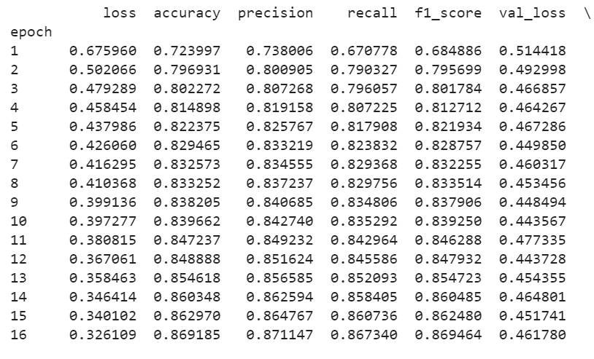
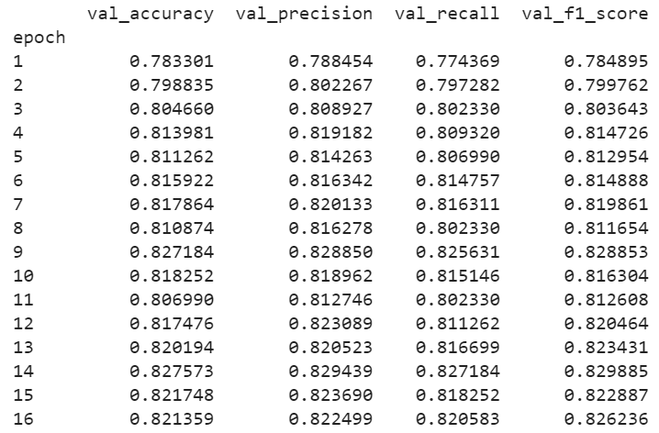
Evaluation And Results:
Metrics for For all Epochs:

Slide 12
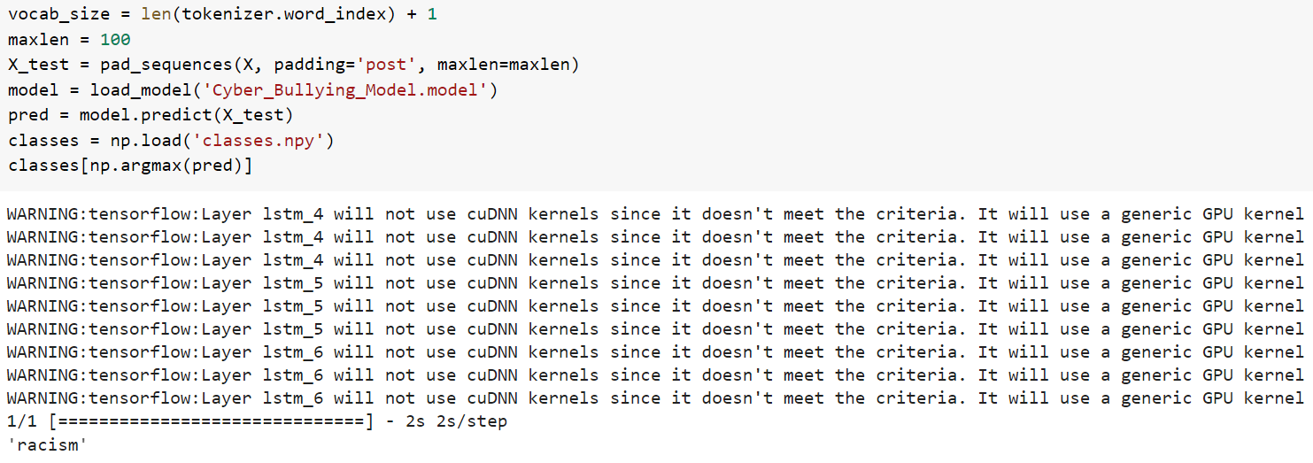
Cyberbullying detection Demo

Slide 13
References:
Cyber Bullying Detection using Natural Language Processing (NLP) and Text Analytics https://ieeexplore.ieee.org/abstract/document/9792931
An Application to Detect Cyberbullying Using Machine Learning and Deep Learning Techniques https://www.ncbi.nlm.nih.gov/pmc/articles/PMC9321314/
Team Arka GitHub Repo: https://github.com/agani3-UNH-DSCI/DSCI6004_NLP_FinalProject_Team_ARKA

Slide 14
THANK YOU Team ARKA

