Slide 1
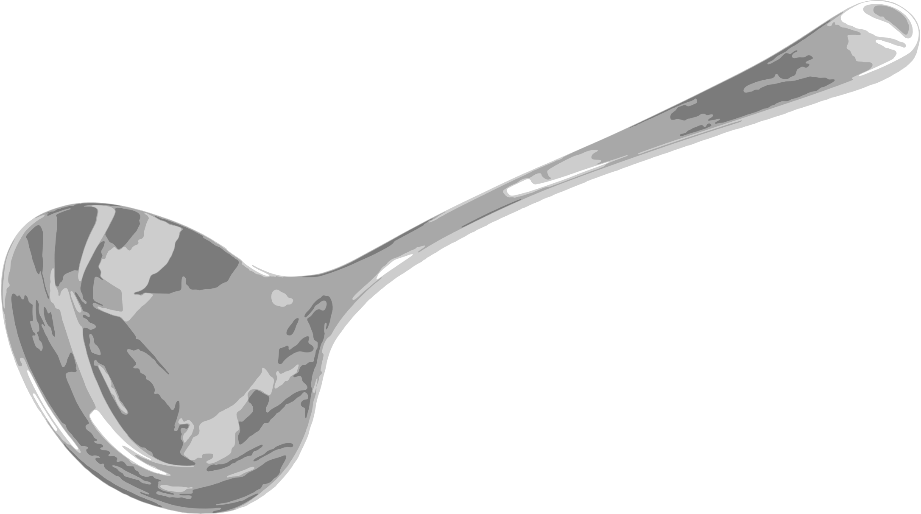
SLEEF
SIMD Library for
Evaluating Elementary Functions

Slide 2
SLEEF
SIMD Library for
Evaluating Elementary Functions

Slide 3
SLEEF
SIMD Library for
Evaluating Elementary Functions

Slide 4
SLEEF
SIMD Library for
Evaluating Elementary Functions

Slide 5
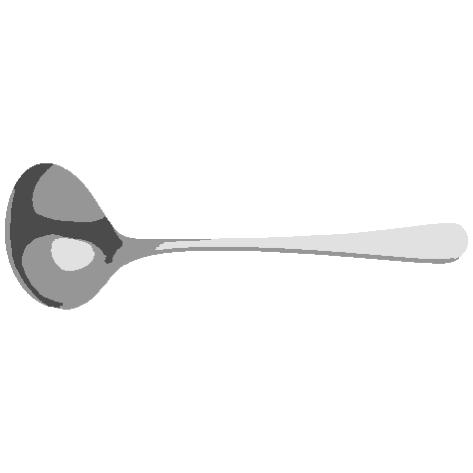
SLEEF
SIMD Library for
Evaluating Elementary Functions

