Slide 1
Team Dating Sim
CIS 350 F2021

Slide 2
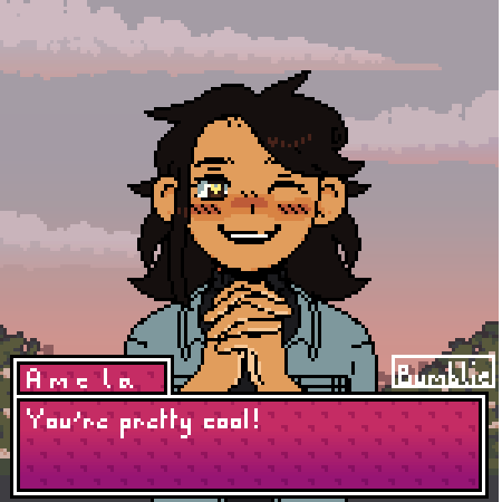
Amela
Senior Computer Science major, German minor
Python programming enjoyer
Digital art hobbyist
Video game enjoyer
Picrew image credit: https://picrew.me/image_maker/657302

Slide 3
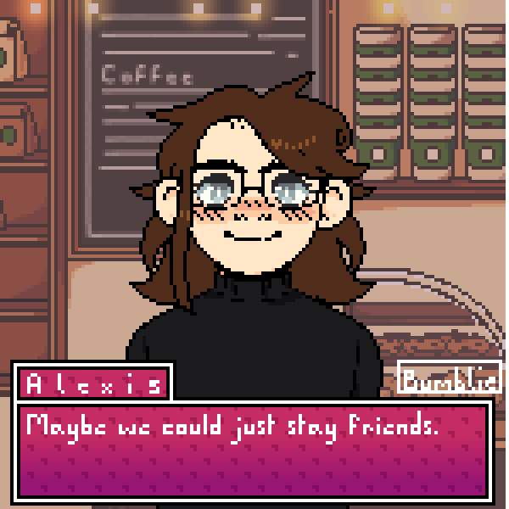
Alexis
Junior Computer Science major
Video game enjoyer
Picrew image credit: https://picrew.me/image_maker/657302

Slide 4
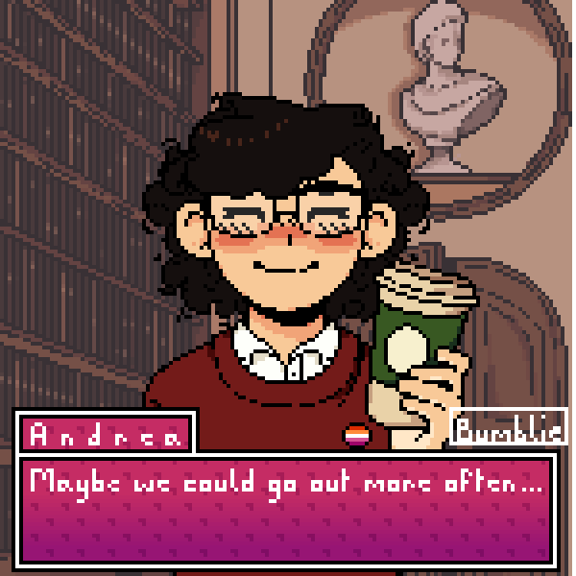
Andrea
Junior (by one(1) credit)
Writing Major
Computer Science Minor
Storytelling enthusiast
Does not know how to describe self
Video game enjoyer
Picrew image credit: https://picrew.me/image_maker/657302

Slide 5

Sam
Computer Science Minor
Loves to code
Enjoys video games
Picrew image credit: https://picrew.me/image_maker/657302

Slide 6


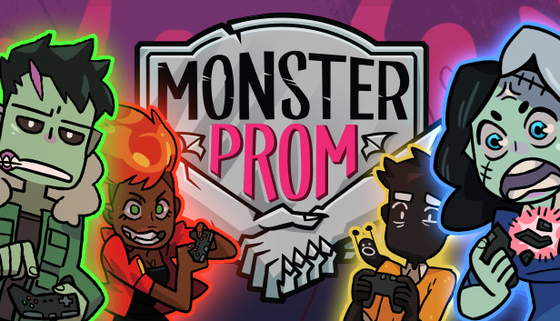

Project Overview
We are creating a visual novel/dating simulator game where a player’s decisions affect the story. The player will choose one of four characters to romance and earn favor points to obtain a certain ending.
We are using the Ren’Py Visual Novel Engine to develop the game.

Slide 7
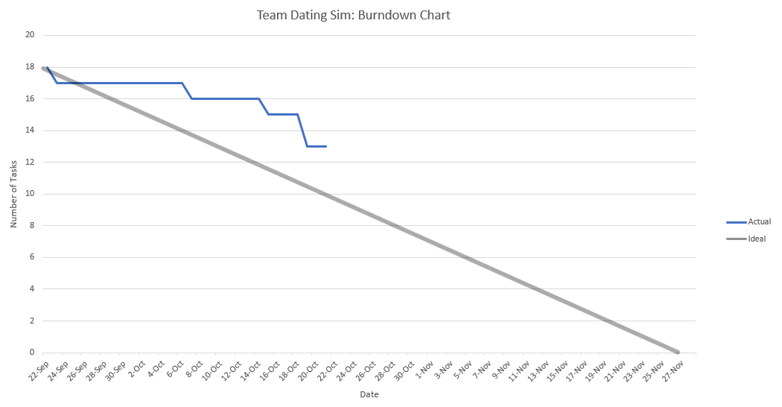
Project Timeline
Remaining Tasks:
Player personality quiz
Complete storyboard (design)
Romance Routes 1-4 with endings
General bad ending
Custom assets/art
Interactive world map
Gallery with unlockable images
Music

Slide 8

Project Demo
← (This is the Ren’Py girl)

