Slide 1


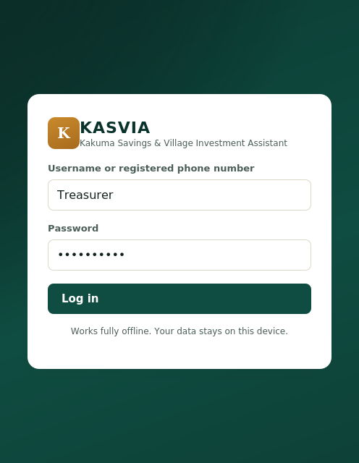
KASVIA
Kakuma Savings & Village Investment Assistant
A digital passbook for every village savings group.
01

Slide 2


Paper record books are the weakest link
One notebook, one point of failure. A torn, wet or lost book can wipe out months of savings history.
Manual arithmetic. Interest and balances are calculated by hand, so small mistakes compound.
Almost impossible to audit. No record of who changed a figure, when or why, which erodes trust in the treasurer.
No connectivity. Most Kakuma VSL groups meet with no reliable internet, ruling out cloud tools.
02

Slide 3
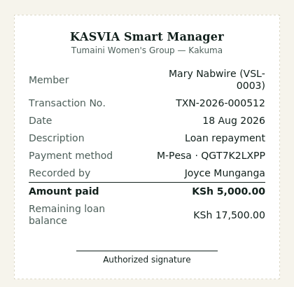

Our Solution
KASVIA replaces the notebook, not the group’s rules
Fully offline: record, calculate, search, print and back up with no internet
Three-role security: Administrator, Treasurer and Secretary see only what their role permits
Nothing is ever deleted: mistakes are voided and reversed, and every change is audit-logged
Runs on what groups already have: a shared laptop or any member’s phone browser
Signed receipt printed for every transaction
03

Slide 4
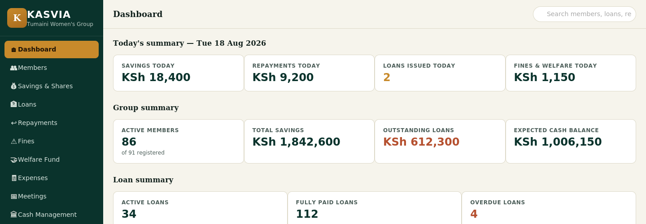
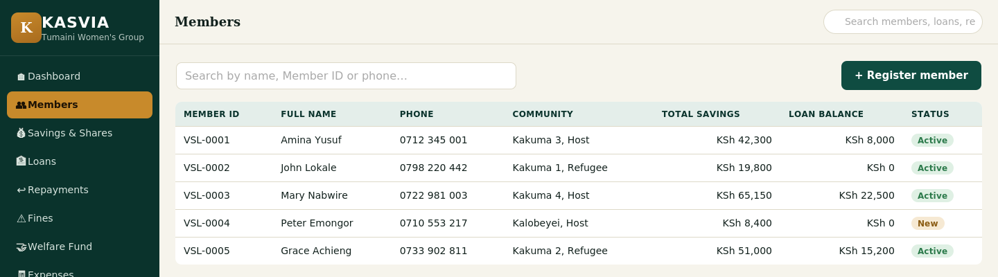
Product
KASVIA is an offline-first web app that digitises every ledger a VSL group keeps.
Members & meetings: registration, attendance, notes
Money in: savings, shares, repayments, fines
Money out: loans, welfare, expenses
Oversight: cash reconciliation, reports, audit log, backups
04

Slide 5



Target Market
Refugee + host
Savings groups in Kakuma, with refugee and host-community members alike.
KES + M-Pesa
Kenyan Shilling throughout, with manual M-Pesa reference capture and no internet.
EN / SW
Interface built to switch between English and Swahili for every member.
05

Slide 6
Market Size
Kenya VSL groups
Total market: VSL and community savings groups across Kenya
Serviceable market: refugee and host-community groups in Kakuma that meet without reliable internet
First target: one pilot VSL group for 4–6 weeks, then a wider rollout
Kakuma groups
Pilot group

Slide 7
Competitors
What groups use today, and the gap KASVIA fills
Paper record books
Fragile, hand-calculated, no audit trail
Spreadsheets
Easy to overwrite quietly, no role-based security
Cloud and mobile savings apps
Need reliable internet and ongoing fees
Mobile money alone (M-Pesa)
Records payments, not shares, loans and meetings
07

Slide 8

Competitive Advantage
Offline-first, tamper-evident and built around how VSL groups already work
1
Truly offline
2
Tamper-evident
Every module works with the Wi-Fi off. Tested fully disconnected, with no cloud or server bill.
Nothing is deleted, only voided and reversed. Sensitive actions need a second Administrator sign-in.
3
Built on the group’s own rules
4
Runs on what they have
Configurable interest, borrowing limits and lending rules checked automatically before approval.
A shared laptop plus members’ phones on a local hotspot. Receipts print for every transaction.

Slide 9
Project Traction: build, pilot, roll out
Tasks
Month 1
Month 2
Month 3
Month 4
Month 5
Core ledgers and dashboard
Role security and audit log
Offline testing and backups
Receipts, reports, EN/SW
Pilot group setup and training
Pilot with one VSL group
Feedback and M-Pesa support
Plan wider rollout
09

Slide 10

Business Model
How we make money
Free pilot with one VSL group to prove the system
Then a small annual licence per group (not per member)
Paid setup, training and support; NGO or donor partners can sponsor groups
Our margins
Near-zero cost to serve: runs on the group’s own devices, no cloud or server bill
Main costs are training and support, so margins grow as groups self-serve
10

Slide 11
Go To Market
Four steps from one group to many
1
2
3
4
Pilot first
Partner locally
Train a champion
Expand
One VSL group for 4–6 weeks, using its own savings rules, interest rate and members.
Work with Kakuma community groups and NGOs that already support savings groups.
Train each group’s Treasurer; groups learn from each other through word of mouth.
Move to more refugee and host-community groups once the pilot proves it in the field.

Slide 12
Social Impact
KASVIA supports four UN Sustainable Development Goals
SDG 1
SDG 8
SDG 10
SDG 16
No Poverty
Decent Work & Economic Growth
Reduced Inequalities
Strong Institutions
Protects members’ savings and loan records from loss.
Gives informal savers a trusted way to save and borrow.
Serves refugee and host-community members alike.
Audit logs and role controls build trust in group leaders.

Slide 13
Our Ask: one pilot group
  Partner with us on one pilot VSL group for 4–6 weeks, using its own savings rules, interest rate and members
  Share feedback on the setup wizard and receipts
  Support connecting M-Pesa records where needed
  In return: a working digital passbook for the group, and field proof before a wider rollout

Slide 14
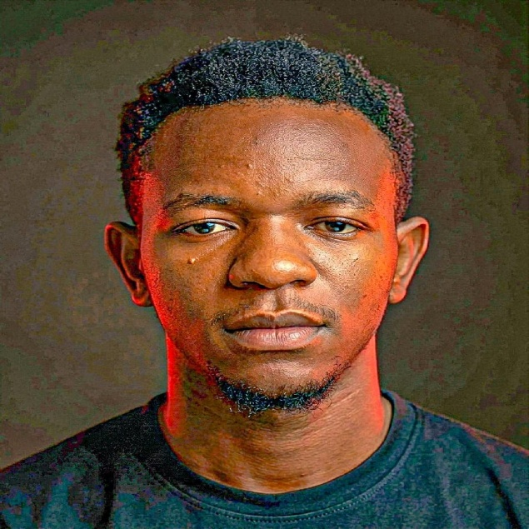


Team Members
The people building KASVIA
Aganze Munganga
Grace Basubi
Victorine Kabule
Team lead
Team Lead assistance
Finance

Slide 15




Thank you!
KASVIA: A digital passbook for every village savings group
chrisjoy5511@gmail.com | +254 708 478 491 | Aganze Munganga
15

