Slide 1
SDB SKULDEYBORE
Name : Matt luis
Class : Information Technology Project 1
App Name: SDR SKULDEYBORE
Date : 10-11-2018

Slide 2

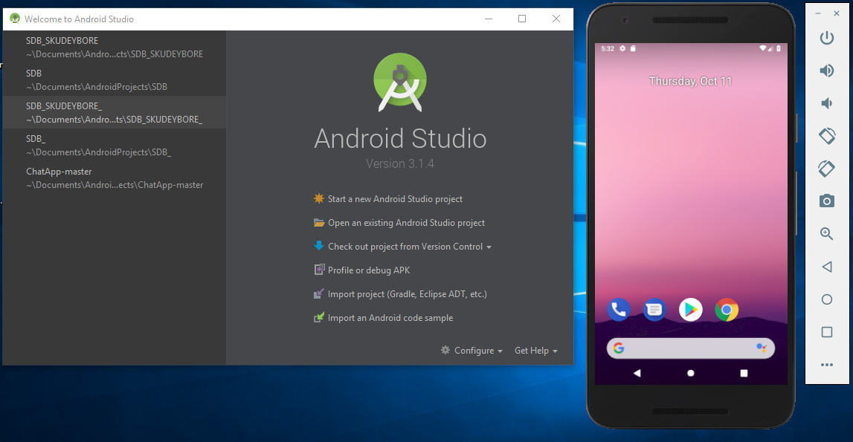

Tools Used
Android Studio
Android Emulator
Notes:
Android is the platform in which the app was built on
The emulator ran the app

Slide 3
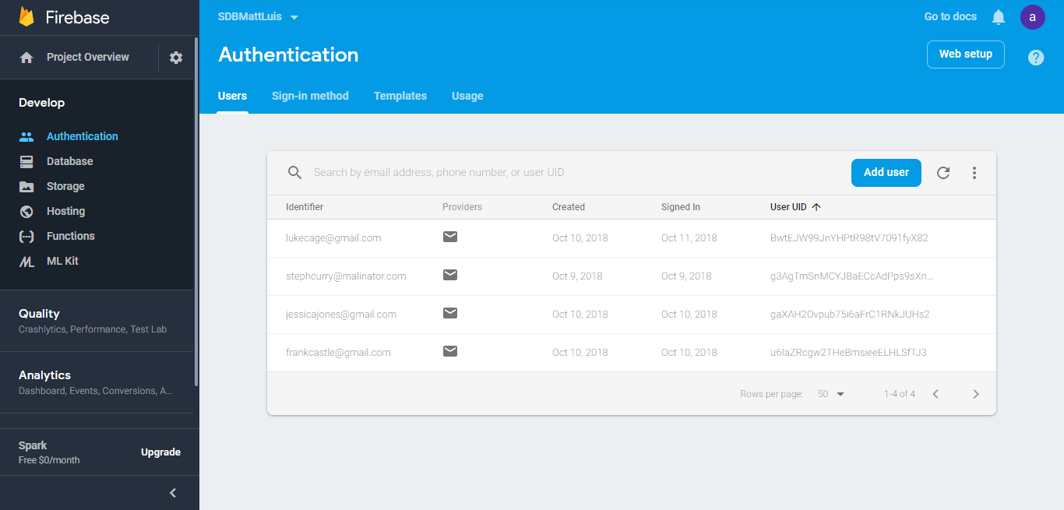
Tools Used
Firebase Database
Notes:
And Firebase was the database used in storing user information

Slide 4
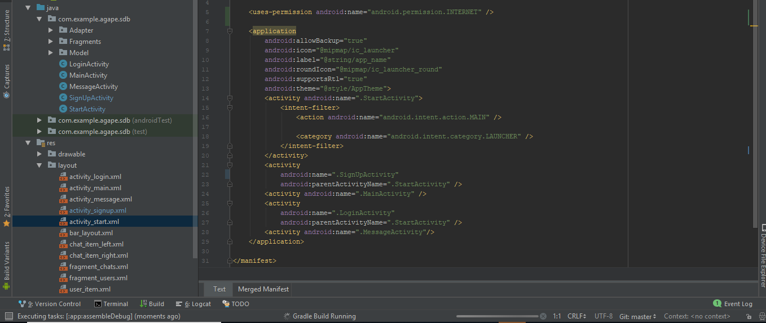
Android Manifest
Helps in Switching Activities
Storing app name
Permissions etc.
Notes:
Helps in switching from one screen to the next , storing the app name and asking for permissions from device

Slide 5
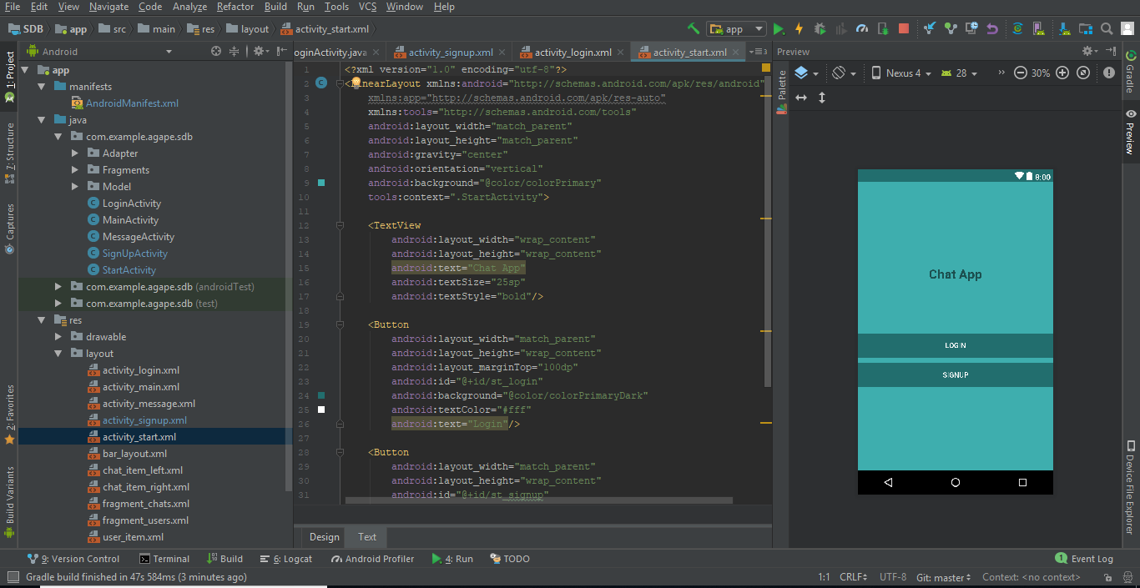
Start Screen
Notes:
This is where the startup screen was designed

Slide 6
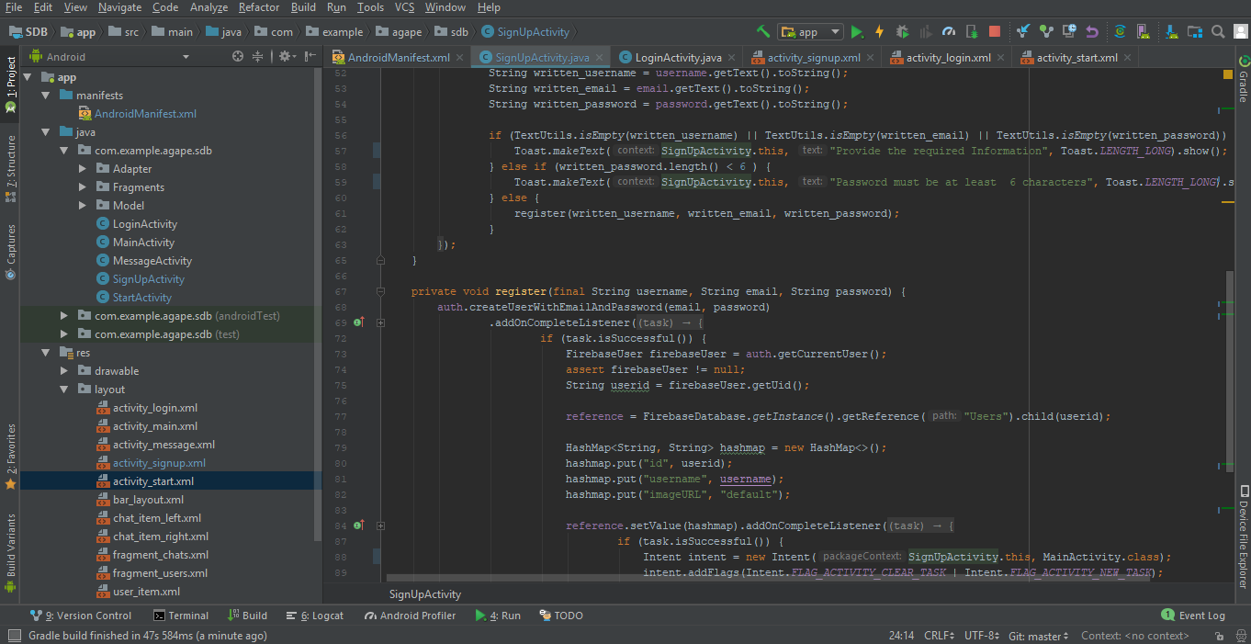
Sign Up
Notes:
This is the signup code

Slide 7
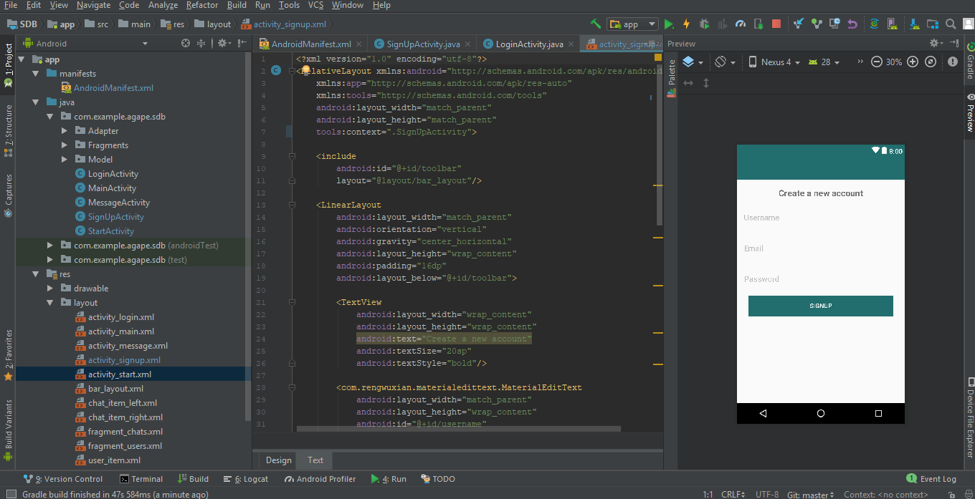
Sign-up Design
Notes:
This is where the signup page was designed

Slide 8
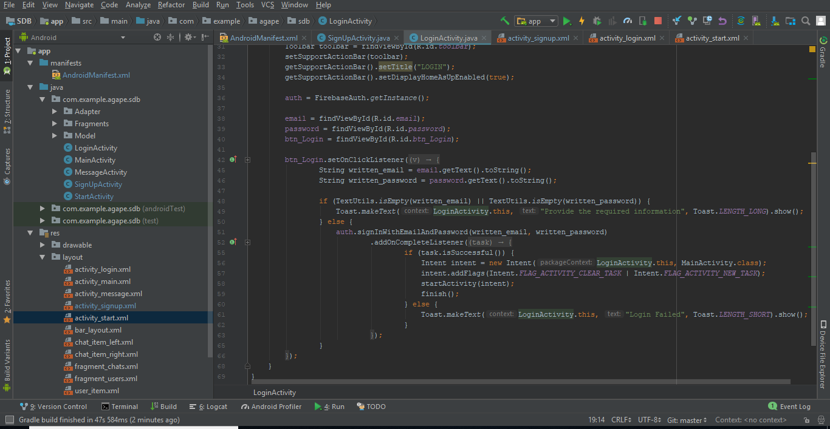
Login
Notes:
Login code

Slide 9
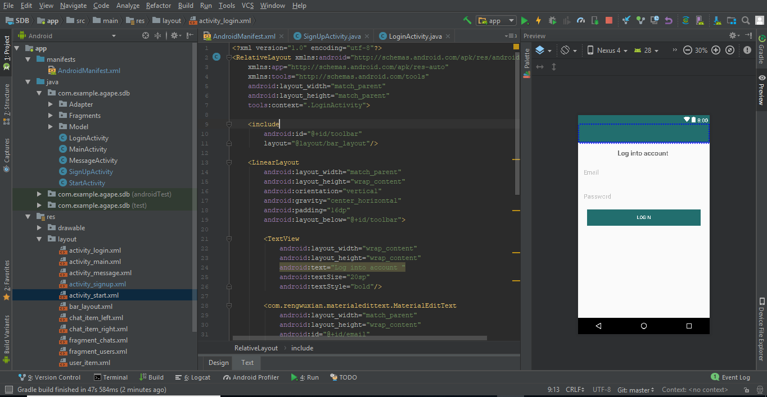
Log-in Design
Notes:
This is where the login page was design

Slide 10
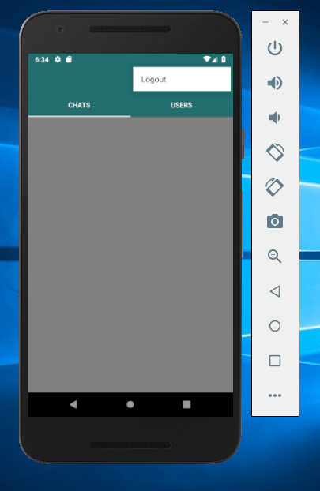
Prototype

Slide 11
Whats’ to Come
Storage of user present
Storing of text
Showing text
Showing transfer of text between multiple users

Slide 12
Google Play-Store
Get your app approved
Pay a certain fee
Notes:
When the app is complete we just have to get the app approved by google pay a certain fee and with that the app can be published

Slide 13
Questions

