Slide 1
BLUEBERRY: ONLINE SHOPPING CART
BY:
SHOBHIT AGARWAL
100903100

Slide 2
CONTENTS
Objective
Scope
Technologies Used
Services Offered
Screen Shots and Videos
Future Scope

Slide 3
OBJECTIVE
The project was designed keeping in mind the busy life of each individual which is getting busier day by day to provide the facility of booking the general grocery, and other items online. Once the order is placed the store person would assemble the order in one place. The customer can visit the store, pay for the order and take away his parcel in no time. It is aimed at reducing customer’s time.

Slide 4
SCOPE
The project offers a great scope in this e-commerce world where customers have become a key resource or most valued resource for a company. This project can be used in any company offering the facility of e-commerce or online shopping.

Slide 5
TECHNOLOGIES USED
Java J2EE Servlets and JSP’s (JavaServer Pages).
Oracle 10g Database as back end.
Netbeans IDE (Integrated Development Environment) to compile and run the project at one place.

Slide 6
SERVLETS
Developed by Sun Microsystems.
Similar to CGI but runs on the server.
Uses Model View Component design pattern.
Uses 3 Tier Architecture.
Open Source.
Runs within J2EE Web Container.

Slide 7
SERVLETS
Advantages:
Faster than CGI as each request runs as a separate thread.
Scalable. Many more requests can be executed because the web container uses a thread rather than an OS process, which is a limited system resource.
Servlets are robust and object oriented as servlets can only be written in Java programming language.
Platform independent as written only in Java.
Additional services, such as error handling and security are provided.

Slide 8
JAVA DATABASE CONNECTIVITY
API for connecting application written in Java with a back end Database like Oracle, MySQL, MS Access etc.
Provided By Sun Microsystems.
Collection of Java interfaces and classes.
Execute queries by encoding them in SQL Statements and passing them to the program that manages the database.
Used JDBC ODBC Driver.

Slide 9
NETBEANS
IDE for creating, debugging and deploying Java programs.
Reusable framework.

Slide 10
NETBEANS
Advantages:
Modularity
Reuse
Quality
Simplicity
Flexibility

Slide 11
SERVICES OFFERED
Customers:
Prepare Shopping cart.
View and edit registered personal details.
Change password.
View previous orders booked along with their status’.

Slide 12
SERVICES OFFERED
Administrator Login:
To add or update existing items in database.
To run various SQL commands for various purposes.
Employee Login:
View and prepare ordered cart by the customers.

Slide 13
DATA FLOW DIAGRAMS

Slide 14
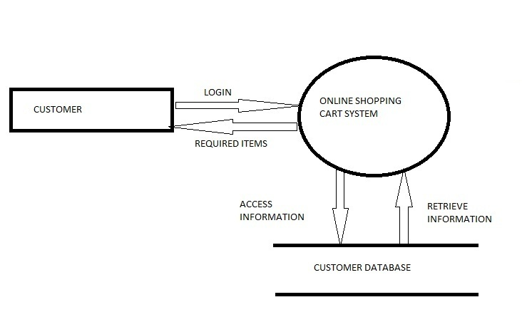
CUSTOMER: LEVEL 0

Slide 15
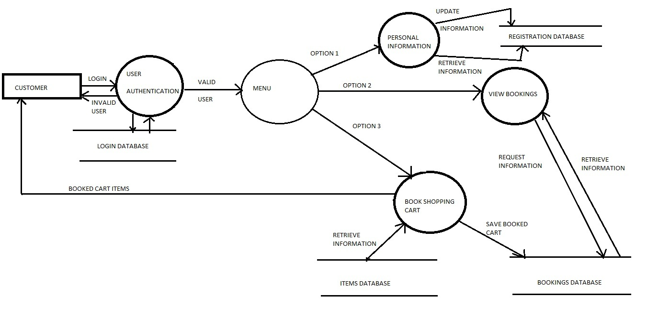
LEVEL 1

Slide 16
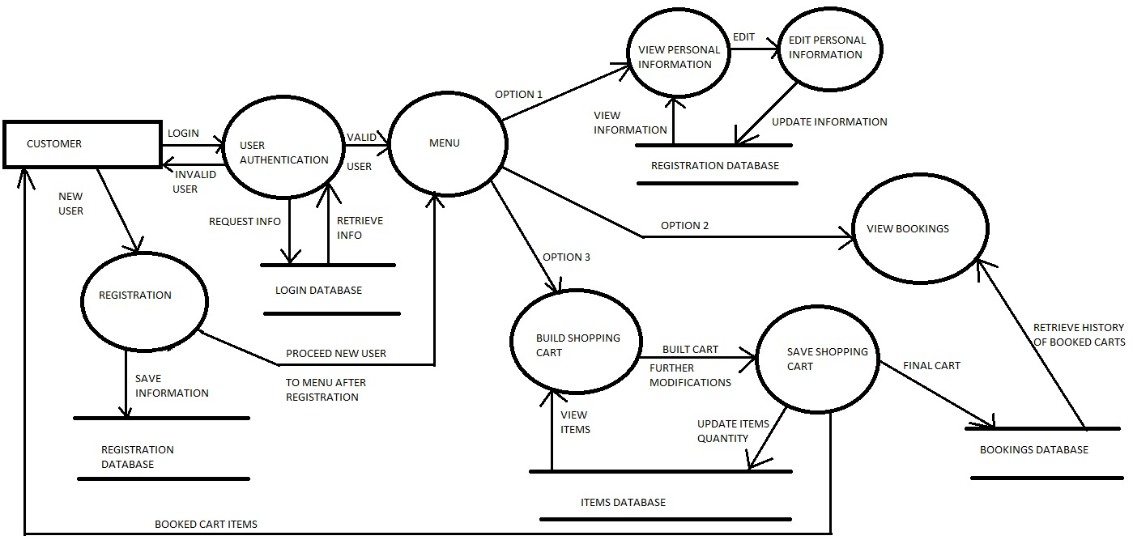
LEVEL 2

Slide 17
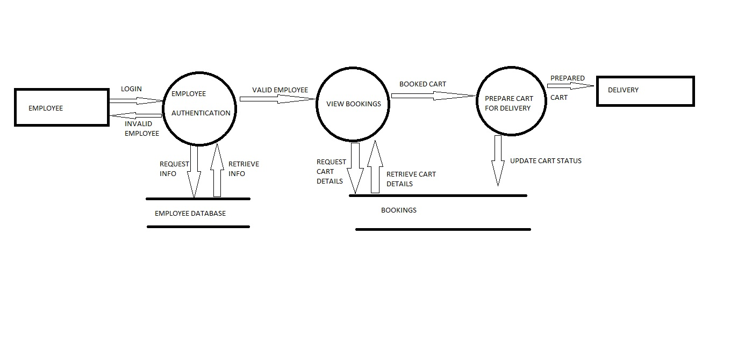
EMPLOYEE

Slide 18
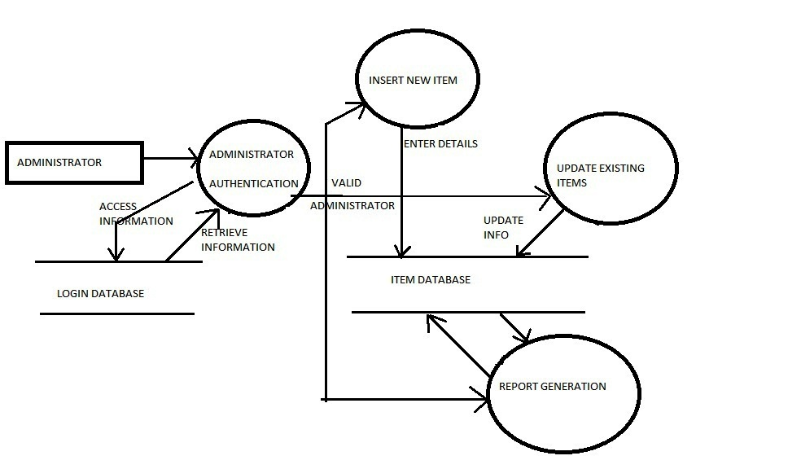
ADMINISTRATOR

Slide 19
SCREENSHOTS

Slide 20
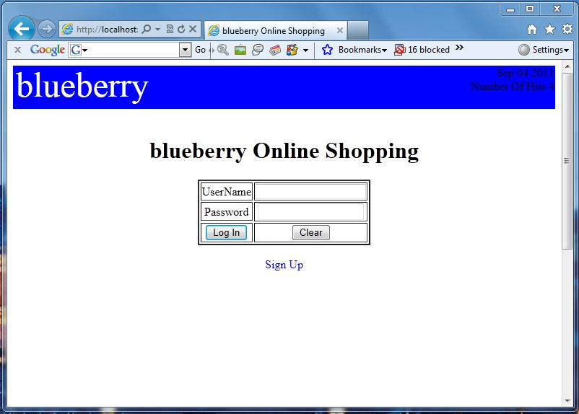
LOGIN

Slide 21
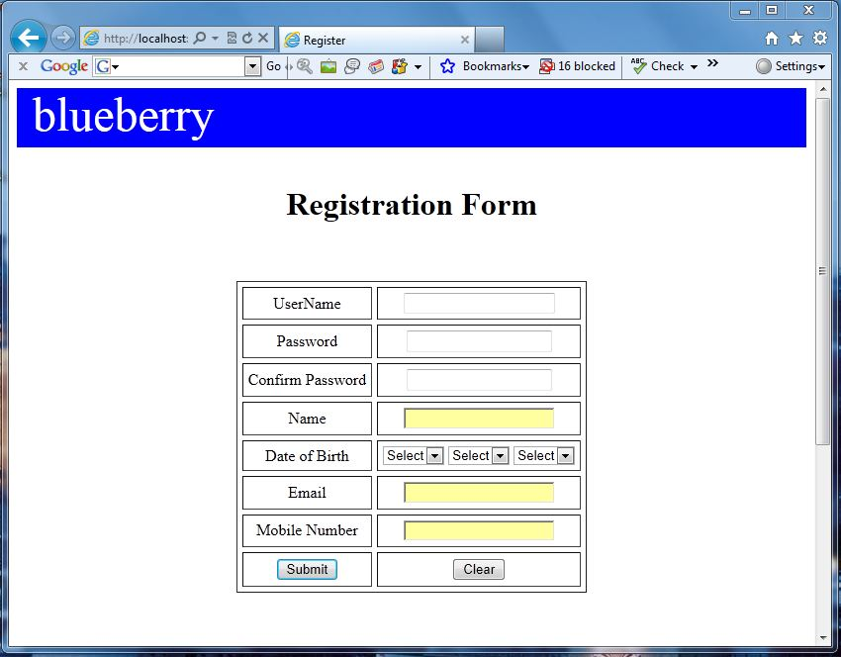
REGISTERATION

Slide 22
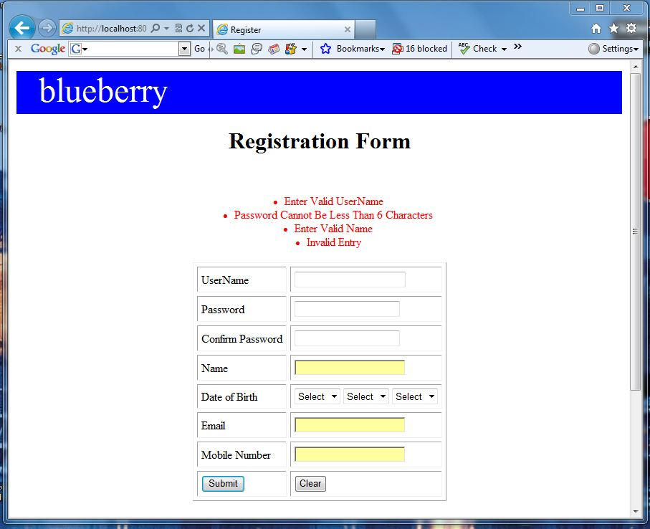
REGISTRATION

Slide 23
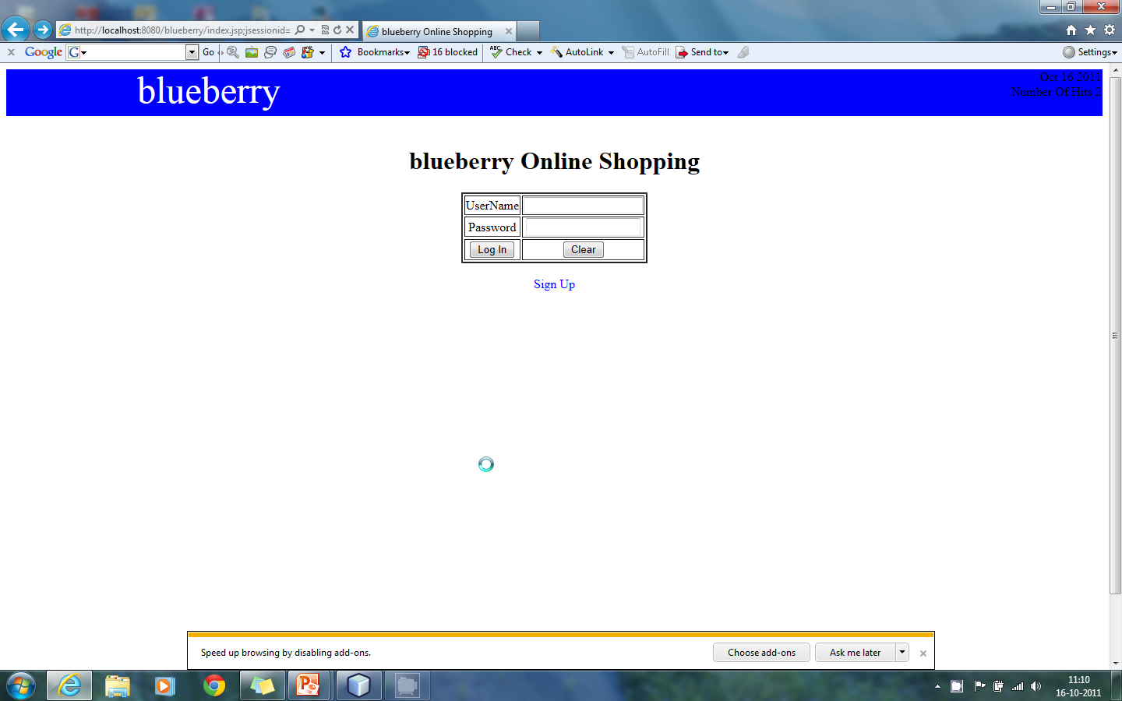
REGISTRATION

Slide 24
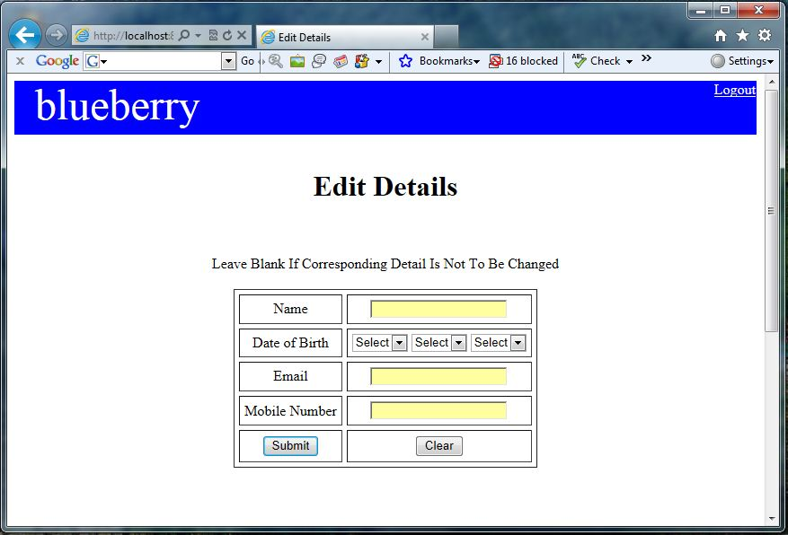
EDIT DETAILS

Slide 25
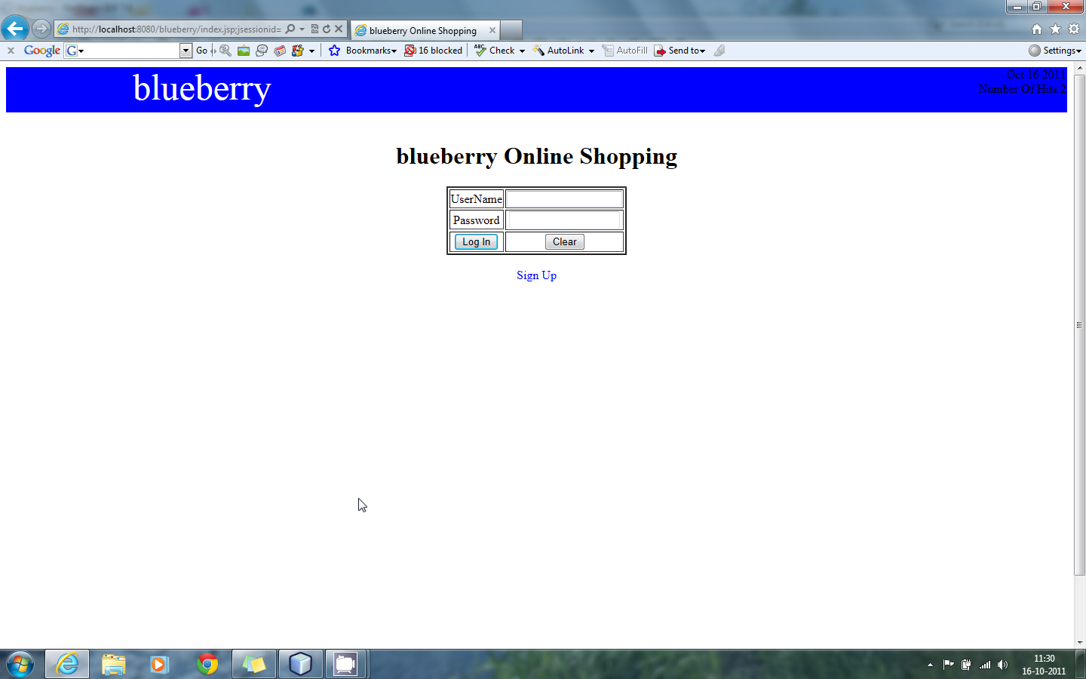
SHOPPING

Slide 26
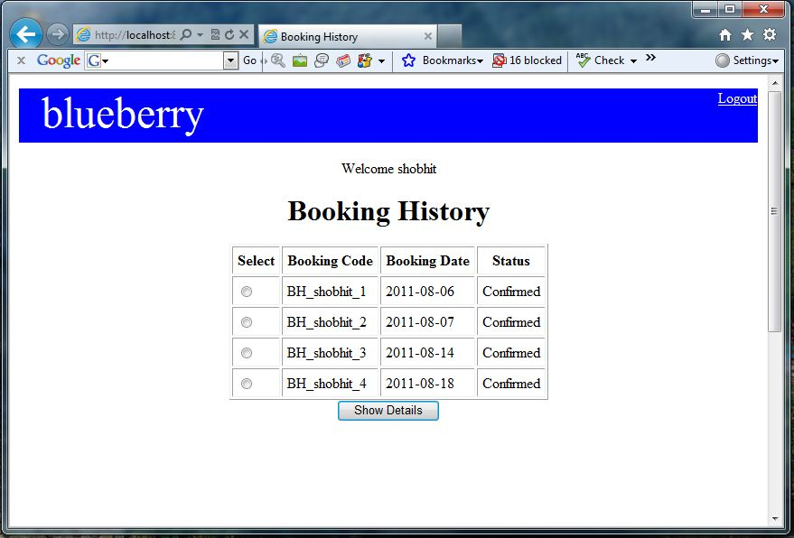
BOOKING HISTORY

Slide 27
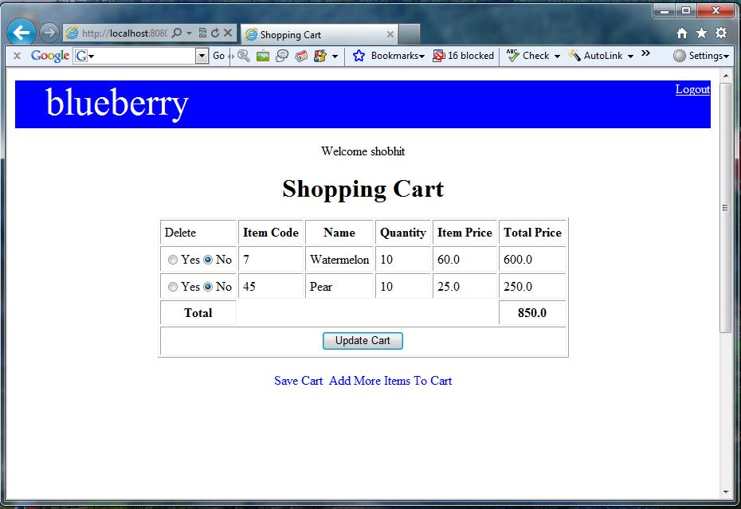
BOOKING HISTORY

Slide 28
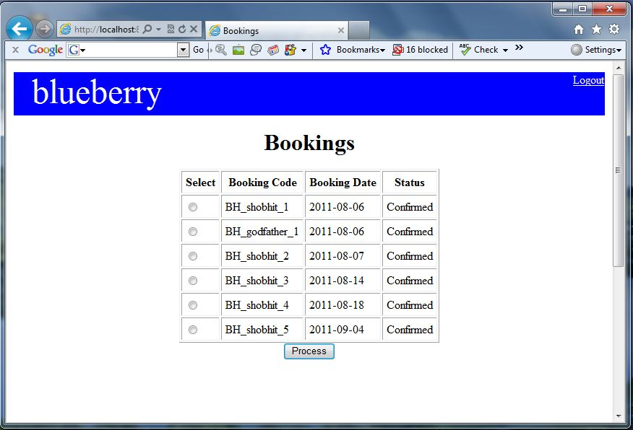
EMPLOYEE

Slide 29
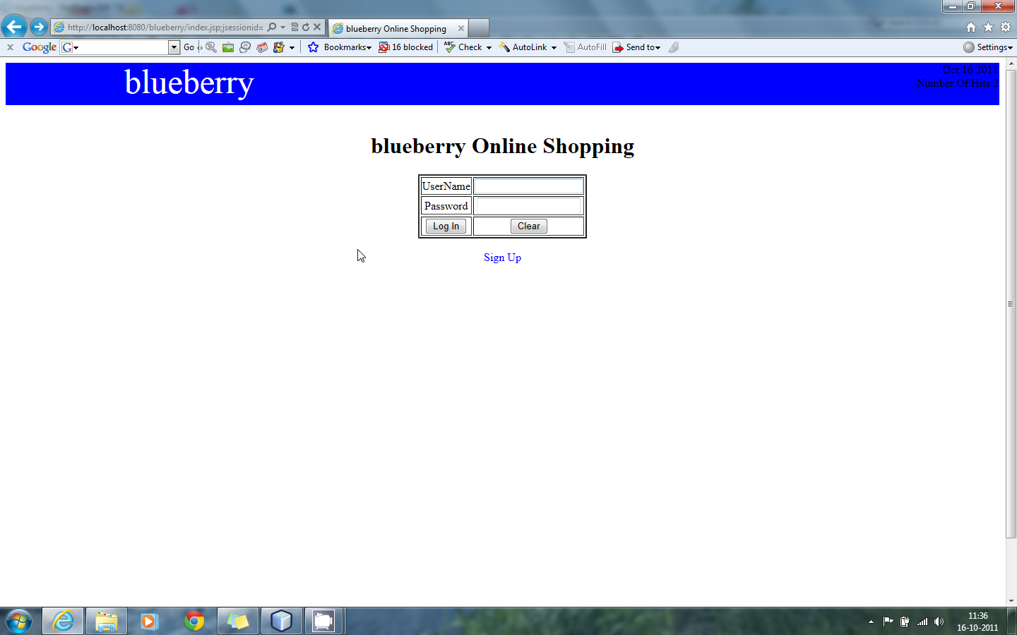
EMPLOYEE

Slide 30

ADMINISTRATOR

Slide 31
FUTURE SCOPE
The following can be implemented further in this project:
Reset password in case user forgets it.
Human Validation Check.
Online Payment .
Shipment of order.
Cancellations of orders.

Slide 32

Thank You

