Slide 1



Hoppy Specter Brewery
Market Analysis: “Pale as a Ghost” Pale Ale
unique(Data Consulting), LLC
January 2019
All images obtained license free from openclipart.org

Slide 2

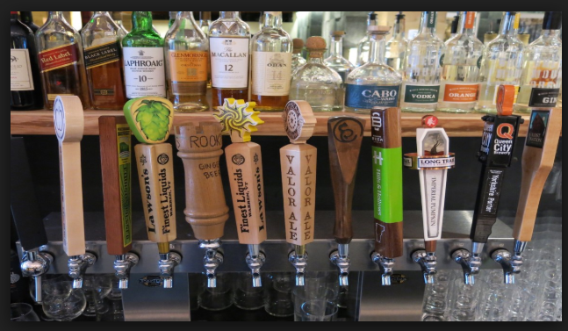
Task Overview:
Client request:
Identify market trends related to beer in the United States.
Identify market saturation in regions of the country to determine possible new locations.
Understand regional preferences for, target values of, and any relationship between Alcohol by Volume (ABV) and International Bitterness Units (IBU)

Slide 3
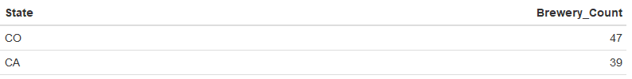
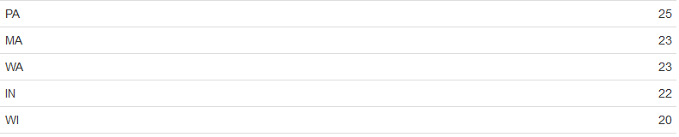
U.S. National Brewing Situational Assessment:
While recent years have seen a significant increase in the number of breweries in each state, market opportunities still exist.
Too many: Market Saturation
Too few: No beer culture
Just right!
These “Just Right” states offer a good balance of beer culture and market opportunity!

Slide 4
Preparing for deeper analysis:
Unique Consulting drew upon multiple data sets to best inform our decision making. Unfortunately, this data required some work.
No billable hours were spent on these tasks. Tasks included:
Combining like data sets
Identifying missing data from client provided data
Ensuring all data were properly formatted for analysis

Slide 5
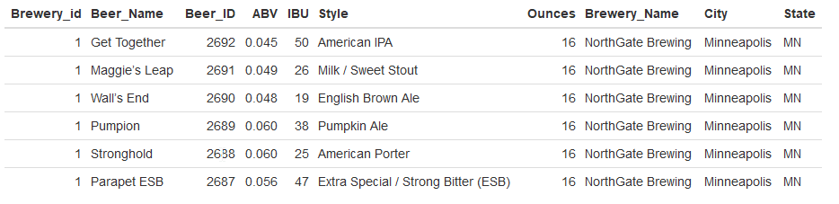
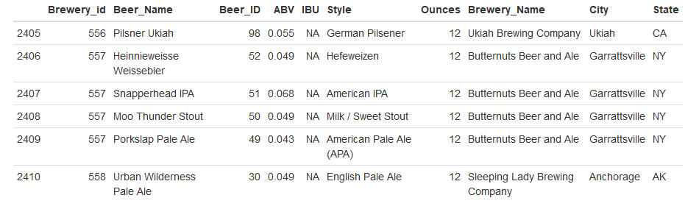
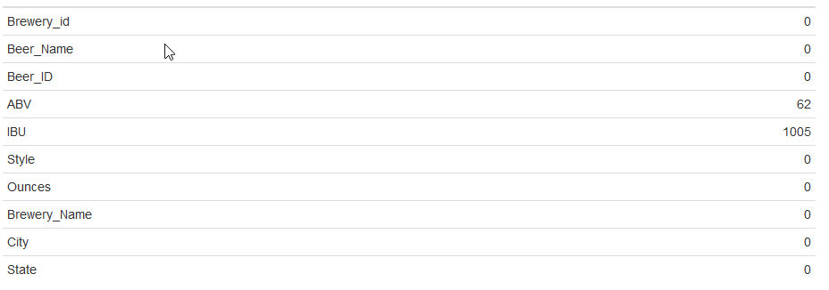
Examples:
Bring Data Together
Identifying missing values:

Slide 6


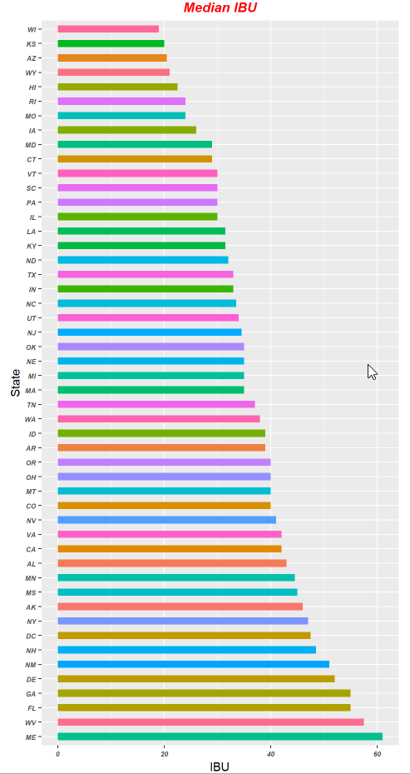
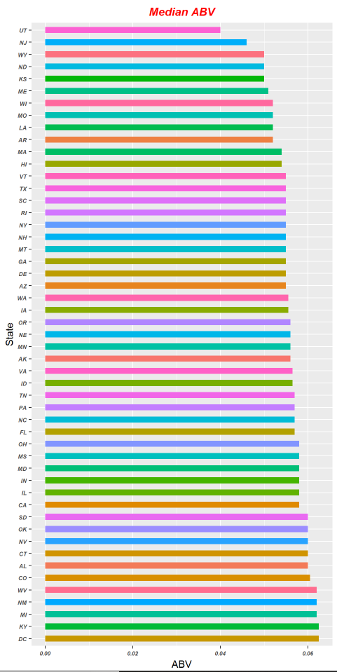


Market Analysis: Regional Preference for IBU (Bitterness measure) / ABV (Alcohol content measure)
IBU
ABV
Massachusetts shows up with a reasonable IBU preference based on median IBU for other beers in the state.
And again here with a reasonable ABV preference based on median ABV for other beers in the state.
And it was a “Just Right” State from above!
Highest Observed Values: IBU: Oregon ABV: Colorado

Slide 7

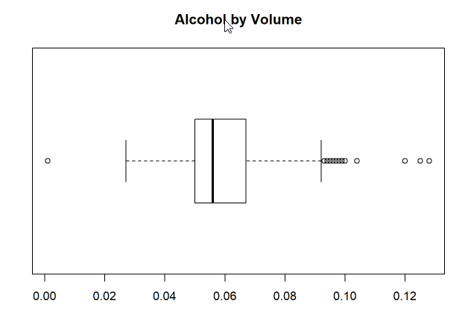
U.S.-wide Assessment of Alcohol by Volume
At the client’s request, an individual assessment of Alcohol by Volume was also conducted. The summary statistics are helpful, but are best viewed in a boxplot.
From these results, we can determine that a full 50% of the measured beers have ABV between 0.05 and 0.07. If Hoppy Specter’s “Pale as a Ghost” product remains within this range, it should be successful.
Note: Massachusetts is also in this range!

Slide 8
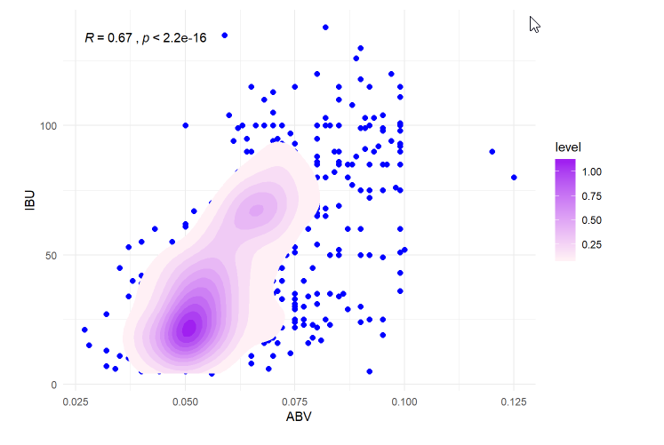
Relationship between Bitterness and Alcohol By Volume
The scatter / density plot to the left seem to indicate some relationship between IBU and ABV . The relationship does appear to be generally linear.
Additional statistical analysis indicates a definite correlation between these two variables (Correlation Coefficient R = 0.67).
Based on these results, we believe that targeting an ABV value for Pale as a Ghost Pale Ale of between 0.05 and 0.07 will also provide an IBU value that is right in the Median range.
Conveniently, the median IBU for Massachusetts is about 35, right in our range!

Slide 9
Conclusions:
Targeting a non-saturated market in a state with a strong “brewing culture” is ideal.
IBU and ABV preferences vary by region, but have a strong center Hoppy Specter can target.
Brewing to a specific ABV range between 0.5 and 0.7 is likely to obtain the IBU value desired due to their strong correlation.
Recommendation:
While a number of potential locations may be viable for the new “Pale as a Ghost” product, µnique Data Consulting recommends Massachusetts as the primary launch location.
Massachusetts offers a strong beer culture, aligned customer preference, and does not demonstrate the characteristics of a saturated market.

Slide 10
References / Resources:
GitHub Repository
Codebook
R Markdown File
Data Sources

