Slide 1
Wireless Smoke Detection
Team wi Five-O
Chris Green Matt Kabert Josh Abbott Jay Taneja Samir Sharma Manish Lamba

Slide 2

Introduction – Wireless Smoke Alarms
Purpose
  Enable wireless communication between multiple smoke alarms in the event of a fire
  Allow for earlier detection of fires and safe exit
Smoke Alarm 1
Smoke Alarm 2
Wireless Signal
wi Five-O

Slide 3
Introduction – Wireless Smoke Alarms
Problem
  Add wireless networking to smoke detector
  Automated network setup
  Send data to a PC
Scope
  Connect 2 smoke detectors wirelessly together and with a PC
wi Five-O

Slide 4
Background
National Fire Protection Agency (NFPA)
  New building requirements
    Hardwiring all smoke alarms together
Current Market
  Single product available (Europe Only)
  Prototype design based on ZigBee protocol
  Strong product demand in existing homes
wi Five-O

Slide 5
Requirements
Reliability extremely important
Interface to central location to allow network monitor
Easy to install additional nodes
Must be able to distinguish external nodes
Designed using current smoke detectors
Sensor Nodes
Network Coordinator
Network Computer
wi Five-O

Slide 6
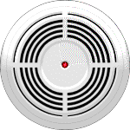

System Design
Network Coordinator
Network Computer
KEY:
Physical Link
Wireless Link
wi Five-O

Slide 7
System Decomposition
Network Computer
- Provides the user interface, displaying node status information
- Desktop PC with Crossbow MOTE-View software
- Wired Ethernet connection to Network Coordinator

Slide 8
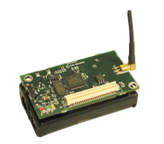
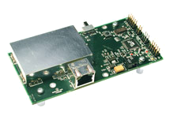
System Decomposition
Network Coordinator
- Gateway between network computer and sensor nodes
  - Crossbow MIB600CA network interface board
  - Wired Ethernet connection to network computer
  - ZigBee 802.15.4 Wireless connection to nearby sensor nodes
MicaZ Mote
LAN and TCP/IP Interface Board

Slide 9
System Decomposition
Sensor Node
- Collects information to be processed by the system
  - Smoke detector units outfitted Crossbow MICAz mote
  - ZigBee 802.15.4 Wireless connection to nearby sensor nodes
Smoke Detector
MicaZ Mote

Slide 10
Sensor Node Decomposition
I
Sensing component – detects presence of smoke; provided by battery-powered smoke detector unit
Computing component – performs A/D conversion and network organization; provided by Mote
Transmitting component – transmits and receives sensor data and node status information; provided by Mote
MPR2400CA (MicaZ) Processor/Radio Board by Crossbow
  ZigBee (802.15.4) Wireless capability for each sensor node
  TinyOS platform for node programming
II
III
wi Five-O
ECE 582

Slide 11
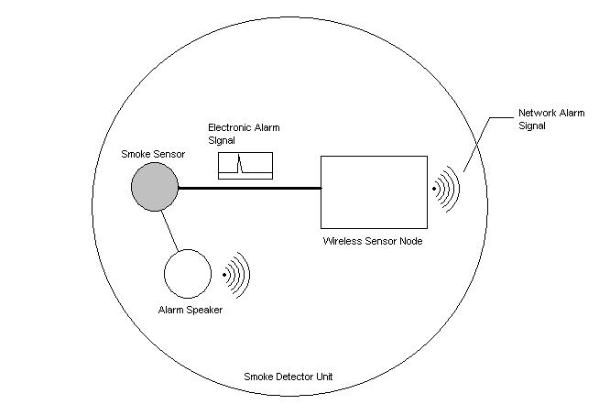
Smoke Detector Layout

Slide 12

Decision – ZigBee (802.15.4)
Low Power
8 uA (sleeping) to 15 mA (active) current draw
Low Bandwidth
250 kbps data rate
Low Range
20-30 meters indoors
I
II
III
ZigBee Logo

Slide 13
Decision - Mesh Topology

Slide 14
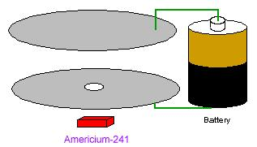
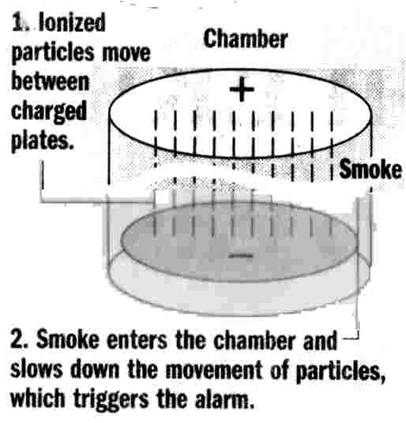
Ionization Smoke Detector
Two plates with a
voltage across them
and a radioactive
source of ionizing radiation
Smoke enters ionization
chamber and disrupts current
causing alarm to sound
wi Five-O

Slide 15
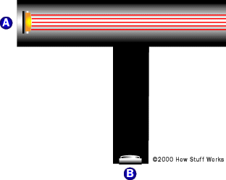
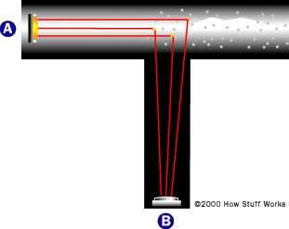

Photoelectric Smoke Detector
FIRE!!!
Normal State

Slide 16
Discussion of the Detectors
Ionization
  Responds quicker to flaming fires
  Cheaper than Photoelectric
  Low Battery Warning
Photoelectric
  Responds quicker to smoldering fires
System design can use either type of detector
wi Five-O

Slide 17
Statement of Work
582 tasks
  Acquire smoke detector and understand how to collect signals from it
    How the circuitry works
    Ionization or Photoelectric Detector
    Where to connect the ZigBee device on the smoke detector
wi Five-O

Slide 18
Statement of Work
682 tasks
  Acquire the necessary equipment: wireless sensors, coordinator, and computer
  Create the interface between the network coordinator and the computer
  Construct a single fully-functioning node that communicates with the computer

Slide 19
Statement of Work
Beyond 682
  Construct a second fully-functioning node that communicates with the computer
  Communicate between the two nodes in a mesh topology
  Communicate status information to external node (i.e. fire department)
  Be able to monitor which smoke detector sent alarm signal

Slide 20
Any Questions?
Network Coordinator
Network Computer
KEY:
Physical Link
Wireless Link
wi Five-O

Slide 21


Book ‘im, Dan-o!
Hawaii Five-O

