Slide 1
BATTLE OF TORONTO NEIGHBORHOODS
Where in Toronto is the best place for you?

Slide 2
Moving to Toronto?
Toronto is considered one of the worlds’ top cities that attracts of many from all backgrounds from Canada and beyond.
Toronto offers a widely diverse cities in its’ landscape, amenities, shops, restaurants, and more.
With a large number of people migrating to major cities, neighborhoods with vastly different offerings appeal to a wide range of people.
Everyone moves at some point in their life, whether it is a single adult or a family, finding the perfect place is always the most common question that needs to be answered.

Slide 3
So much data!
Sourced and cleaned data for Toronto neighborhoods from Wikipedia page: https://en.wikipedia.org/wiki/List_of_postal_codes_of_Canada:_M
FourSquare API provided the many venues and their location data in Toronto.
Removed any community and neighborhood that contained “Not assigned” in data.

Slide 4
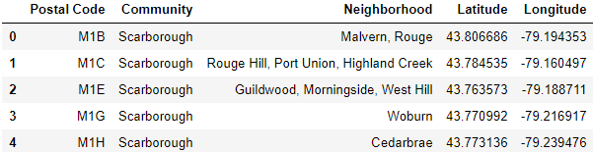
Sample geographical coordinates for neighborhoods in Toronto

Slide 5
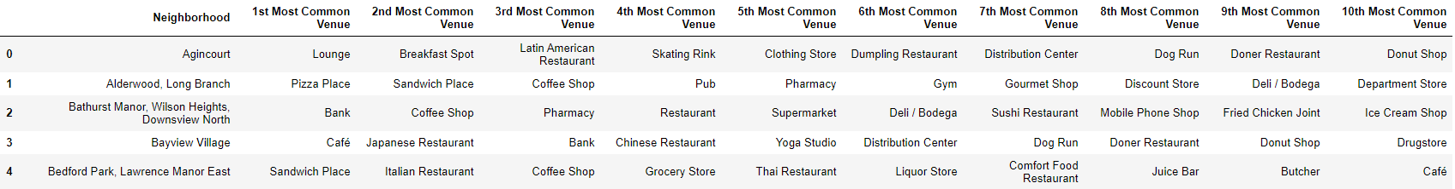
Sample of Neighborhoods and Venues

Slide 6
Data Organization
103 different communities
Communities may contain multiple neighborhoods
2145 venues returned by Foursquare
274 unique categories

Slide 7
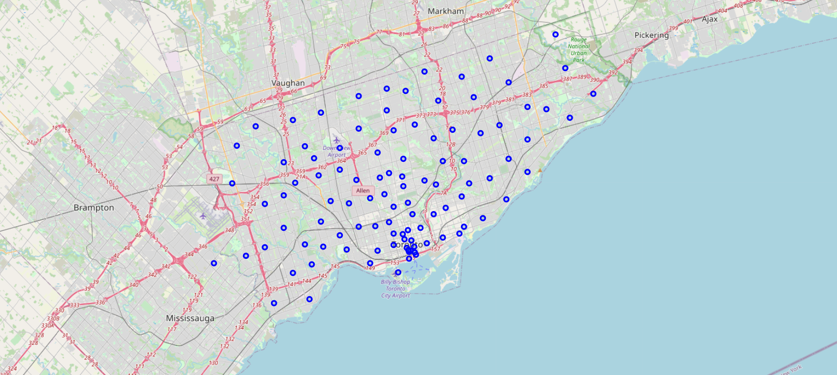
Map of Toronto

Slide 8
Data Organization
Clustered neighborhoods together that appear in the same community.
Listed out the 10 Most Common Venues found in each cluster.
People may choose neighborhoods grouped together that offer more venues that they may be interested in.
Some may have the same top 3 venues of importance, seeing the top 10 gives helps separate neighborhoods apart from people who are looking for more specific venues later in the list.

Slide 9
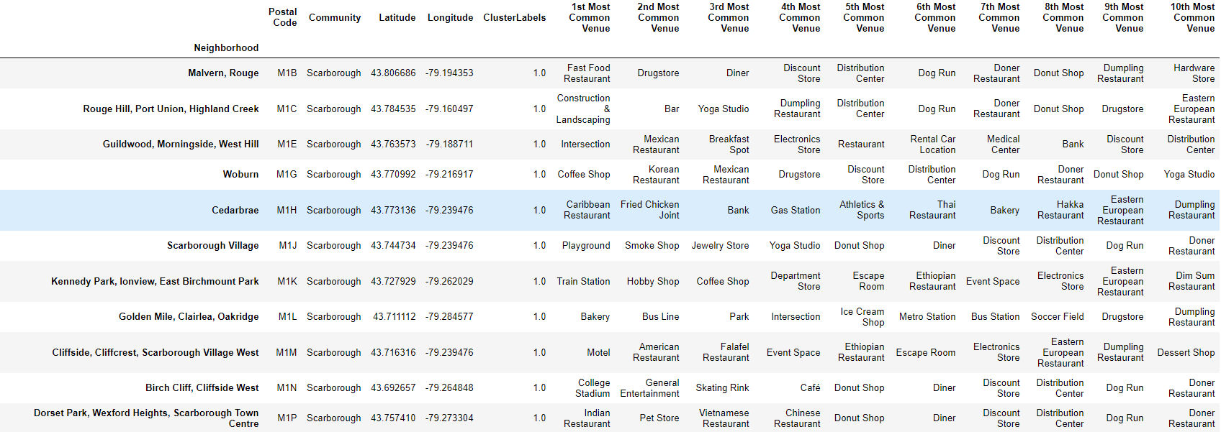
Sample of neighborhoods with 10 most common venues.

Slide 10
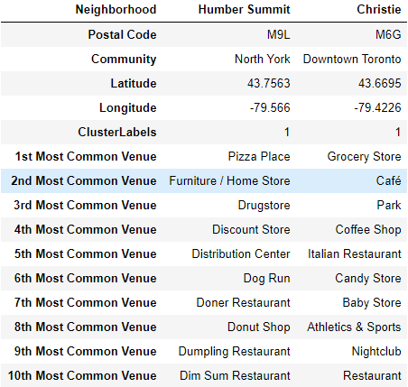
Comparing Neighborhoods
Application allows you to choose neighborhoods and compare them to each other.
Data shows: location, community, 10 most common venues.
Sample of comparing Humber Summit and Christie neighborhoods.

Slide 11
Conclusion
Whether a family or a single user is looking for a place to move in Toronto, they should all the chance to see the neighborhoods closer. Without knowing the specifics of the neighborhood, its hard to tell whether that neighborhood is right or not.
Seeing up to 10 most common venues and comparing neighborhoods against each allows our user to gain more insight on where they would like to move.
This helps the user see what is around them, how far, and what variety is available to them.
With more information about users and clients, more data can be added such as housing and rental pricing as well as schooling ratings for families.
For now this applicated serves as a general base for everyone!

