Slide 1



Malaria Detection
Milestone 2 Convolutional Neural Network
Alexis Garduno

Slide 2
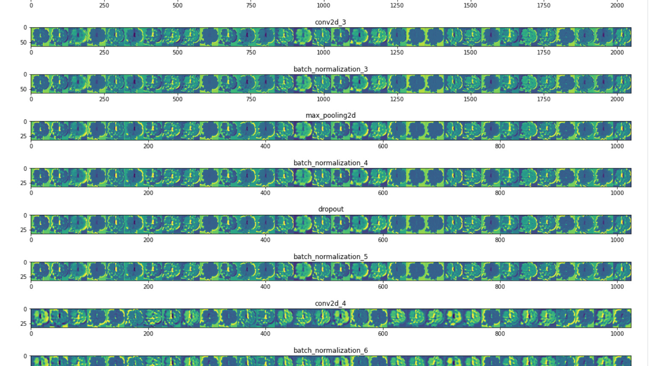
Refined Insights
- Visualization of feature map shows that the neural network is detecting the edge or the shape of the cells and uses that information in its decision to classify cells as infected or not infected.
-It appears that the convolutional neural network is detecting dark splotches on infected cells that may indicate damage to the cell?
- This information about the edges and shape of the cell are abstracted to less discernable features towards the end of the network.

Slide 3
Comparison of various techniques and their relative performance
Alternative Activation Functions: Relu activation function converges faster than sigmoid and other functions, but also faster than the Leaky Relu but the training speed is more similar to each other; both the Relu and the Leaky Relu functions keeps positive values and kills gradient for negative values. Some relu activation functions may not activate; if the learning rate is too high, the weights may jump and the relu may die during training. To minimize the loss of dead Relu functions, leaky relu can help address this concern, since negative values are assigned a slight slope and not automatically set to 0 like Relu.
Batch Normalization: Instead of weight initialization, batch normalization sets gaussian distribution at each layer, we can normalize each neuron and calculate mean and variance for each layer for each batch. Batch normalization facilitates training, allows higher learning rates, reduces dependence of the result on the initialization, and regularizes results.
Drop-Out: Avoided overfitting by using drop-out and hopefully retains more robust features by reducing reliance on identifying a single feature or overfitting by learning and unlearning the same feature through co-adaptation.
Data Augmentation: Data augmentation helped distinguish model 3 from the base model; it was not until data augmentation was added that model 3 began outperforming the base model. Prior to data augmentation, the base model was performing similarly to model 3. The pre-trained model from ImageNet did not appear to outperform either the base model or model 3 using the augmented data.

Slide 4
Proposal for the final solution design
Model 3 was the best performing model in terms of overall accuracy, precision, f1 and recall regardless of the Red Blood Cell’s infected or uninfected status.
This approach avoided overfitting, where the overall accuracy of the validation set was ~99% compared to the base model with overall accuracy in the validation set around ~97%.
This model was more precise and more sensitive to detecting malaria than the base model.
This model differed from the base model, since it had greater depth (more layers), utilized leaky relu activation functions, utilized batch normalization prior to each convolutional layer, utilized drop-out and optimized using RMSprop as compared to adam. Binary cross-entropy optimizer was kept for all models, since the task was to class cells as either infected or no infected by malaria, which is binary.

