Slide 1
Film Score Generation
David Cummings

Slide 2
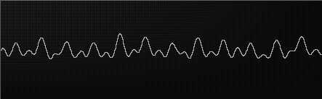
Concept
★ Video-based generation
★ Database of short clips
★ Separation of musical elements
★ Quantification of music

Slide 3
Mapping
Video | Audio
Rate of change | Speed
Brightness | Brightness / Frequency
Variation in frame | Noisiness / Punch
Saturation | Angst
Hue | Punch

Slide 4
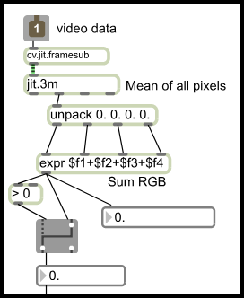
Rate of change → Speed
★ Video: Mean of frame-to-frame difference
★ Audio: Internal rhythms
A screenshot of Max/MSP, a graphical programming language in which this project was realized.

Slide 5
Brightness → Brightness/Frequency
★ Video
Mean brightness of all pixels
★ Audio
Brightness: Weighted mean of all frequencies in clip
Frequency: Overall mean frequency of clip

Slide 6
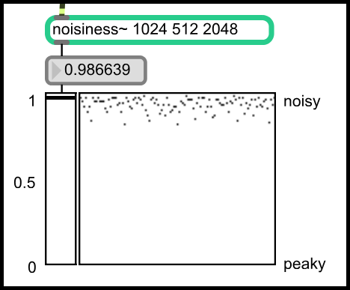
Variation → Noisiness
★ Video
Distribution of colors
★ Audio
“Spectral Flatness”
Screenshot of a noisiness analyzer in Max/MSP.

Slide 7
Saturation → Angst
Hue → Punch
★ Video
Mean saturation/hue of all pixels
★ Audio
Angst: Subjective
Punch: Attacks per second
Screenshot from “Sin City” with blue hue and low saturation.

Slide 8
Combination
★ Weighted vectors
1. Normalize each parameter
2. Multiply by weight
★ Four tracks: Melody, Harmony, Drum, SFX
★ Melody determines key and tempo of other tracks

Slide 9
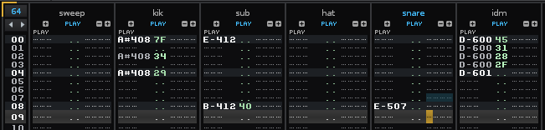
Composition Style
★ Sample and synthesis-based
★ Multi-track composition
★ Sliced into 2 or 4-bar clips
A screenshot from the program Renoise, in which much of the music was composed.

Slide 10

Problems
★ Connection to video not obvious
★ Complexity → Aleatoric
★ Sudden transitions

Slide 11
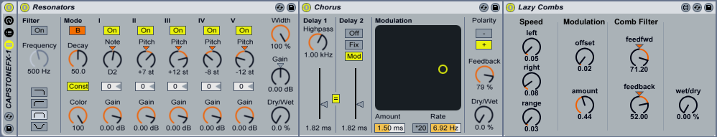
Solutions
★ Live control of volume and effects
★ Additional music clips
★ “Smart” transitions
A screenshot of some effects in the program Ableton Live, through which the generated music was processed.

Slide 12
Demonstration!

